Slide 1
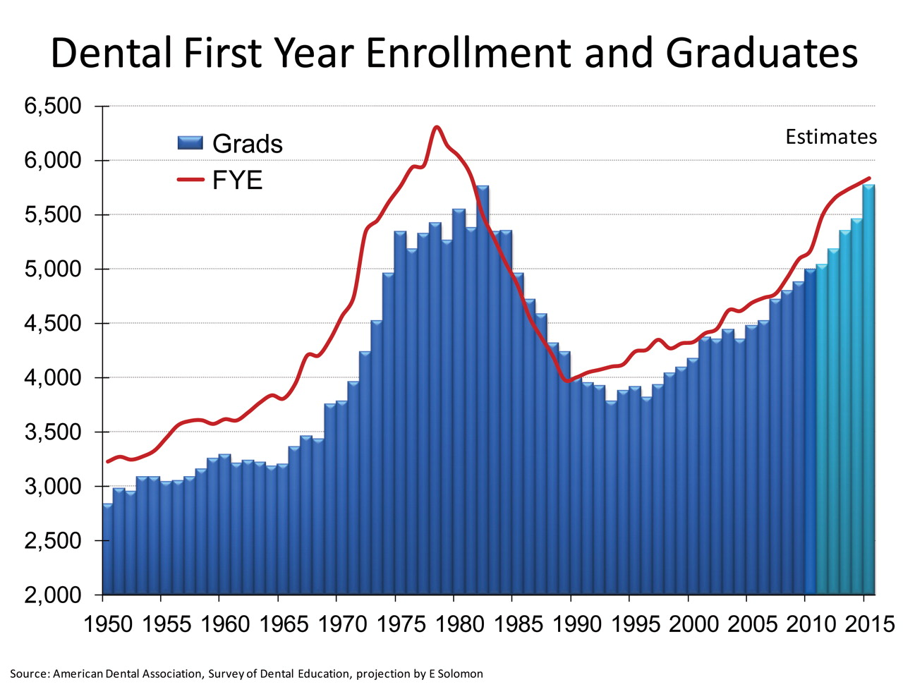
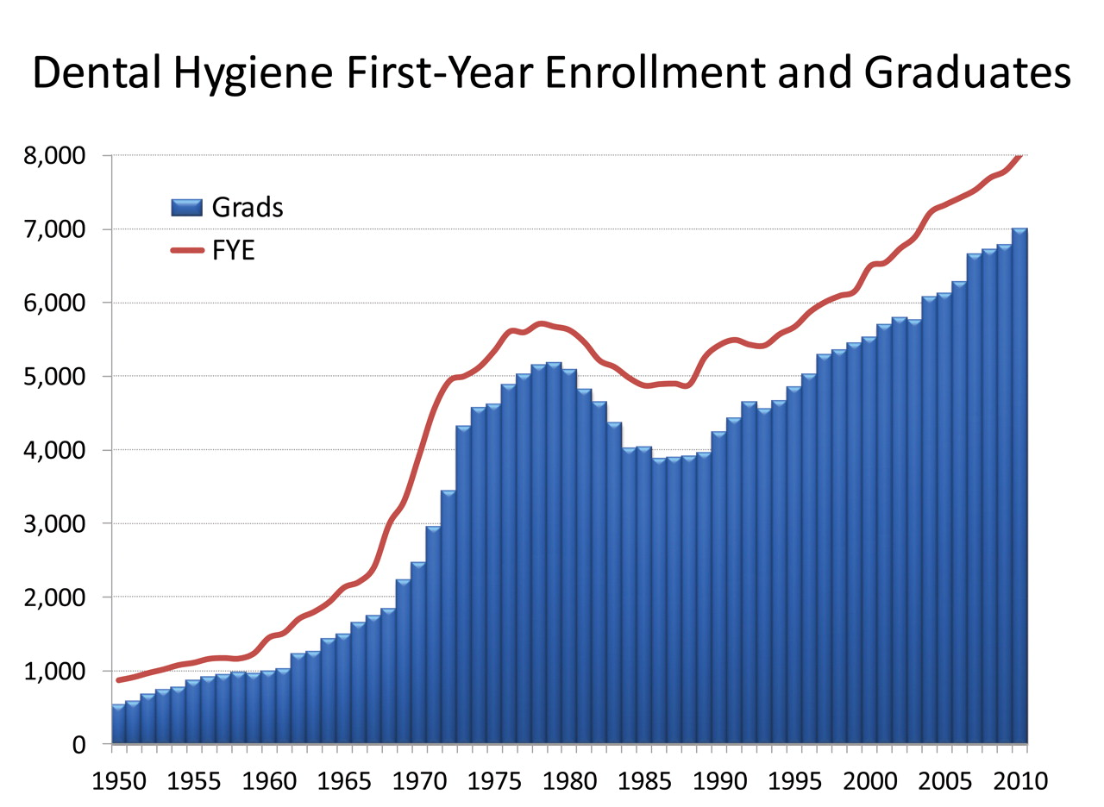
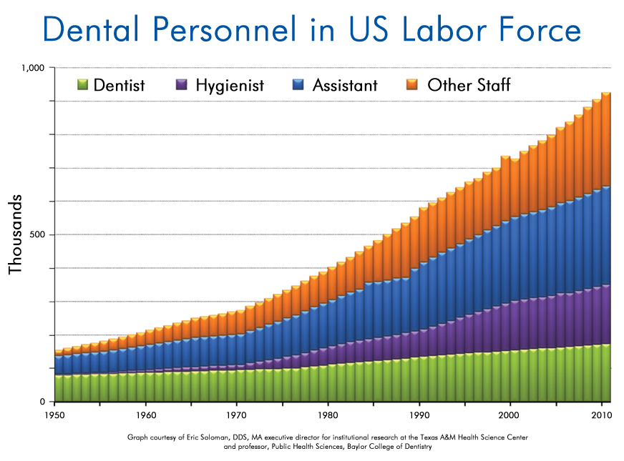
Dental Science collection?
404 dental hygiene programs in the US
66 Dental Schools
~13,000 yearly graduates
Journal of Dental Education August 2012, 76 (8) 1028-1035

