Slide 1
Syncardia Figures
Journal of Visualized Experiments
Note: where appropriate we have tried to place similar figures from the web for ease of understanding alongside our sketches

Slide 2
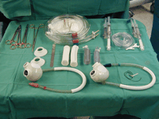
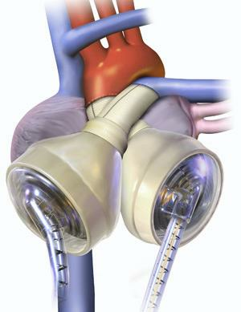
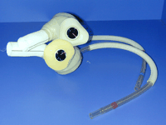
Figure 0: Syncardia TAH (total artificial heart)
Overall view of system components (Left)
Pump with atrial cuffs, outflow grafts and drivelines (bottom left)
Orientation of Syncardia TAH in adult heart with normal anatomy (below)
Notes:
Figures from: http://mmcts.oxfordjournals.org/content/2007/0329/mmcts.2006.002485.full, accreditednursing.com,

Slide 3
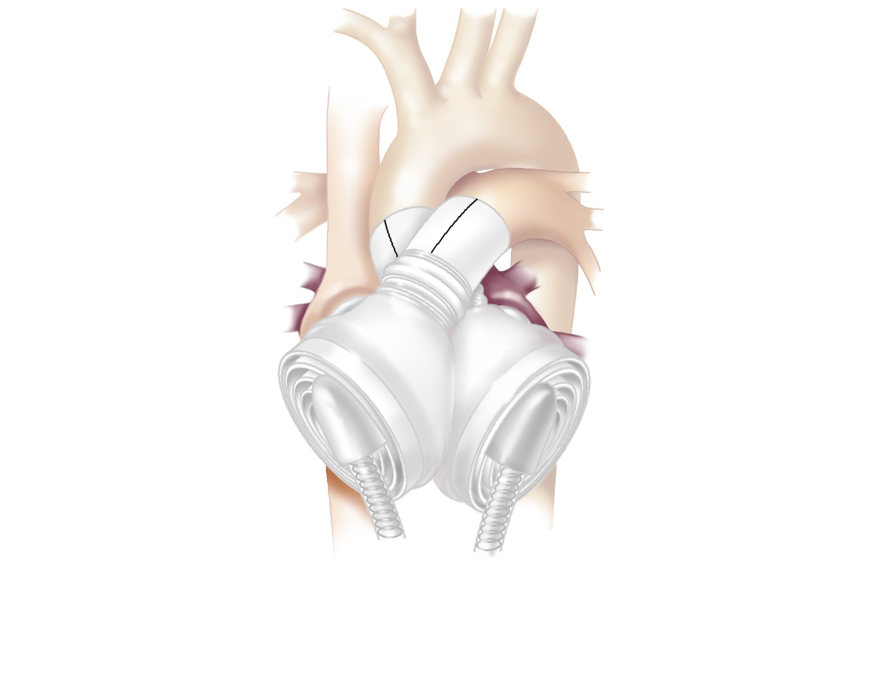
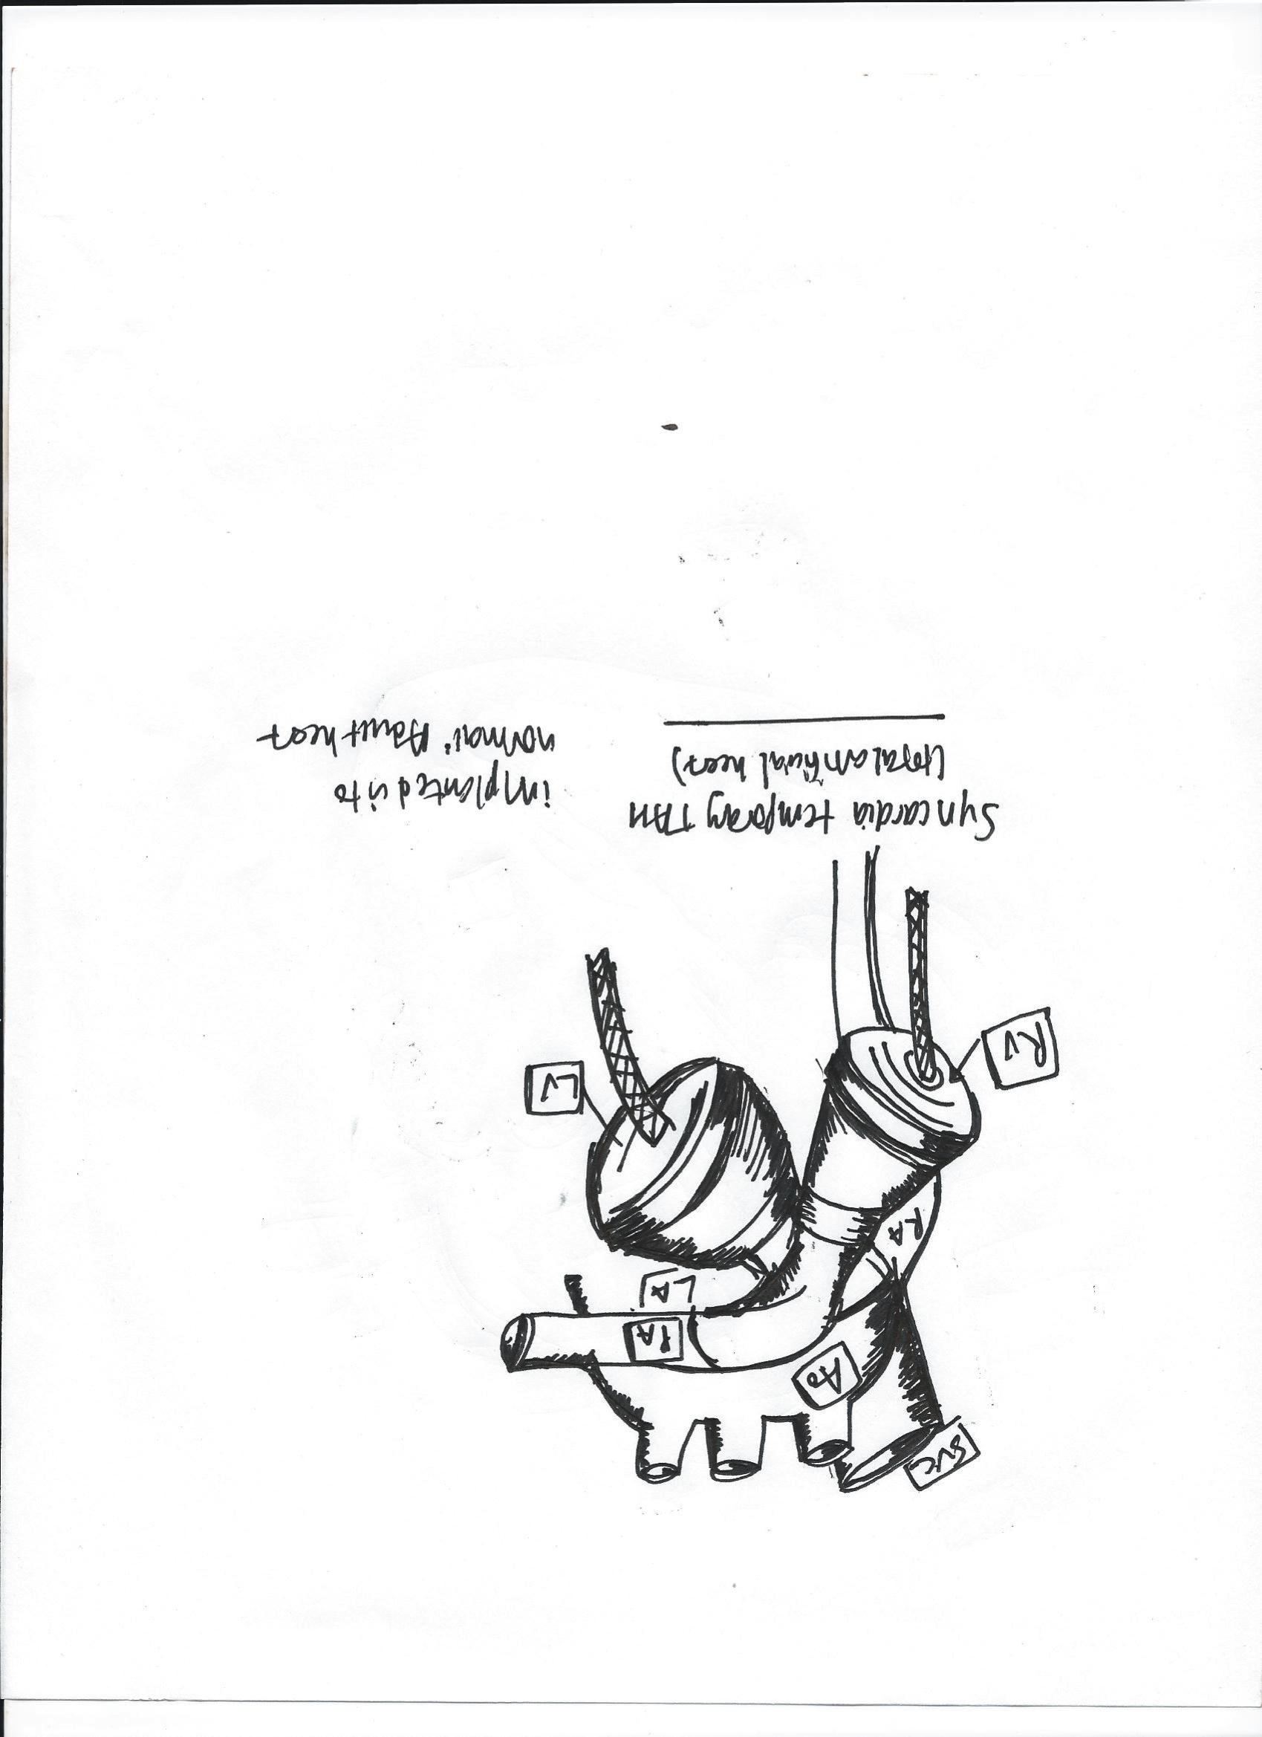
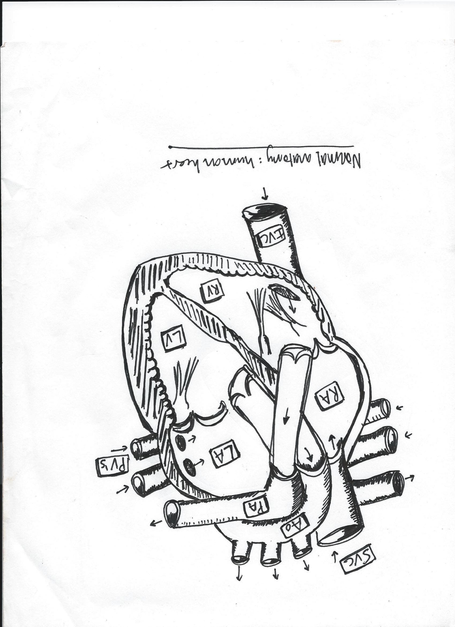
Figure 1- Panels A and B: Normal Anatomy
Figure 1-Panel B:
Orientation of Syncardia TAH (total artificial heart) in an adult heart with normal anatomy of the great vessels. Note that the LV and RV pumps appear crossed as they correspond to the normal anatomy of the pulmonary artery (which connects to the RV) and the aorta (which connects to the LV)
Figure 1-Panel A:
Normal anatomy of the adult human heart. The pulmonary artery connects to the RV and aorta to the LV.
Notes:
Abbreviations used: SVC= superior vena cava; IVC= inferior vena cava; Ao= aorta; PA= pulmonary artery; PV= pulmonary veins; LA= left atrium; RA= right atrium; LV=left ventricle; RV= right ventricle

Slide 4
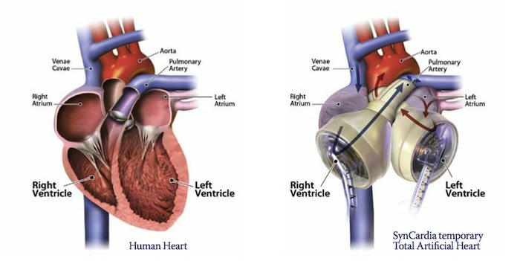
Notes:
http://www.sentara.com/Services/Cardiac/Advanced-Heart-Failure/PublishingImages/syncardia-heart-image.jpg

Slide 5
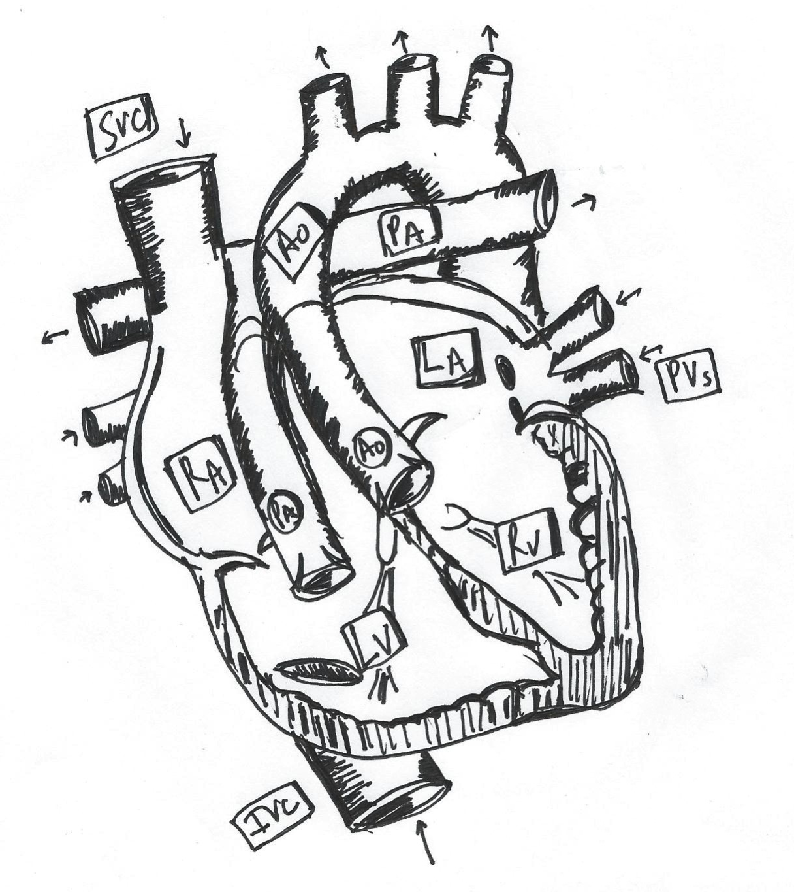
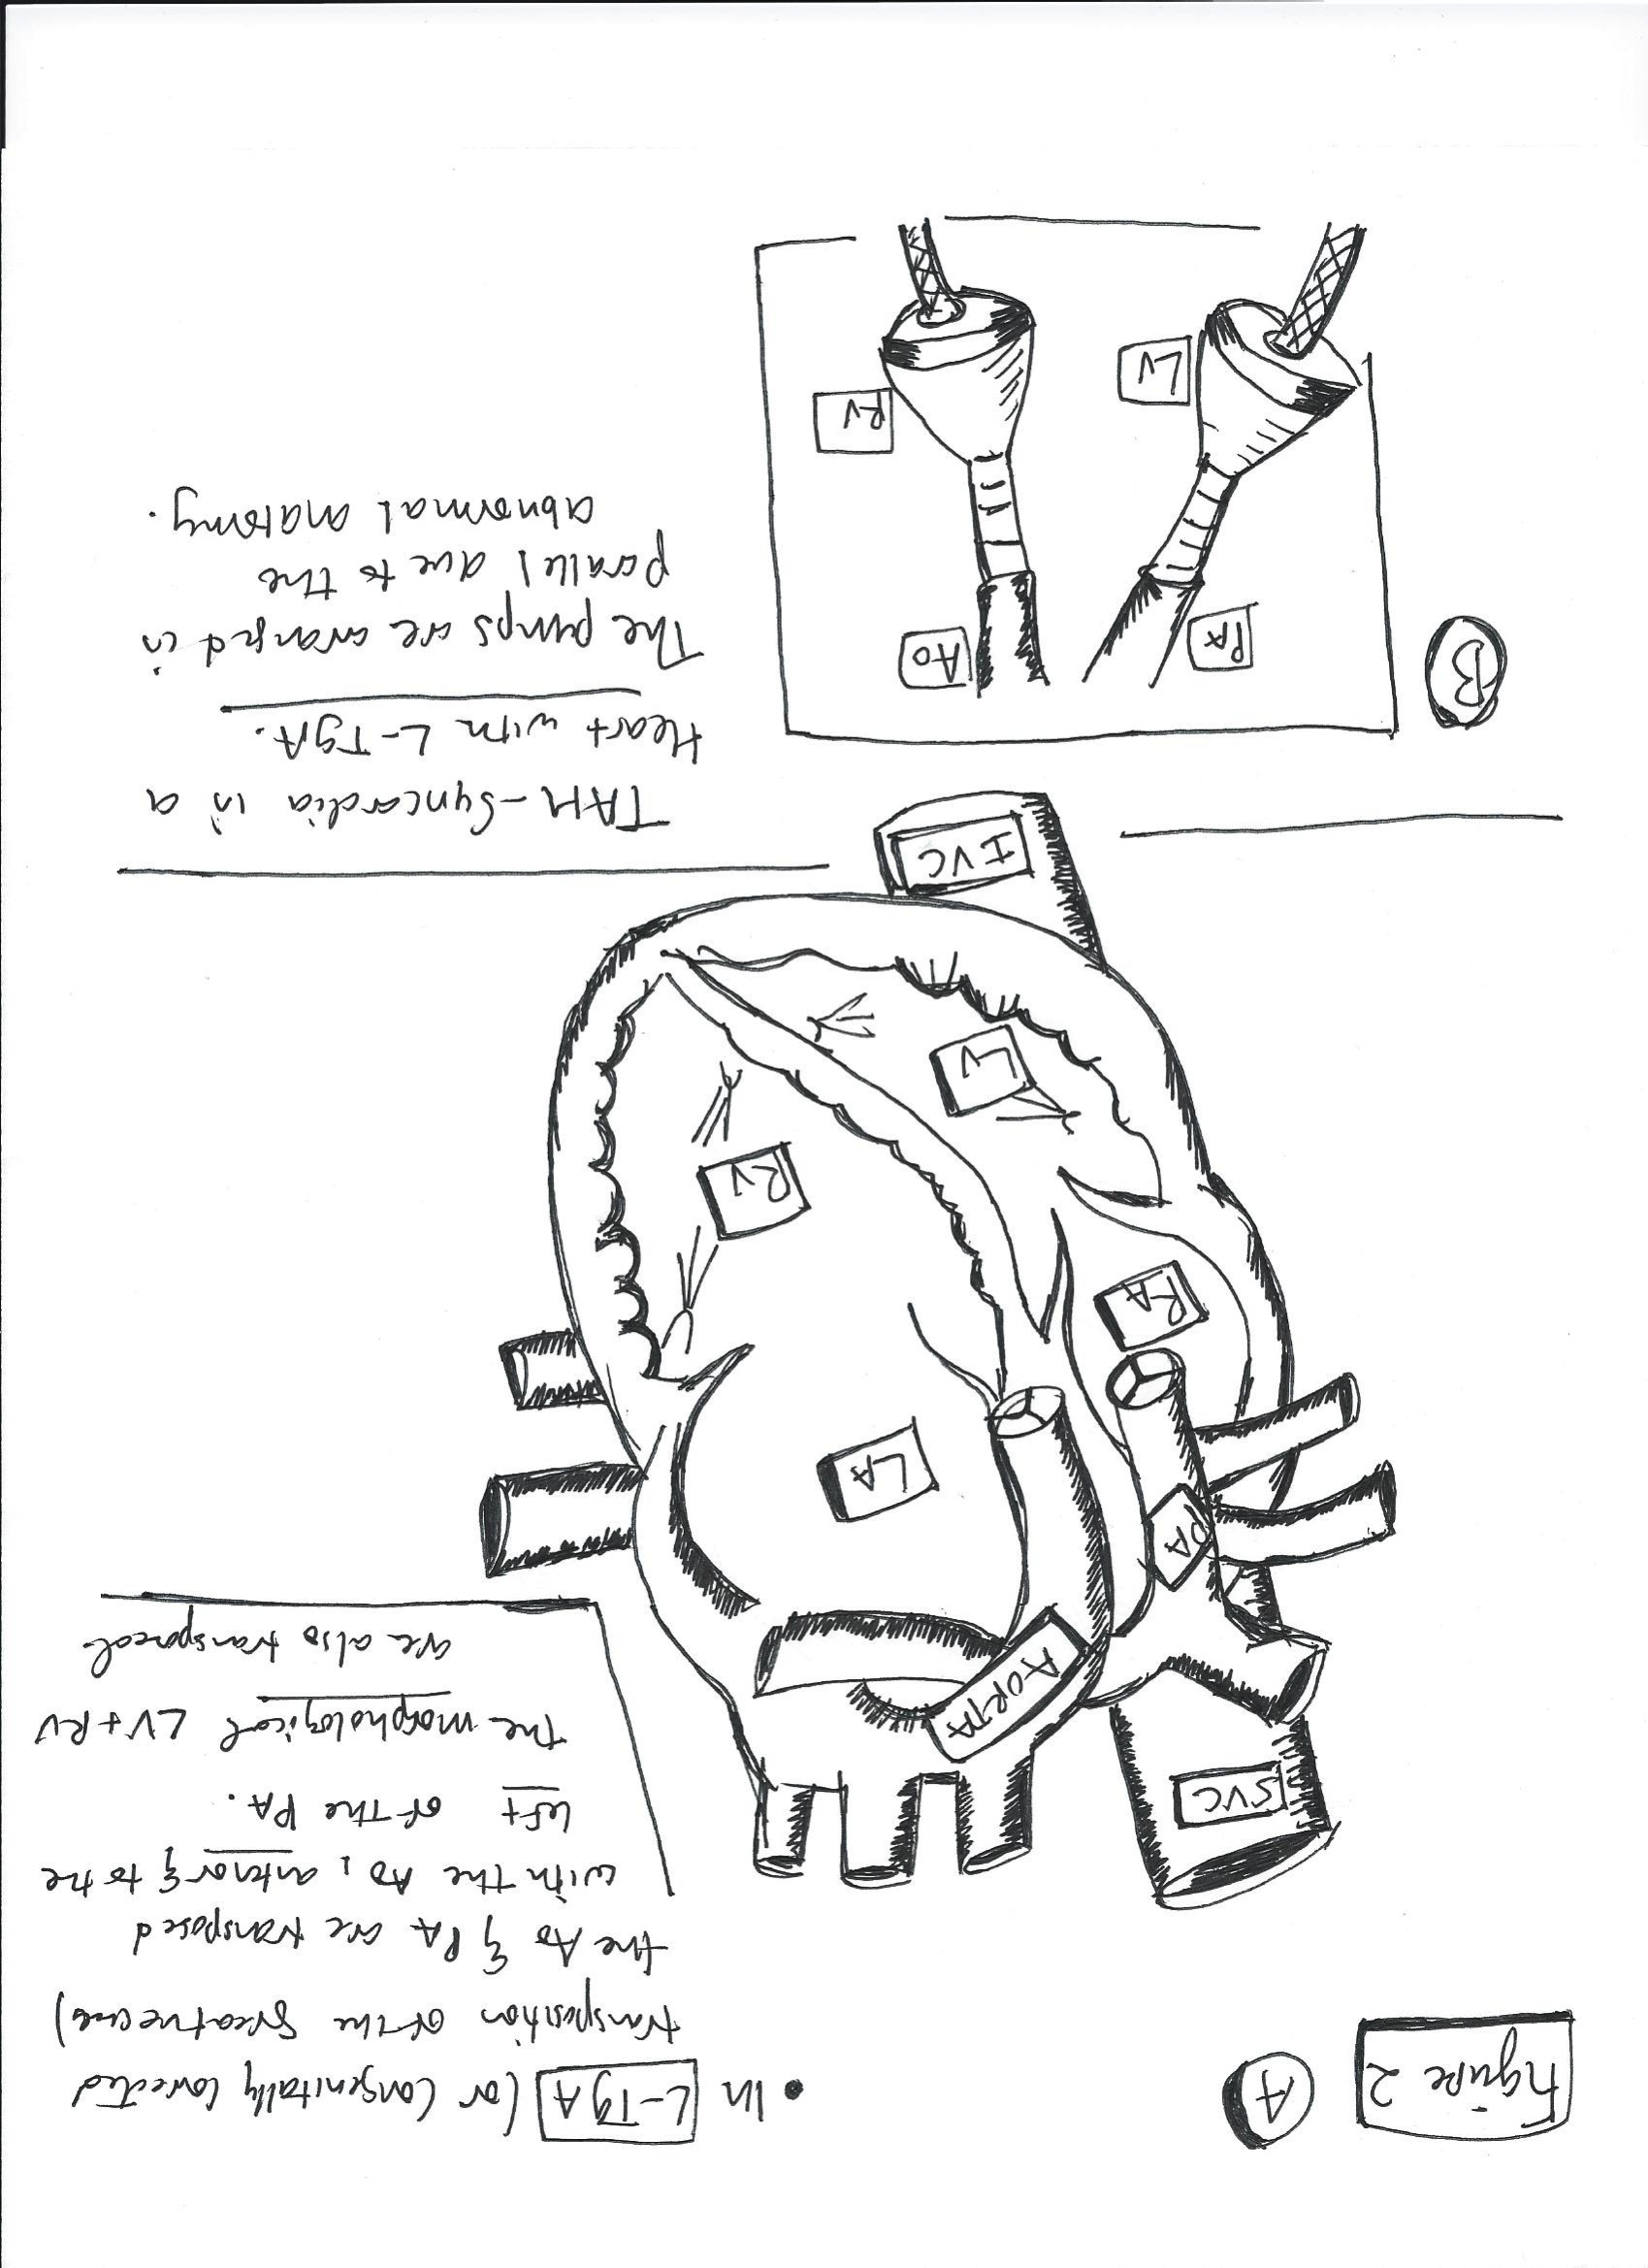
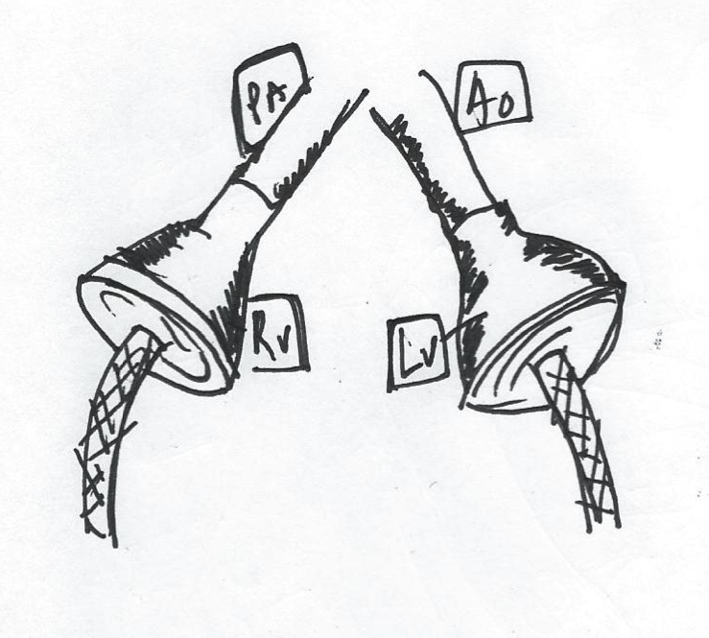
Figure 2- Panels A and B: Congenitally Corrected Transposition of the Great Vessels (CC-TGA)
Figure 2-Panel B:
Orientation of Syncardia TAH in an adult heart with CC-TGA. Since the congenitally abnormal heart has the Ao opening to RV and PA to LV, the pumps must be placed in an orientation to correct the anatomy so that the Ao opens to LV and PA to RV; therefore, the pumps appear to be in a parallel orientation instead of crossed over as in Figure1-Panel B
Figure 1-Panel A:
Normal anatomy of the adult human heart. The pulmonary artery connects to the RV and aorta to the LV.

Slide 6
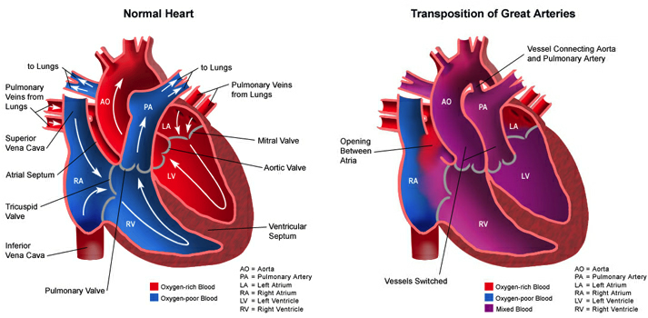
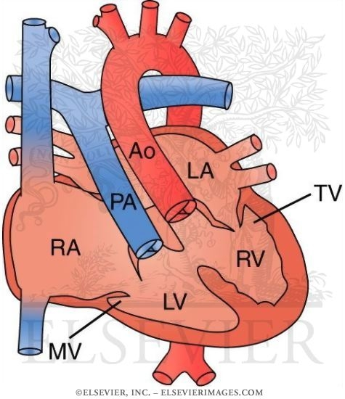
Notes:
http://7billiontravellors.wordpress.com/2011/08/24/congenital-heart-disease-transposition-of-the-great-vessels/

Slide 7
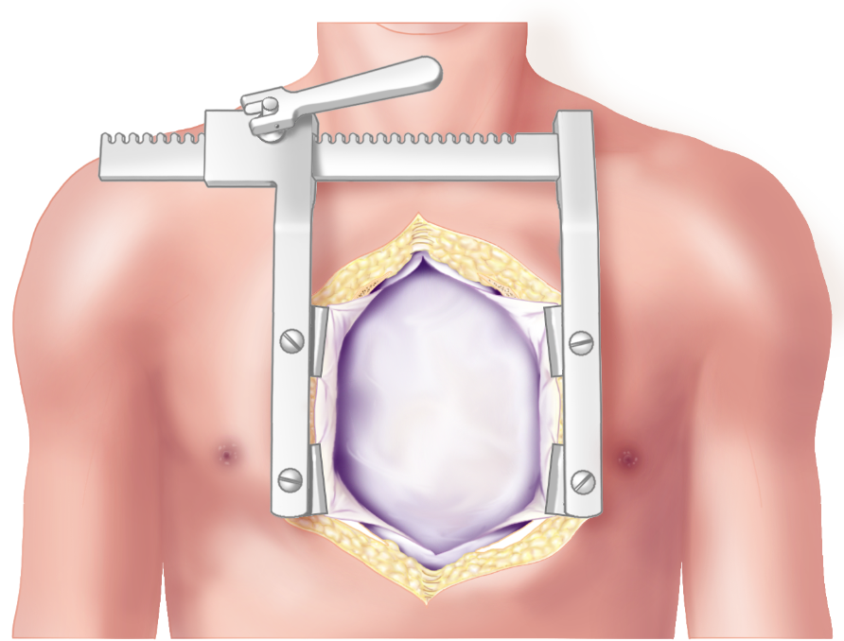
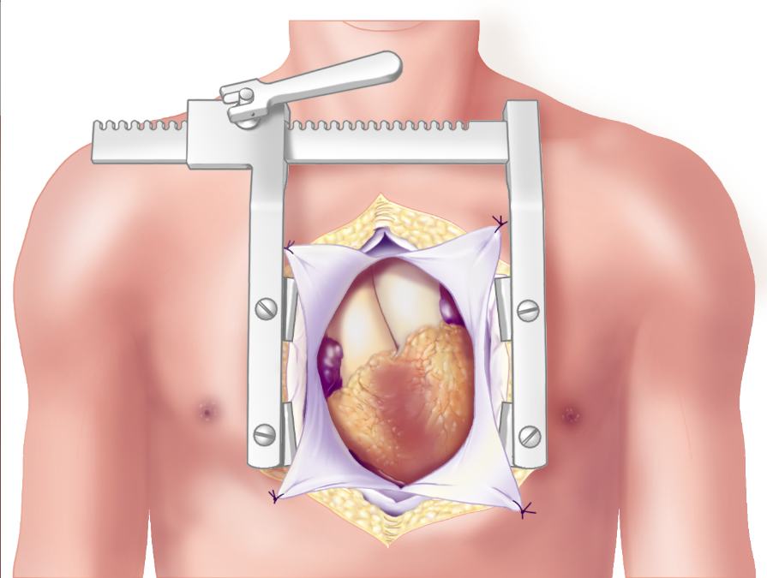
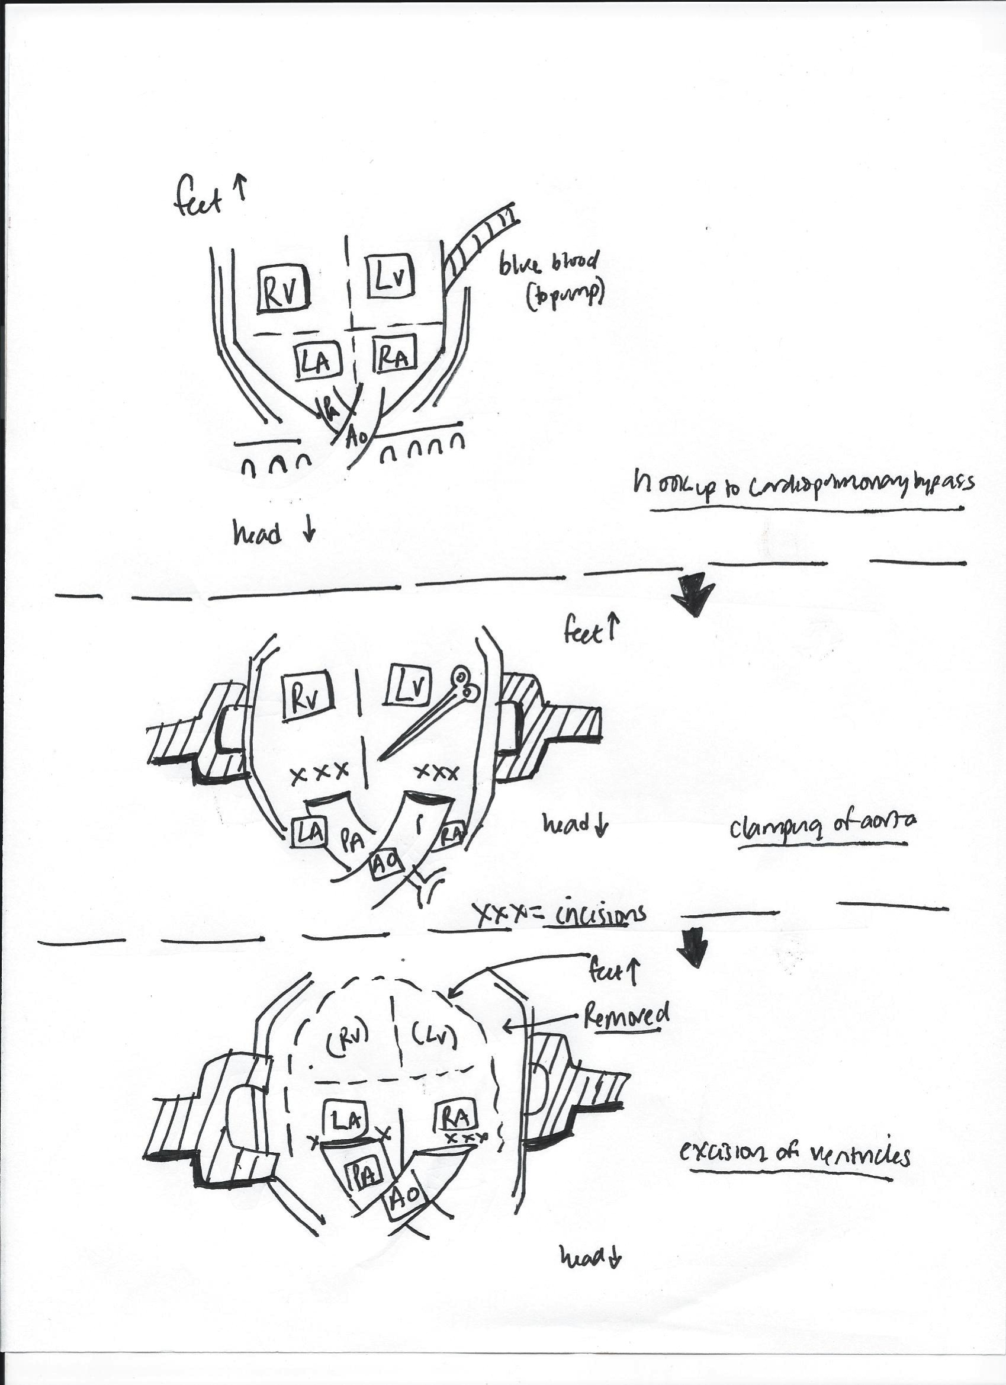
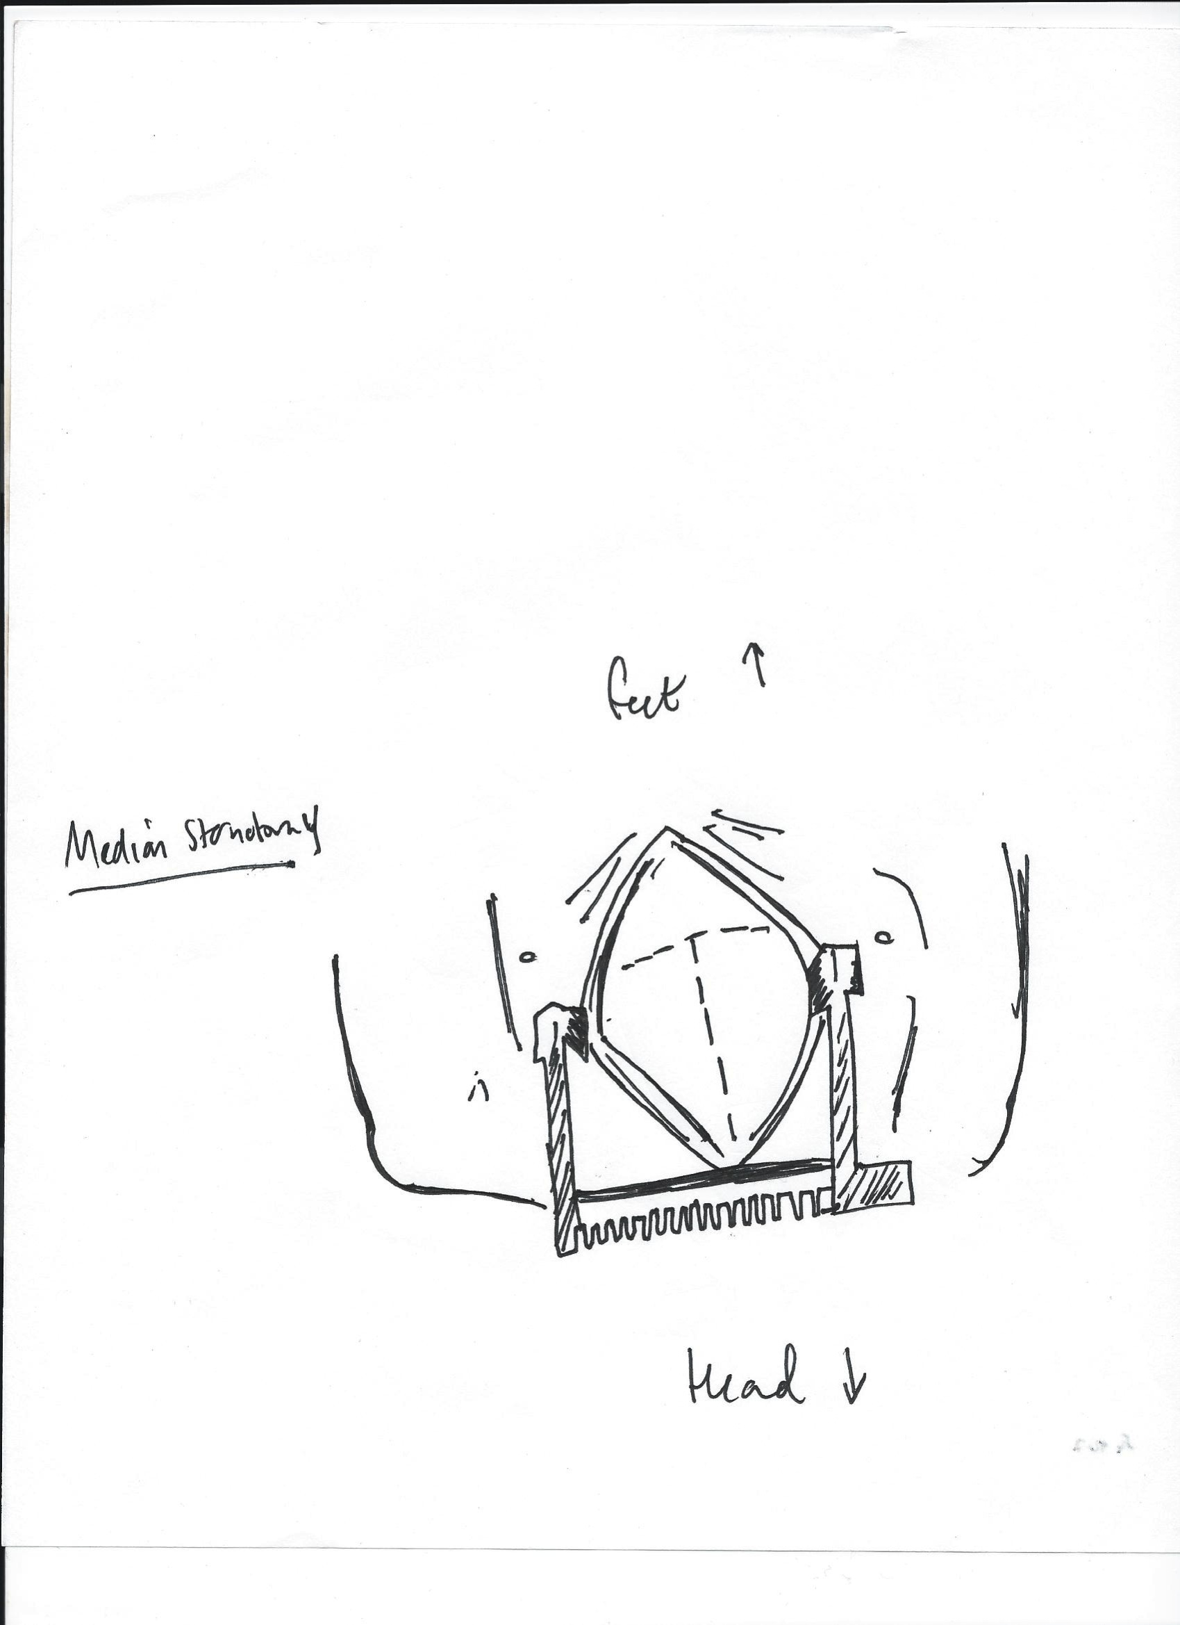
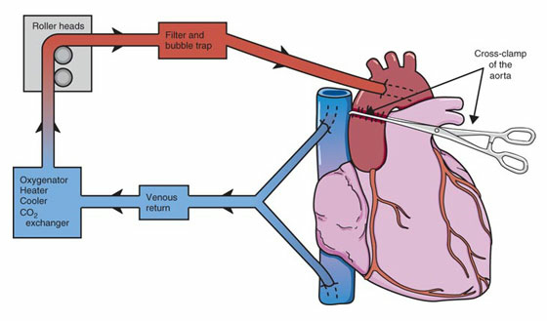
Figures 3 and 4: Surgical Procedure
Figure 3-Panel A: Median sternotomy
Figure 3-Panel B: Hook up to cardiopulmonary bypass
Notes:
Fig3. Begin w/ median sternotomy.
http://ht.edwards.com/sci/edwards/sitecollectionimages/products/heartvalves/magnamitralsternotomy.jpg
Fig 4. Connection of heart-lung bypass machine and transfer to total cardiopulmonary bypass
http://www.tabers.com/tabersonline/ub?cmd=repview&type=tabers_21&name=h086p0

Slide 8
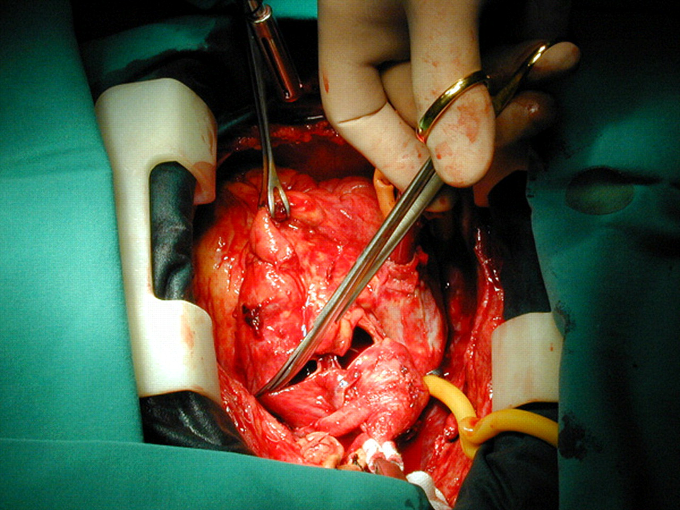
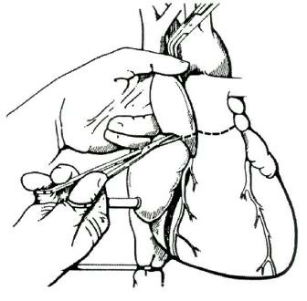
Figures 4 and 5: Surgical Procedure
Notes:
Figure 4- after cross-clamping the aorta, section the aorta and pulmonary arteries close to the valves.
http://mmcts.oxfordjournals.org/content/2007/0329/mmcts.2006.002485/F11.large.jpg
Figure 5- Both ventricles are excised at the atrioventricular level, sparing the valvular rings
http://www.fda.gov/ohrms/dockets/ac/04/briefing/4029b1_FINAL_files/image008.jpg

Slide 9
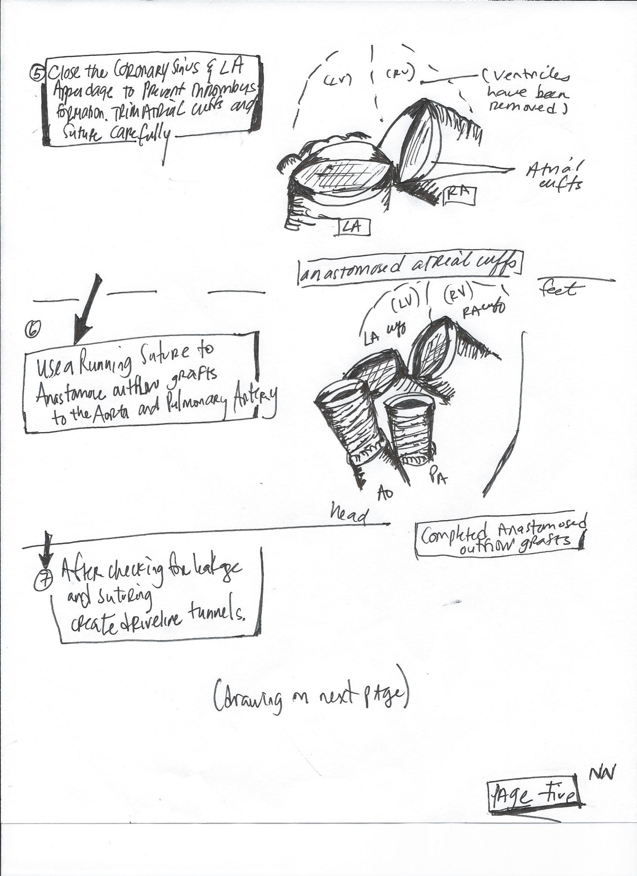
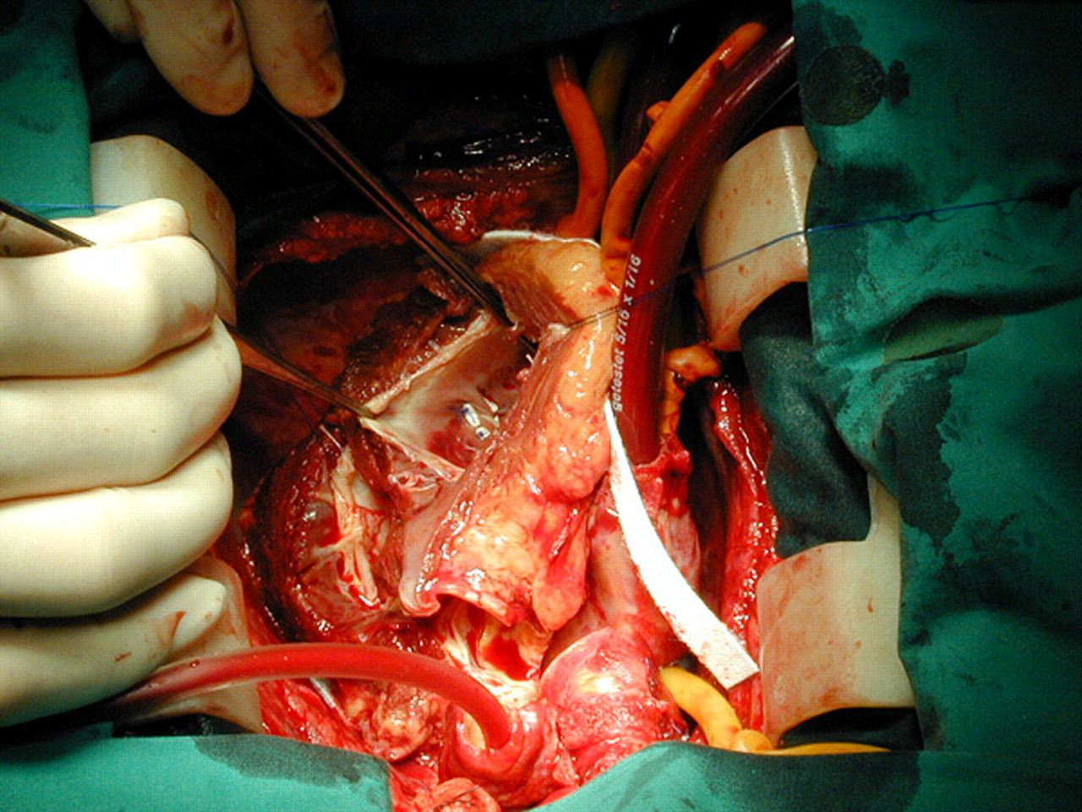
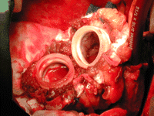
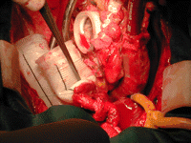
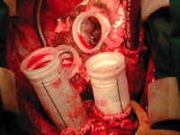
Figures 6,7,8: Surgical Procedure
RV
LV
RV
LV
Notes:
Figure 6: close the coronary sinus and left atrial appendage. Suture trimmed atrial cuffs with running suture.
http://mmcts.oxfordjournals.org/content/2007/0329/mmcts.2006.002485/F13.expansion.html
Figure 7: Use running suture to anastomose outflow grafts to aorta and pulmonary artery.
(the photographs show the anastomosis of outflow graft and completed anastomosis)

Slide 10
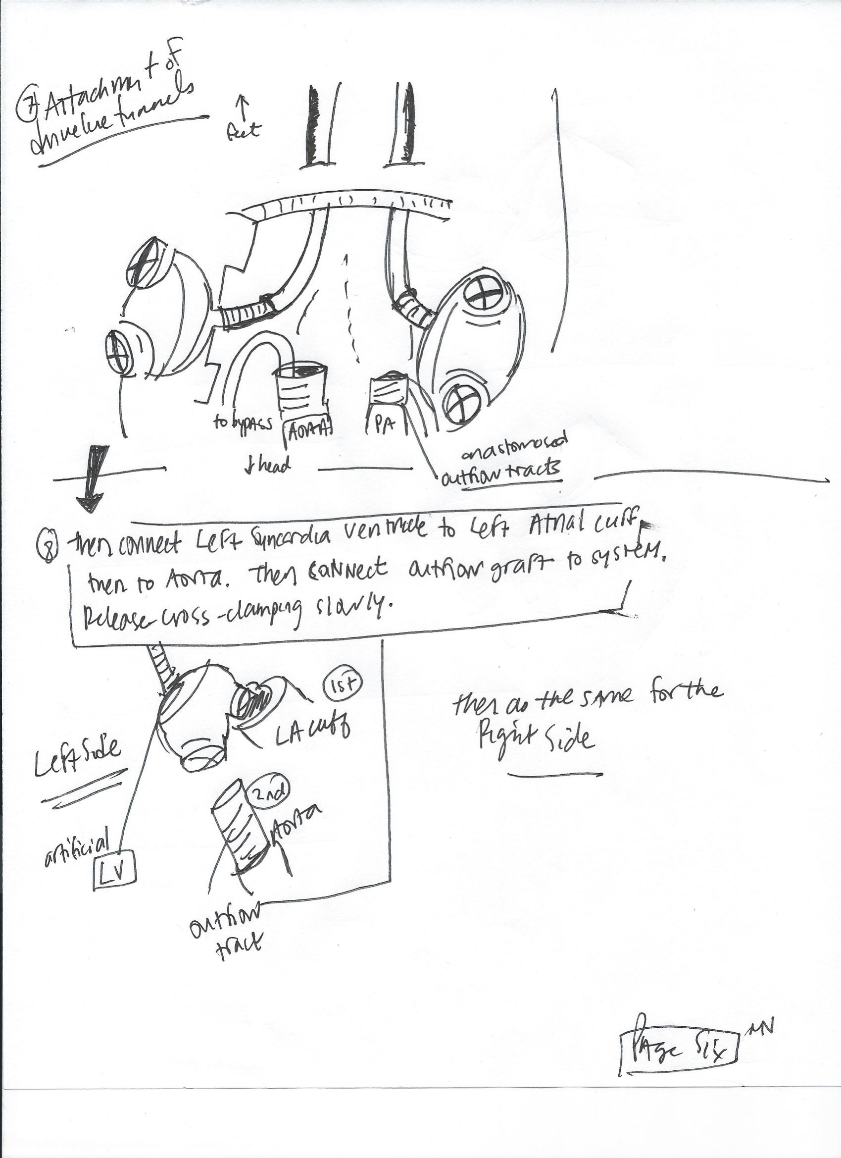
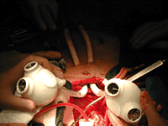
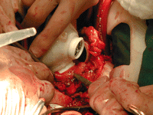
Figures 9 and 10: Surgical Procedure
RV
Notes:
Figure 9- creation of driveline tunnels.
Figure 10- start with left side. Connect the Syncardia LV to the atrial cuff and then to the aorta. After this, connect the outflow graft of the aorta .
Images from: http://mmcts.oxfordjournals.org/content/2007/0329/mmcts.2006.002485.full

Slide 11
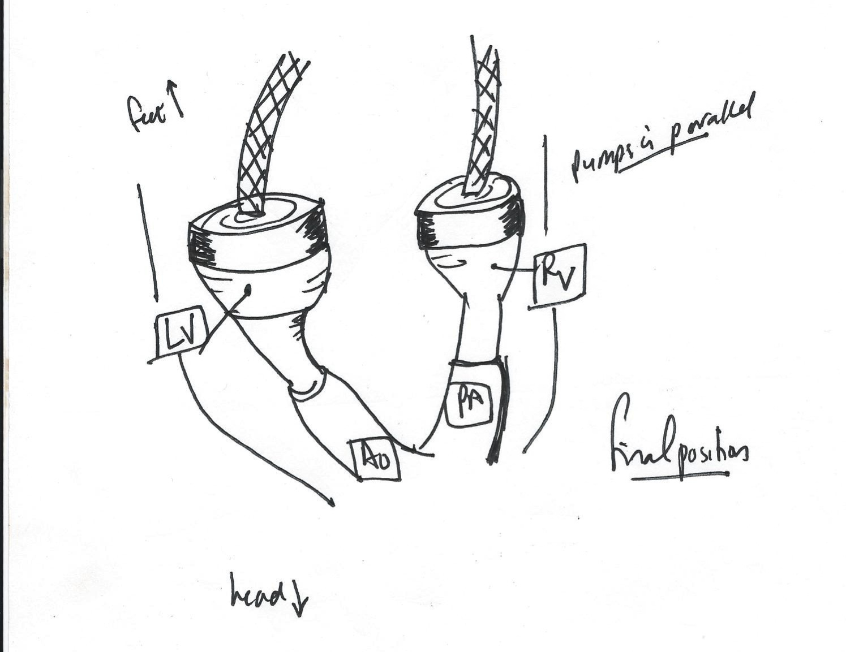
Figure 11: Surgical Procedure
Notes:
Figure 11- after the left and right sides are connected (Syncardia LV to aorta and then to atrial cuff of LA and Syncardia RV to pulmonary artery and then to atrial cuff of RA), in a patient with TGA, the pumps should appear in parallel.
Here is a good site for drawings (but shows implantation in normal adult heart): http://www.fda.gov/ohrms/dockets/ac/04/briefing/4029b1_final.pdf

