Slide 1
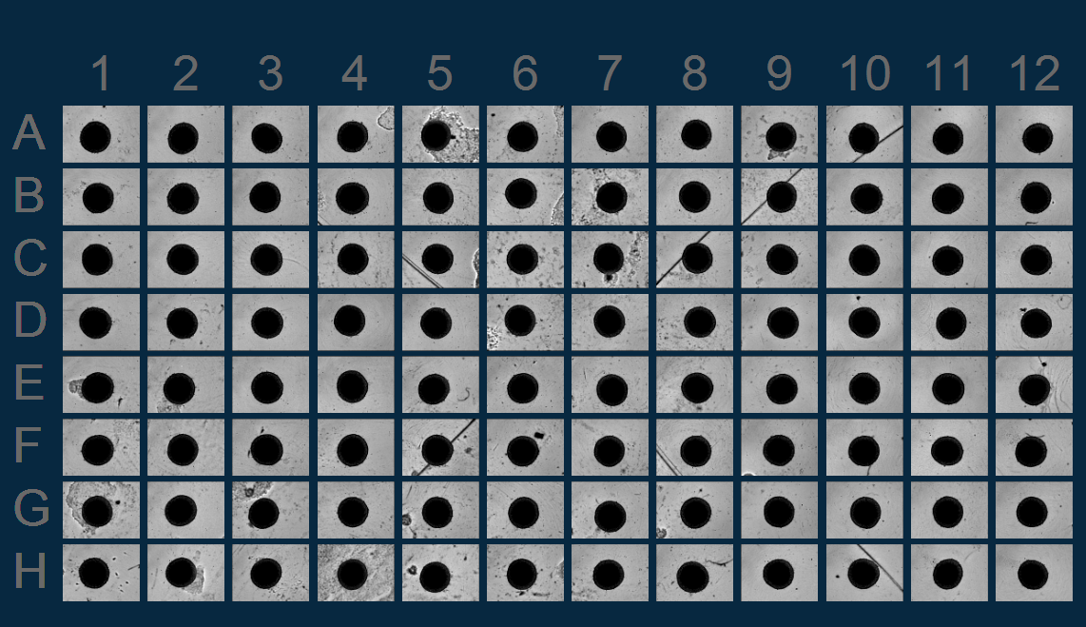
3.5.1 -3.6.1

Slide 2
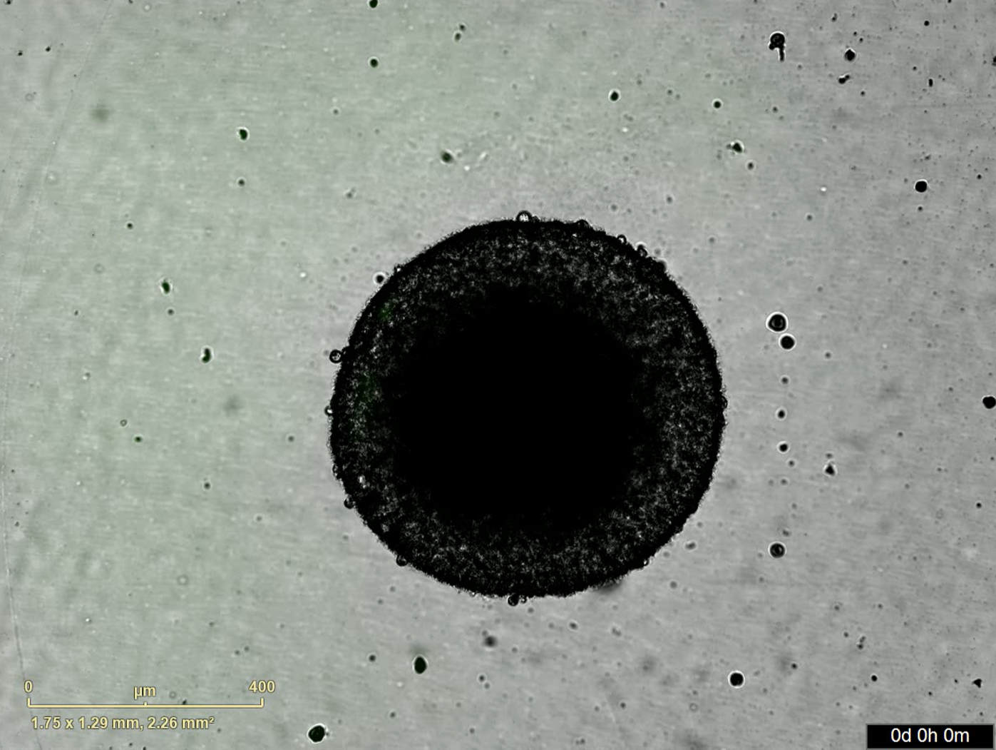
3.6.2

Slide 3
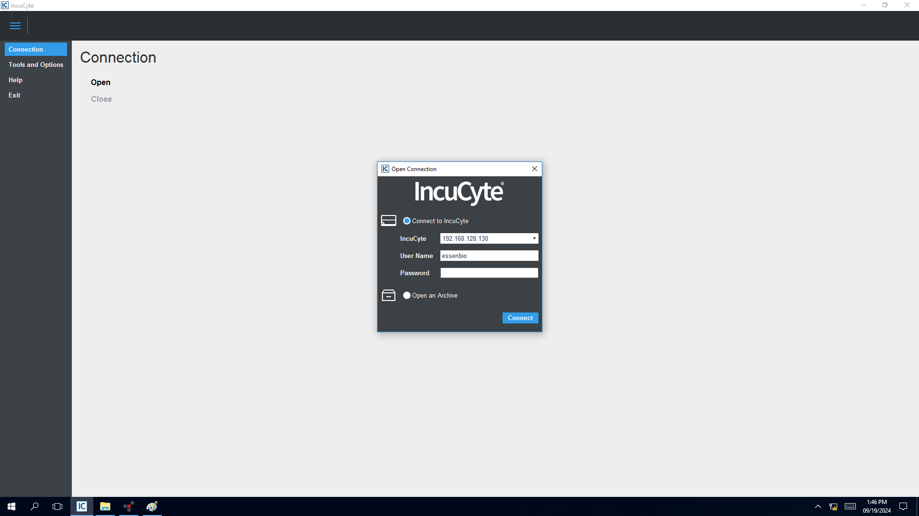
4.2.1

Slide 4
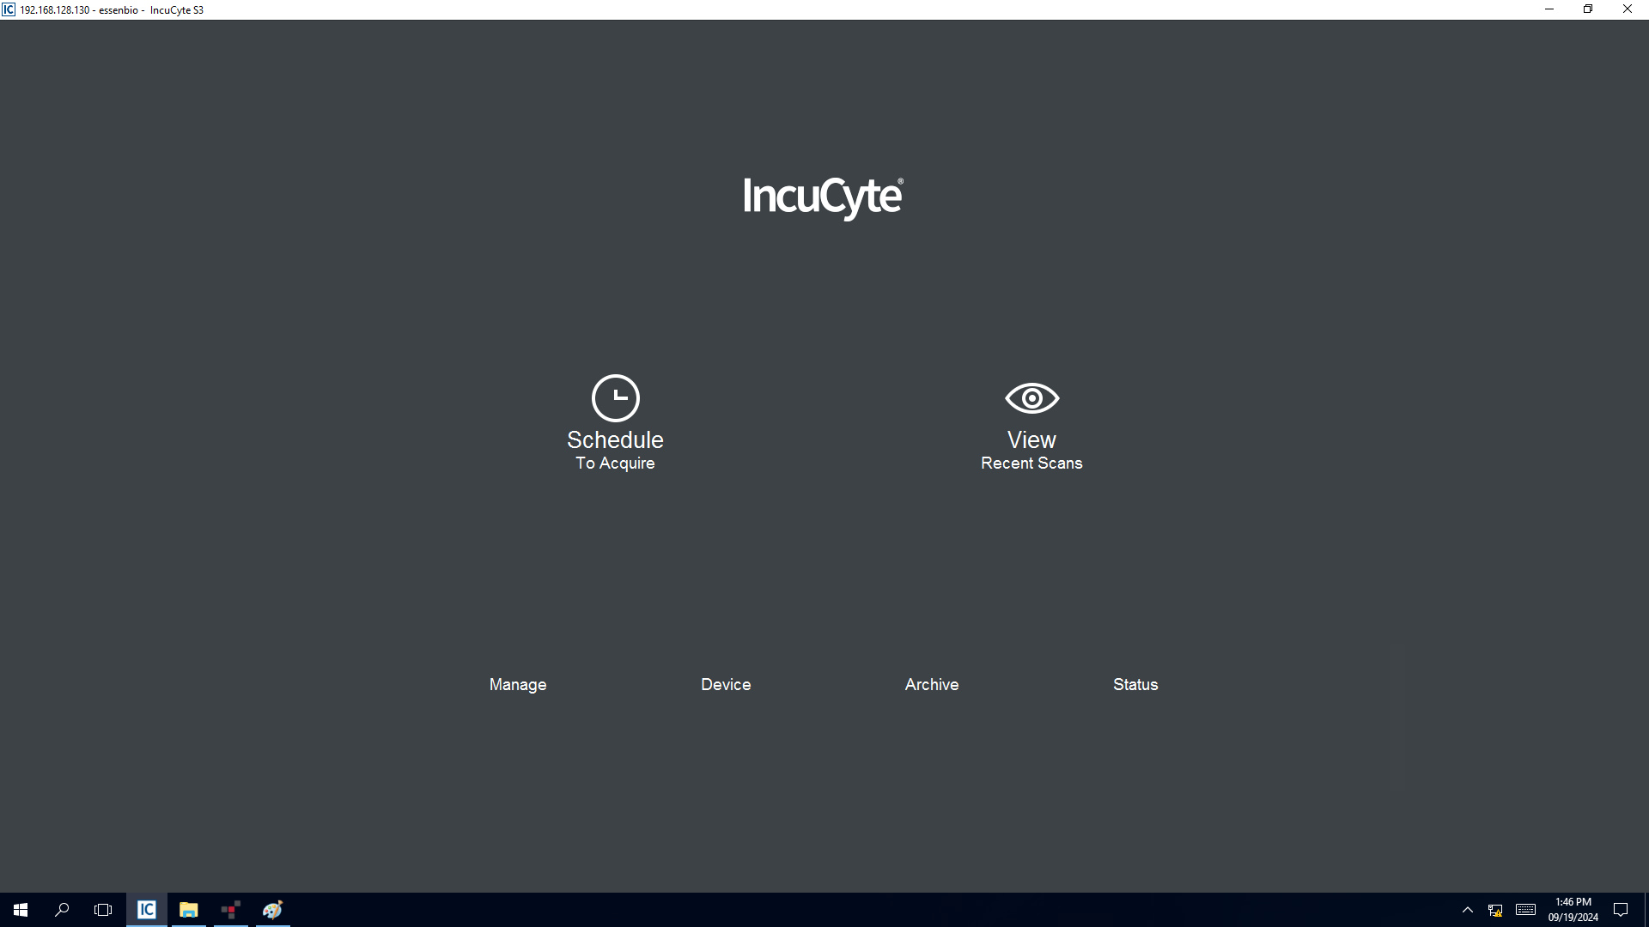
4.2.2

Slide 5
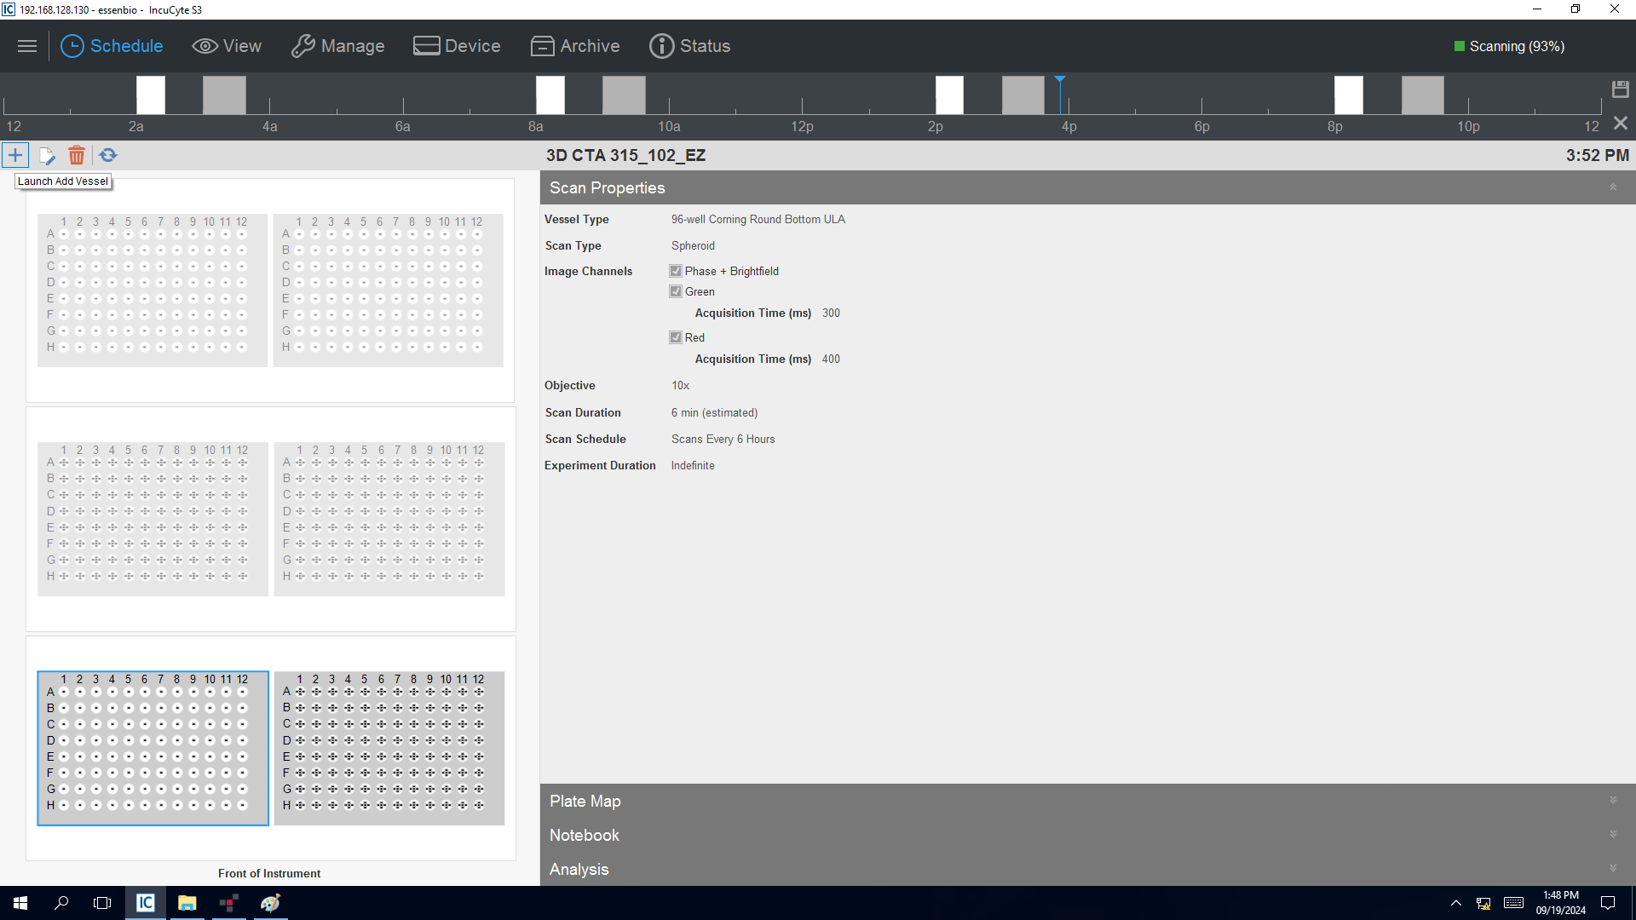
4.2.2 Launch add vessel

Slide 6
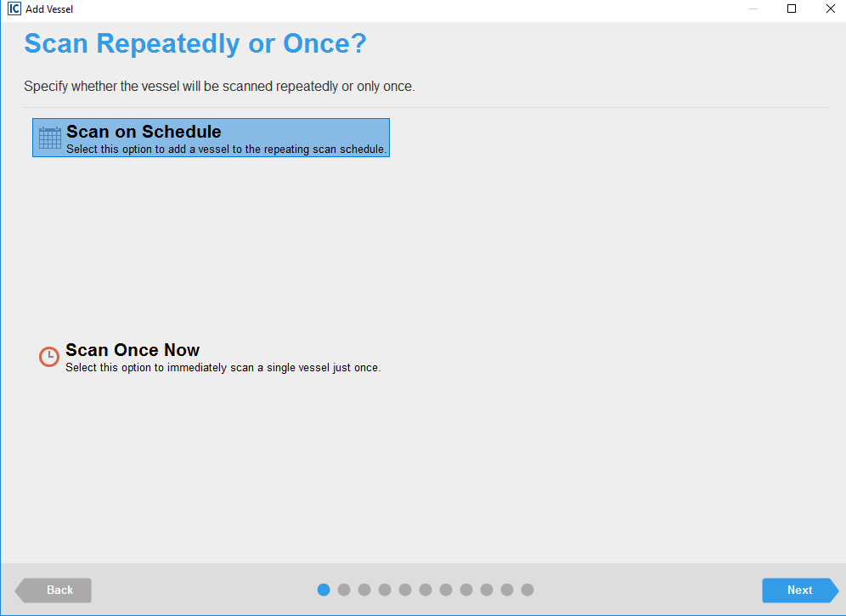
4.2.2 scan on schedule

Slide 7
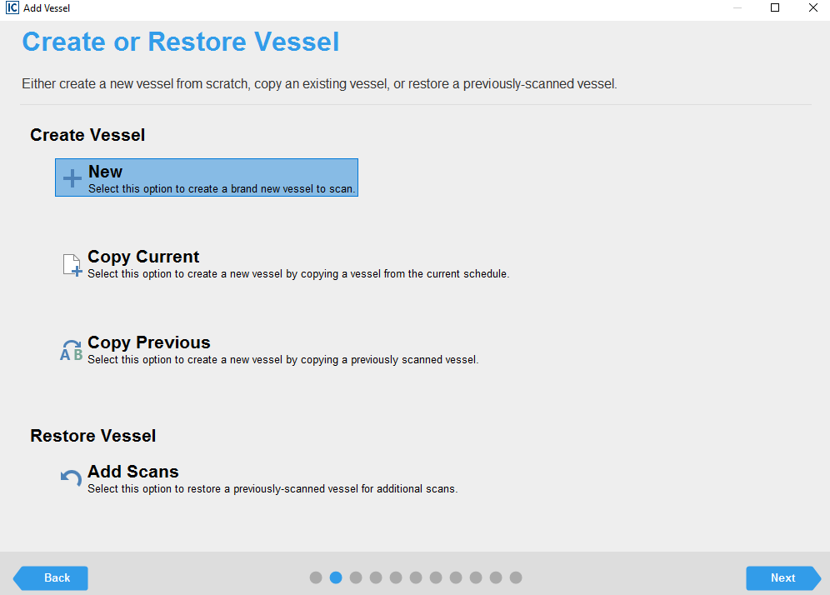
4.2.3 Create vessel

Slide 8
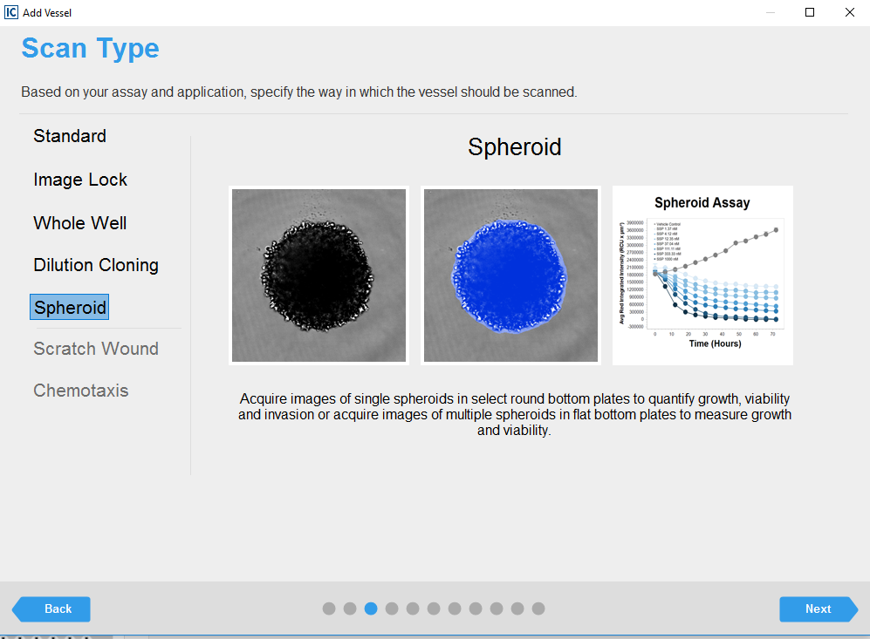
4.3.1

Slide 9
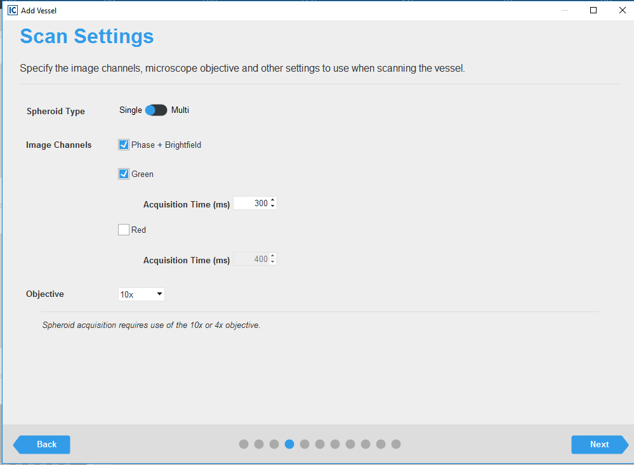
4.3.2-4.3.3

Slide 10
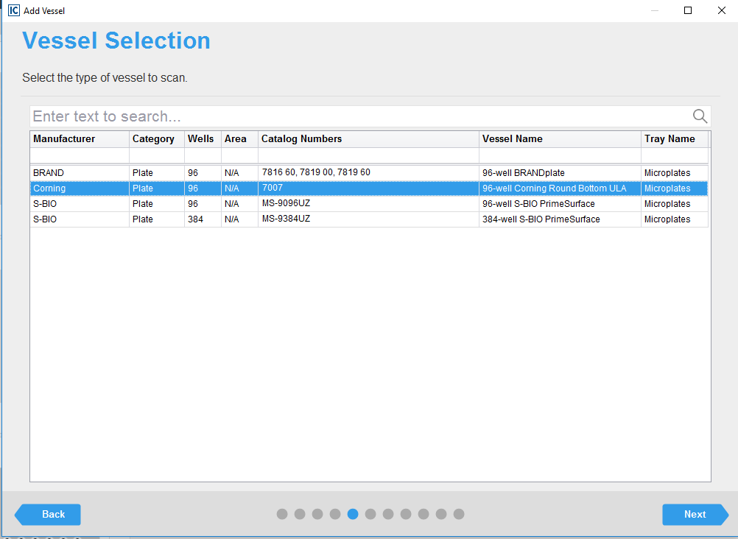
4.4.1

Slide 11
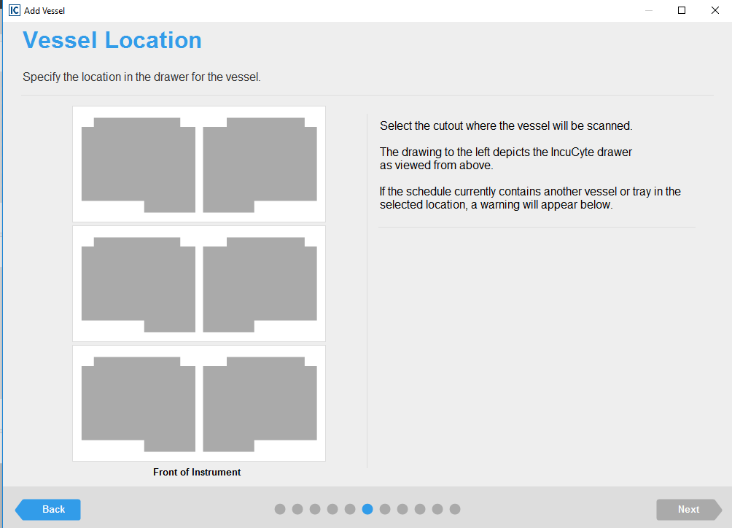
4.4.1

Slide 12
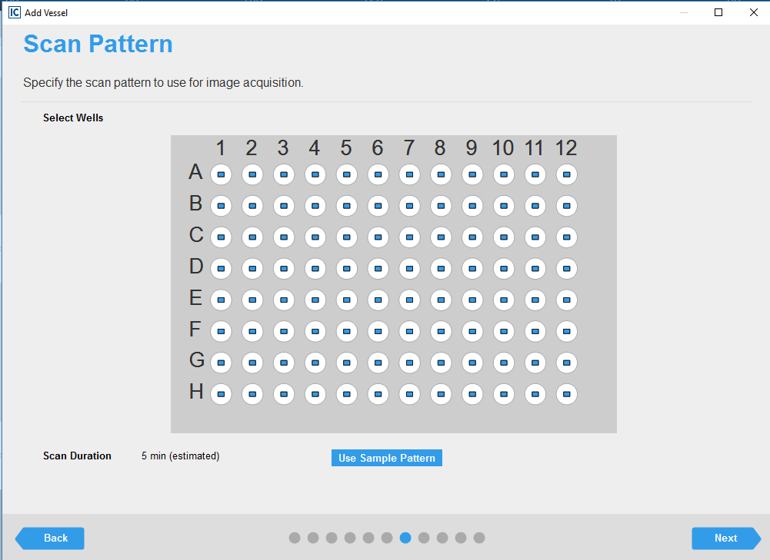
4.4.2

Slide 13
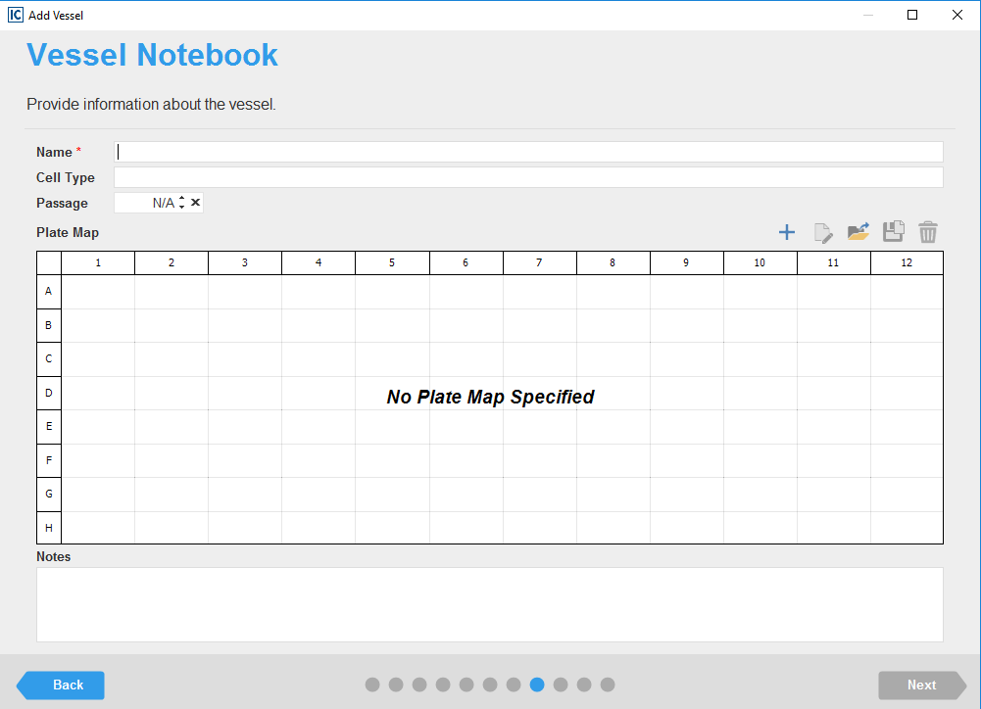
4.4.3

Slide 14
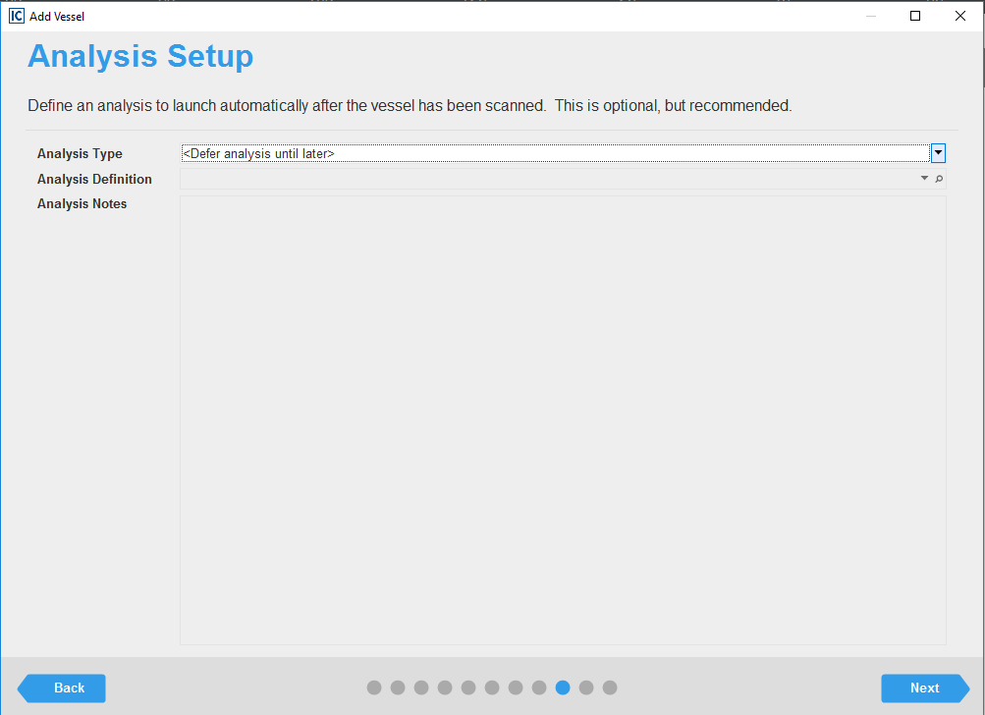
4.5.1

Slide 15
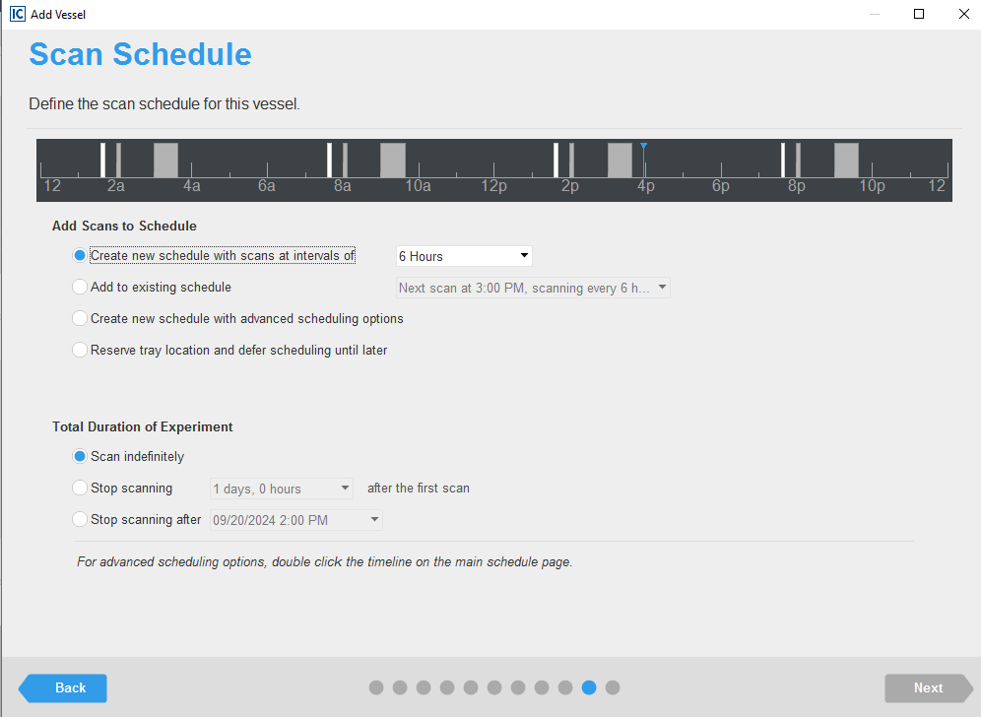
4.6.1-4.7.2

Slide 16
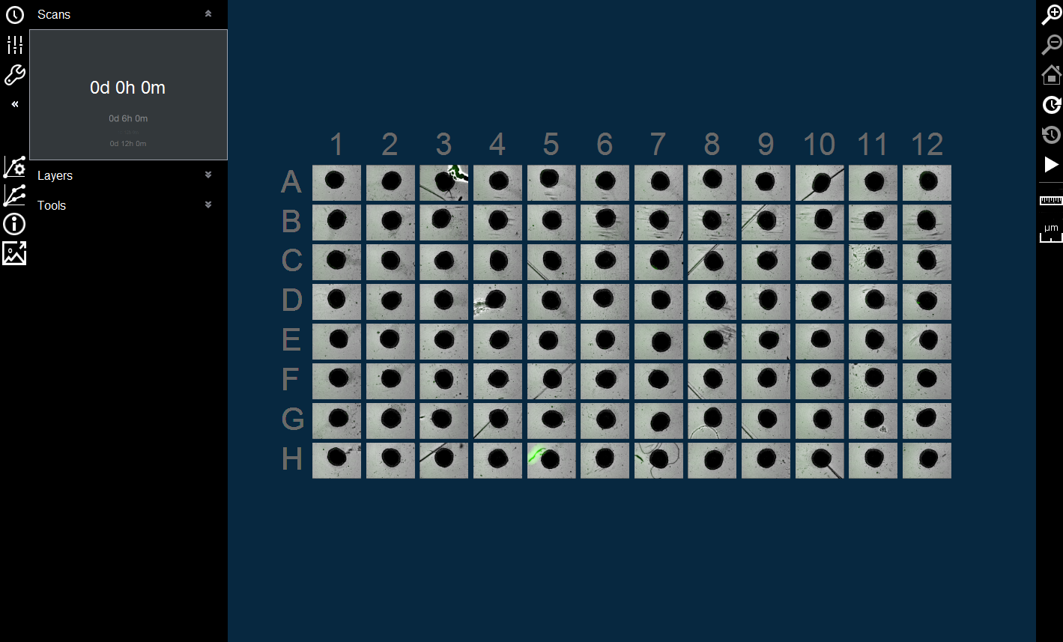
4.8.1 dashboard showing spheroid growth

Slide 17
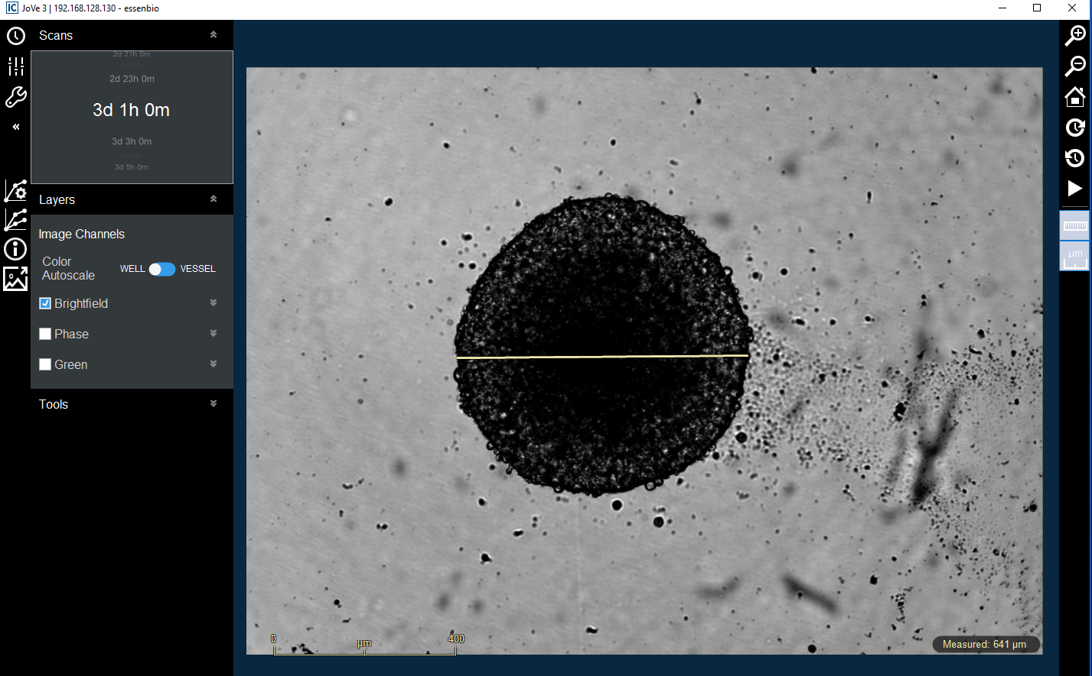
4.9.1-4.9.2

Slide 18
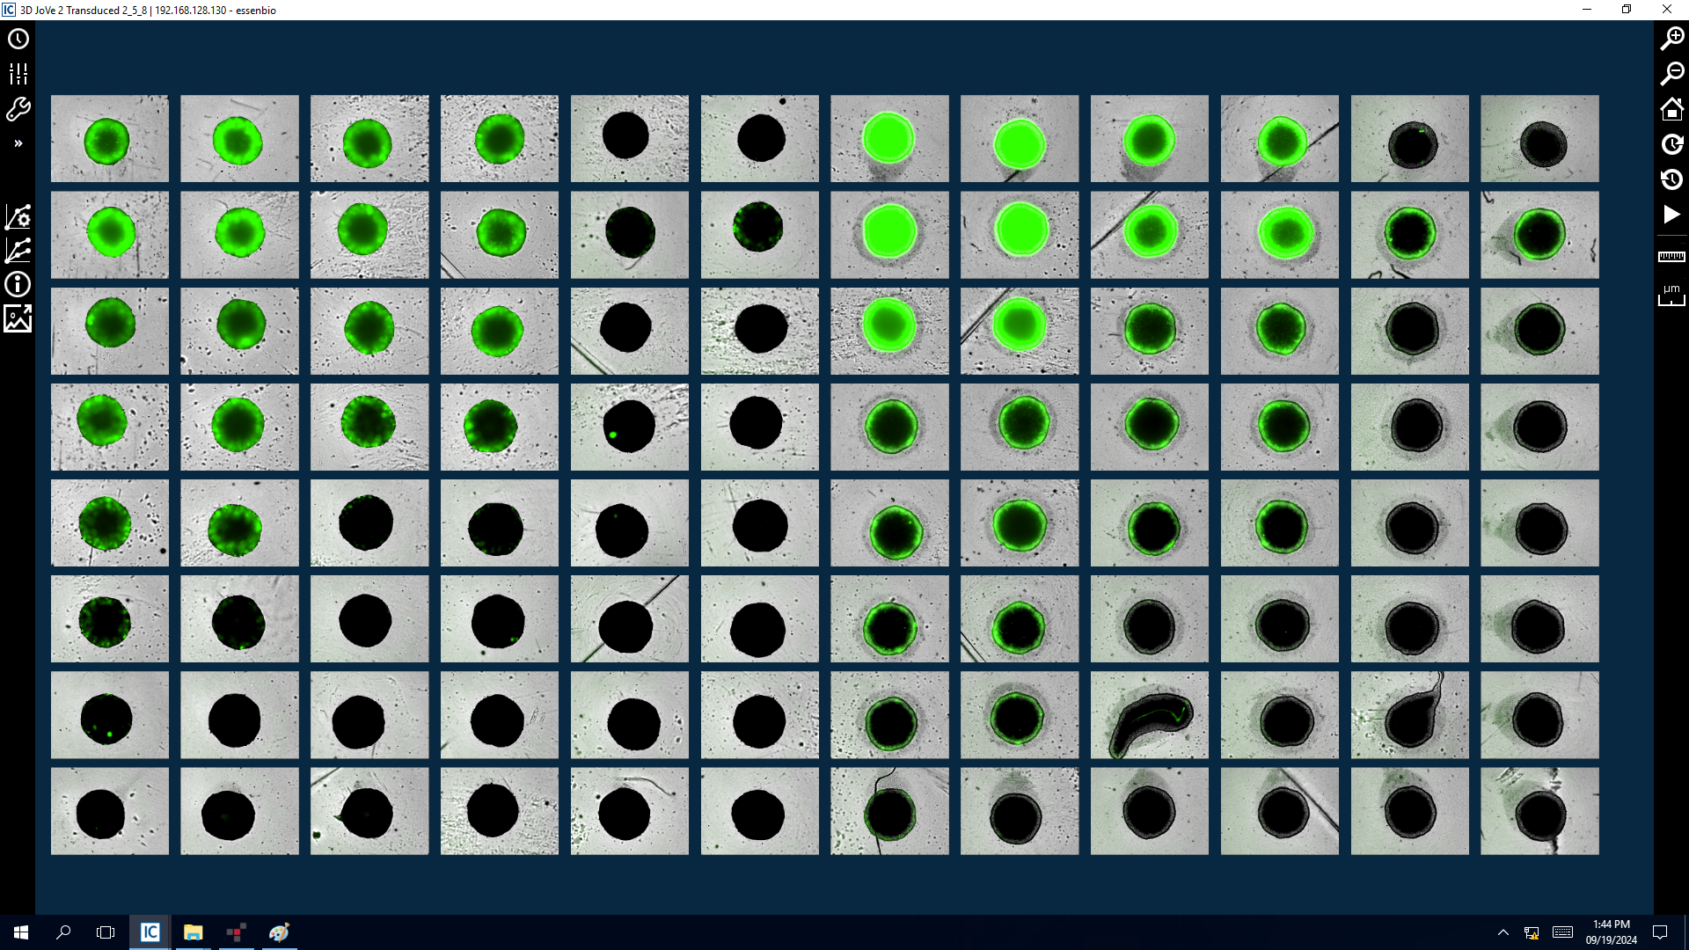
5.5.2

Slide 19
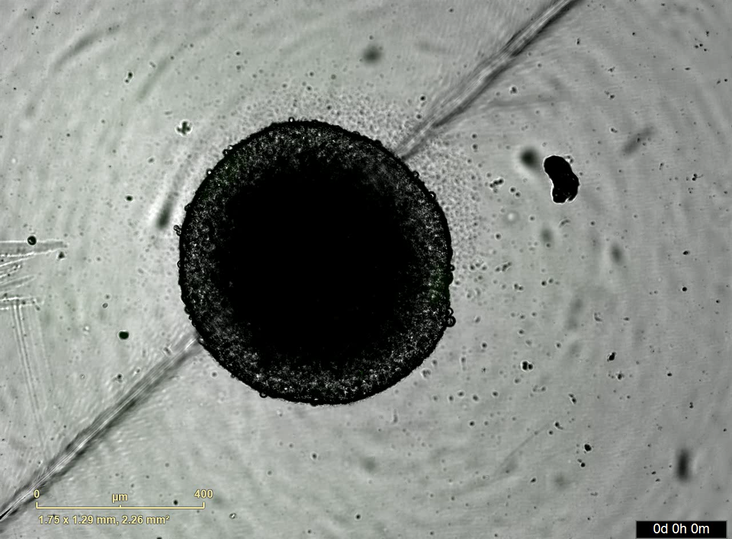
5.7.2

Slide 20
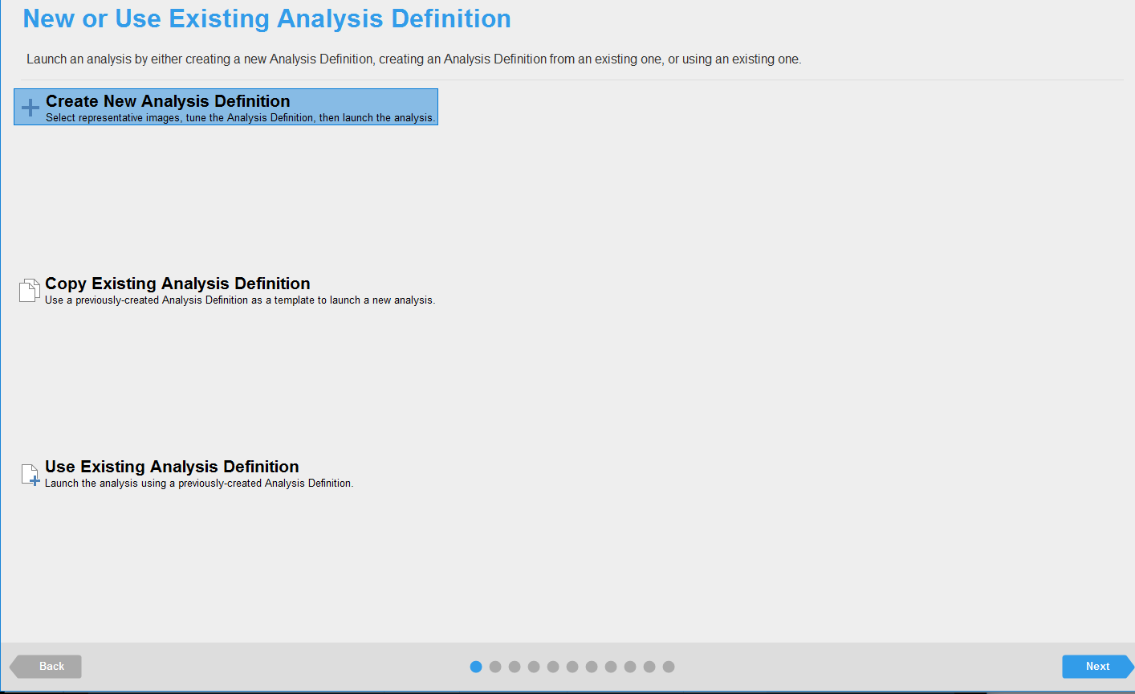
5.8.1 Data is analyzed

Slide 21
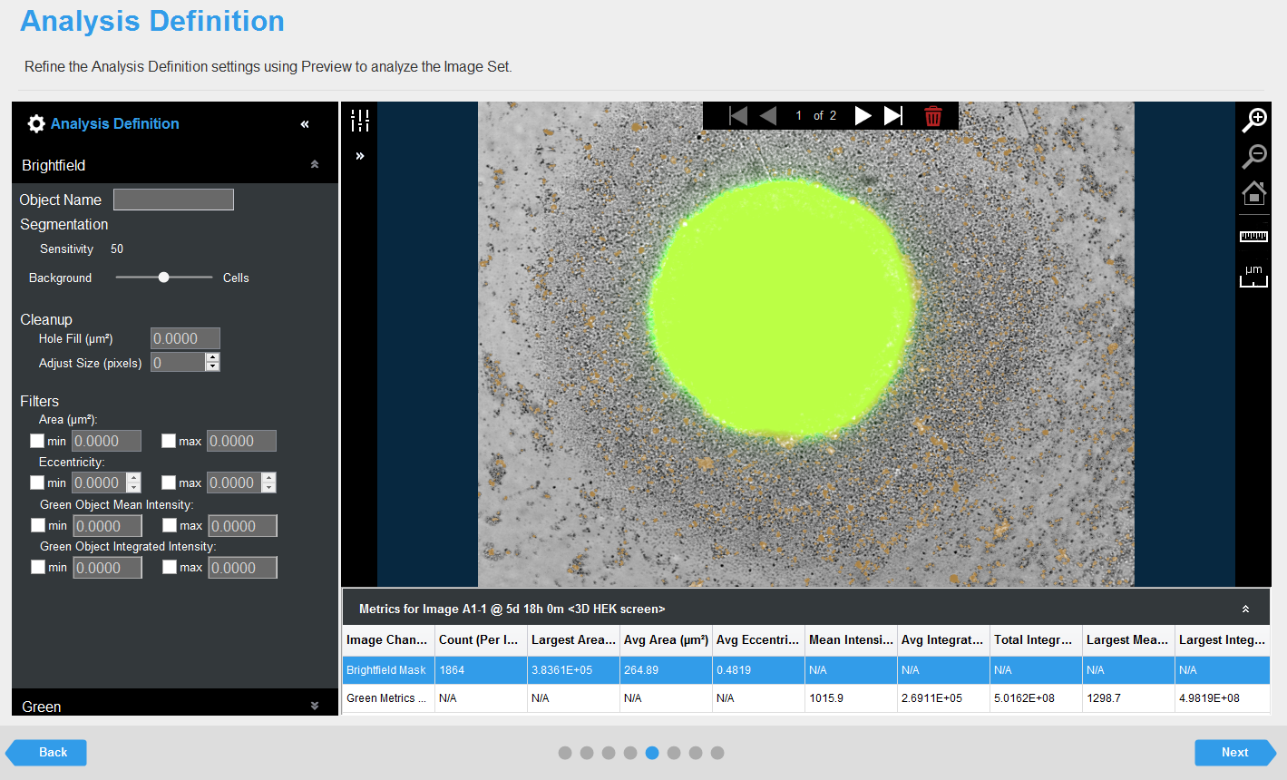
5.8.1 Data is analyzed

