Slide 1
Marked screenrecordings
JoVE video 68775
Ellen Heeren

Slide 2
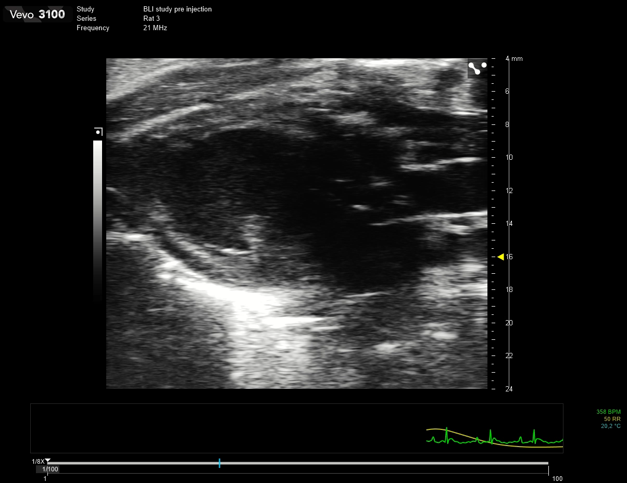
68775_screenshot_5.mp4: 2.5.1: Cine loop of PSLAX B-mode image showing infarcted region

Slide 3
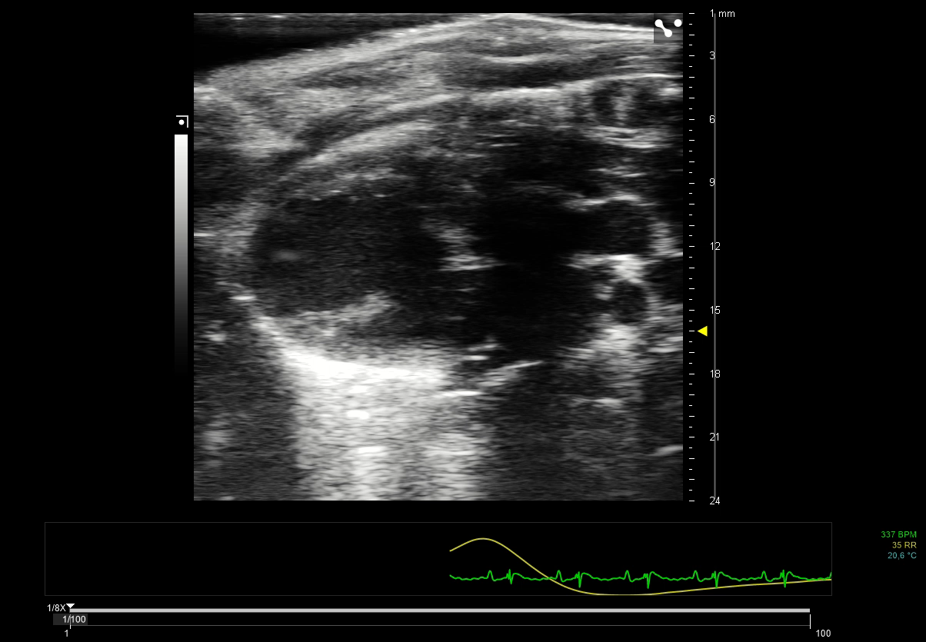
68775_screenshot_8.mp4: 3.8.2: Cine loop of PSLAX B-mode: Guide needle clearly visible, needle bevel visible near the left ventricular anterior wall

Slide 4
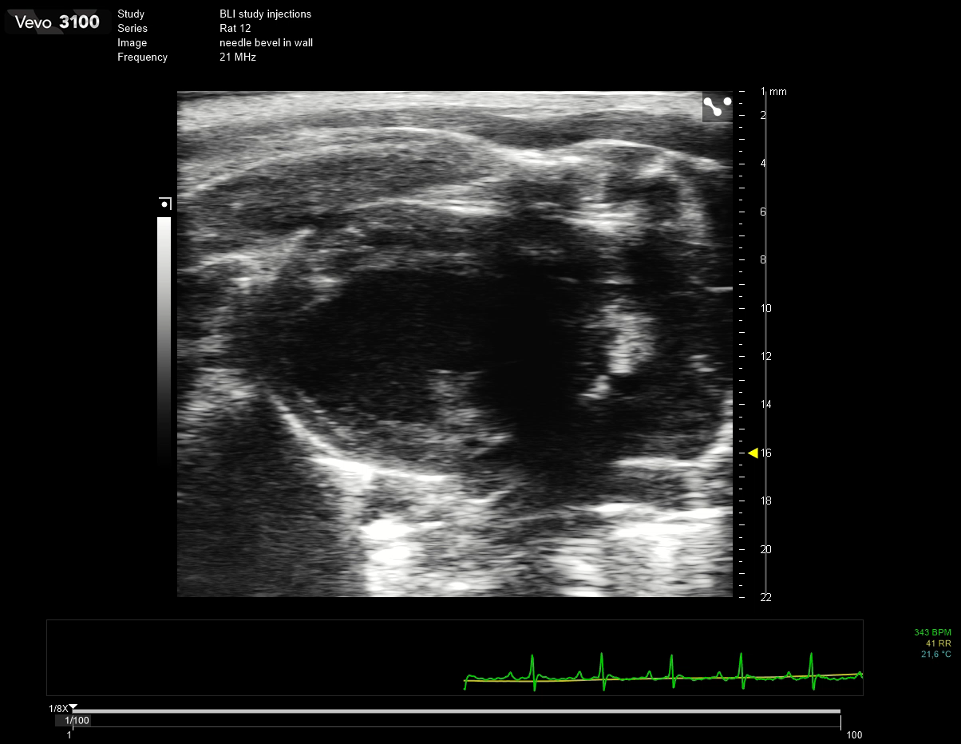
68775_screenshot_10.mp4: 3.12.2: Cine loop of PSLAX B-mode: 29G needle bevel fully embedded in the myocardium

Slide 5
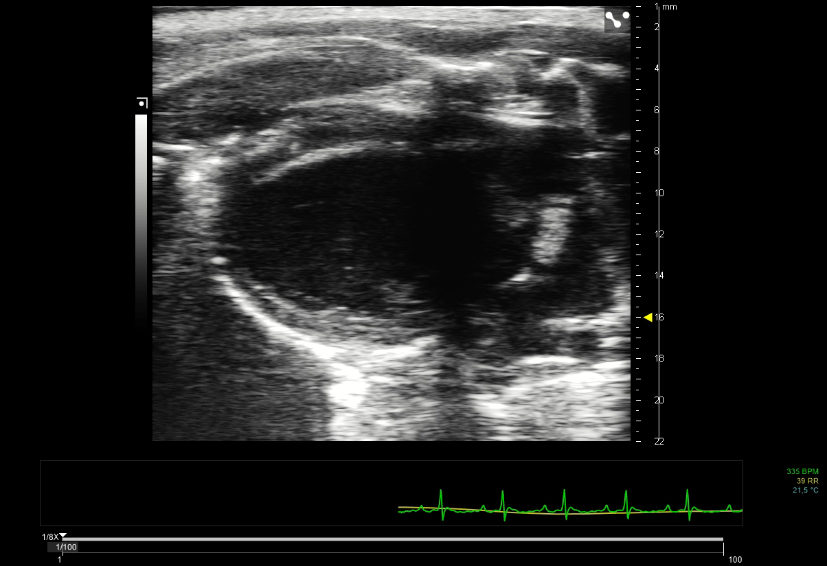
68775_screenshot_11mp4: 3.13.2: Cine loop of PSLAX B-mode: Injectate visible in myocardium

