Slide 1
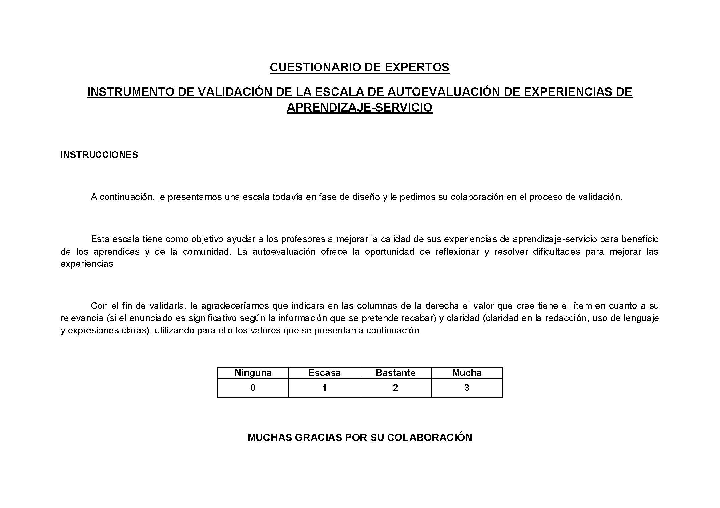

Initial phase
Planning
Closure
Replication
Execution
Categorize all items
Design
Implementation
Evaluation

