Slide 1
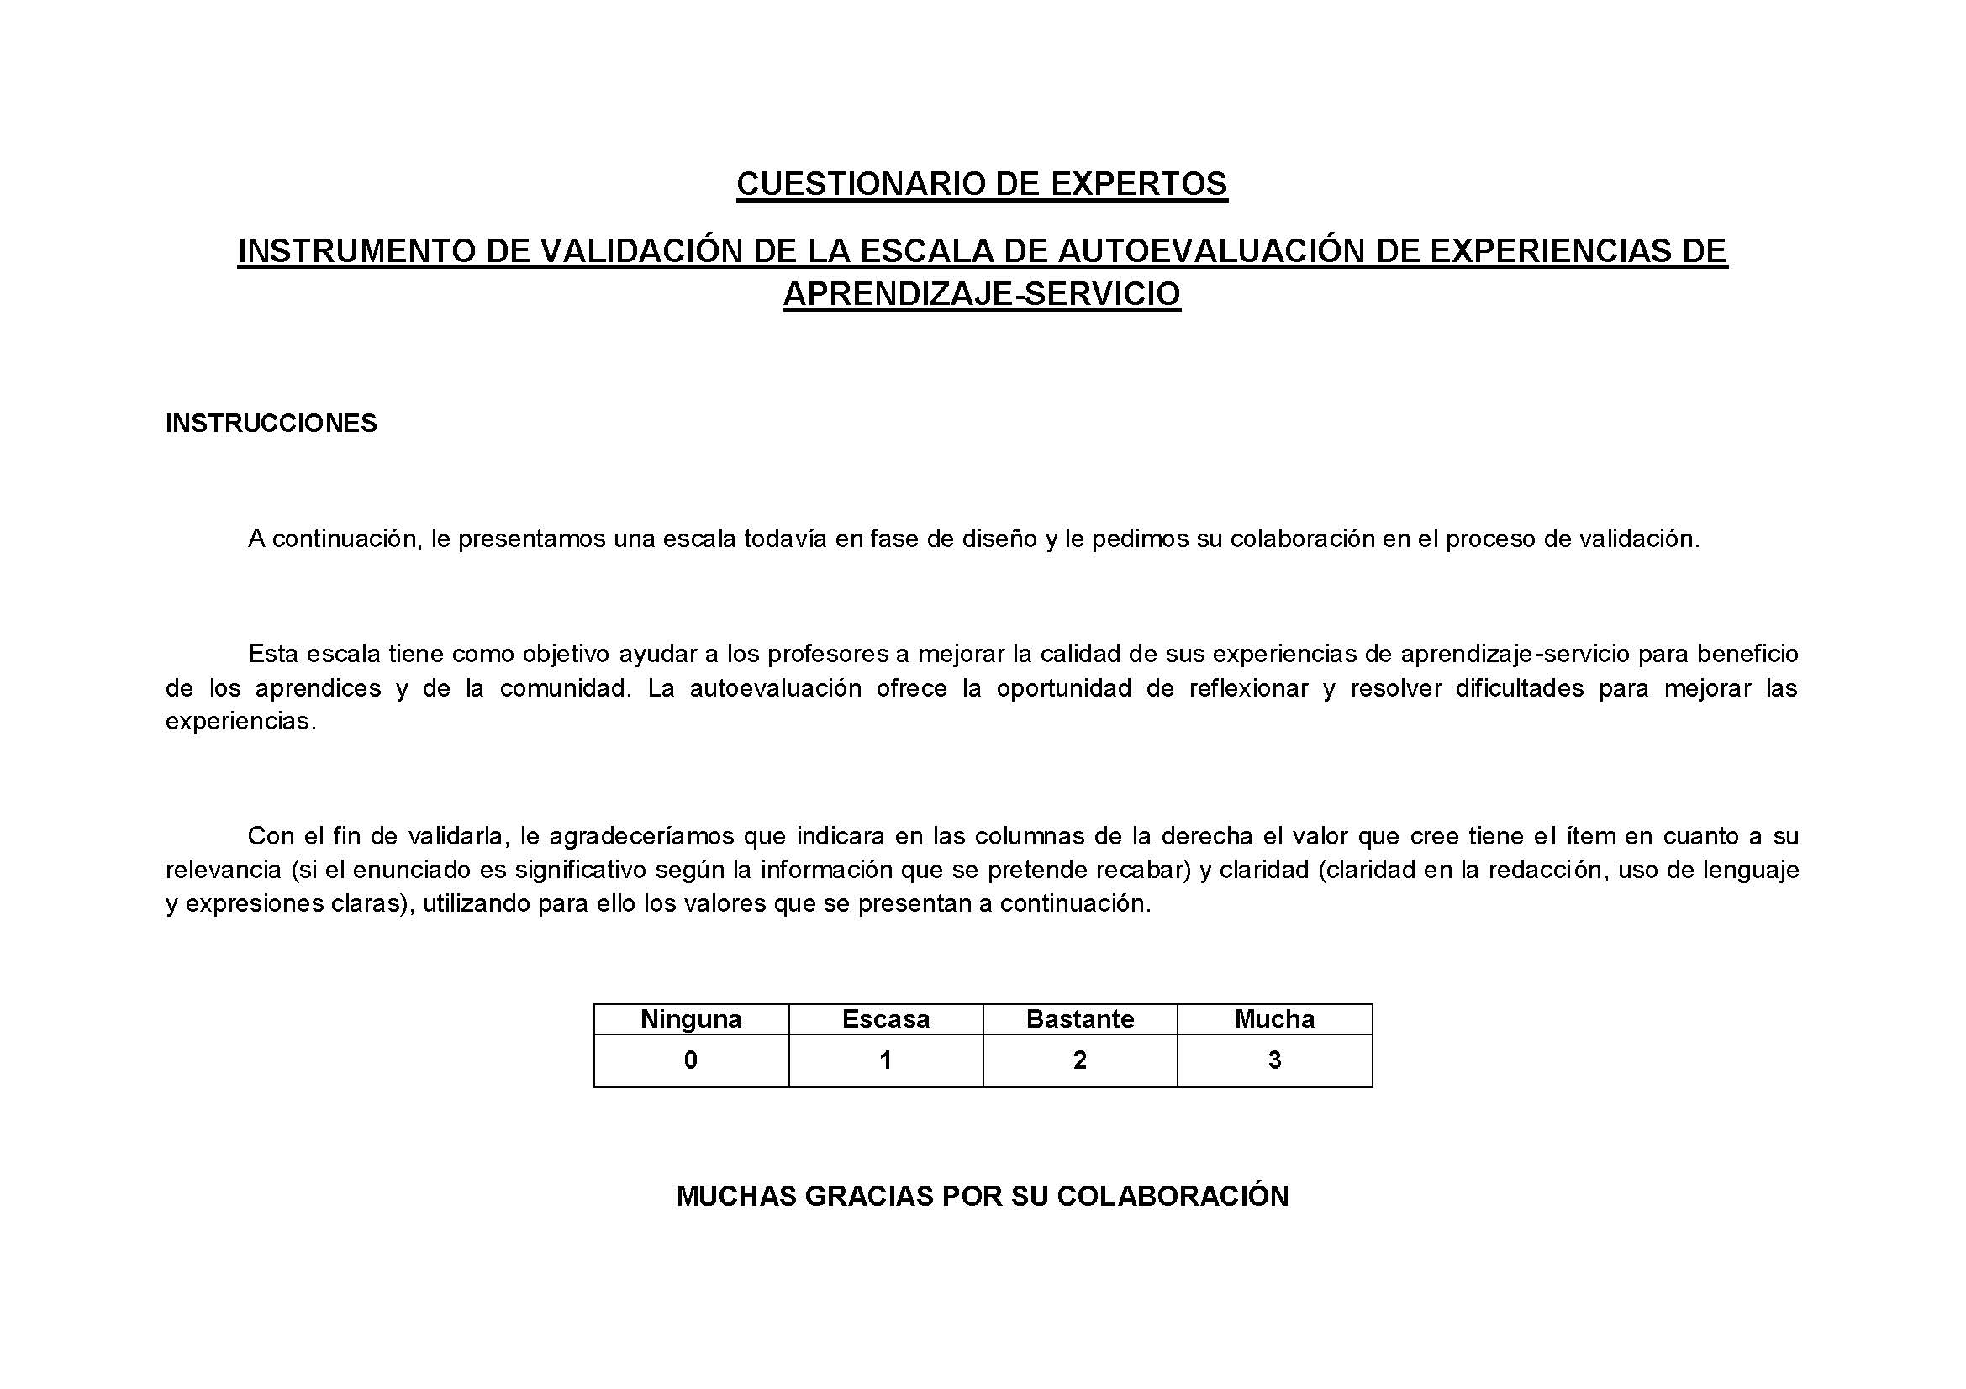




Content Analysis
Review items

