Slide 1
JOVE FILMING

Slide 2
Physical Exam
361 lb (164 kg)
BMI 46 kg/m²
^{Class III obesity}
^{Weight history}
^{Attempts weight loss}
  ^{Tracking app}
  ^{Support group}
  ^{Various diets}

Slide 3
^{Past Medical History}
  ^{Prediabetes (2022)}
  ^{Hypertension (2010)}
  ^{Depression (2000)}
  Metablic Dysfunction-Associated Fatty Liver Disease (2024)
^{Surgical history}
  Left meniscus repair, complete tear, left (2000)

Slide 4
Medications
^{Buproprion XL – 300 mg daily}
^{Amlodipine 10 mg daily}
^{Chlortalidone – 25 mg}
^{Metoprolol}

Slide 5
Labs
A1c = 6.1%, fasting glucose: 105 mg/dL
Lipid panel:
  total cholesterol of 220 mg/dL,
  LDL of 140 mg/dL
  HDL of 35 mg/dL
  Triglycerides of 190 mg/dL
ALT of 60 U/L and AST of 55 U/L
TSH: 1.5 mIU/L

Slide 6
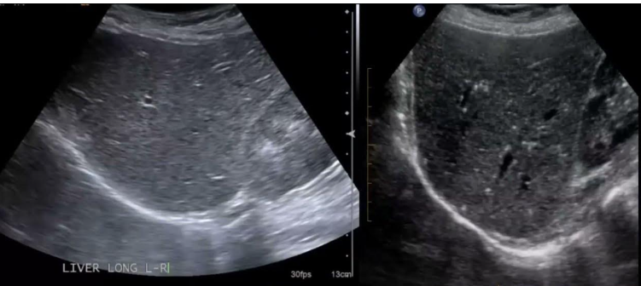
Imaging – RUQ Ultrasound – MAFLD

Slide 7
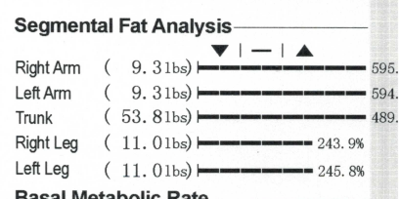
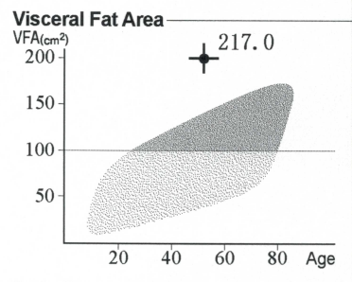
Tests
Resting Metablic Rate: 2,400 calories/day
Body composition test:
  Percent Body fat: 34.4%
  Visceral fat level: 20

Slide 8
Sleep
STOP BANG Screening
  Snores loudly?
  Tiered/fatigue?
  Observed stopped breathing during sleep?
Sleep study history
Headache when waking up? Yes/no
Day time sleepiness? Yes/no
Neck circumference:

Slide 9
Exercise Log
3 sets with 8-10 repetitions
Upper body, lower body and core
  Back squat
  Deadlift
  Overhead press
  Seated single-arm low rows,
  Suitcase carry
  Stagger stance single-arm chest presses

