Slide 1
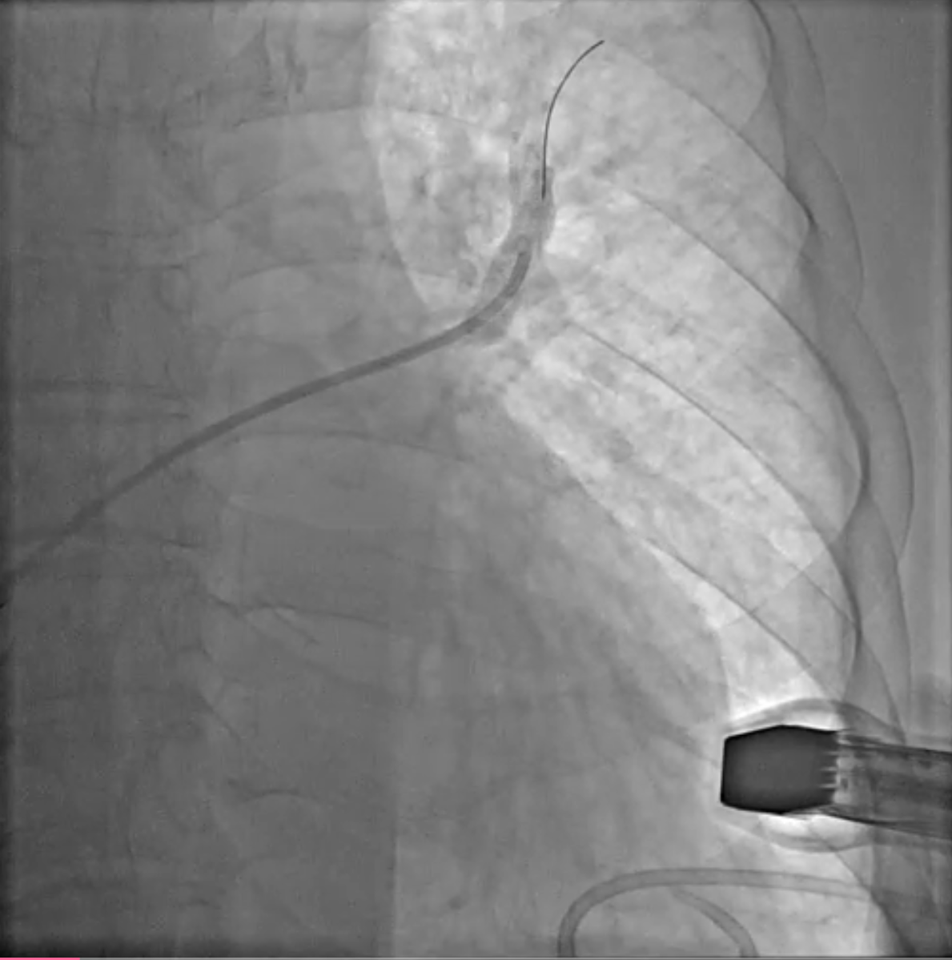
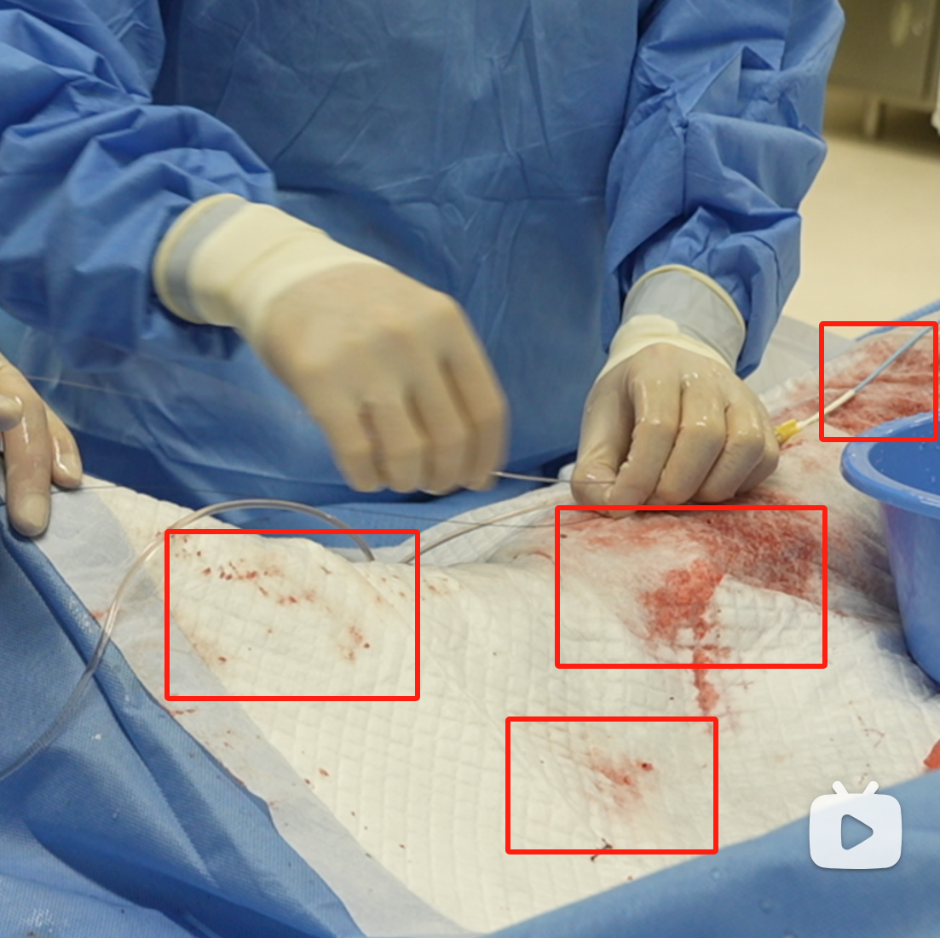
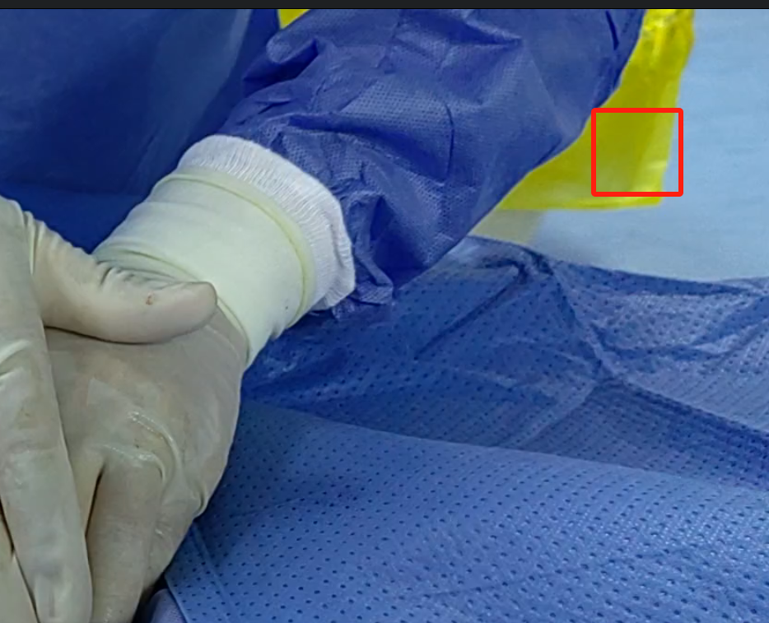
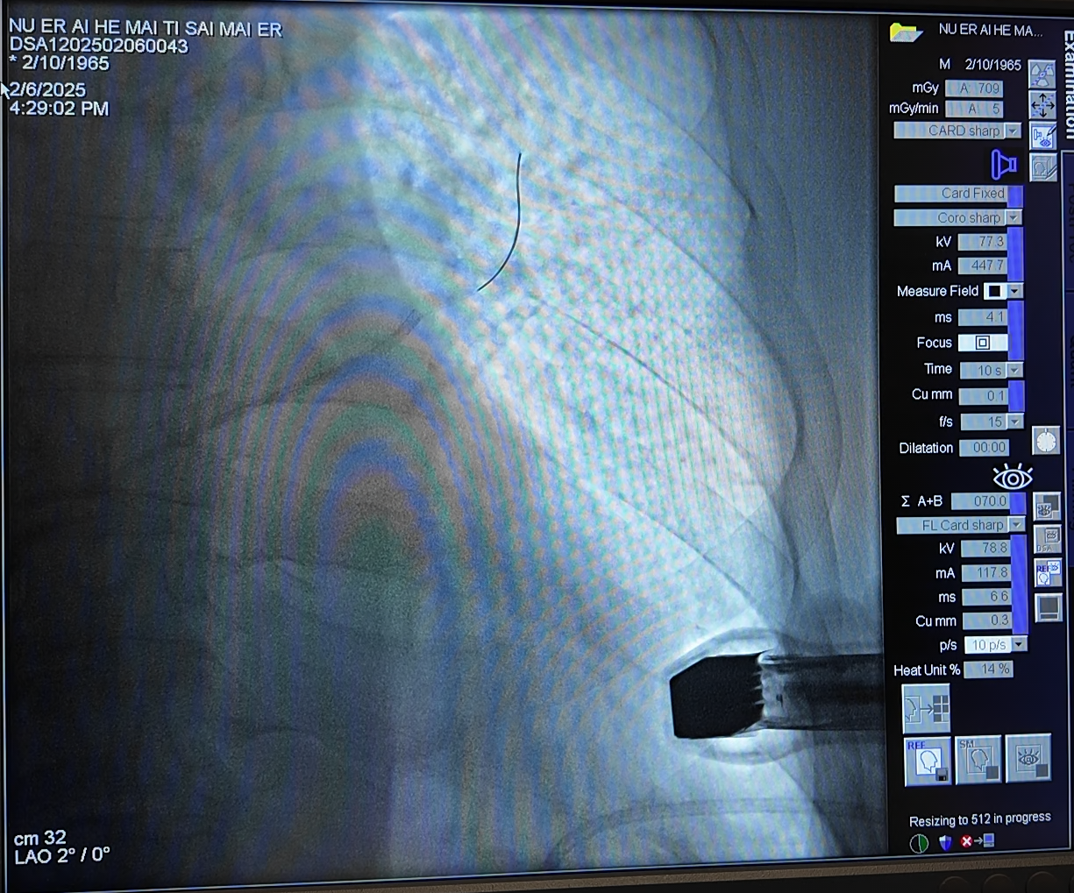
Video production requirements
Hide the patient's information.
Please hide the redundant parts in the picture.
Please apply mosaic to the bloodstains.
Example:

