Slide 1
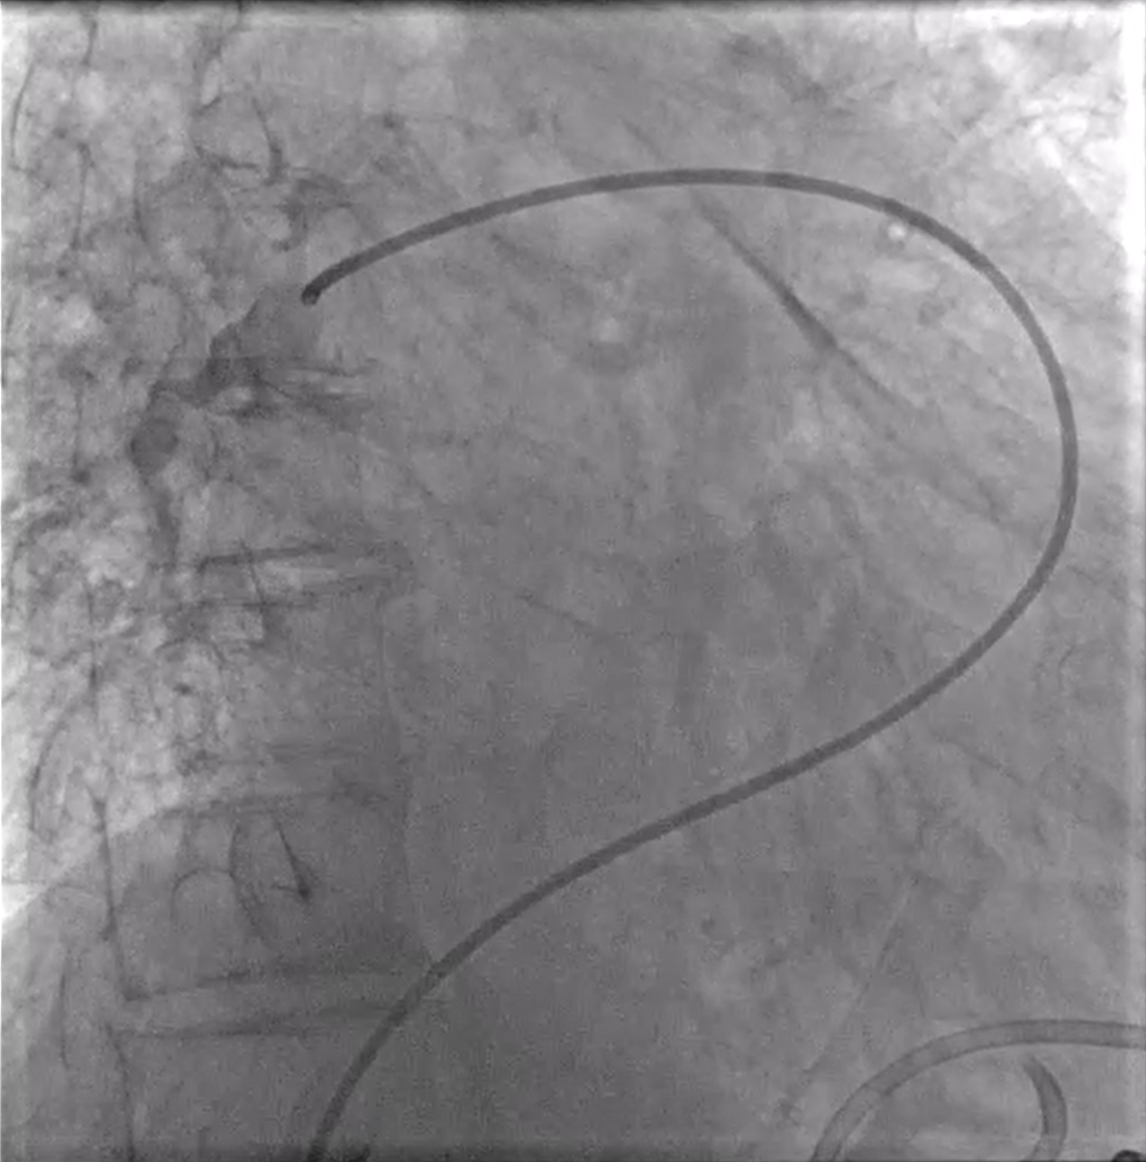
2.5.2-DSA 00:05-anatomical landmarks

