Slide 1
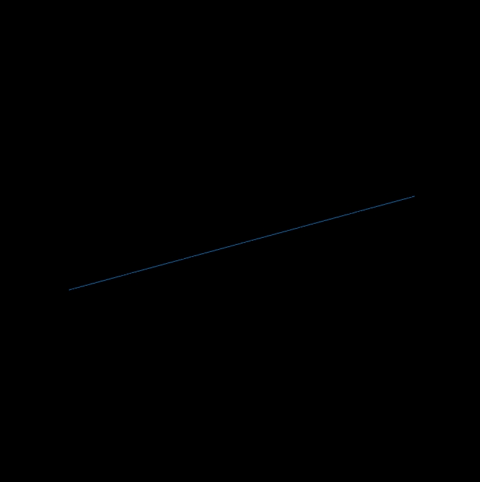



3D Phase-Resolved Functional Lung MRI
Ventilation dynamics
Post-Processing
3D stack-of- stars acquisition
(8 Min ~ whole lung volume), free-breathing
16 respiratory phases, spatial resolution: 1.95 mm³
Notes:
3D phase-Resolved Functional Lung MRI is a Proton Imaging Method in Free-Breating without requirement for any contrast-media. For Acquisition a commercially available stack-of-stars gradient echo sequence is used. Via Post-Processing Information about Ventilation dynamics is obtained.

Slide 2
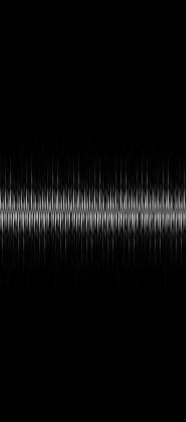
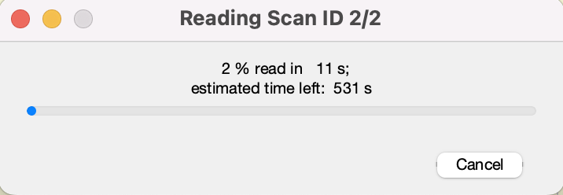
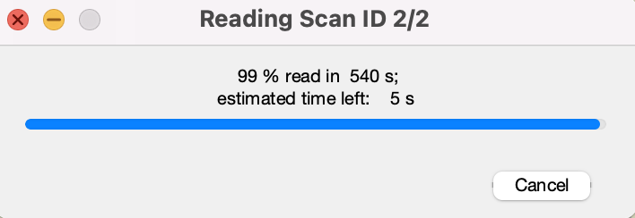
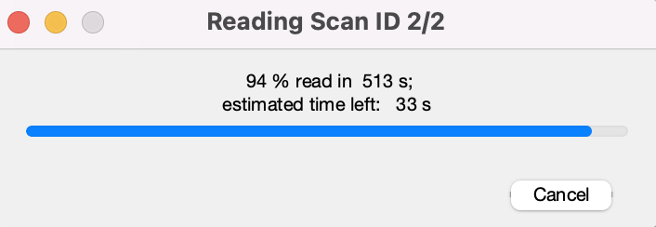
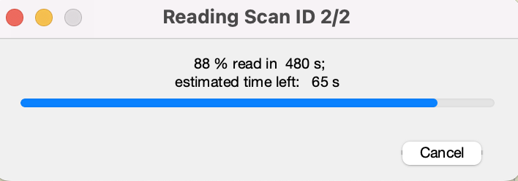
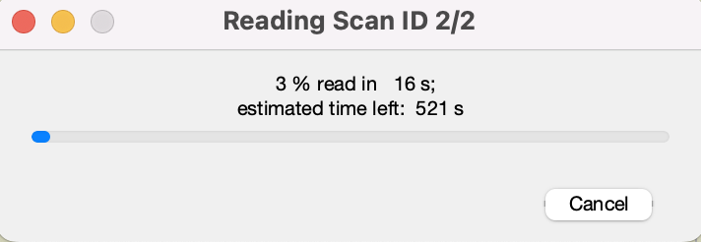
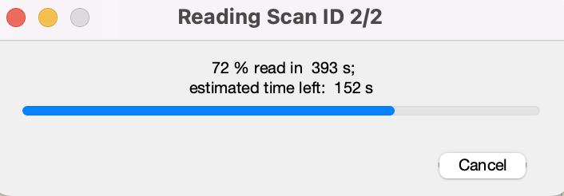
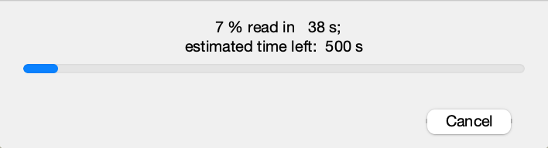
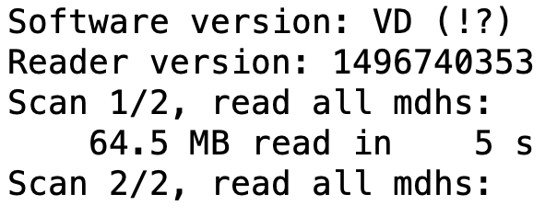
Retrieve k-space data
pathData = uigetdir();
Notes:
After acquisition, k-space data is retrieved using your programming platform. In this publication we use Matlab. After opening Matlab, the path to rawdata is set and the acquired data is appearing.

Slide 3
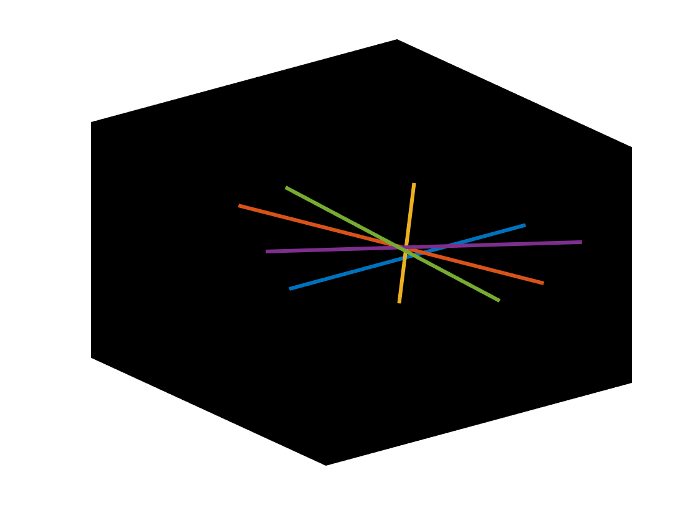

Gradient imperfections
out = evalc("bart('estdelay -R ', permute(traj(:,:,:),[1 3 2]), permute(spokes4Calib(:,:,:), [4 1 3 2]))");
Compute the gradient delays
Apply gradient delay correction
Notes:
In radial imaging gradient delays induce parallel and orthogonal trajectory shifts as seen on the left. The gradient delays might be estimated from data using the Bart Toolbox via the ‚estdelay‘ function. The obtained gradient delays are applied to the data. This step is depicted on the right.

Slide 4
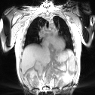

Ringing artefact removal
filter1 (1,1,1,:) = hann( size(data,4) , 'periodic');
Apply Hanning filter
Notes:
Prior further processing of the k-space, a Hanning window is applied to remove ringing artefacts as highlighted by the red arrows.

Slide 5
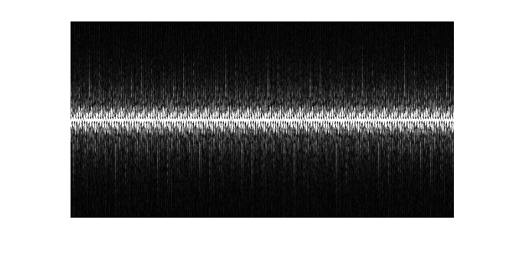
Low-resolution Image Reconstruction
1. Select of one-eighth and one-fourth of the k-space data centered around the middle index of the readout and partition dimension.
data_LR = data(:,:,:,size(data_fft,4)/2 - floor(size(data_fft,4)/8) +1: size(data_fft,4)/2 + round(size(data_fft,4)/8));
Notes:
For low-resolution image reconstruction, select one-eighth or one-fourth of the k-space data centered around the middle index of the readout or partition dimension.

Slide 6
Low-resolution Image Reconstruction
2. Reshape the k-space data and trajectories to include time dimension
3. Reconstruct the low-resolution images using a PICS command in BART
igridDynamic_LR = bart('pics -g -S -R Q:0.1 -R T:1024:0:0.01 -R T:3:0:0.0001 -t', permute(trajT,[1 2 3 4 5 7 8 9 10 11 6]) , permute(kspaceT, [1 2 3 4 5 7 8 9 10 11 6]), double(sens));
time
Notes:
Reshape the matrices of k-space data and corresponding trajectories to include additional time dimensions, so that the each timeframe includes 14 spokes and utilize the parallel imaging and compressed sensing (pics) command in BART to perform image reconstruction.

Slide 7
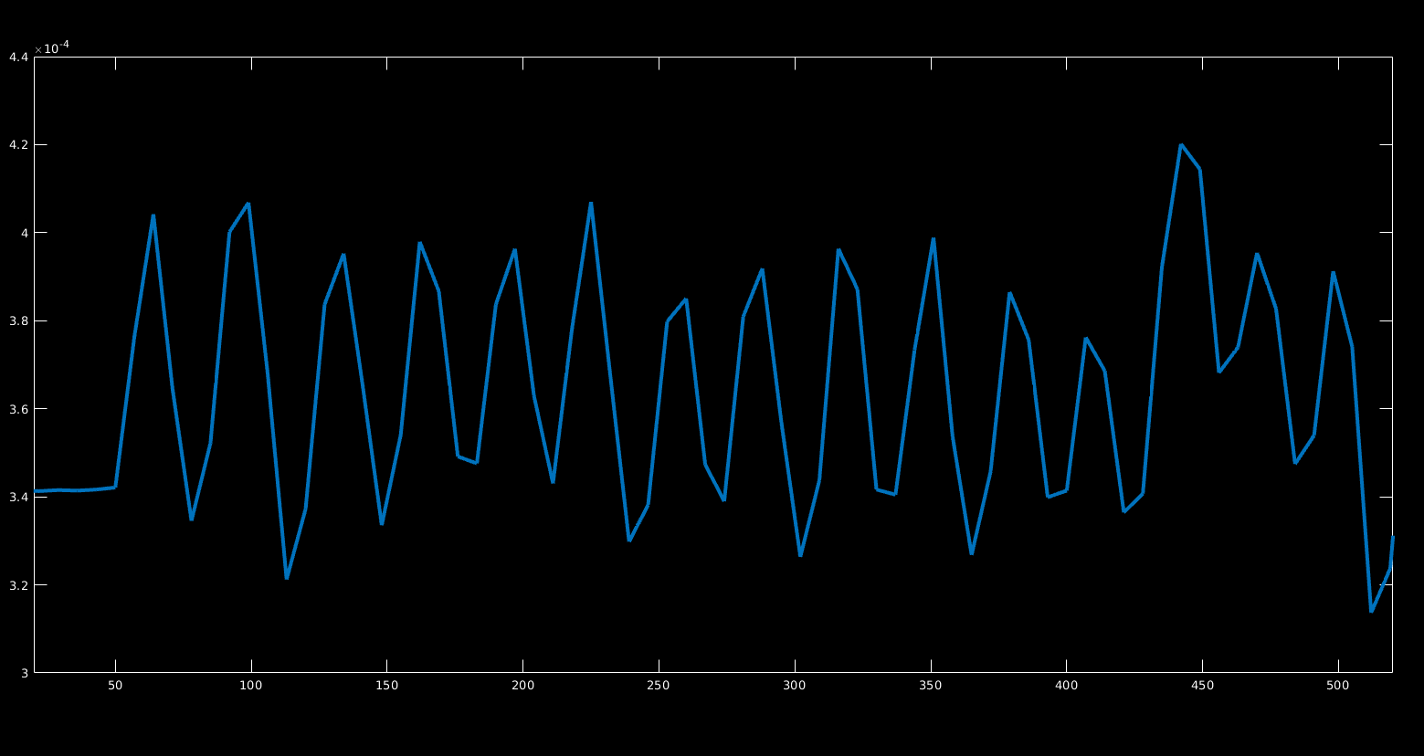
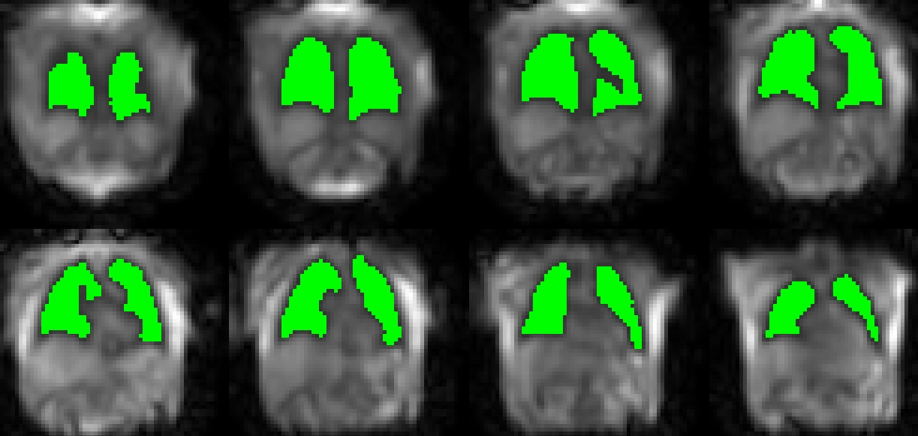
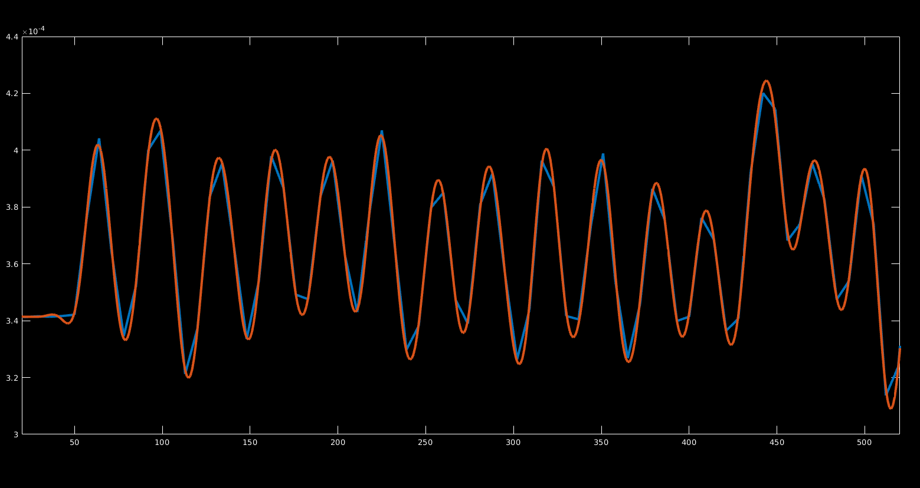
Segmentation of Low-resolution images
Otsu‘s Segmentation
lung volume
time
dt ≈ 100 ms, spatial resolution: 7.8 x 7.8 x 15.6 mm³
Apply Low-Pass Filter
Notes:
The lung parenchyma in each reconstructed low-resolution 3D image is being segmented using Otsu‘s thresholding. The lung volume for each time is calculated and the low-pass filter with cut-off frequency of 0.7 Hzis applied on the timeseries.

Slide 8
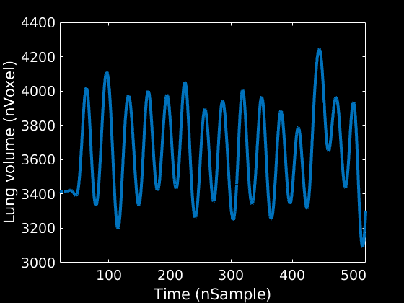
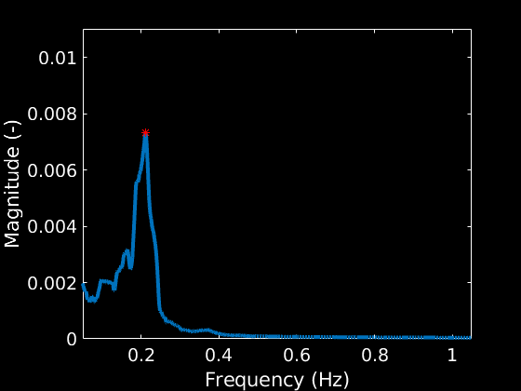
Volume time series postprocessing
Extract the breathing frequency
Notes:
The breathing frequency is calculated from the low-pass filtered lung volume timeseries.

Slide 9
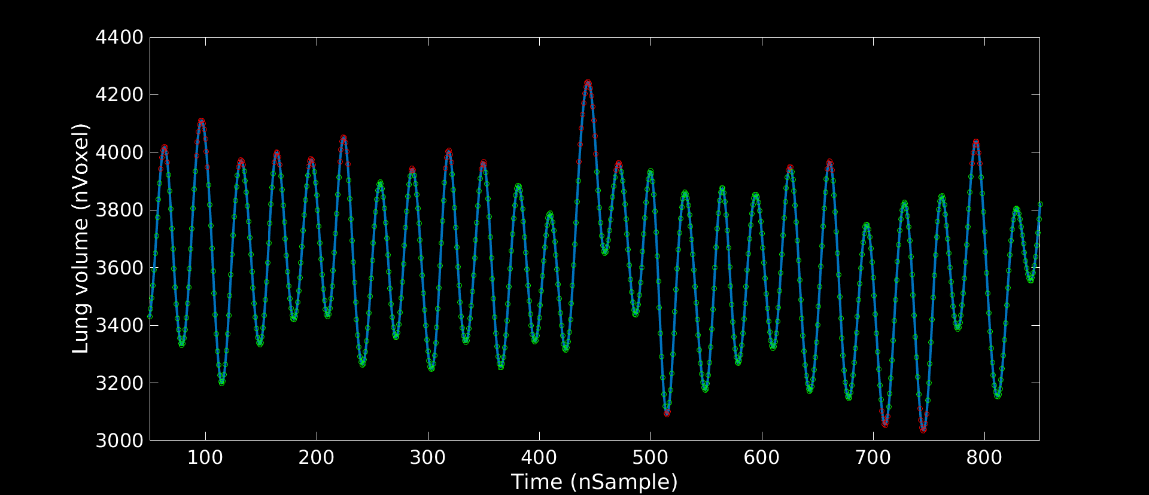
Volume time series postprocessing
Inspiration
Expiration
Exclude outliers - excluded acquisitions
Notes:
Extreme outliers are excluded from the volume time series.

Slide 10
Prepare for image reconstruction
1. Apply FFT along the slice direction
dat (1,:,:,:,:) = ifftshift (ifft (ifftshift (data, 4), [] , 4 ), 4 );
2. Reshape the k-space data to include time dimension
time
Notes:
In the next step, perform fast Fourier transform on the hanning-filtered data along the slice direction slice-by-slice image reconstruction.
Reshape the k-space data matrix based on the extracted time series so that each respiratory bin contains a minimum of 100 spokes.

Slide 11
Prepare for image reconstruction
20%
Resp. Bin 1
Resp. Bin 2
Resp. Bin 3
Apply viewsharing for each bin
20%
Notes:
Utilize 20% of projections from adjacent bins to enhance the signal to noise ratio of each respiratory bin.

Slide 12
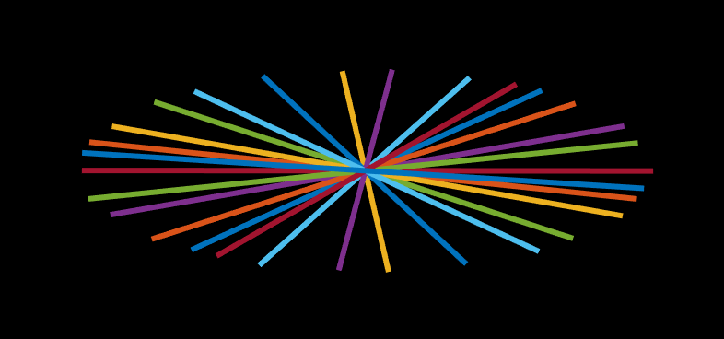
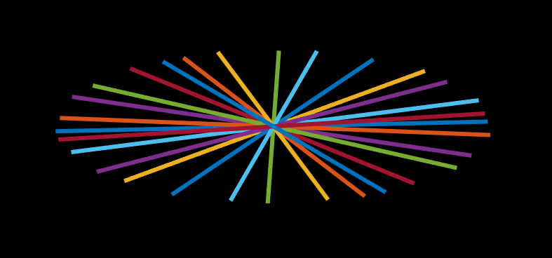
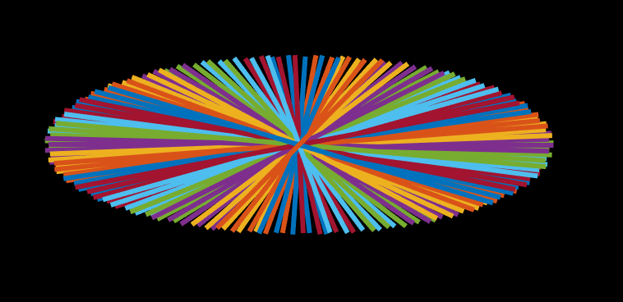
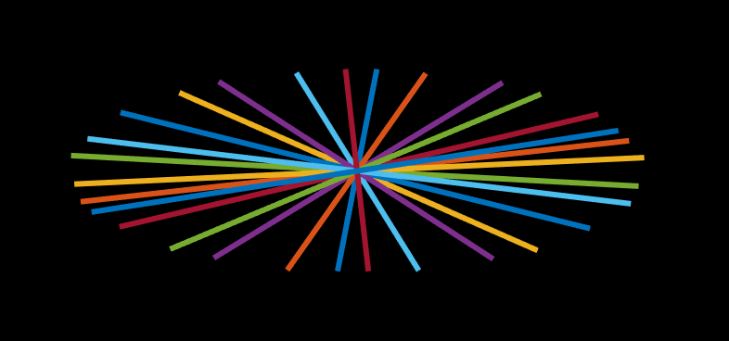
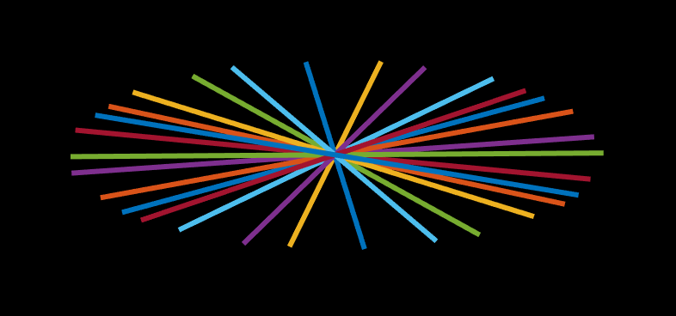
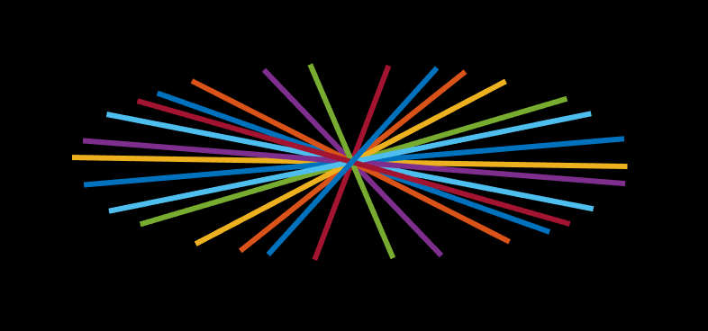
Prepare for image reconstruction
1. Reshape the trajectories to include time dimension
2. Reconstruct the images using a PICS command in BART
igridDynamic = bart('pics -g -S -R Q:0.1 -R T:1024:0:0.01 -R T:3:0:0.0001 -t', permute(trajT,[1 2 3 4 5 7 8 9 10 11 6]) , permute(kspaceT, [1 2 3 4 5 7 8 9 10 11 6]), double(sens));
Bin 1
Bin 3
Bin 40
Bin 2
Bin 4
Notes:
Reshape the k-space trajectories matrix to match the size of the k-space data [2].
Execute the pics command for image reconstruction for each slice.

Slide 13
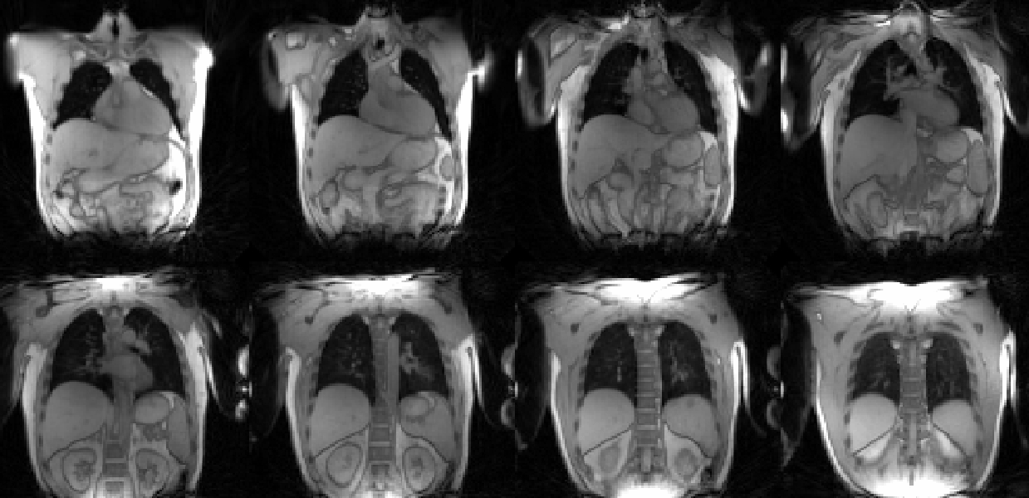
Saving the results
Save results
save([path2save '/ResultsRecon.mat'],’ImgsDyn','breathingFreq’,’AcqTimes’)
Notes:
Save the variables, including the reconstructed images of one complete respiratory cycle, breathing frequency, and acquisition times, in a .mat file.

Slide 14
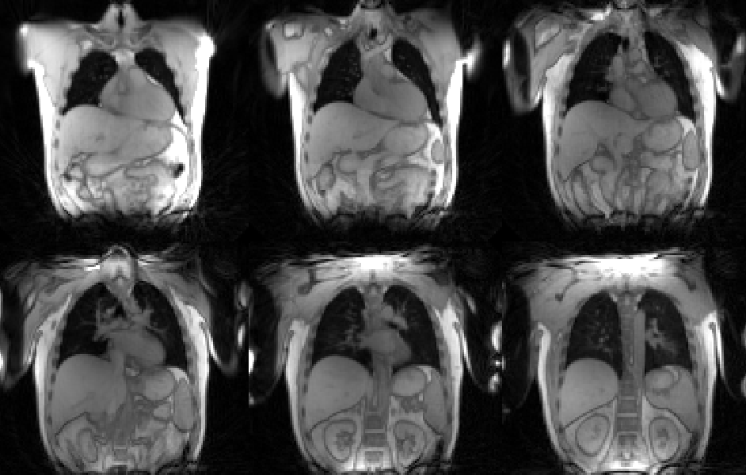
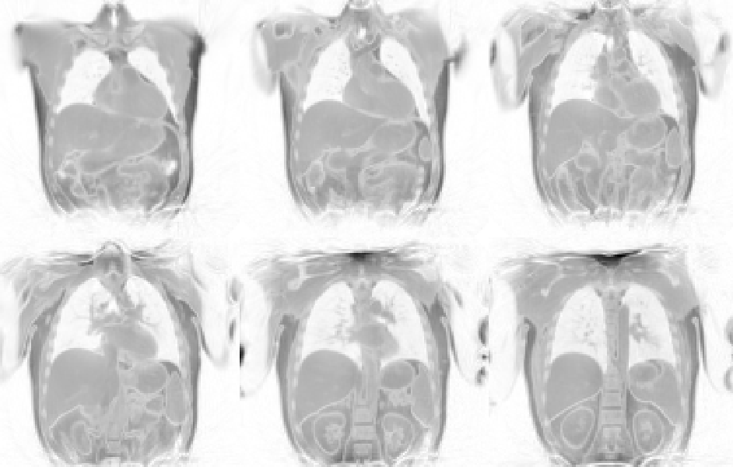
Prepare for image registration
Invert the signal intensities of the images
Notes:
Signal intensities of the reconstructed images being inverted.

Slide 15

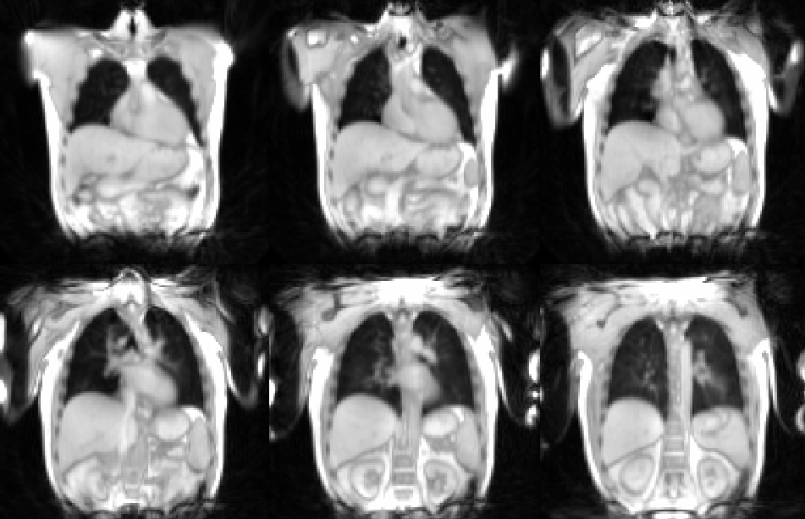
Image registration
Register images to one fixed respiratory state (ANTs or Forsberg package)
Notes:
Inverted images being registered to a selected respiratory state, using non-rigid registration technique.

Slide 16
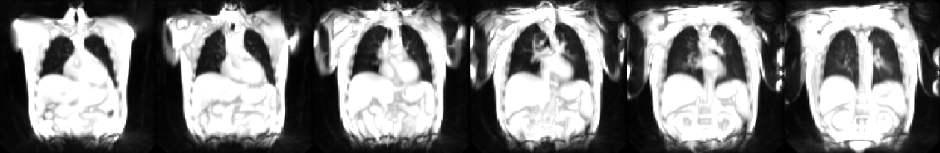
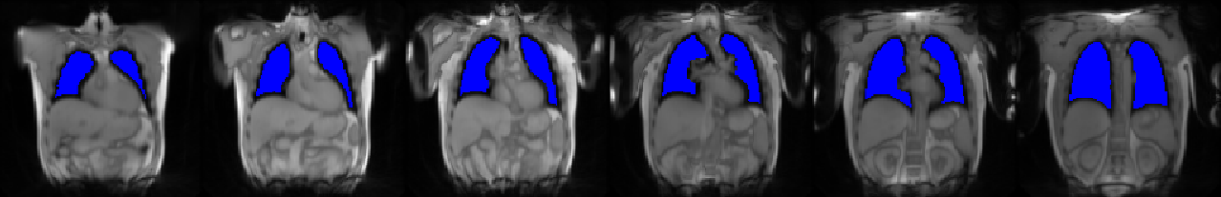
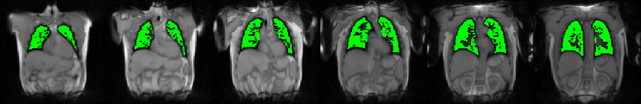
Segmentation
Morphology
nnU-Net based lung volume segmentation
U-Net based vessel recognition
Notes:
Segmentation is also required for all subsequent analysis steps. Lung parenchyma of the fixed image used for registration is segmented using a convolutional neural network with nnUnet architecture.
Lung vessels being excluded from the segmented images using a vessel recognition algorithm resulting in final lung parenchyma ROI.

Slide 17
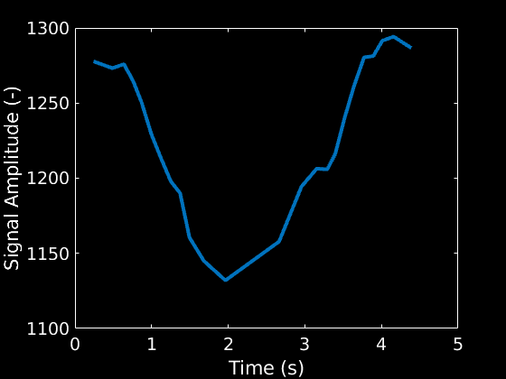
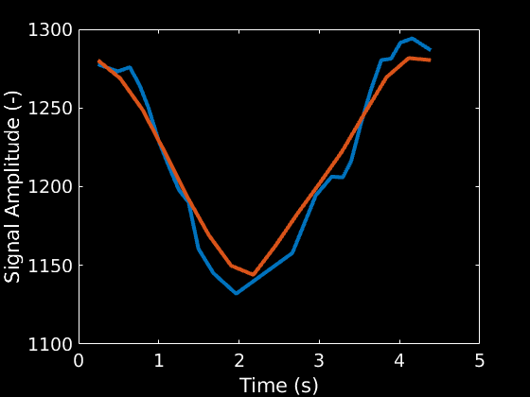
General Filtering – uniform time grid
1 respiratory cycle
24 respiratory phases
Non-uniform time grid
1 respiratory cycle
16 interpolated respiratory phases
Uniform time grid
Perform Watson-Nadaraya regression
Notes:
A filtering with Nadaraya-Watson kernel to the registered and reinverted is performed so that 16 phases are interpolation onto a uniformly spaced time grid.

Slide 18
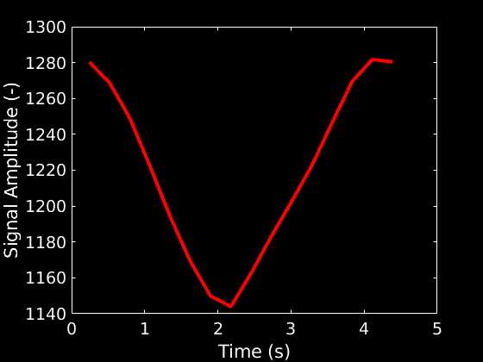
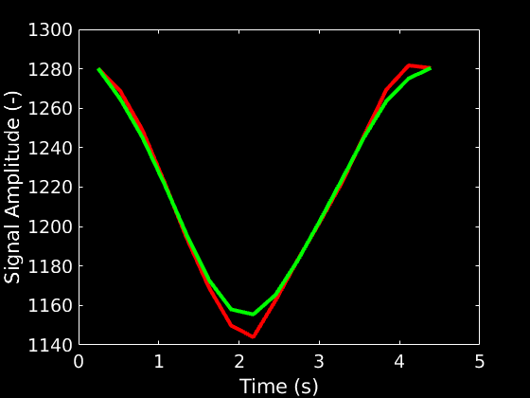
General Filtering – Low-pass filtering
1 respiratory cycle
16 interpolated respiratory phases
Uniform time grid
1 respiratory cycle
16 interpolated respiratory phases
Uniform time grid
Low-pass filtered
Apply Low-Pass filter
Notes:
Eliminate signal variations unrelated to respiration using a low-pass filter at 0.7 Hertz to the interpolated data in the time domain

Slide 19
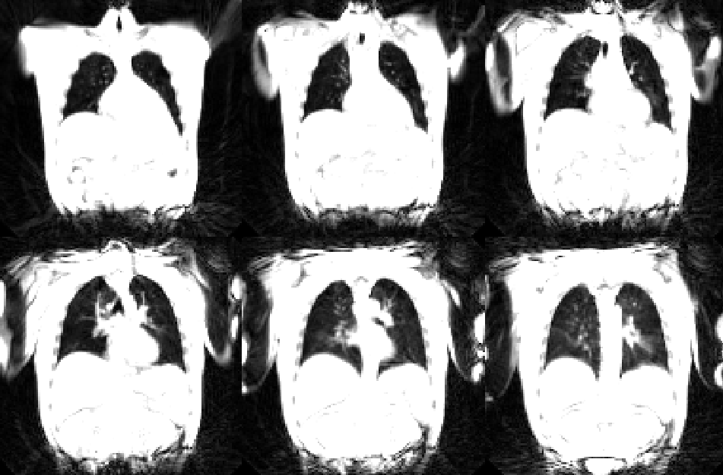

General Filtering - Image guided filtering
Apply Image-guided filter
Set the parameters:
window size = [5 5 5]
lambda = 0.001
Notes:
Denoise the low-pass filtered images using image-guided filtering, with the temporally averaged registered image as the guiding image.
Set the parameters of Window Size to [5, 5, 5] and lambda to 0.001.

Slide 20


Ventilation – Respiration Cycle
$$RVent= \frac{S_{Fix}}{S_{Insp}}−\frac{S_{Fix}}{S_{N}}$$
Notes:
After all of the postprocessing steps, a full respiration cycle is reconstructed.

Slide 21
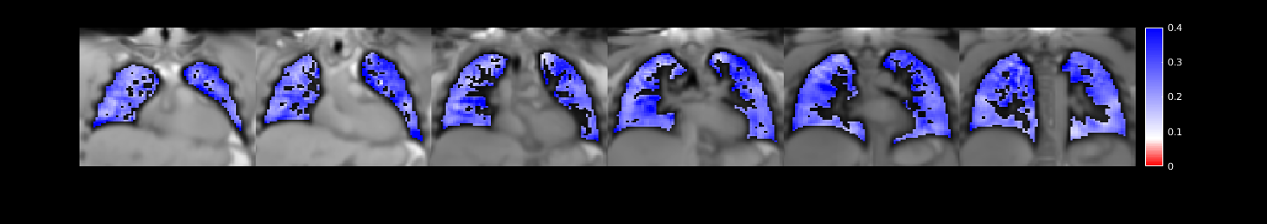
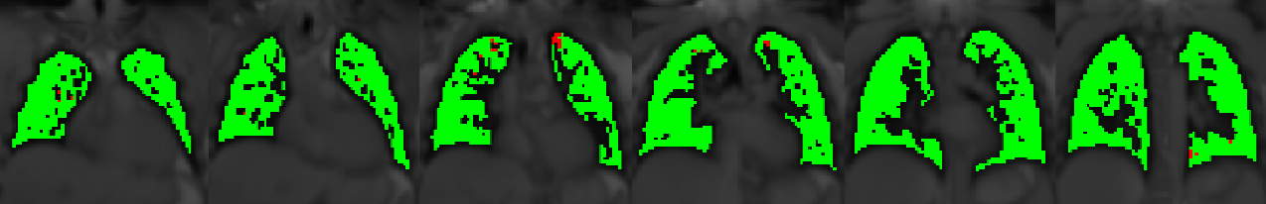

Ventilation – Regional Ventilation (RVent)
$$RVent= \frac{S_{Fix}}{S_{Insp}}−\frac{S_{Fix}}{S_{Exp}}$$
RVent map
ml/ml
Ventilation defect (VD) map
Healthy
Defect
Threshold: 90th Percentile * 0.4
Notes:
Regional ventilation (RVent) maps being calculated in milliliter/milliliter (mL/mL) for each respiratory phase.
Ventilation defect (VDRVent) map being calculated for the RVent map of the 8th phase.

Slide 22
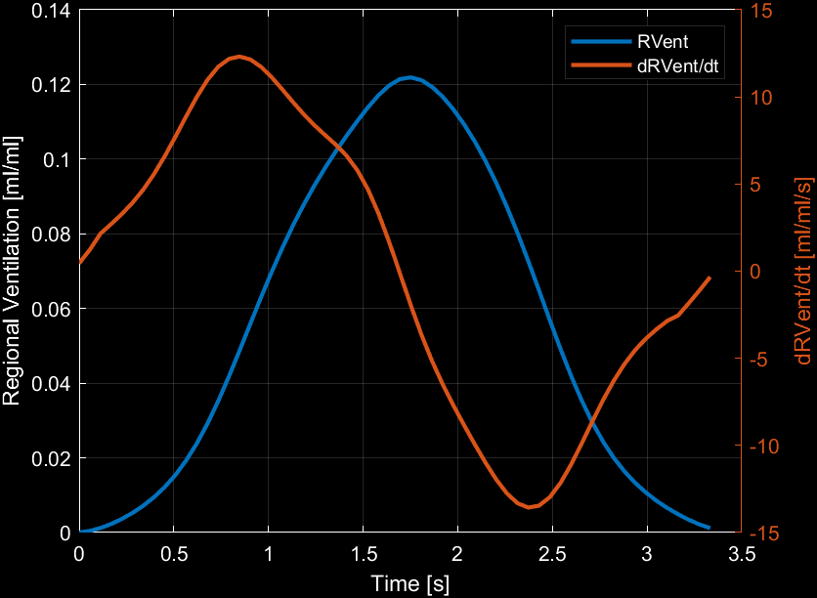
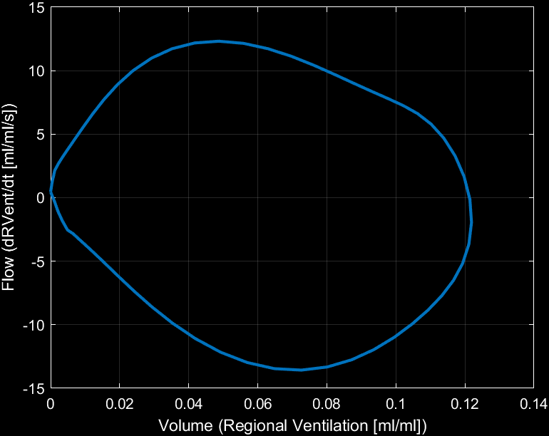

Parameter Calculation – Flow
$$\frac{df}{dt}=\frac{\left.f\left(t+h\right)−f(t−h\right)}{2h}$$
Notes:
The ventilation dynamics is further quantified, using the concept of the Flow-Volume measurements from spirometry. The slope of regional ventilation is a surrogate for flow. Thus a visualisation of regional flow-volume can be obtained with MRI.

Slide 23

Ventilation – Flow-Volume (FVL) Correlation Metric
Reference FVL with
RVent values in
75th and 95th percentile
*Schematic Representation
Notes:
The flow-volue loops are calculated for each voxel. And a reference FVL for each slice is being established from a healthy region defined by RVent values between the 75th and 95th percentile.

Slide 24


Ventilation – Flow-Volume (FVL) Correlation Metric
Reference
Correlation
86%
Reference FVL with
RVent values in
75th and 95th percentile
$$R_{xy}\left(0\right)=\sum_{n=0}^{N−1}{x_{n}y_{n}}$$
$$R_{xy, norm}\left(0\right)=\frac{1}{\sqrt{\left.R_{xx}(0)R_{yy}(0\right)}}R_{xy}\left(0\right)$$
Correlation
95%
Correlation
23 %
*Schematic Representation
Notes:
For this purpose, dynamics with Rvent in the 75th to 95th percentile range are defined as a reference. All Flow-volume loops are correlated to this measurement to obtain an easy way of visualizing normal and abnormal dynamics.

Slide 25
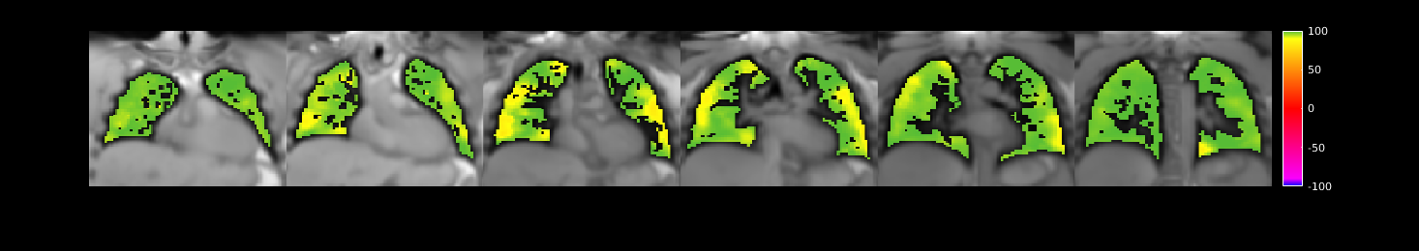



Ventilation – Flow-Volume (FVL) Correlation Metric
$$R_{xy}\left(0\right)=\sum_{n=0}^{N−1}{x_{n}y_{n}}$$
$$R_{xy, norm}\left(0\right)=\frac{1}{\sqrt{\left.R_{xx}(0)R_{yy}(0\right)}}R_{xy}\left(0\right)$$
FVL-CM map
%
Ventilation defect (VD) map
Healthy
Defect
Threshold: 0.9
Notes:
Flow-volume-loop correlation metric (FVL-CM) map being calculated using the cross-correlation.
VD_{FVL-CM} being computet using a fixed threshold of 0.9.

Slide 26
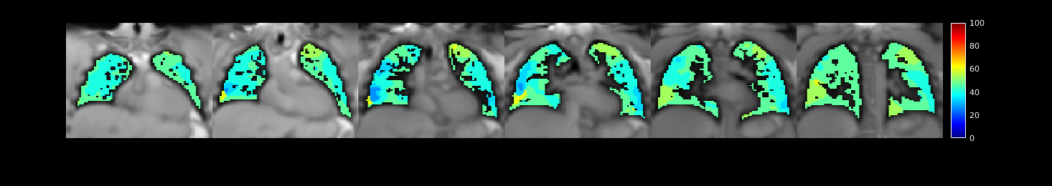
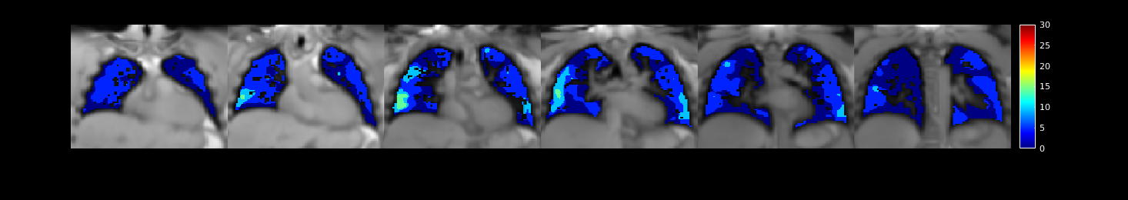

Ventilation – Ventilation time-to-peak (VTTP)
VTTP map
% respiratory cycle
$${VTTP}_{Dev}=\left|VTTP−50\%\right|$$
VTTP_{Dev} map
deviation from peak in %
Notes:
VTTP maps being computed in percentage (%) of the respiratory cycle. The deviation of the VTTP value (VTTP_{Dev}) from the peak inspiration at 50% being computed.

Slide 27
Threshold and Statistics
Median value in lung parenchyma
Mean value in lung parenchyma
Standard deviation in lung parenchyma
Interquartile range in lung parenchyma
Parameter/Statistics |  |  | RVent [ml/ml] | FVL-CM [-] | VTTP [%] | VTTP_{Dev} [%]
 | Median: |  | 0.25 | 0.987 | 46.67 | 0.00
 | Mean: |  | 0.26 | 0.977 | 45.85 | 3.22
 | Standard deviation |  | 0.06 | 0.026 | 5.17 | 3.70
 | Interquartile range |  | 0.21-0.29 | 0.971-0.994 | 40.00-46.67 | 0.00-6.25
Notes:
For general statistics, the median, the mean, standard deviation and intequartile range are calculated using the values inside the lung parenchyma ROI. Exemplary results for all assessed parameters are shown here.

Slide 28
Threshold and Statistics – Defect Statistics
Defect percentages are calculated as #(Voxels<Threshold) / #(ROI Voxels) * 100
 | Parameter
 | VDP_{RVent}: | 8.45%
 | VDP_{FVL-CM}: | 2.66%
Export statistics to a spreadsheet file!
Notes:
Such maps are further quantified by calculating the defect percentages as number of voxels below threshold in relation to the total amount of lung parenchyma voxels. Exemplary results are shown here.
All calculated parameters being exported to a spreadsheet file.

