Slide 1
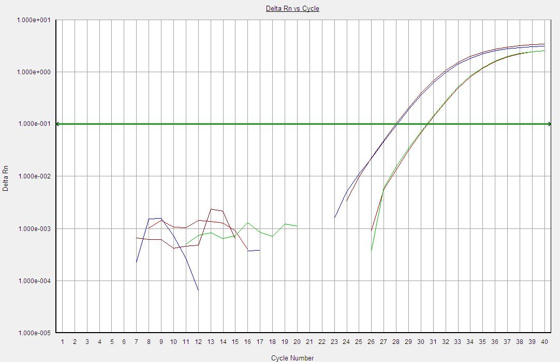
Cell-free
Cellular

