Slide 1
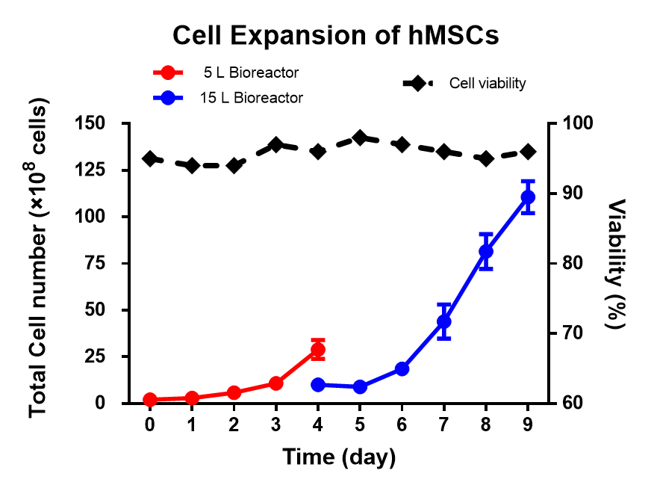
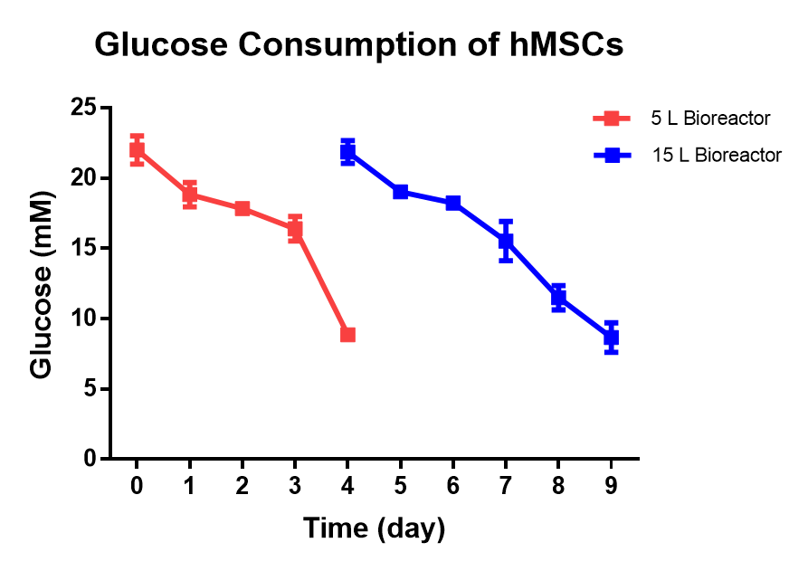
For Video
3.18 Fig 2B, 2C

Slide 2
For Video
3.19 Fig 4A
CD73
CD90
CD105
Positive markers
CD34
CD45
CD19
CD14
HLA-DR
Negative markers

Slide 3
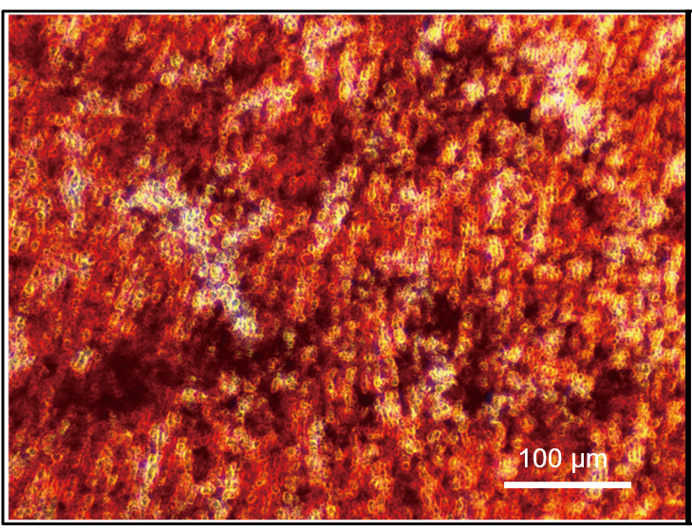
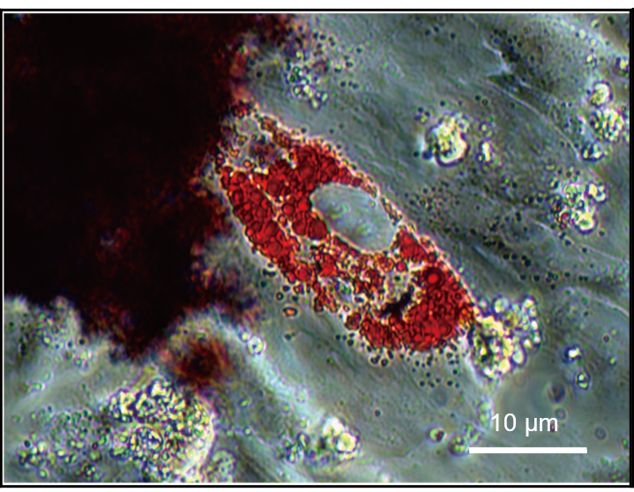
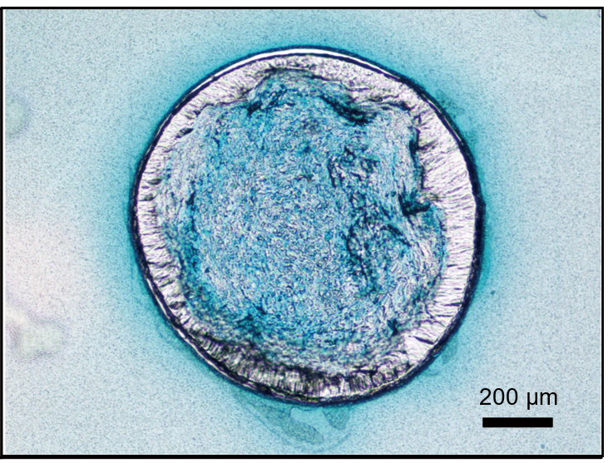
For Video
3.21 Fig 4D
Osteogenic
Adipogenic
Chondrogenic

Slide 4
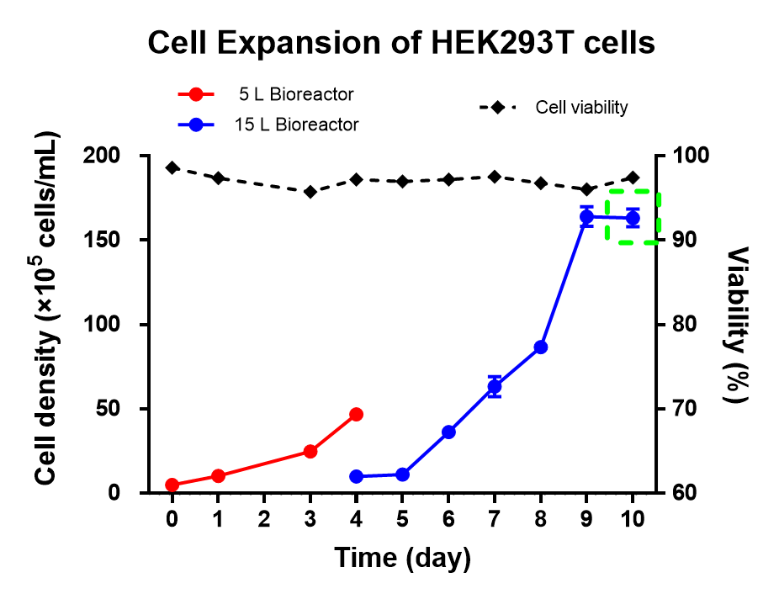
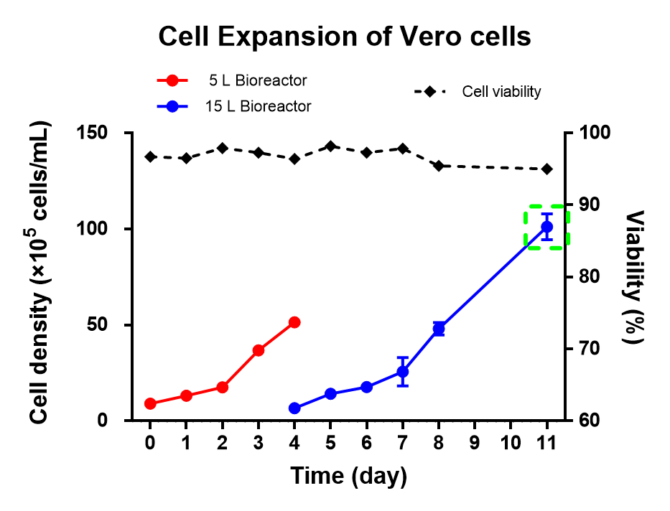
For Video
3.22 Fig 5A, 6A

Slide 5
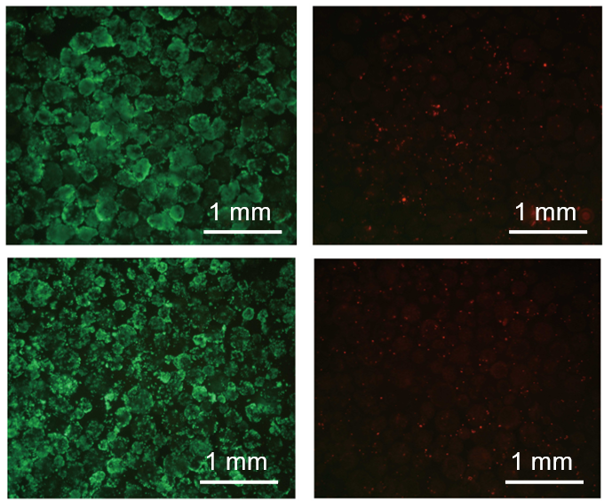
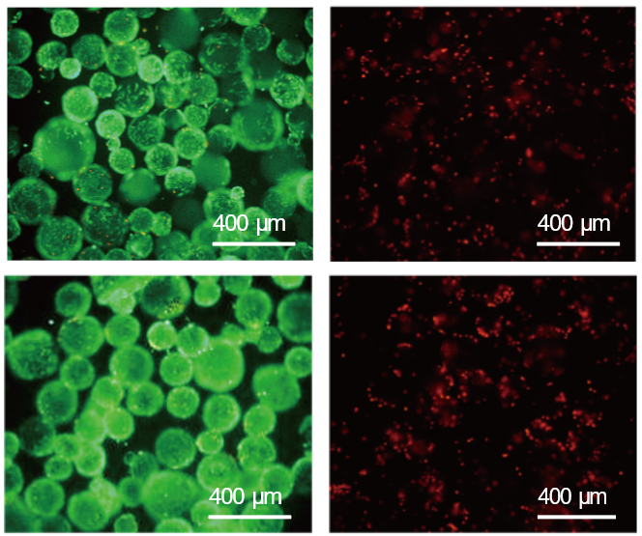
For Video
3.22 Fig 5B, 6B
HEK293T Cells
Vero Cells
Live
Dead
Live
Dead
5 L
15 L

