Slide 1
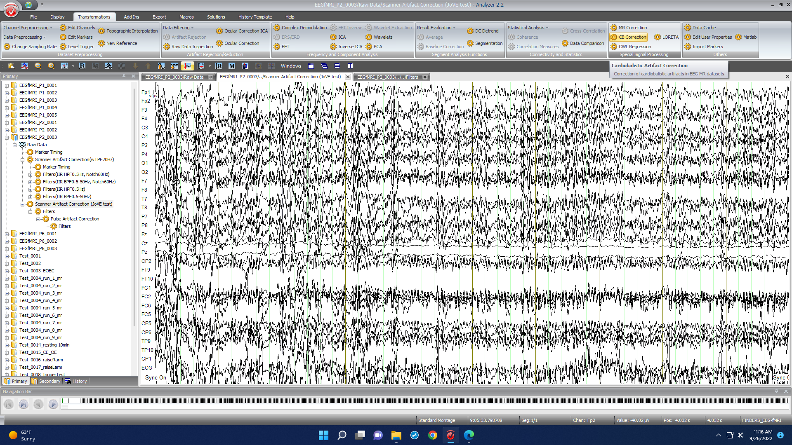
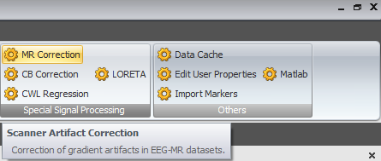

$$⋯$$
Notes:
Apply MR artifact correction by clicking “Transformations\Special Singal Processing\MR Correction” tap.

Slide 2
$$⋯$$
Notes:
Apply MR artifact correction by clicking “Transformations\Special Singal Processing\MR Correction” tap.

Slide 3
$$⋯$$
Notes:
Apply MR artifact correction by clicking “Transformations\Special Singal Processing\MR Correction” tap.

Slide 4
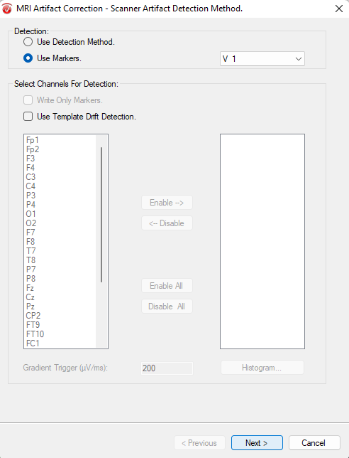
Notes:
Then a small window will be generated. Check “Use Markers.”

Slide 5
Notes:
Indicate a trigger signal from the scanner and use it as a reference to remove MR artifacts.

Slide 6
Notes:
And then, click “Next.”

Slide 7
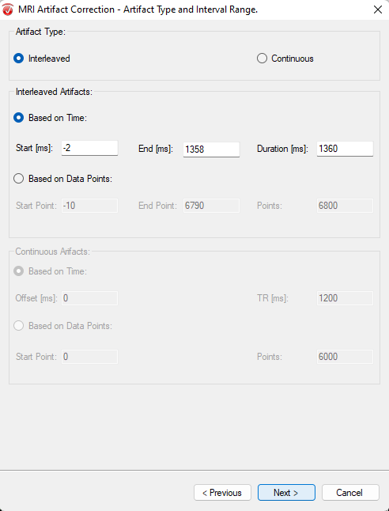
Notes:
On the next page, check “interleaved” option.

Slide 8
Notes:
Check “Based on Time.”

Slide 9
Notes:
Based on the trigger intervals, insert “Start,” “End,” and “Duration” time.

Slide 10
Notes:
And then, click “Next.”

Slide 11
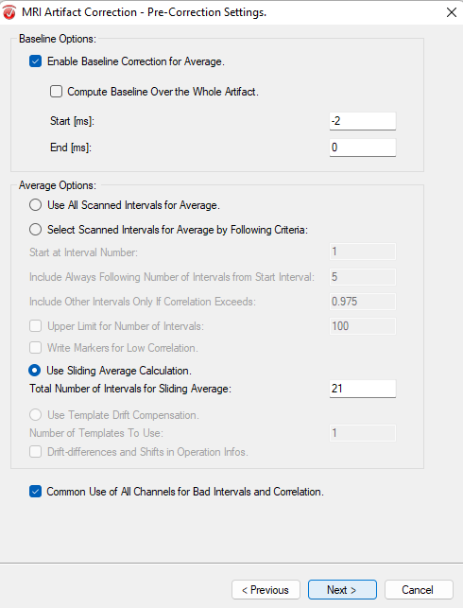
Notes:
Correct the baseline based on a sliding window by checking “Enable Baseline Correction for Average.” Uncheck “Compute Baseline Over the Whole Artifact.”

Slide 12
Notes:
Correct the baseline based on a sliding window by checking “Enable Baseline Correction for Average.” Uncheck “Compute Baseline Over the Whole Artifact.”

Slide 13
Notes:
Insert “Start” and “End” time values.

Slide 14
Notes:
Check “Use Sliding Average Calculation” and insert “Total Number of Intervals for Sliding Average.”

Slide 15
Notes:
Check “Use Sliding Average Calculation” and insert “Total Number of Intervals for Sliding Average.”

Slide 16
Notes:
Check “Common Use of All Channels for bad Intervals and Correction.”

Slide 17
Notes:
And then, click “Next.”

Slide 18
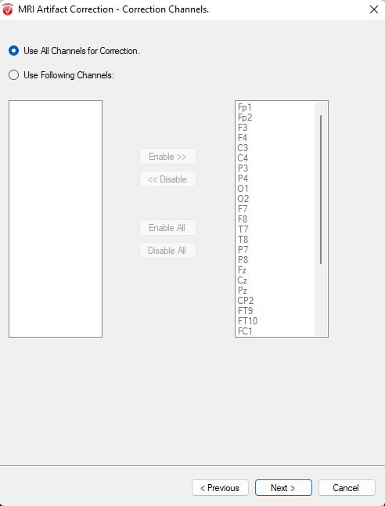
Notes:
Apply the configured settings for all channels by checking “Use All Channel for Correction.”

Slide 19
Notes:
And then, click “Next”

Slide 20

Notes:
Apply downsampling to 500 Hz by checking “Do Downsampling” option and select “500” for “New Frequency” in Hz.

Slide 21
Notes:
Apply downsampling to 500 Hz by checking “Do Downsampling” option and select “500” for “New Frequency” in Hz.

Slide 22
Notes:
Apply low pass filter of 70 Hz by checking “Apply Lowpass Filter” and “Use FIR Filter.” Insert “70” for “Cut-off Frequency” in Hz.

Slide 23
Notes:
Apply low pass filter of 70 Hz by checking “Apply Lowpass Filter” and “Use FIR Filter.” Insert “70” for “Cut-off Frequency” in Hz.

Slide 24
Notes:
Apply low pass filter of 70 Hz by checking “Apply Lowpass Filter” and “Use FIR Filter.” Insert “70” for “Cut-off Frequency” in Hz.

Slide 25
Notes:
And then click “Next.”

Slide 26
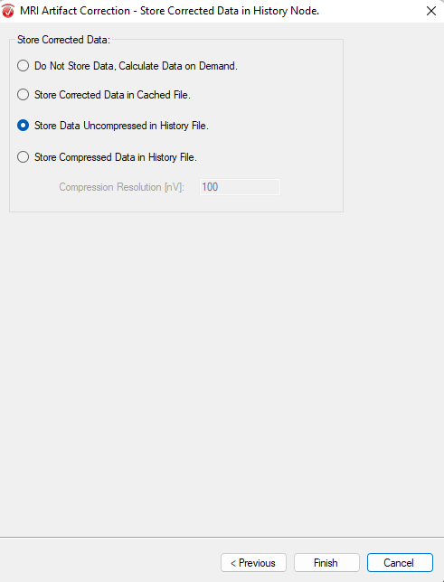
Notes:
Select a “Store Corrected Data” option.

Slide 27
Notes:
And then click “Finish.”

Slide 28
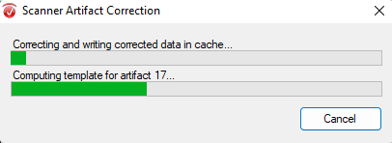
NOTE: This MR correction process may take some time to complete, depending on the EEG data size.
Notes:
A small “Scanner Artifact Correction” window will appear in the middle of the Analyzer and show the processing status. This MR correction process may take some time to complete depending on the EEG data size.

Slide 29
NOTE: This MR correction process may take some time to complete, depending on the EEG data size.
Notes:
A small “Scanner Artifact Correction” window will appear in the middle of the Analyzer and show the processing status. This MR correction process may take some time to complete depending on the EEG data size.

Slide 30
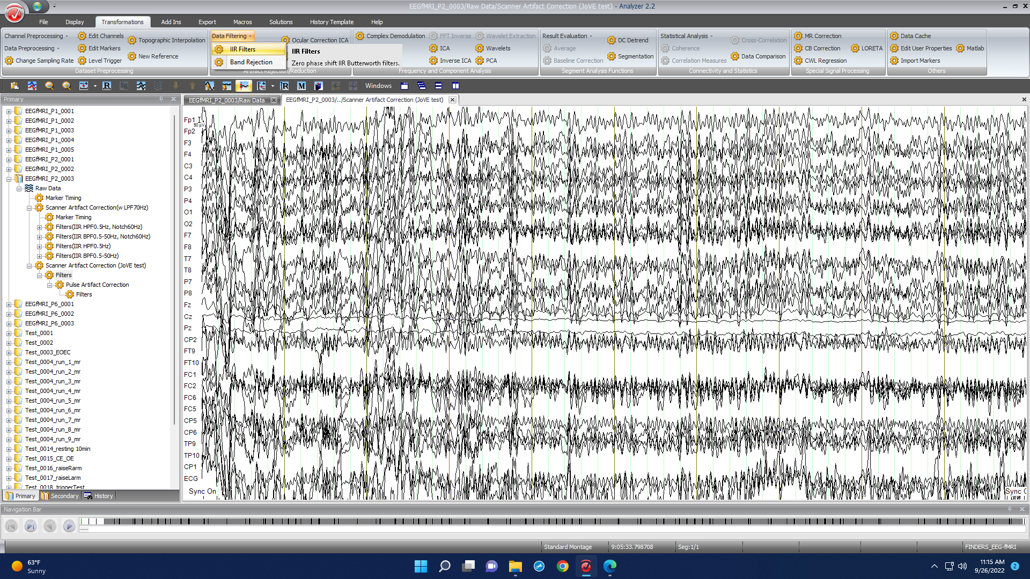
Notes:
Apply a high pass filter of 0.5 Hz by clicking “Transformation\Data Filtering\IIR Filters” tap.

Slide 31
Notes:
Apply a high pass filter of 0.5 Hz by clicking “Transformation\Data Filtering\IIR Filters” tap.

Slide 32
Notes:
Apply a high pass filter of 0.5 Hz by clicking “Transformation\Data Filtering\IIR Filters” tap.

Slide 33
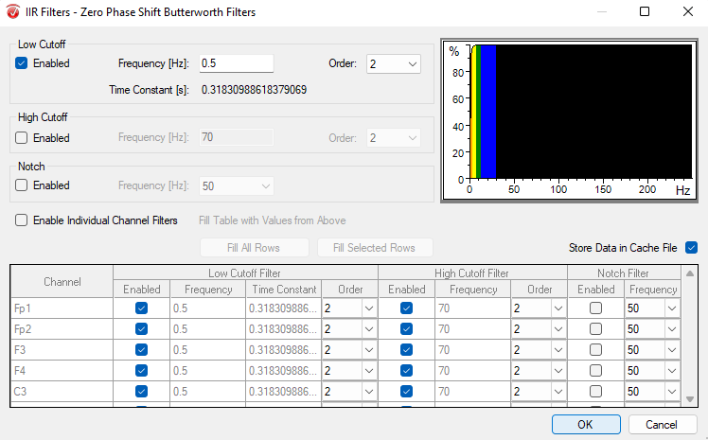
Notes:
On a newly generated window, check “Low Cutoff Enabled.” Insert the cutoff “Frequency” of “0.5” Hz and select the filter “Order” as “2.”

Slide 34
Notes:
On a newly generated window, check “Low Cutoff Enabled.” Insert the cutoff “Frequency” of “0.5” Hz and select the filter “Order” as “2.”

Slide 35
Notes:
On a newly generated window, check “Low Cutoff Enabled.” Insert the cutoff “Frequency” of “0.5” Hz and select the filter “Order” as “2.”

Slide 36
Notes:
On a newly generated window, check “Low Cutoff Enabled.” Insert the cutoff “Frequency” of “0.5” Hz and select the filter “Order” as “2.”

Slide 37
Notes:
And then click “OK.”

Slide 38
$$⋯$$
Notes:
Remove cardioballistic artifacts by clicking “Transformations\Special Signal Processing\CB Correction” tap.

Slide 39
$$⋯$$
Notes:
Remove cardioballistic artifacts by clicking “Transformations\Special Signal Processing\CB Correction” tap.

Slide 40
$$⋯$$
Notes:
Remove cardioballistic artifacts by clicking “Transformations\Special Signal Processing\CB Correction” tap.

Slide 41
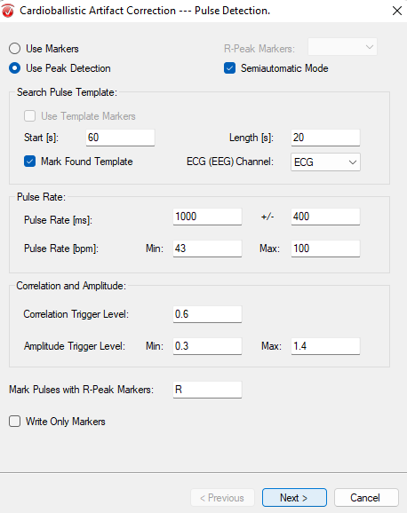
Notes:
On the window that subsequently opens, check “Use Peak Detection” and “Semiautomatic Mode.”

Slide 42
Notes:
On the window that subsequently opens, check “Use Peak Detection” and “Semiautomatic Mode.”

Slide 43
Notes:
Under “Search Pulse Template” section, insert “Start” and “Length” values. Check “Mark Found Template” to make sure the appropriate ECG channel is selected.

Slide 44
Notes:
Under “Search Pulse Template” section, insert “Start” and “Length” values. Check “Mark Found Template” to make sure the appropriate ECG channel is selected.

Slide 45
Notes:
Under “Search Pulse Template” section, insert “Start” and “Length” values. Check “Mark Found Template” to make sure the appropriate ECG channel is selected.

Slide 46
Notes:
Insert proper parameters for “Pulse Rate” and “Correlation and Amplitude,”

Slide 47
Notes:
Insert proper parameters for “Pulse Rate” and “Correlation and Amplitude,”

Slide 48
Notes:
Insert proper parameters for “Pulse Rate” and “Correlation and Amplitude,”

Slide 49
Notes:
And then click “Next.”

Slide 50
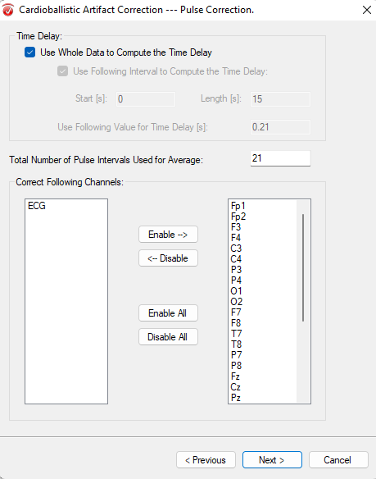
Notes:
Check “Use Whole Data to Compute the Time Delay.”

Slide 51
Notes:
Insert “Total Number of Pulse Intervals Used for Average.”

Slide 52
Notes:
Under the “Correct Following Channels,” move all EEG channels to the right column except the ECG channel

Slide 53
Notes:
Under the “Correct Following Channels,” move all EEG channels to the right column except the ECG channel

Slide 54
Notes:
Under the “Correct Following Channels,” move all EEG channels to the right column except the ECG channel

Slide 55
Notes:
And then click “Next.”

Slide 56
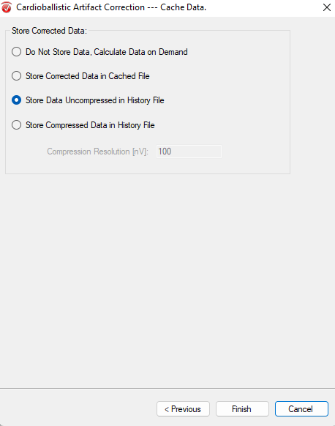
Notes:
Select a “Store Corrected Data” option.

Slide 57
Notes:
And then click “Finish.”

Slide 58
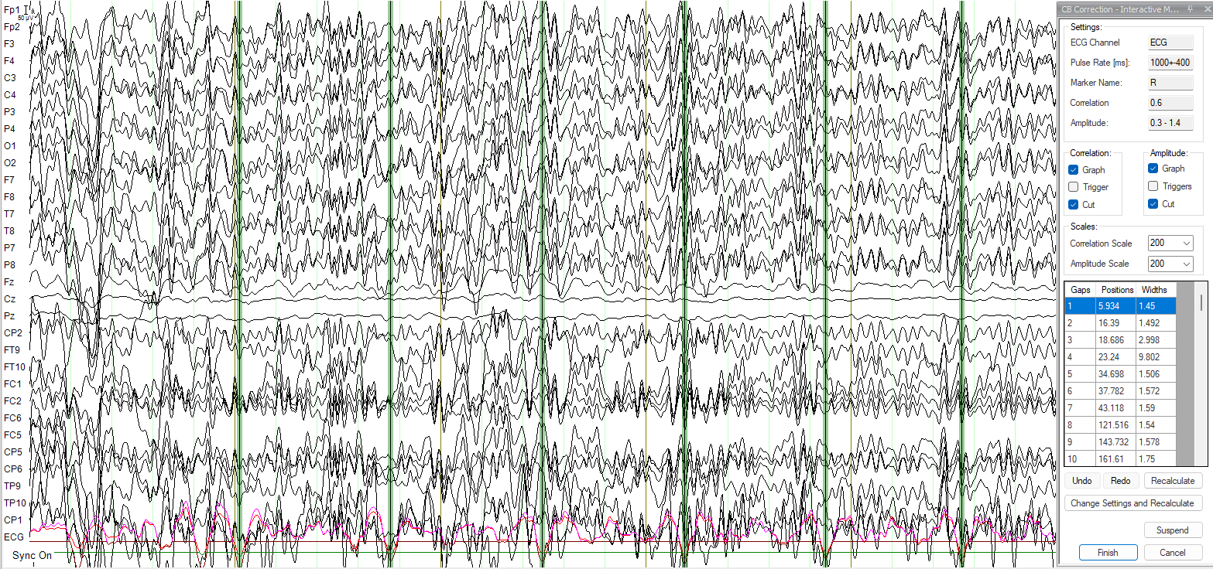
Notes:
After that, a “CB Correction - Interactive Mode” window will appear on the right side of the Analyzer.

Slide 59
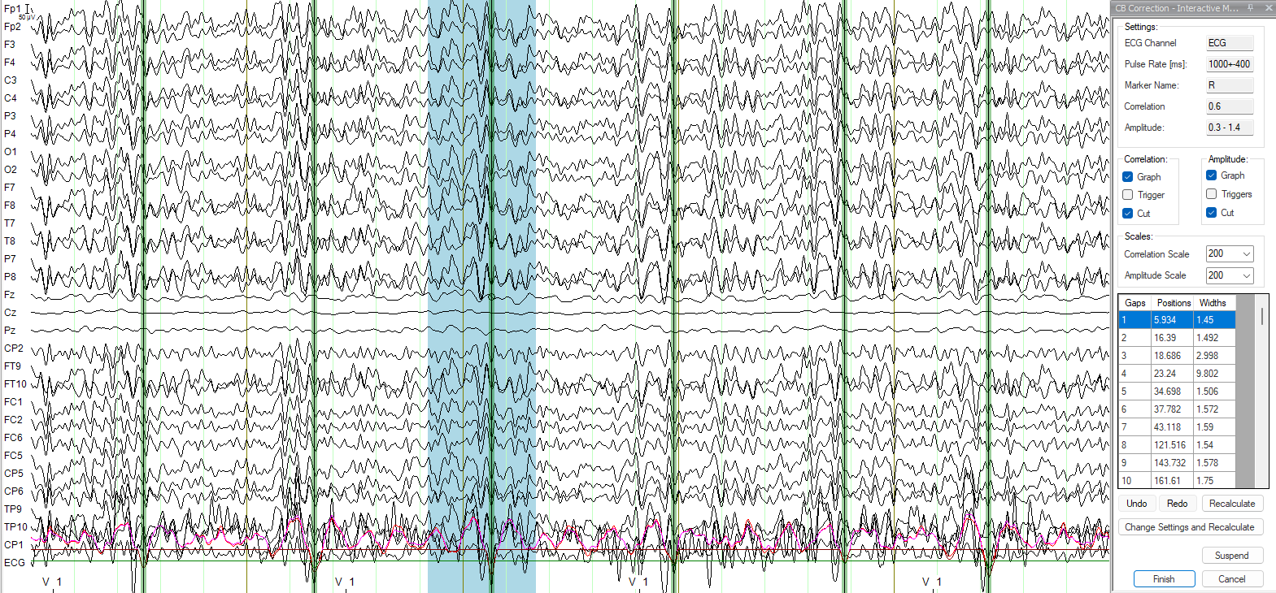
Notes:
Slide over the time axis at the bottom of the Navigation Bar and check where the base template ECG is highlighted with a blue shaded box.

Slide 60
Notes:
Slide over the time axis at the bottom of the Navigation Bar and check where the base template ECG is highlighted with a blue shaded box.

Slide 61
Double Click ECG Channel
Notes:
Slide over the time axis at the bottom of the Navigation Bar and check where the base template ECG is highlighted with a blue shaded box.

Slide 62
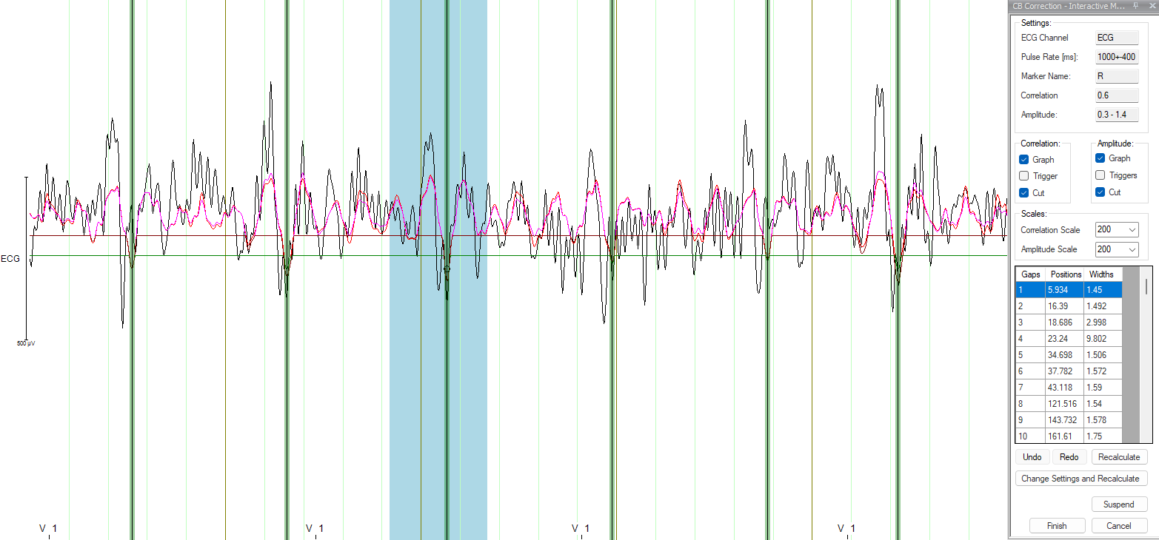
Notes:
Confirm the base template of the ECG is correctly marked.

Slide 63
Notes:
Confirm the base template of the ECG is correctly marked.

Slide 64
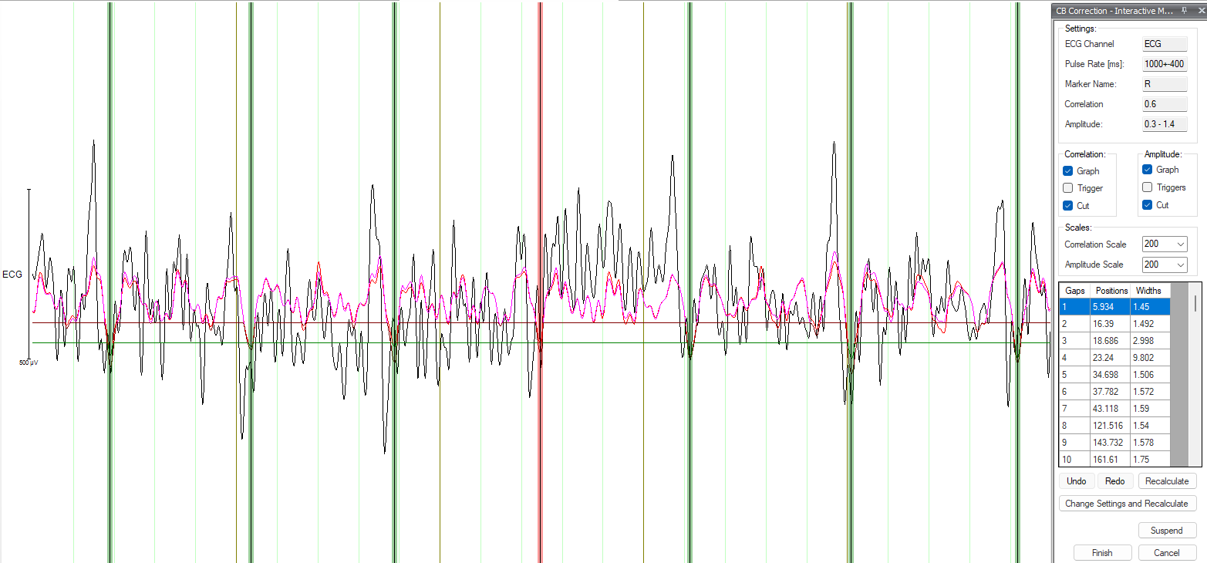
Double Click
Notes:
Check each marked ECG by double clicking the number of “Gaps” on each row of the table.

Slide 65
Notes:
Adjust the detected peak locations as needed.

Slide 66
Notes:
Once all detected ECGs are reviewed, click “Finish.”

Slide 67
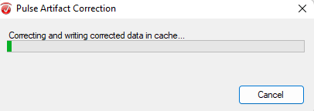
Notes:
After that , a small “Pulse Artifact Correction” window will appear in the middle of the Analyzer and show the processing status.

Slide 68
Notes:
Apply a notch filter of 60Hz by clicking “Transformation\Data Filtering\IIR Filters” tap.

Slide 69
Notes:
Apply a notch filter of 60Hz by clicking “Transformation\Data Filtering\IIR Filters” tap.

Slide 70
Notes:
Apply a notch filter of 60Hz by clicking “Transformation\Data Filtering\IIR Filters” tap.

Slide 71

Notes:
In a consequently open window, check “Notch Enabled,” select “Frequency [Hz]” as “60.”

Slide 72
Notes:
In a consequently open window, check “Notch Enabled,” select “Frequency [Hz]” as “60.”

Slide 73
Notes:
And then click “OK.”

