Slide 1
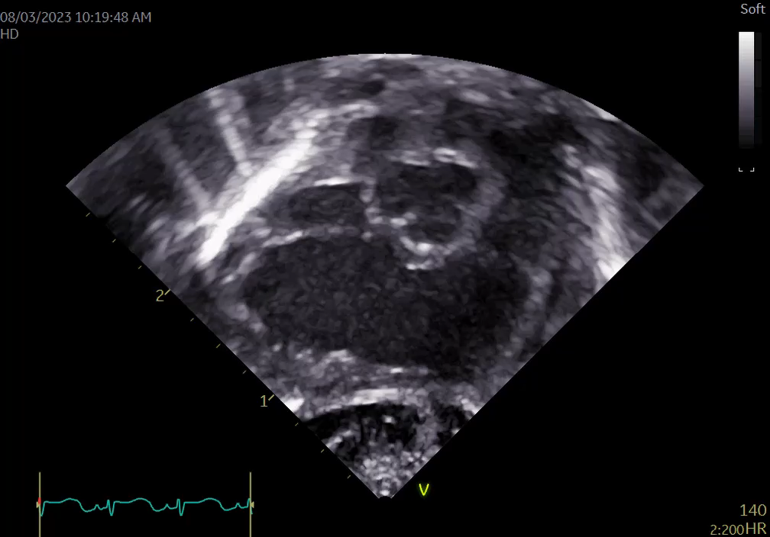
RV3 Chamber View
Ao
RA
PA
Tricuspid
RV
Pulmonary Valve

