Slide 1
JoVE #63839
Video footage note

Slide 2
For 3.92 and 3.93
Systemic blood pressure recording

Slide 3
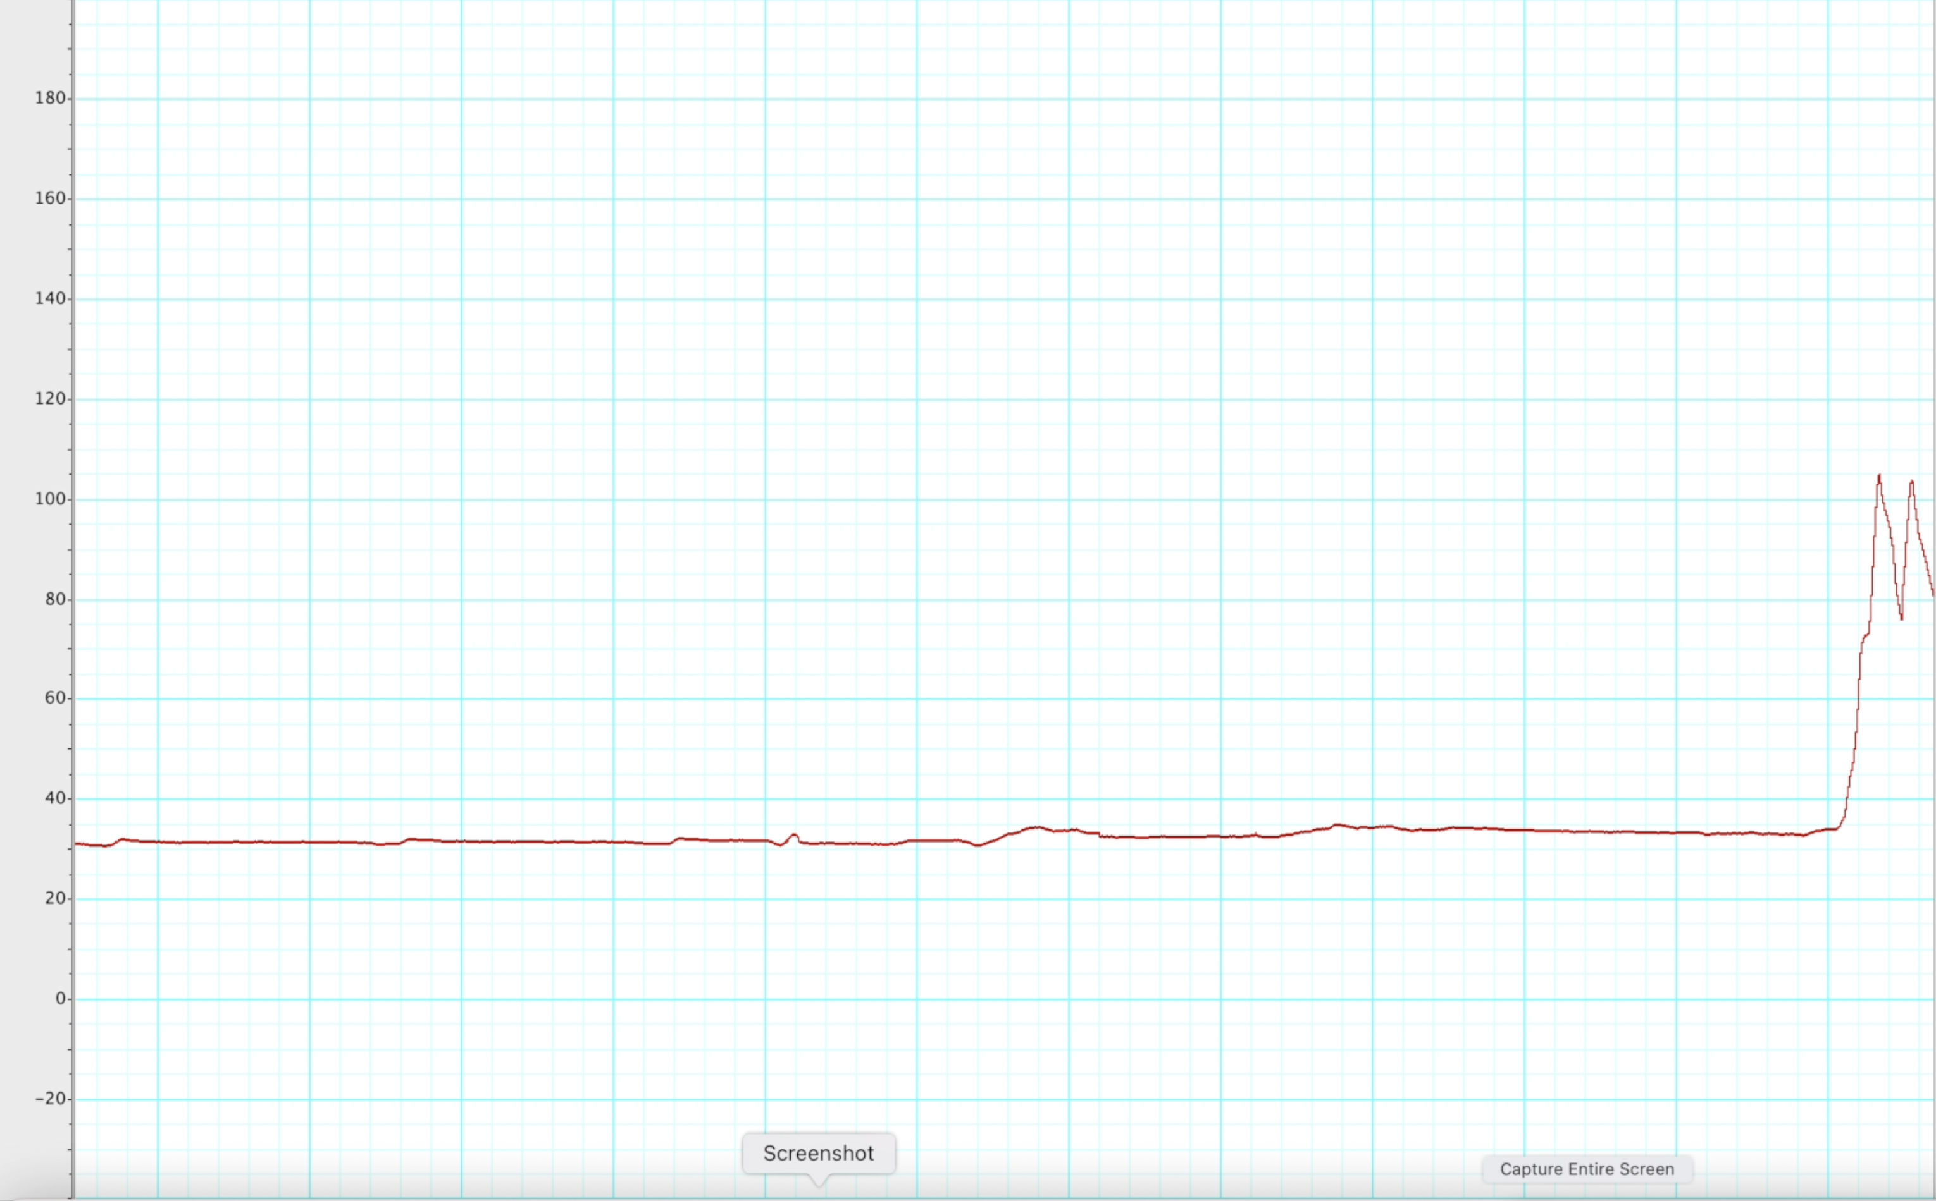
Insert the catheter
Catheter in correct position

Slide 4
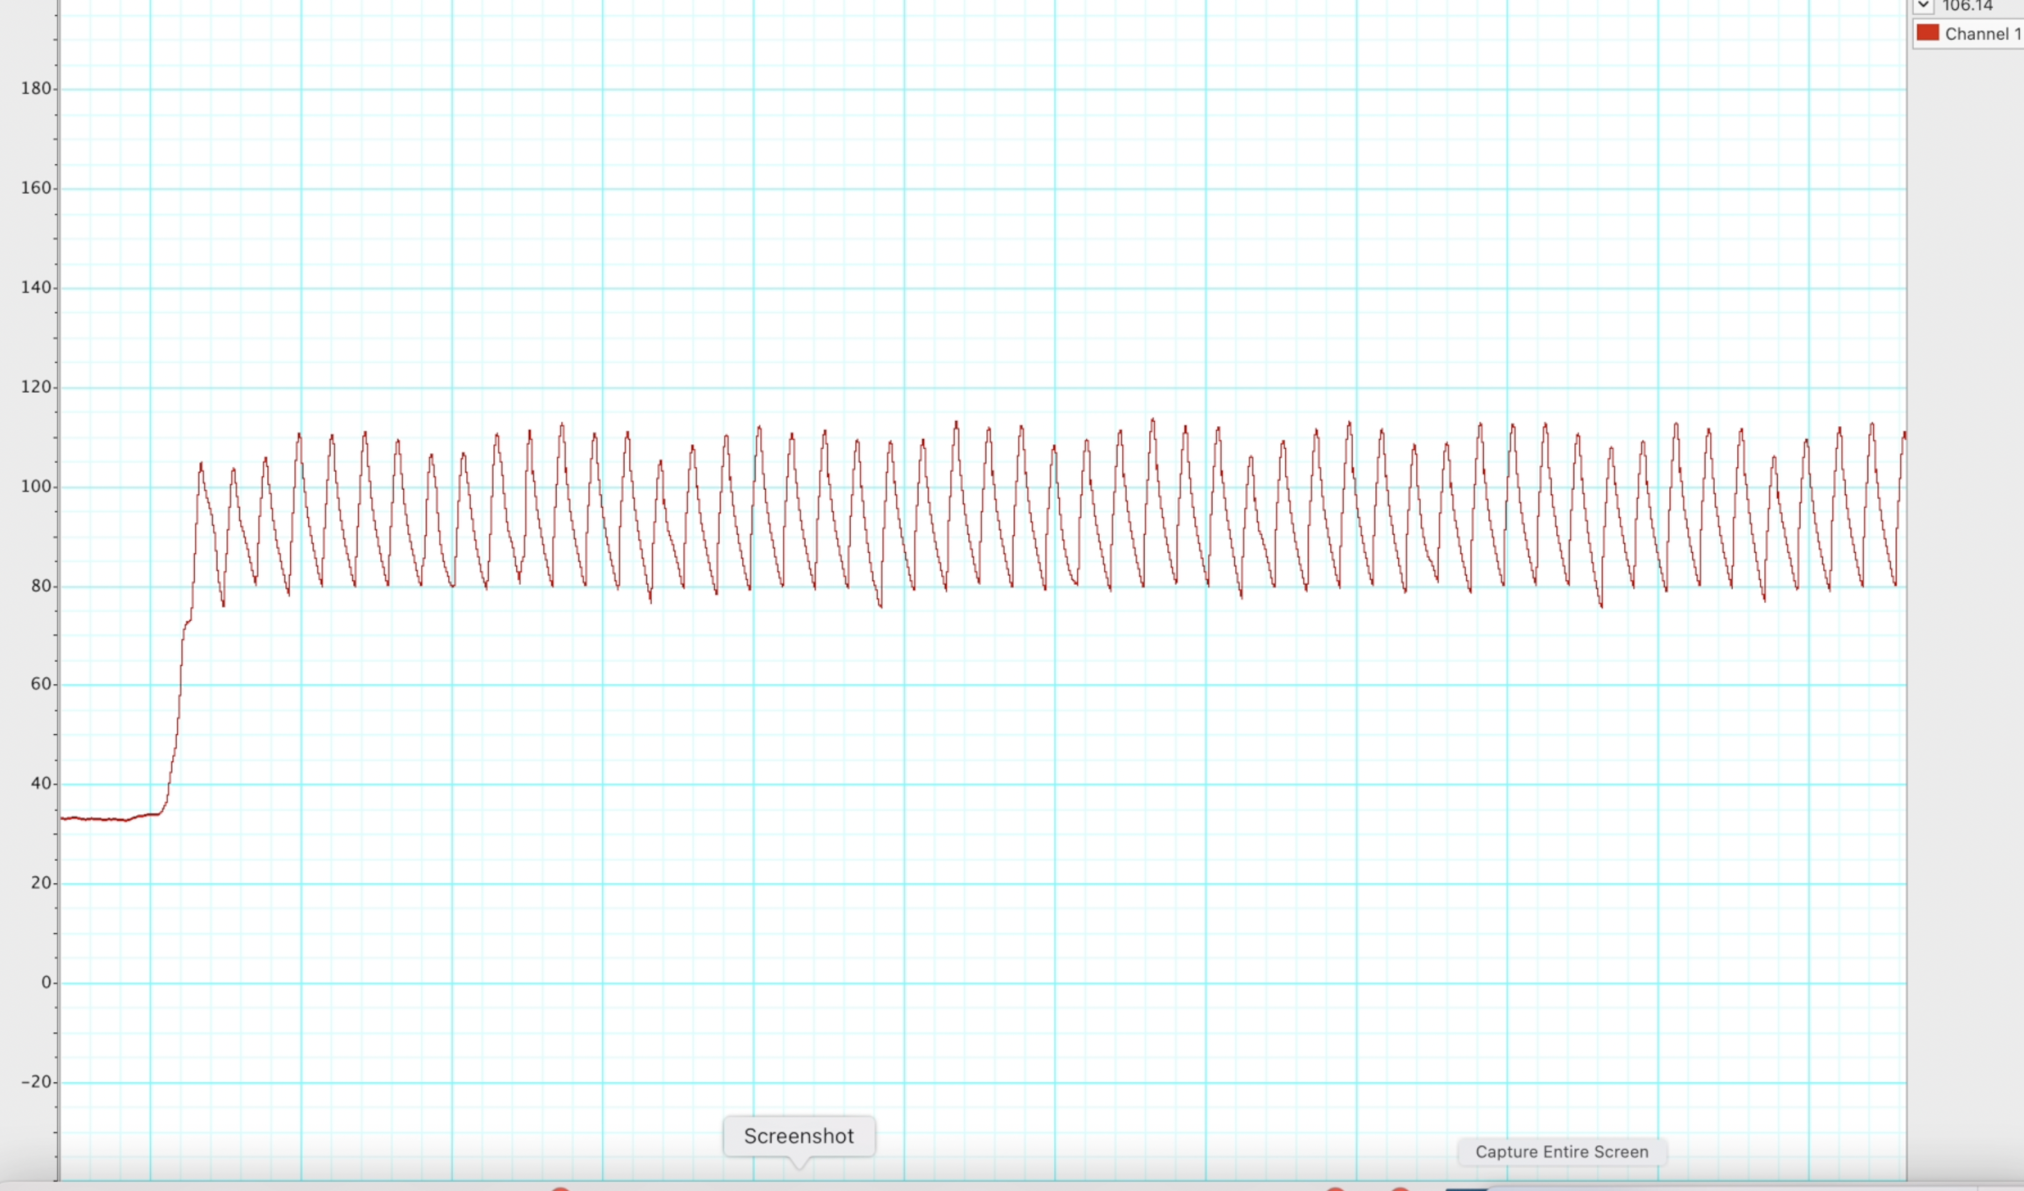
Very stable systemic blood pressure recording

Slide 5
For 3.13 – 3.15
Right ventricle blood pressure recording

Slide 6
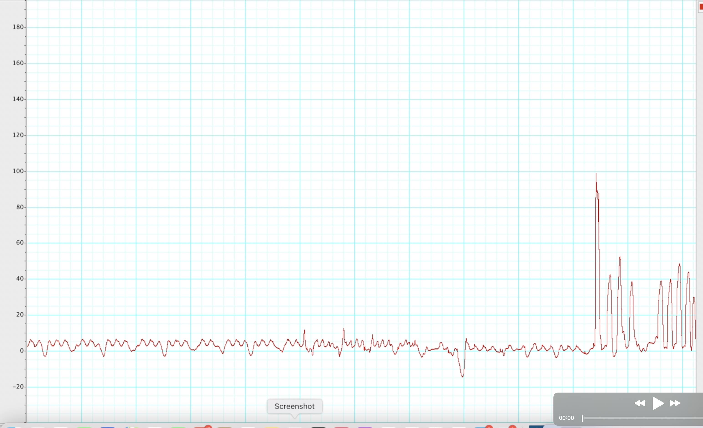
Insert the catheter
Catheter in right ventricle

Slide 7
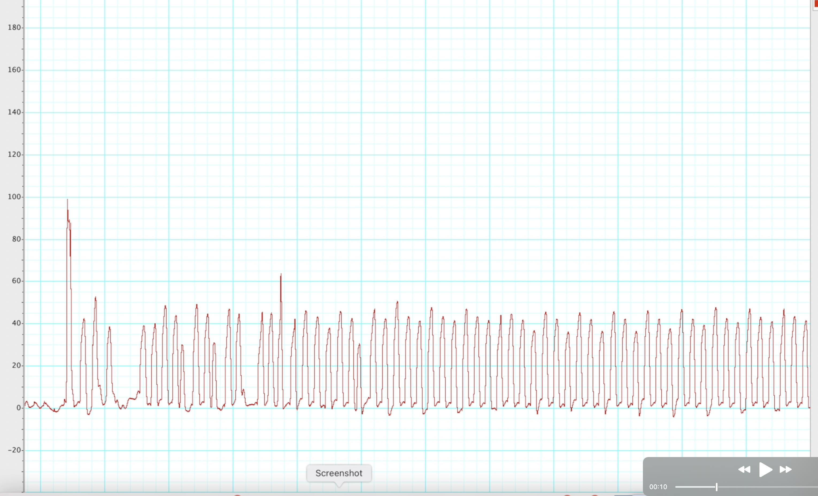
unstable right ventricle blood pressure recording
stable right ventricle blood pressure recording

Slide 8
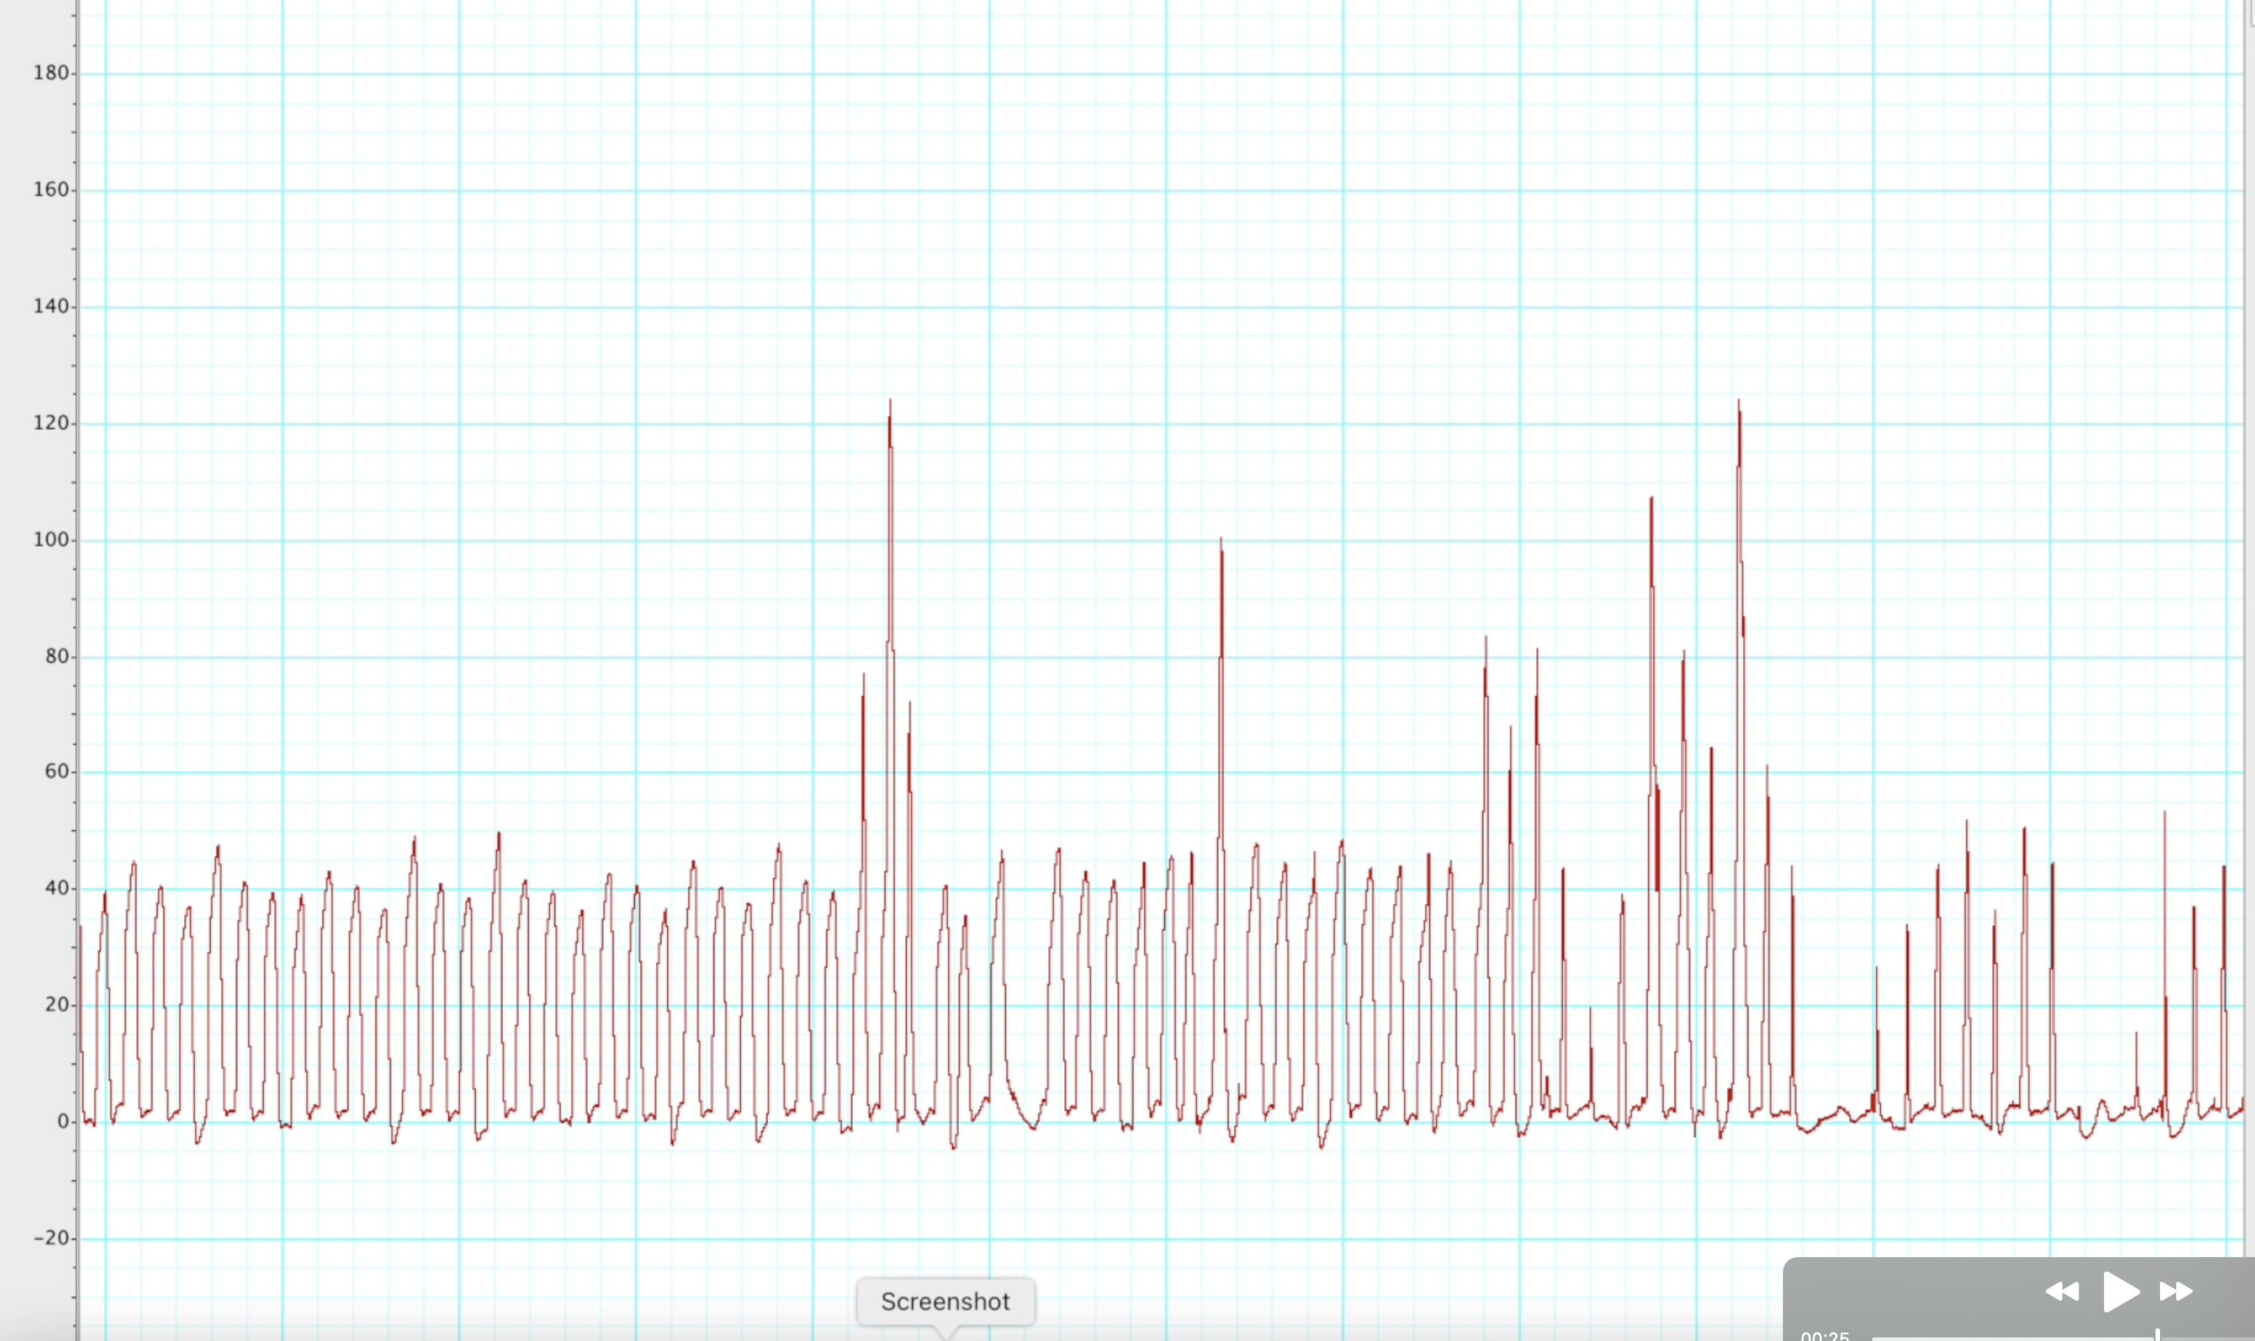
Slowly pull the catheter out

Slide 9
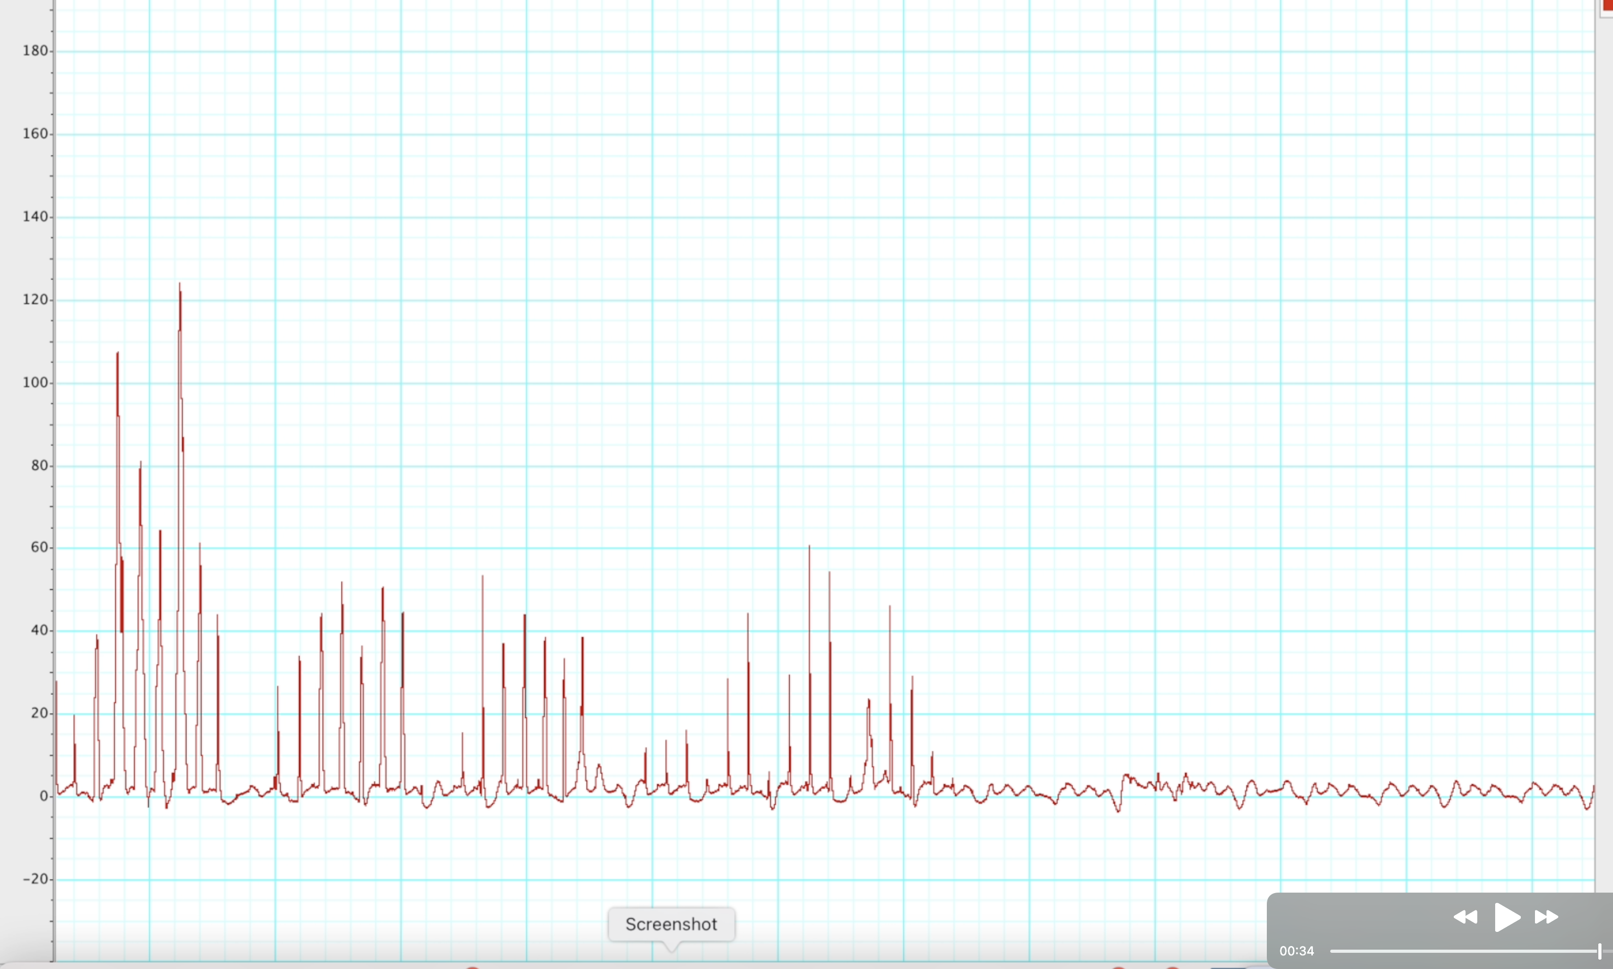
Slowly pull the catheter out
Catheter completely out- no pressure recording

