Slide 1
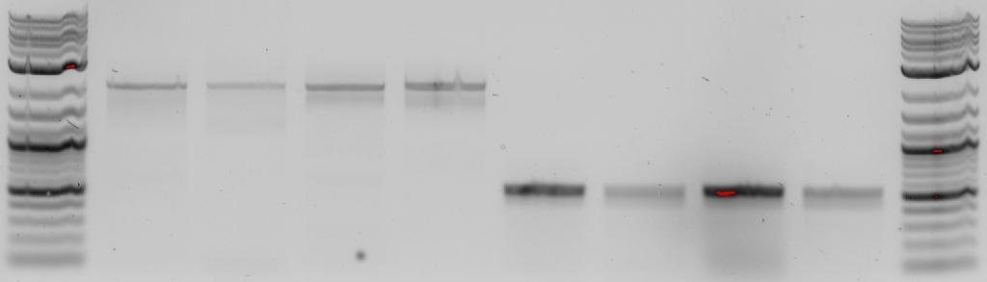
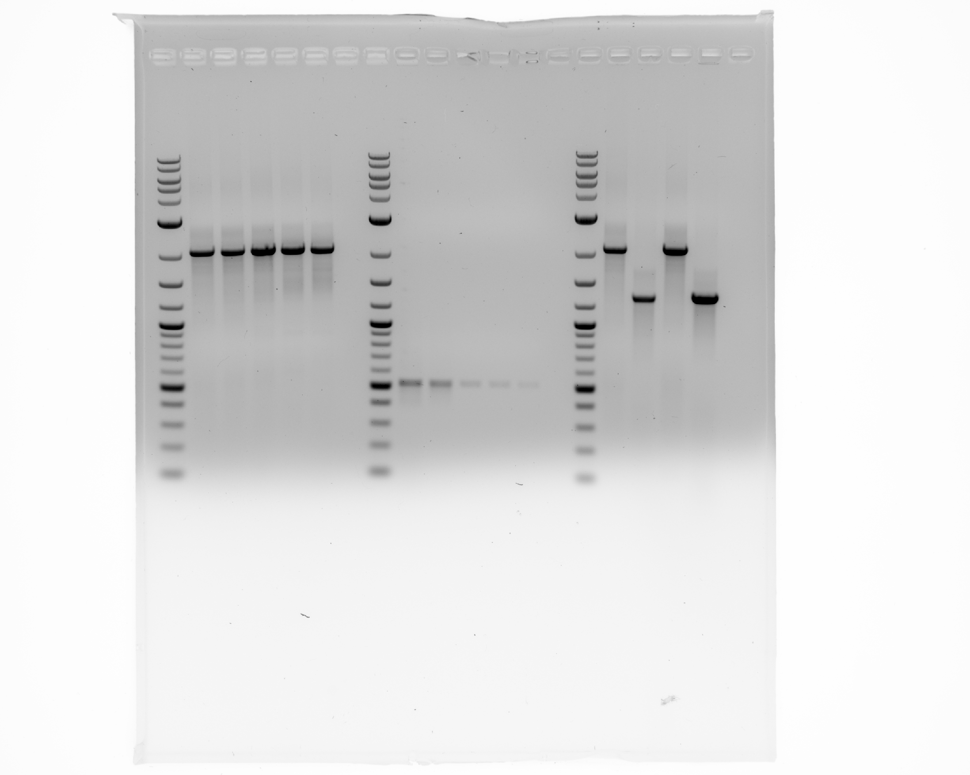
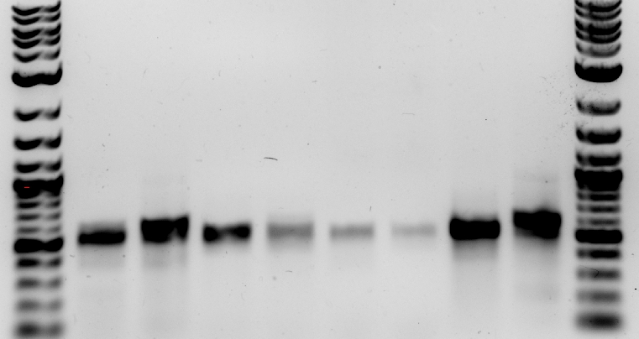
A
C
D
lane | 1 | 2 | 3 | 4 | 5 | 6 | 7 | 8
prep | K | kit | K | kit | K | kit | K | kit
kb | 2.1 | 1 | 2.1 | few | 0.5 | 1 | 9 adults | few
lysis | 1 adult |  | 9 adults |  | 1 adult |  | 9 adults
lane | 1 | 2 | 3 | 4 | 5
st. | L4 | emb | emb | emb
kb | 2.1
dil. | 1 | 1/2 | 1/10 | 1/20 | 1/50
6 | 7 | 8 | 9 | 10
L4 | emb | emb | emb
0.5
1 | 1/2 | 1/10 | 1/20 | 1/50
lane | 1 | 2 | 3 | 4
st. | L4 | emb | emb | emb
kb | 2.1 | 1.3 | 2.1 | 1.3
lysis | 1 | 16 | 1 | 16
kb
kb
kb
3
2
1
0.5
3
3
B
2
2
lane | 1 | 2 | 3 | 4 | 5 | 6 | 7 | 8
PCR | Pol A |  | Pol B |  | Pol C |  | Pol D
kb | 0.5 | 1 | 0.5 | few | 2.1 | 1 | 0.5 | few
lysis | 1 | 9 | 1 | 9 | 1 | 9 | 1 | 9
1.5
1.5
1.2
1.2
kb
3
0.5
2
1
0.5

