Slide 1

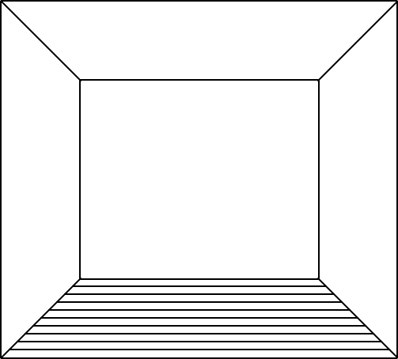


x
0.2 – 1.0 mA
0.5 sec

