Slide 1
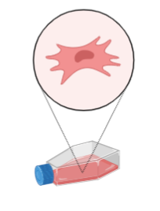
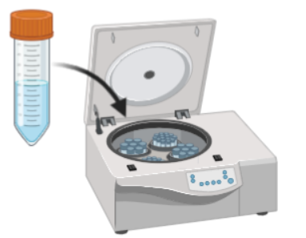
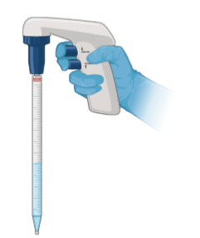
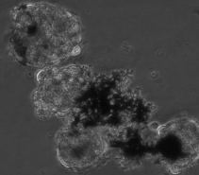
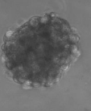
Ways to put cells into bioink
In the bioink preparation stage, the cells are added to the homogeneous bioink and the printing stage is started.
After the bioink is prepared and printed, it is washed after cross-linking and added to the cells mixed into the medium. In a short time, cells can form "Spheroid Form".
Bioink
Spheroids

