Slide 1
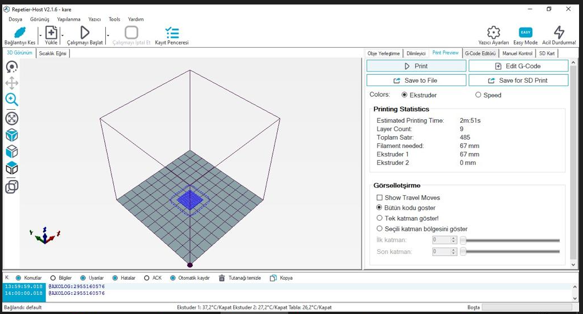
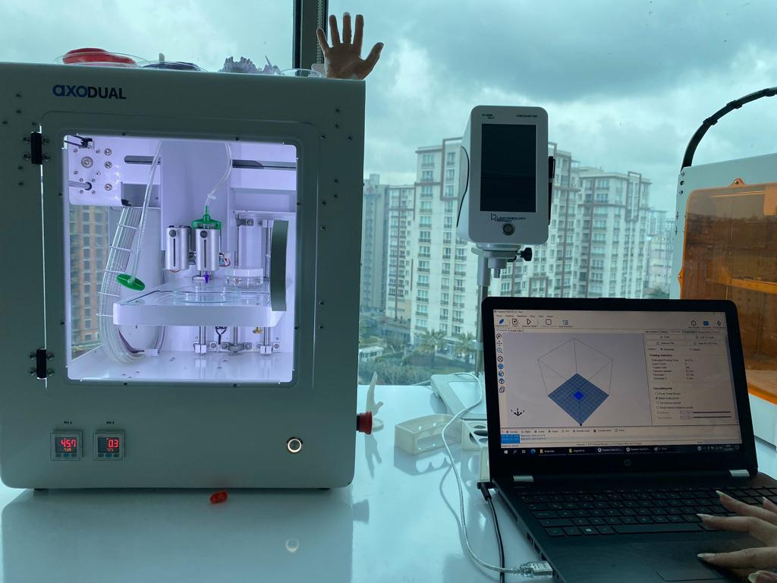
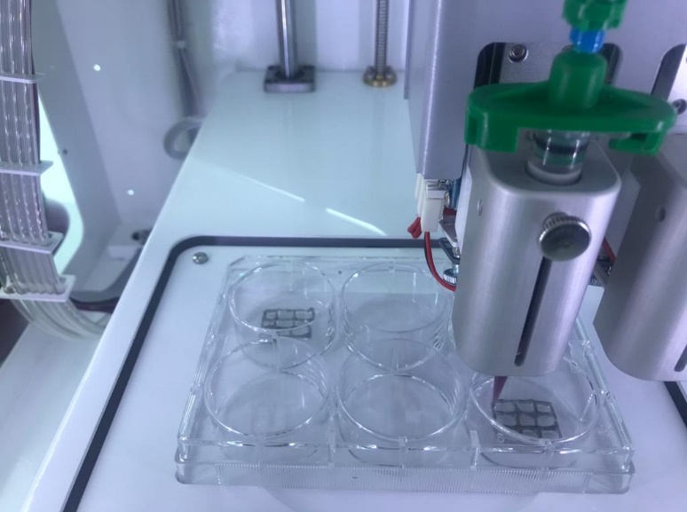
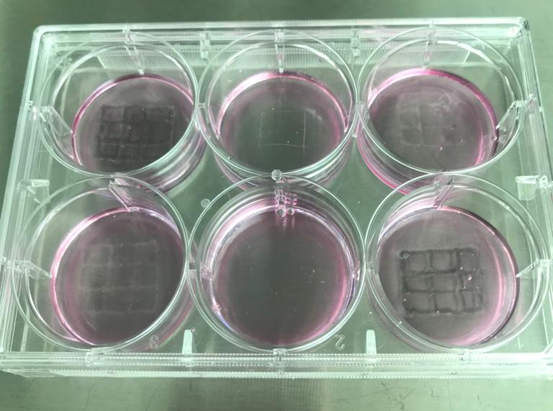
Create the 3D models using open-source, web-based CAD programs
Put the system in the home position during the writing phase
Position the axes (X, Y, Z) automatically
Select the extruder, and set
Start the printing process

