Slide 1
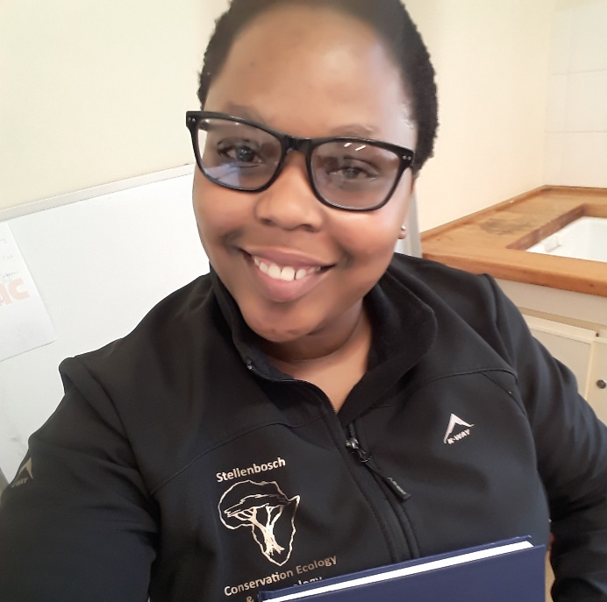
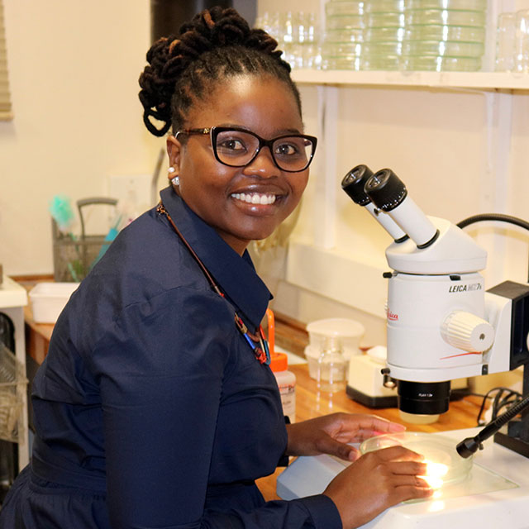
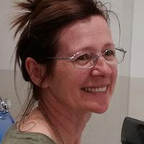
L.L Mathulwe
Dr. N.F Stokwe
Prof. A.P Malan
Notes:
-Thank you to Hortgro for funding of the project.

