Slide 1
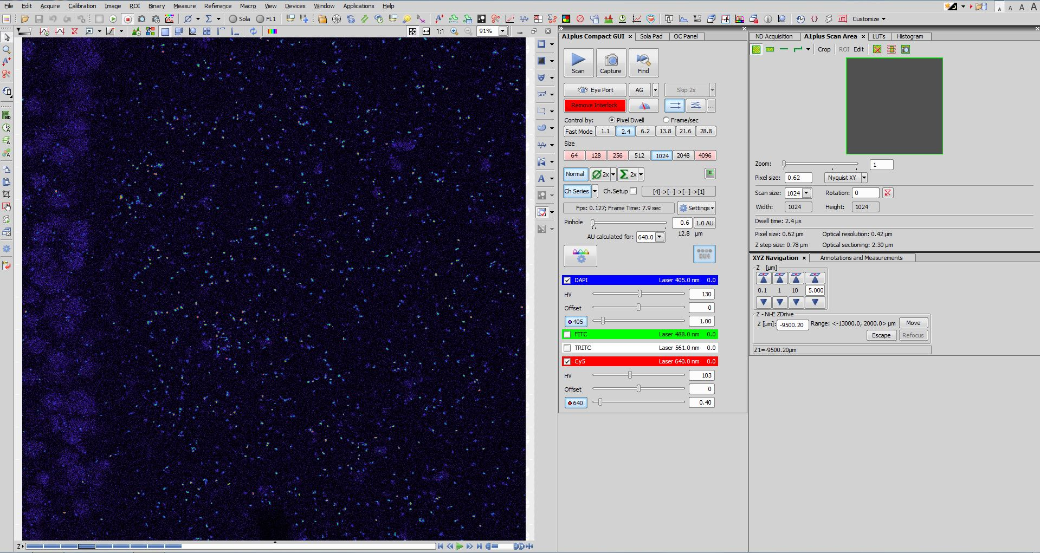
Power, Offset, and Gain Adjustments
Notes:
STEP 4.1.2

Slide 2
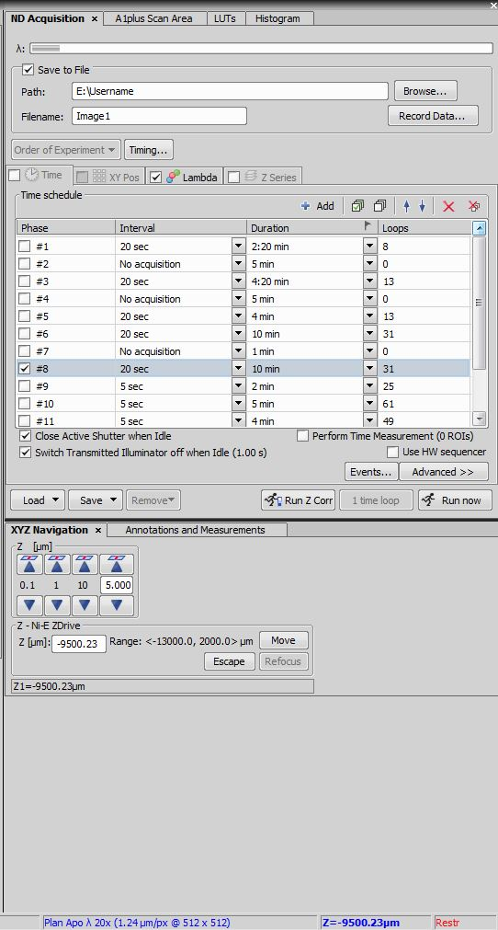
1. ND Acquisition Tab
3. Save File under assigned Folder
2. Save to File
Notes:
STEP 4.2.1

Slide 3
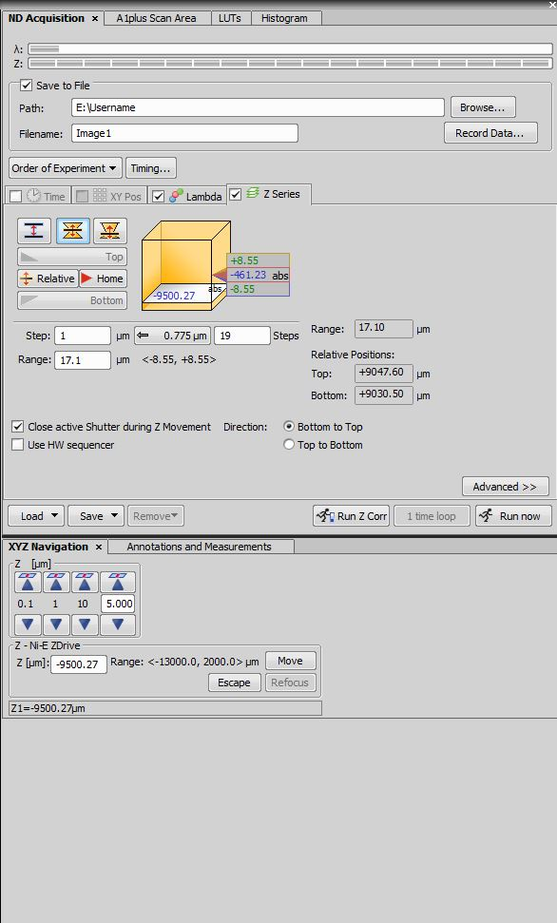
1. Symmetric Mode Defined by Range
2. Adjust focal plane
3. Select ‘Relative’
Notes:
STEP 4.3.1

Slide 4
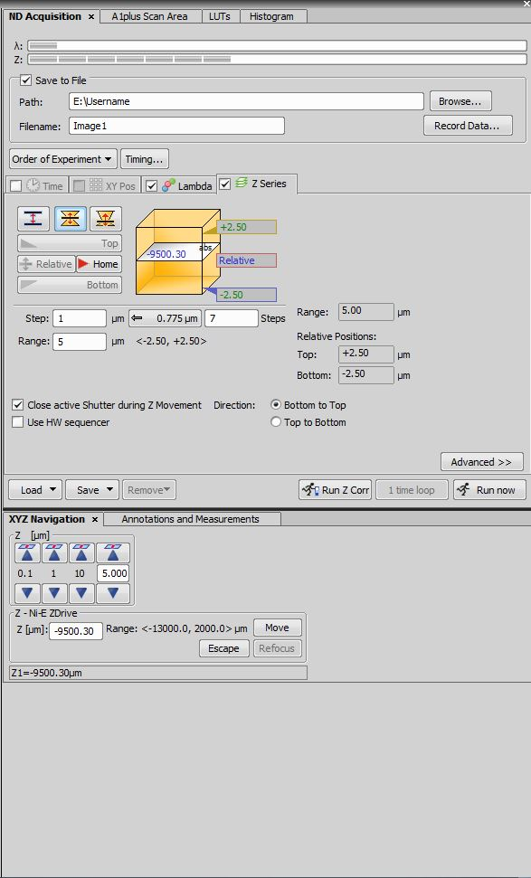
Check box under ‘Close active Shutter’
Notes:
STEP 4.4.1

Slide 5
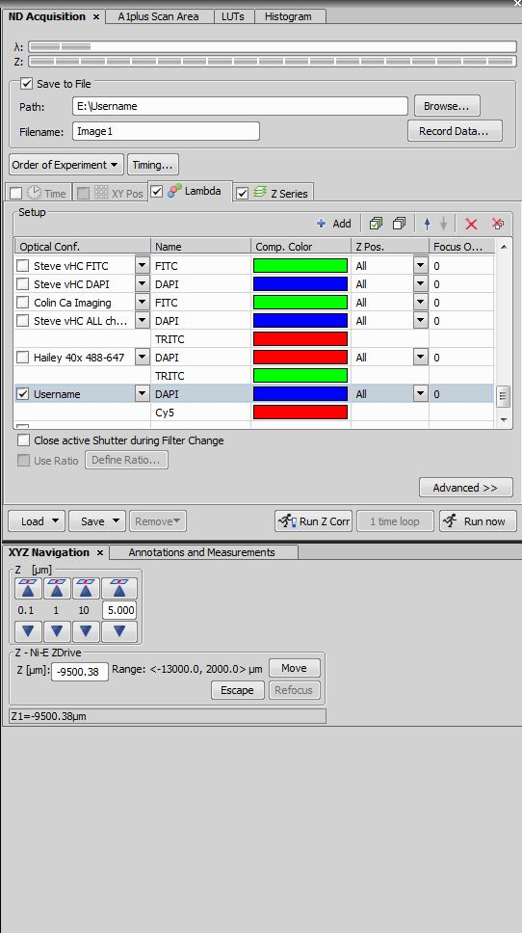
1. Correct Optical Configuration selected
2. Click ‘Run Now’
Notes:
STEP 4.4.2

Slide 6
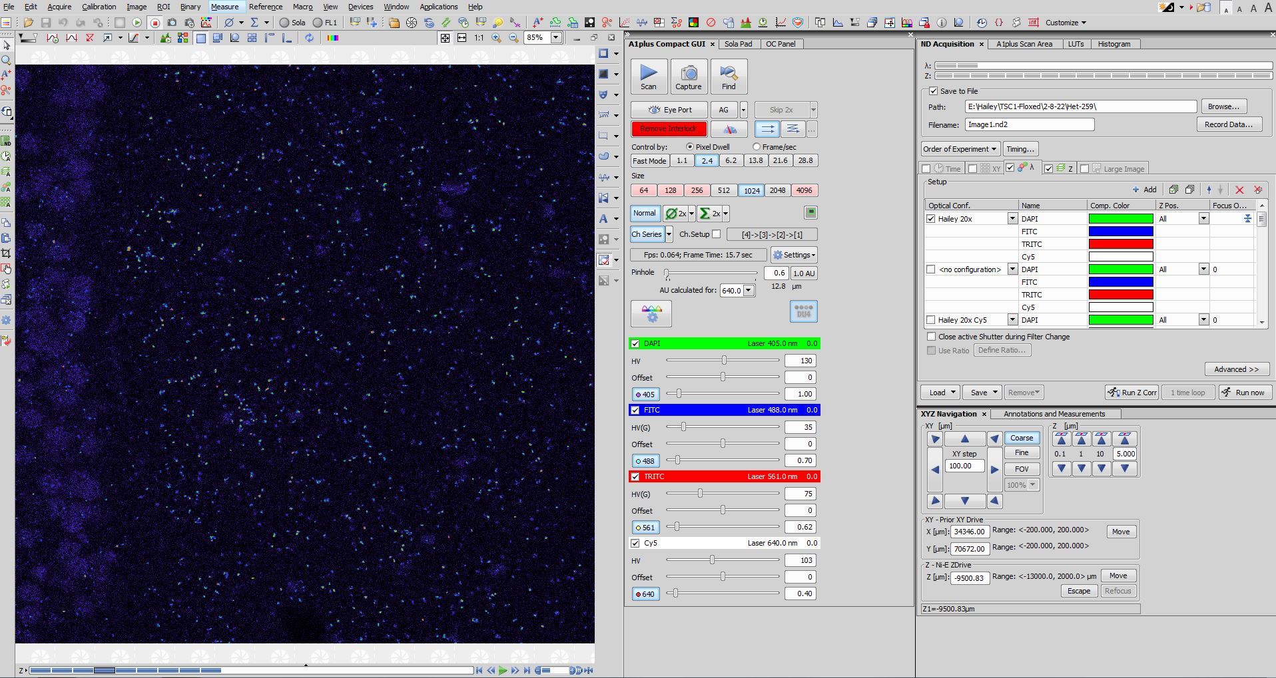
Acquire and select ‘Scan Large Image’
Username
Notes:
STEP 4.5.1

Slide 7
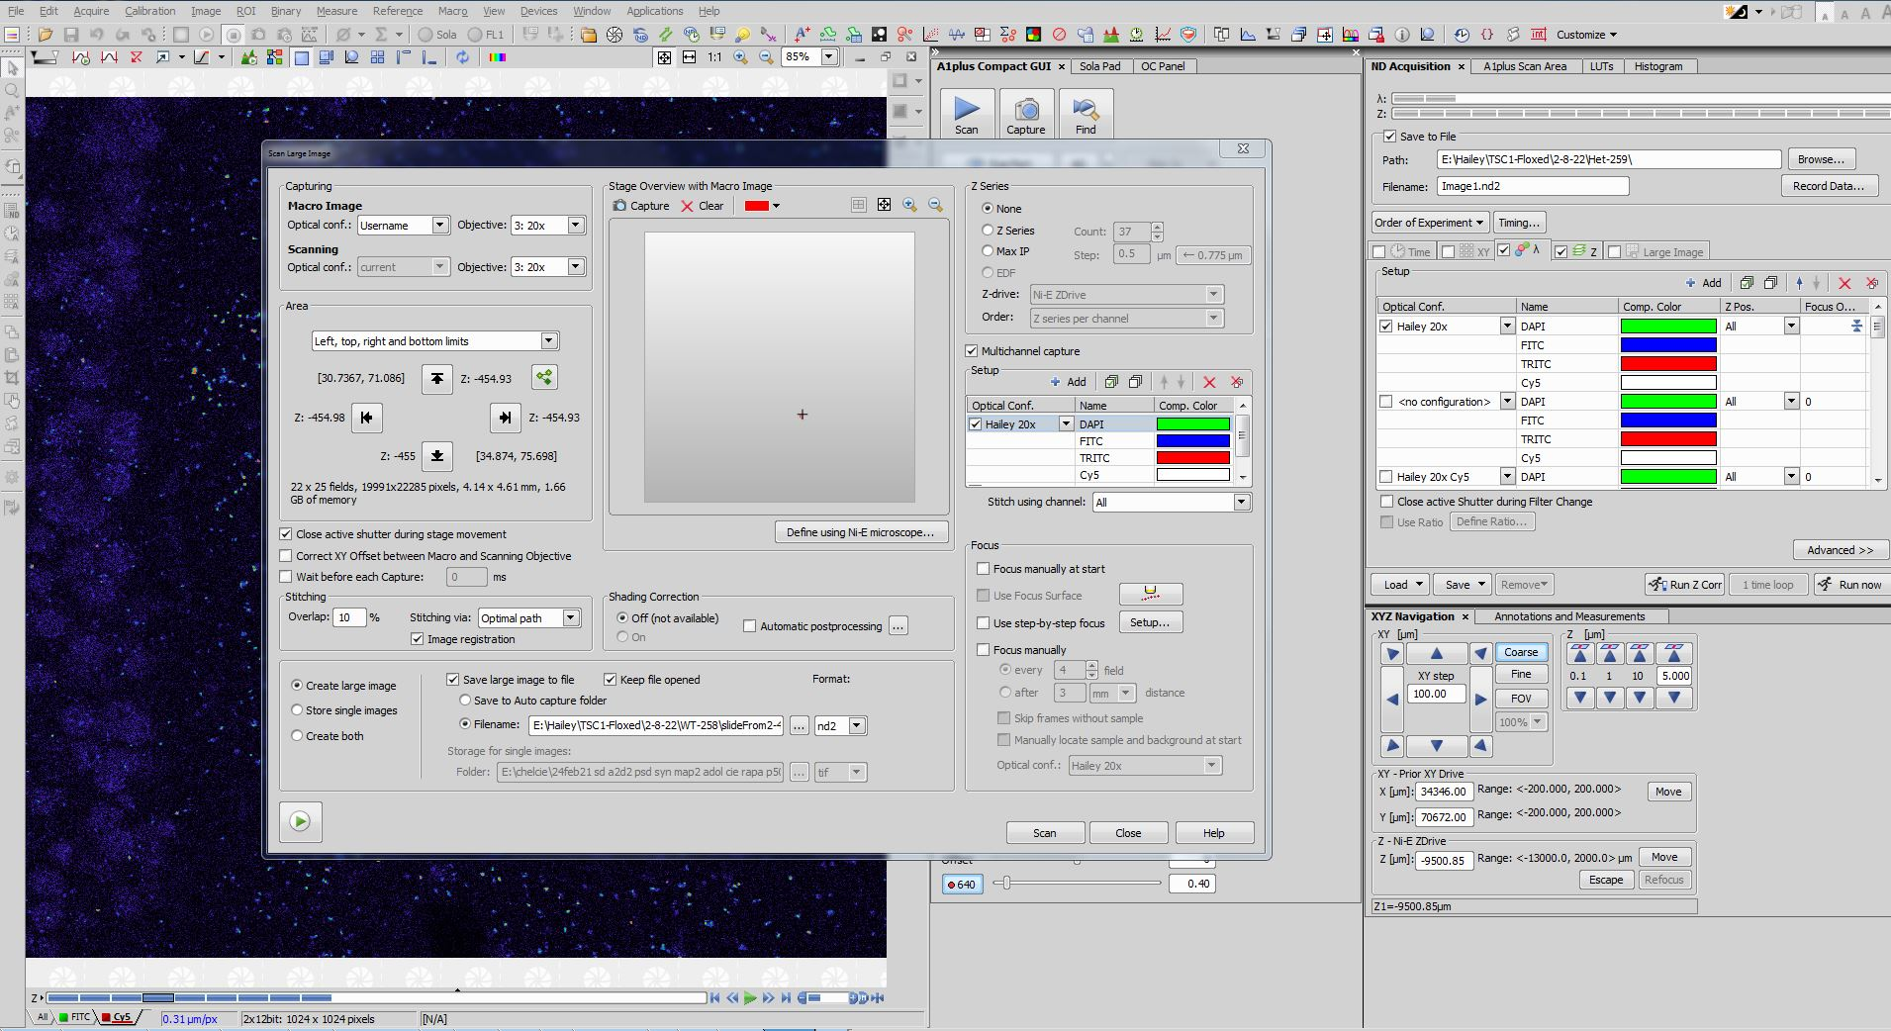
Select optical button’s name and objective
Username
Notes:
STEP 4.5.2

Slide 8
1. Set ROI boundaries
Username
2. Select ‘Save large image to file’ and save to assigned folder
Notes:
STEP 4.6.1 and 4.6.2

Slide 9
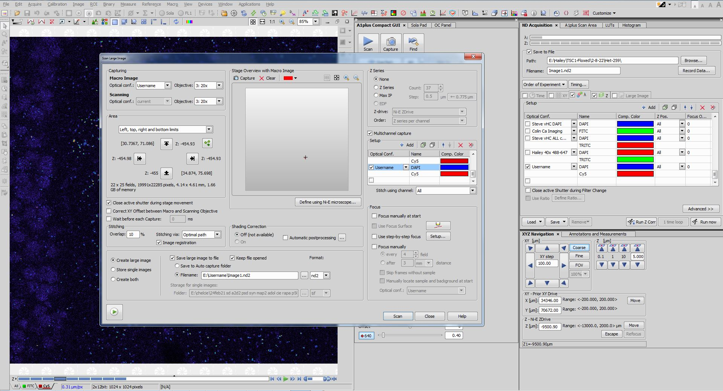
1. Select ‘Multichannel Capture’
2. Select designated optical configuration
Notes:
STEP 4.7.1

Slide 10
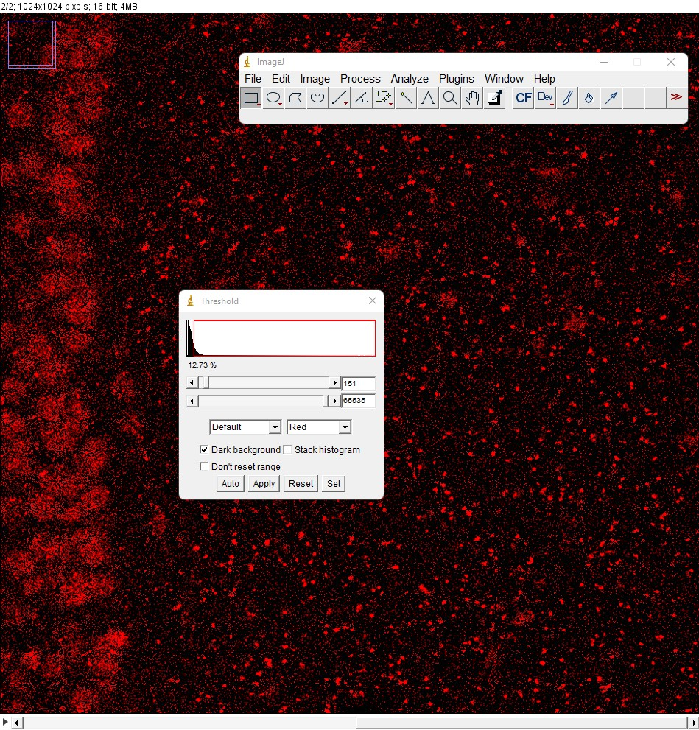
1. Select Adjust, then Threshold
2. Check “Dark Background”
Notes:
STEP 5.1.2

Slide 11
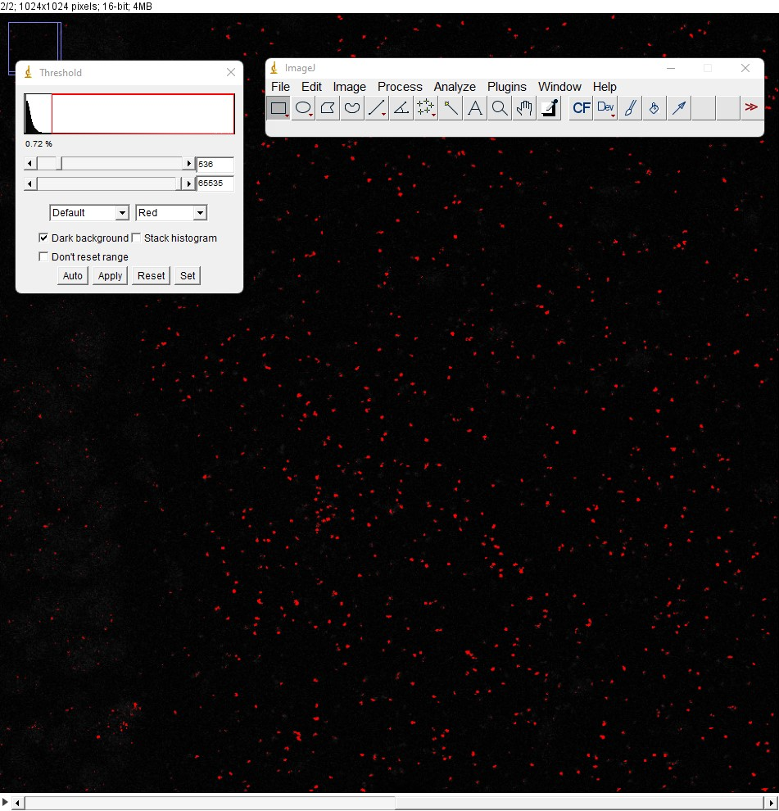
Adjust threshold. Click “Apply”
Notes:
STEP 5.2.1

Slide 12
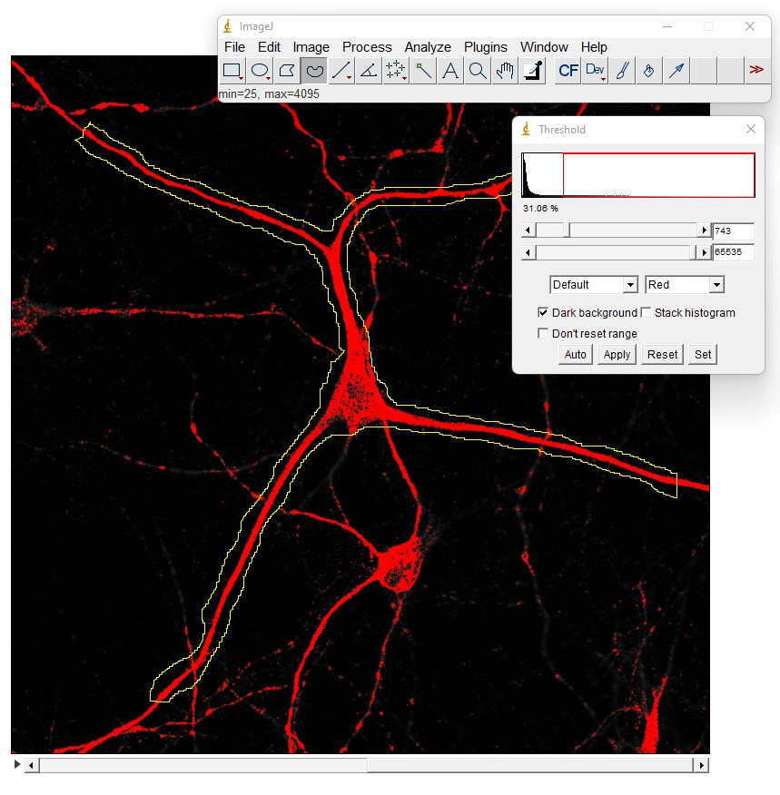
Draw ROI with MAP2 channel
Notes:
STEP 5.3.1

Slide 13
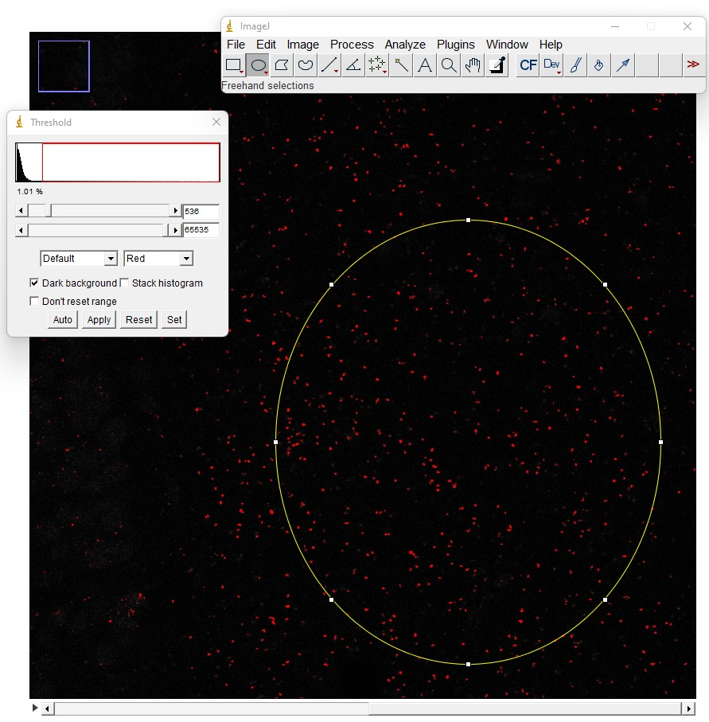
Draw ROI in slice
Notes:
STEP 5.3.2

Slide 14
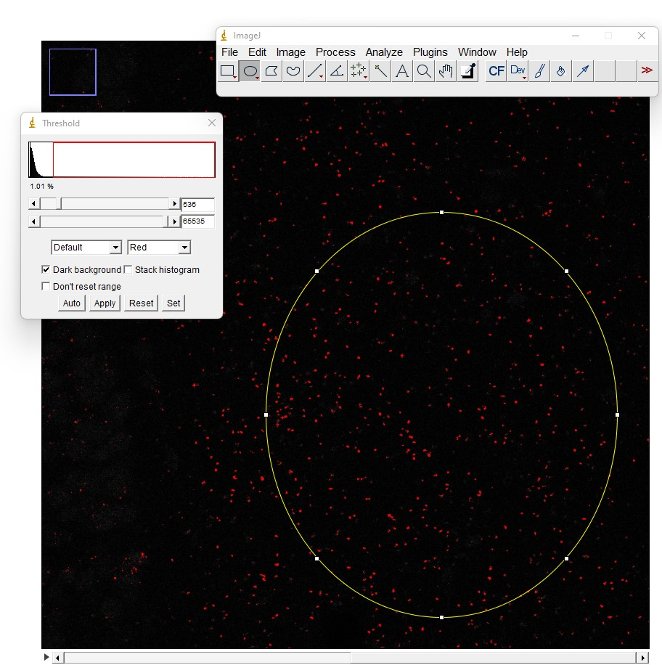
Obtain ROI Area: Click Analyze, then Measure
Notes:
STEP 5.4.1

Slide 15
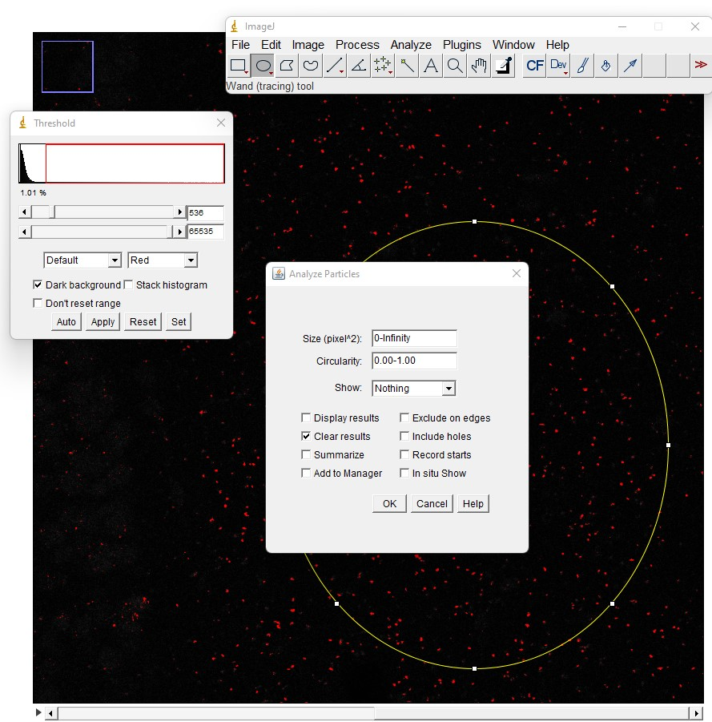
Obtain # Punta: Click Analyze, then Analyze Particles
Notes:
STEP 5.5.1

Slide 16
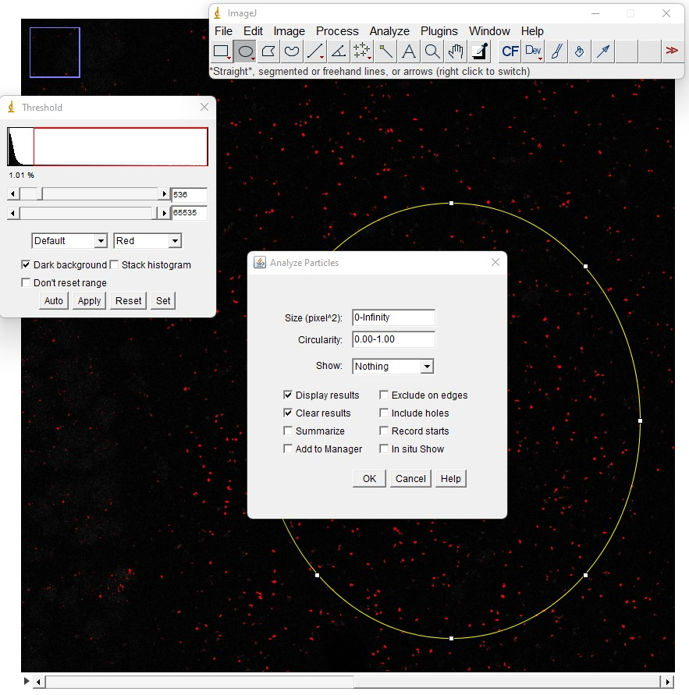
1. Click drop-down arrow. Select “Overlay Masks”
2. Check “Display results”
Notes:
STEP 5.6.1

Slide 17
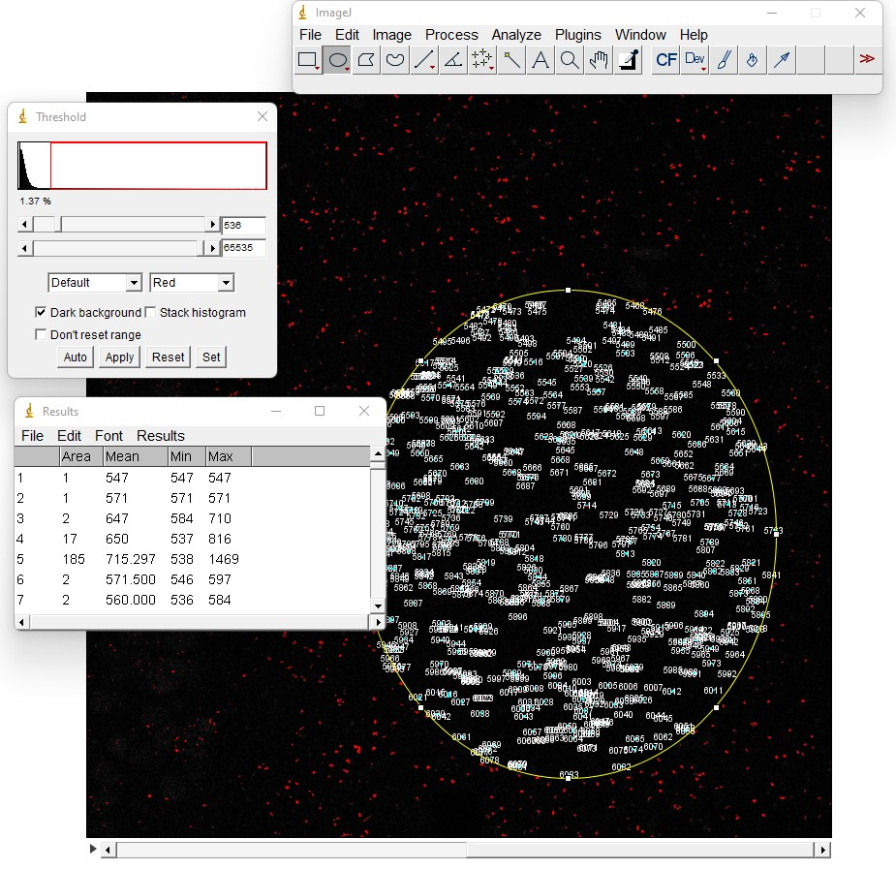
Copy & paste results into spreadsheet
Notes:
STEP 5.7.1

Slide 18
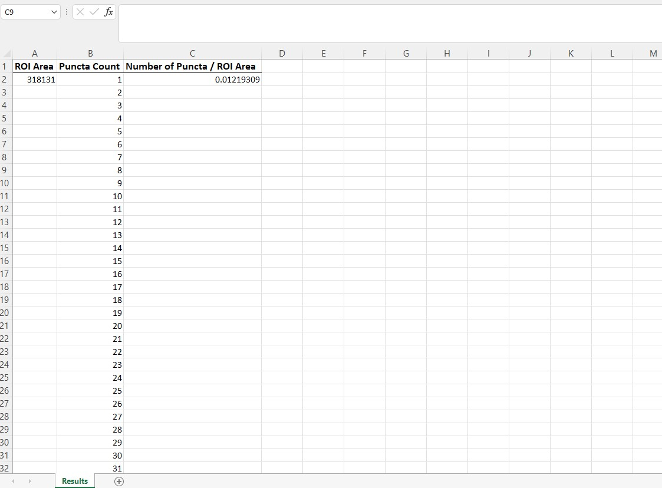
Divide # puncta / ROI area for each image
Notes:
STEP 5.7.2

Slide 19
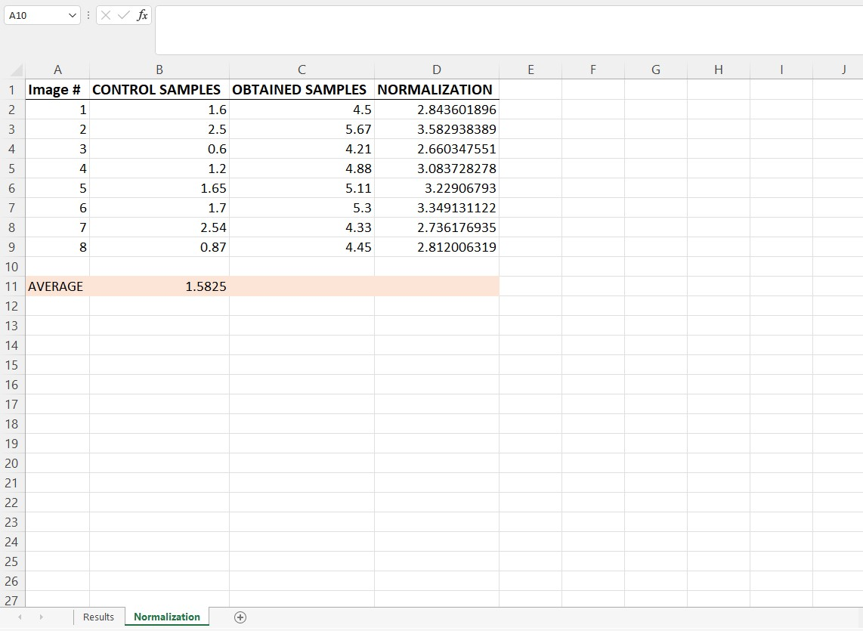
Divide each obtained result by average of all control samples
Average of all Control Samples
Notes:
STEP 5.8.1

