Slide 1
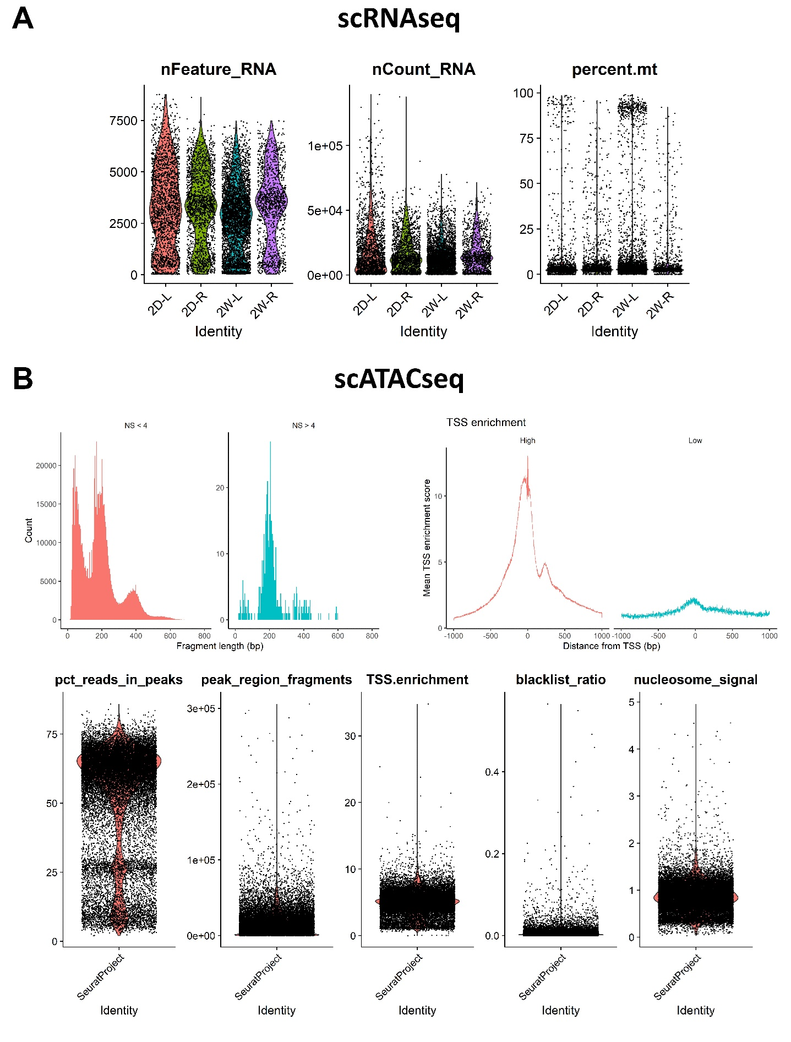
A
B
C
D
E
F
Counts
G
H
I
J
K

