Slide 1

Figure 1
CD95
DISC
DD
DD
FADD
Procaspase-8
DD
DD
DD
Procaspase-10
DED
DED
DED
DED
DED
DED
DED
DED
DED
DED
DED
DED
DED
DED
c-FLIP_{L}
DED
DED
p18
p18
p18
p17
p20
p10
p18
p18
p10
p10
p10
p10
p10
p12
DED filaments
DED filaments
p18
p10
p18
p10
active heterotetramer
(Caspase-8 p18₂/p10₂)
Procaspase-3/7
active
Caspase-3/7
Apoptosis

Slide 2
Figure 2
procaspase-8a/b
D210/D216
D374
D384
p55/p53
NH₂
DED
DED
p18
p10
COOH
1. cleavage step
D210/D216
D216
p43/p41
p26/p24
NH₂
DED
DED
p18
NH₂
+
DED
DED
+
D216
D374
D384
D384
p10
p18
COOH
COOH
p30
p10
2. cleavage step
D216
D384
p26/p24
NH₂
DED
DED
p18
p10
COOH
+
D384
p18
p10
COOH
p10
p18
p18
p10
active heterotetramer
p18₂/p10₂

Slide 3
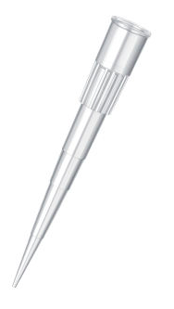
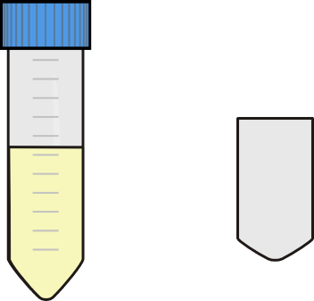
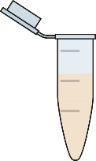
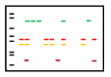
Figure 3
CD95L
CD95L stimulation
harvest
centrifugation
washing
lysis
DISC-IP
Cellular lysates containing DISC
Anti-CD95 antibodies/ protein A sepharose beads
Washing
sepharose
beads
Detection via Western Blot

Slide 4
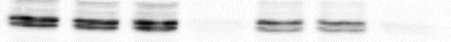
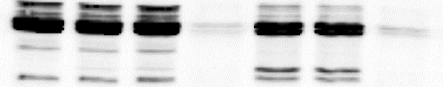
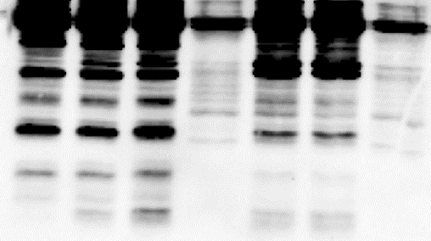
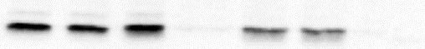
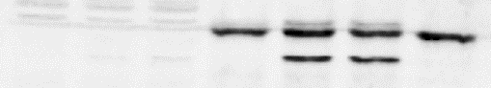
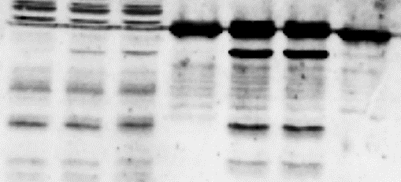
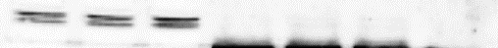
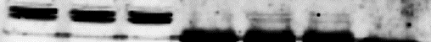
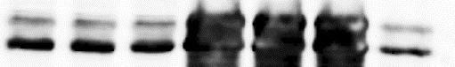
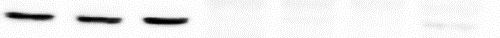
Figure 4
HeLa-CD95 cells
lysate
DISC-IP
M [kDa]
- | 0.5 | 1 | - | 0.5 | 1 | BC
125 ng/mL CD95L [h]
55/53
procaspase-8 p55/p53 (s. e.)
procaspase-8 p55/p53 (l. e.)
p43/p41
1.6 | 0.9
1.6 | 0.9
p55/p53/CD95
p43/p41/CD95
procaspase-8 p55/p53 (l. e.)
p43/p41
p30
p18
1.6 | 0.7
1.6 | 0.9
p30/CD95
p18/CD95
27
FADD
55
c-FLIP_{L} (s.e.)
p43
c-FLIP_{L} (l.e.)
p43
26
FLIP_{S}
p22
59/55
procaspase-10 p59/p55 (s.e.)
procaspase-10 p59/p55 (l.e.)
54/45
CD95
42
actin

Slide 5
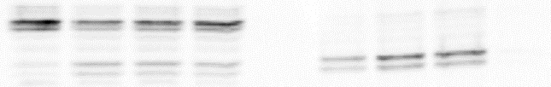
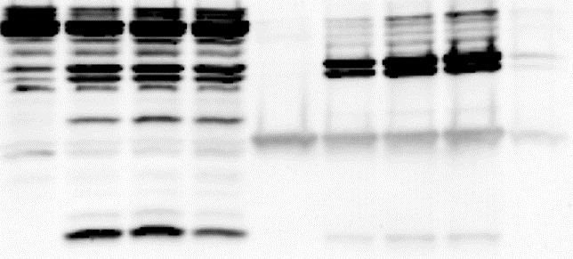
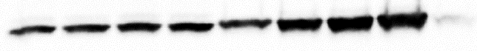
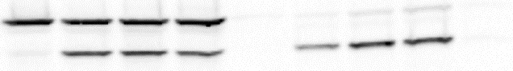
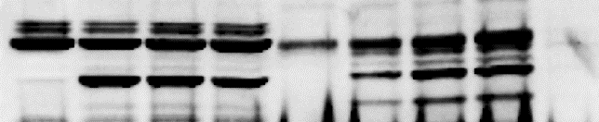
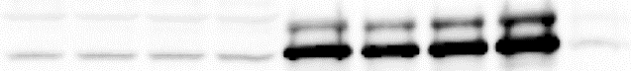
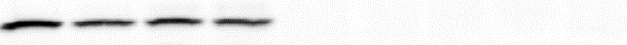
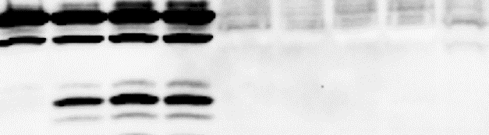
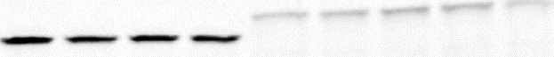
Figure 5
HeLa-CD95-FL cells
lysate
DISC-IP
M [kDa]
- | 1 | 2 | 3 | - | 1 | 2 | 3 | BC
250 ng/mL CD95L [h]
55/53
procaspase-8 p55/p53 (s. e.)
p43/p41
1.0 | 1.9 | 2.0
p43/CD95
procaspase-8 p55/p53 (l. e.)
p43/p41
p30
p18
1.0 | 1.7 | 1.0
1.0 | 0.7 | 0.7
1.0 | 1.2 | 1.1
p55/CD95
p30/CD95
p18/CD95
27
FADD/ light chain
55
c-FLIP_{L}
p43
59/55
procaspase-10 p59/p55
p43
54/45
CD95
35
procaspase-3 (s. e.)
procaspase-3 (l. e.)
p19/p17
116/89
PARP1
cleaved PARP1
42
actin

Slide 6
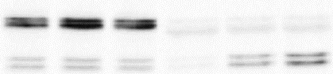
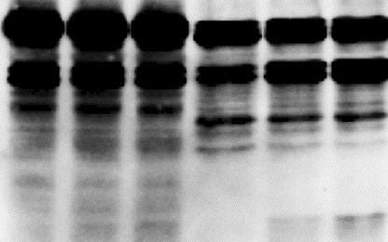
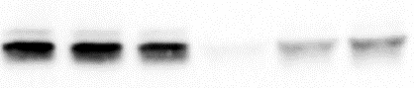
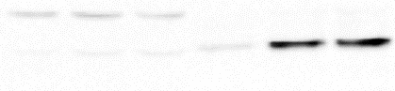
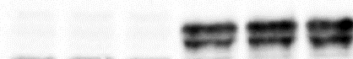
Figure 6
Activated primary T cells
lysate
DISC-IP
M [kDa]
- | 15 | 30 | - | 15 | 30
500 ng/mL CD95L [min]
55/53
procaspase-8 p55/p53 (s. e.)
p43/p41
procaspase-8 p55/p53 (l. e.)
p43/p41
p18
1.3 | 2.6
1.3 | 2.4
p43/p41/CD95
p18/CD95
27
FADD
55
c-FLIP_{L} (s.e.)
p43
c-FLIP_{L} (l.e.)
p43
59/55
procaspase-10 p59/p55
p43
54/45
CD95
42
actin

