Slide 1
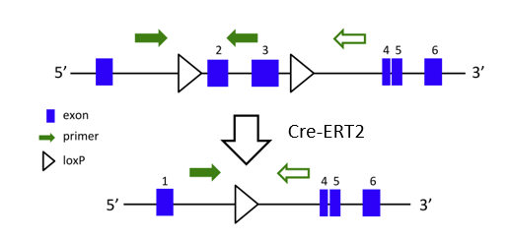
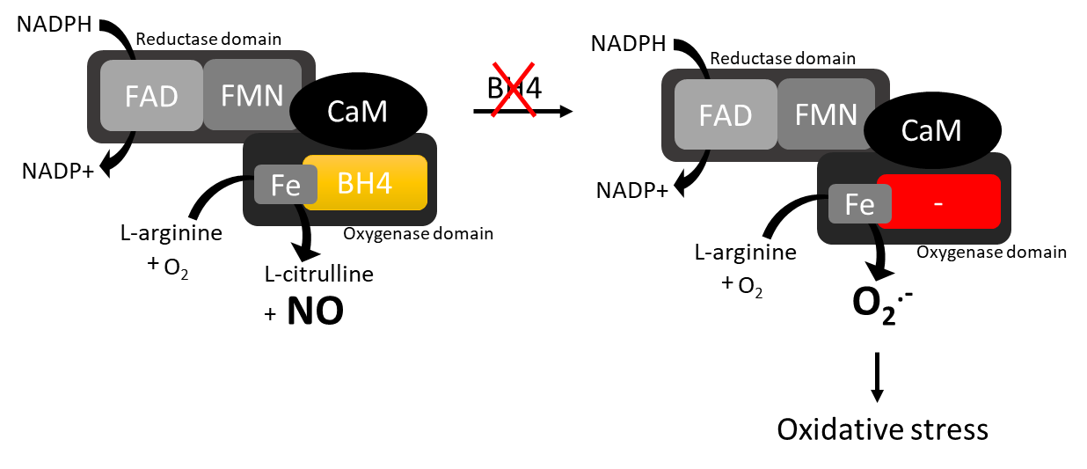
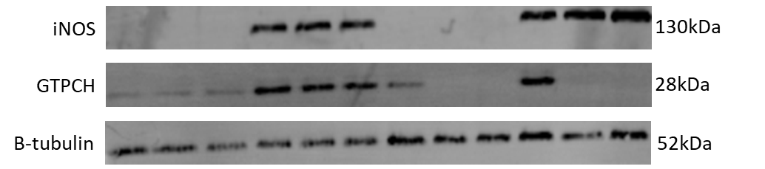
Figure 3.
A
Gch1
B
Nitrite
C
D
GCH^{fl/fl}
R26-CreER^{T2}Gch^{fl/fl}
GCH^{fl/fl}
R26-CreER^{T2}Gch^{fl/fl}
Vehicle
0.1 µM
1.0 µM
Vehicle
0.1 µM
1.0 µM
Vehicle
0.1 µM
1.0 µM
Vehicle
0.1 µM
1.0 µM
Vehicle
0.1 µM
1.0 µM
Vehicle
0.1 µM
1.0 µM
Vehicle
0.1 µM
1.0 µM
Vehicle
0.1 µM
1.0 µM
-
-
-
+
+
+
-
-
-
+
+
+
NTC
-
-
-
+
+
+
-
-
-
+
+
+
LPS/IFNγ
LPS/IFNγ

