Slide 1
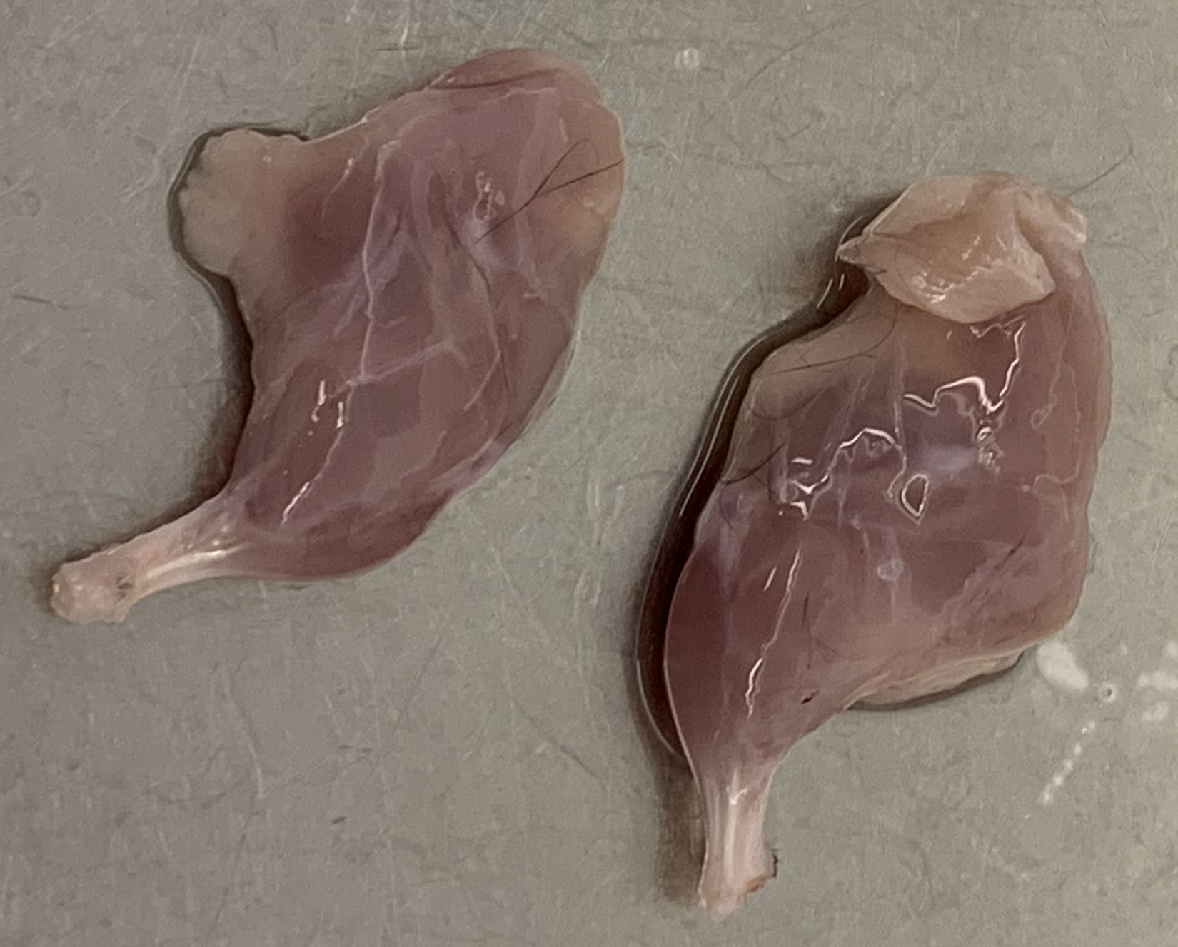
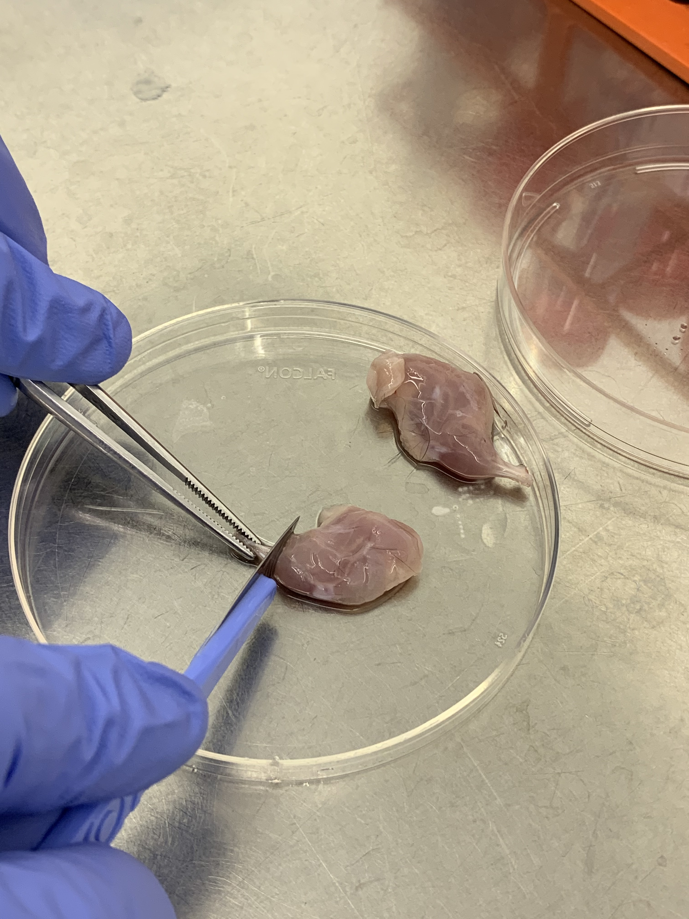
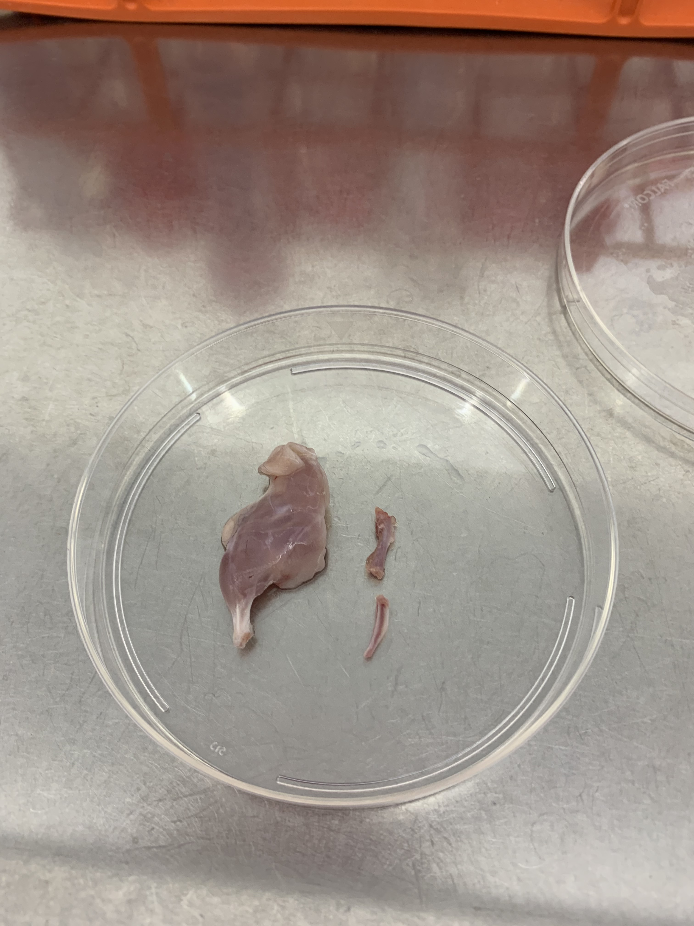
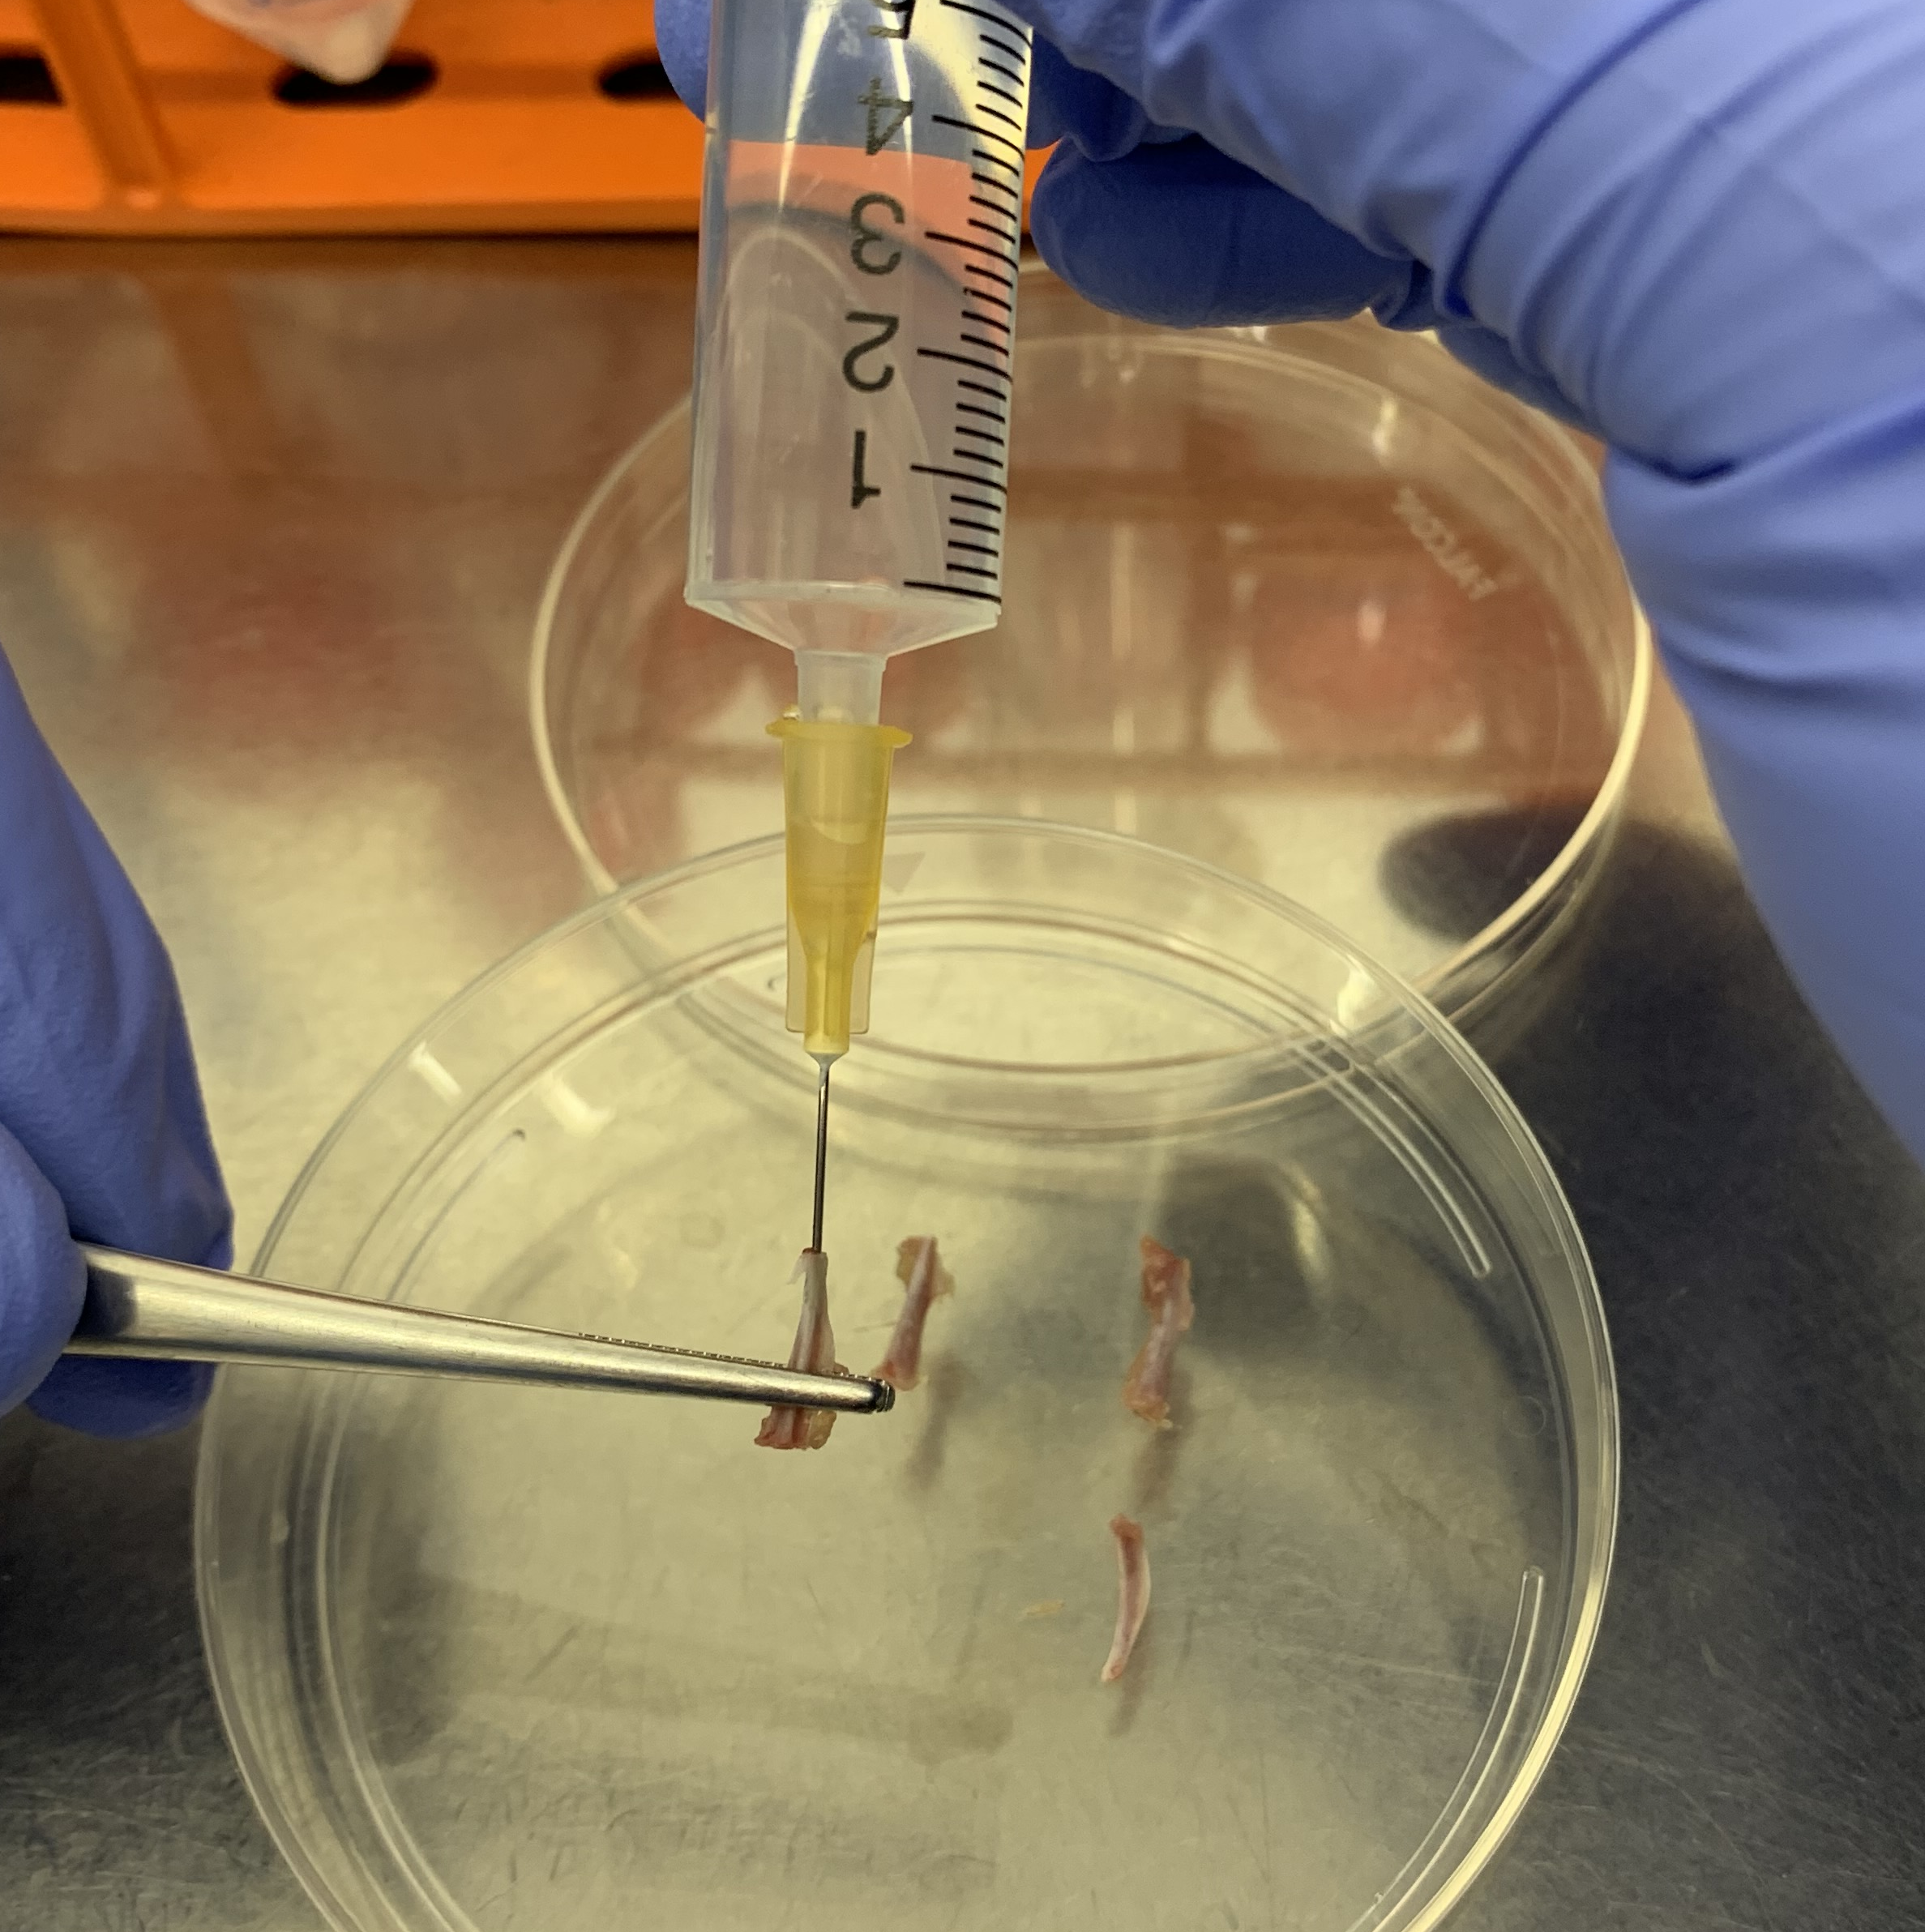
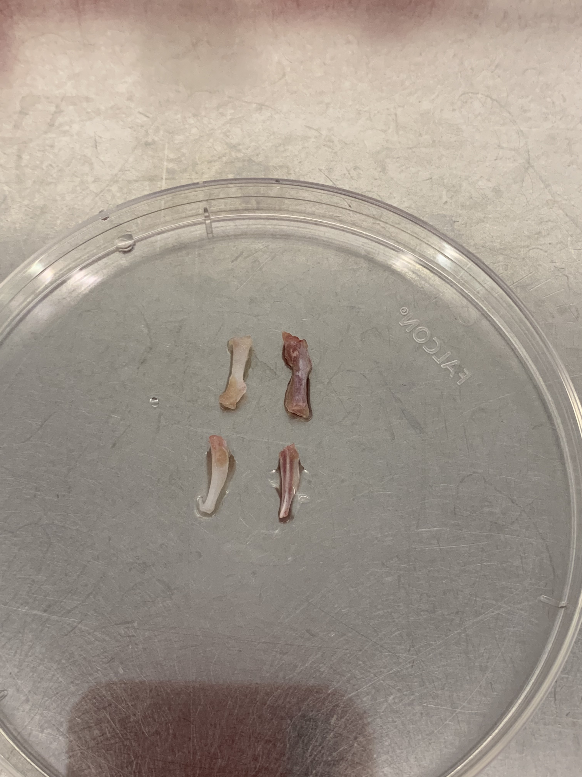
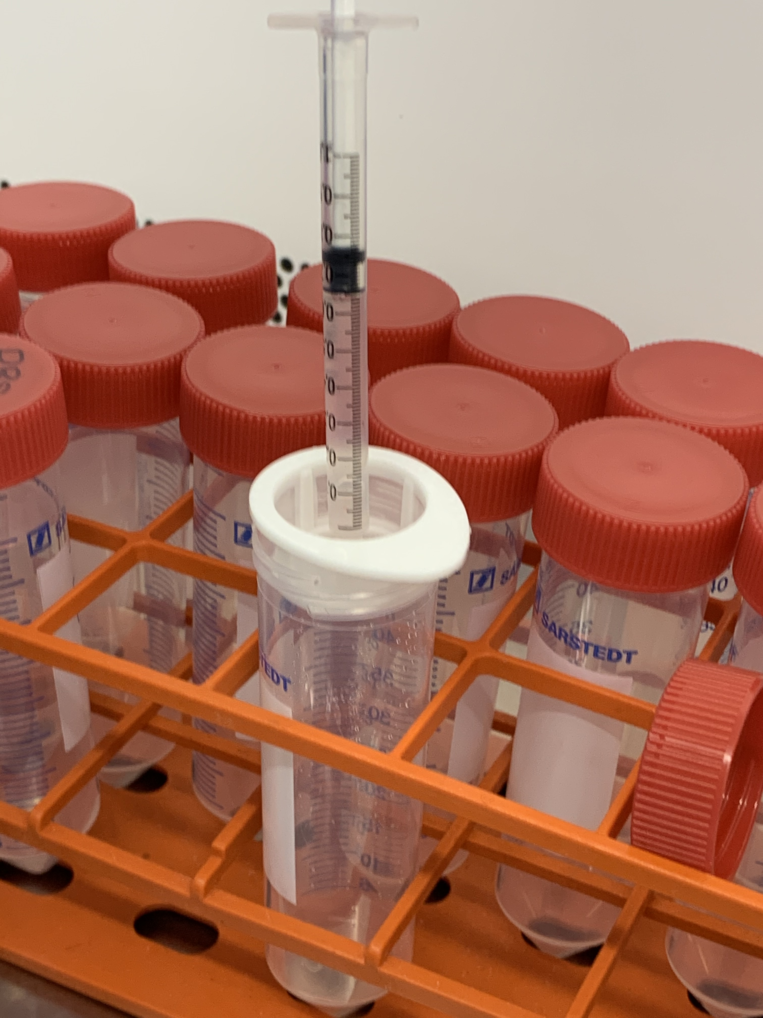
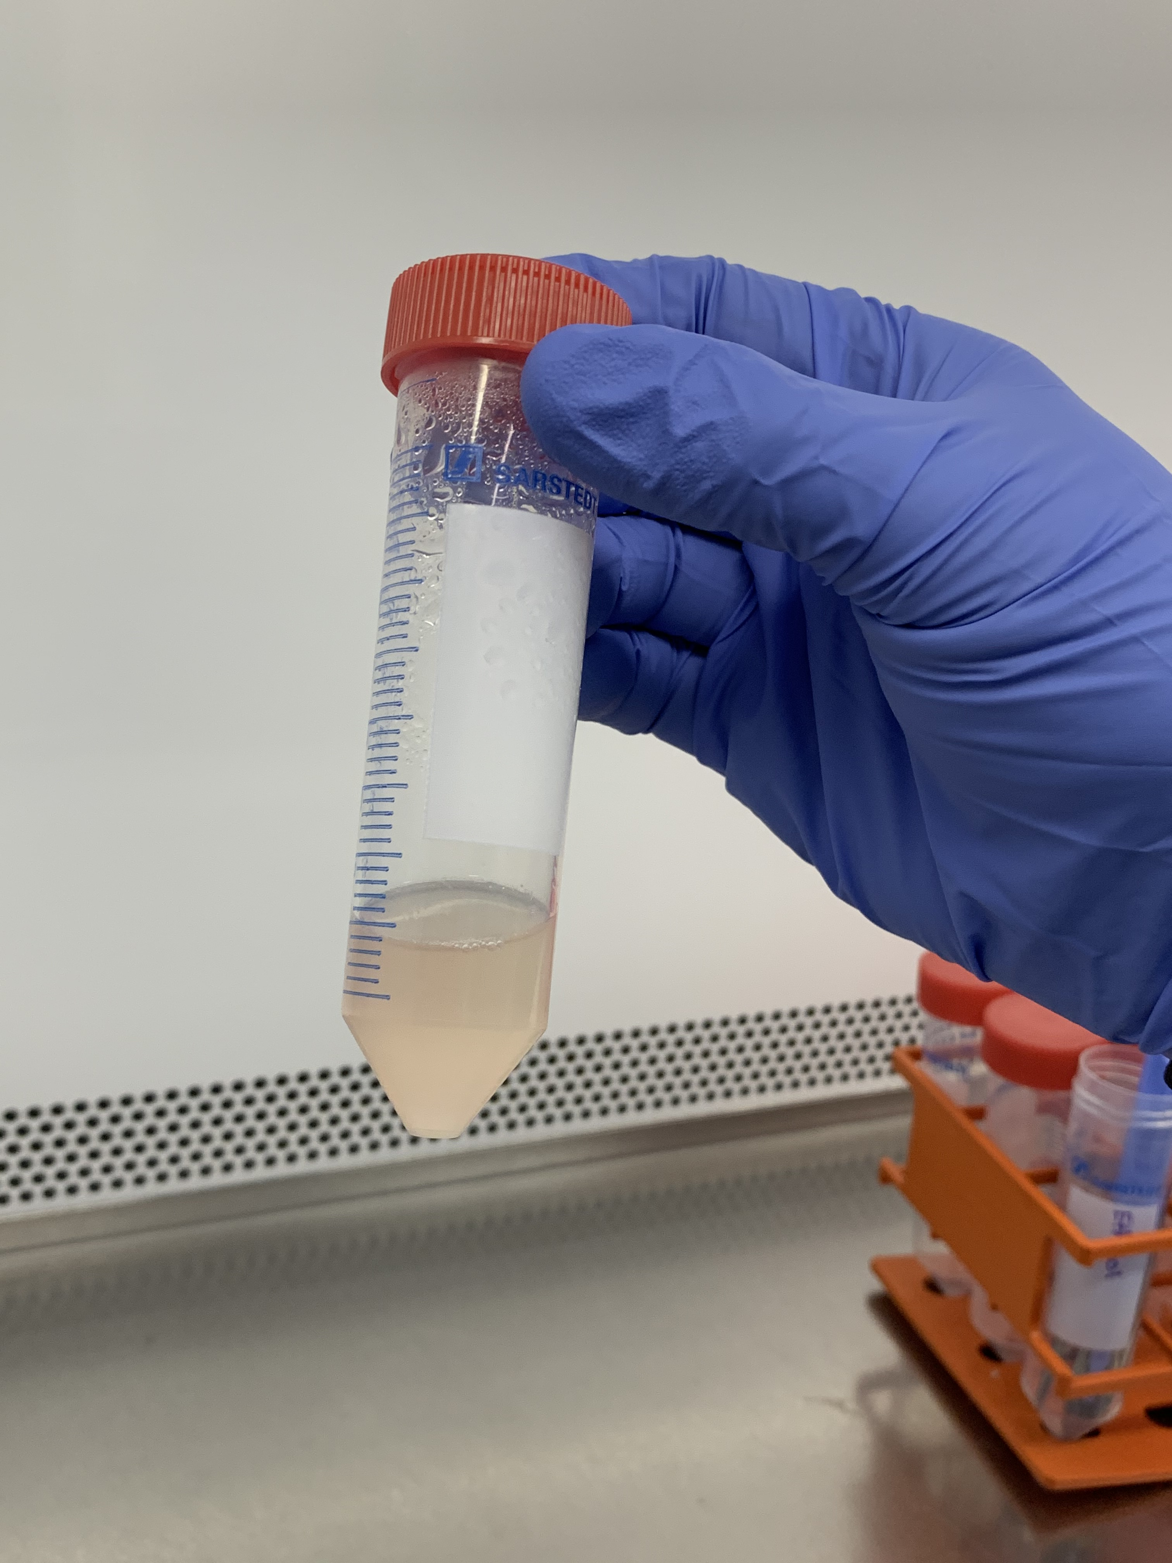
Figure 1
PART 1: Isolation of bone marrow cells
A
B
C
D
E
F
G
⍙
⍙
PART 2: Selection, differentiation and stimulation of BMDMs
+ 25 ng/mL M-CSF
+50 ng/mL GM-CSF
Stimulation: + LPS (100 ng/mL)/IFN(10 ng/mL)
or: + IL-4 (100 ng/mL)
+ 25 ng/mL M-CSF
+ 50 ng/mL M-CSF
+ 50 ng/mL GM-CSF
Media is quickly centrifuged to remove cells debris and frozen for further analysis (cytokines, Griess assay)
Cells are harvested in cold PBS, pelleted by gentle centrifugation and frozen down for further analysis (WB, PCR, HPLC metabolites)
Leave stimulation overnight
Day 0
Day 5
Day 6
Day 7
Cells are defrosted and seeded according to the table in 5% FBS DMEM:F12 and left at 37 °C
Cells are fed by adding 50% of the original volume of 5% DMEM:F12
Remove media
Wash with warm PBS
Replace with 2% FBS DMEM:F12

