Slide 1
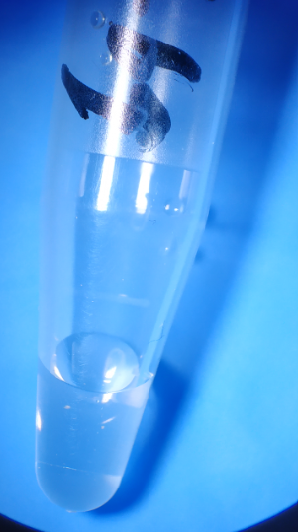
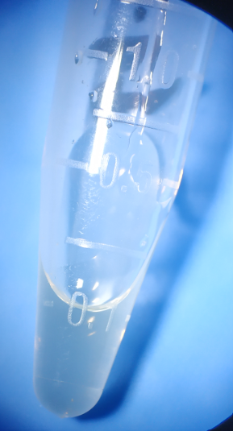
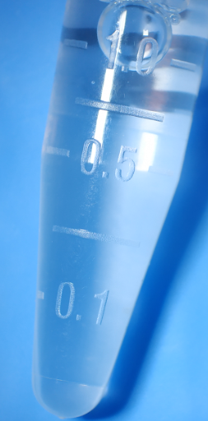
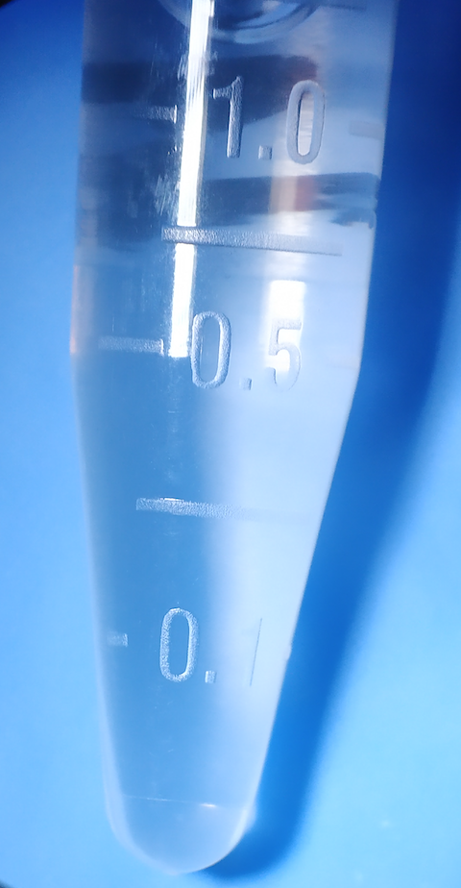
Figure 3
A
B
C
D
Nar+DMSO
(57.2 mg/mL)
Nar+DMSO+Tween 80
(28.6 mg/mL)
Nar+3.52% DMSO+ 3.52% Tween 80 + 92.96% PS
(Spin down)
Nar+3.52% DMSO+ 3.52% Tween 80 + 92.96% PS
1 cm
1 cm
1 cm
1 cm
Nar: Naringenin

