Slide 1
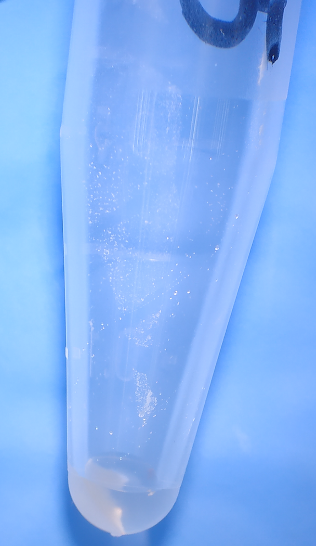
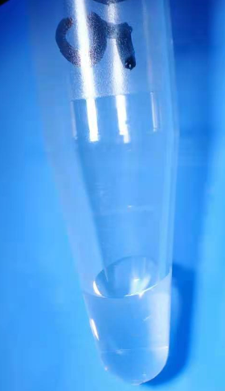
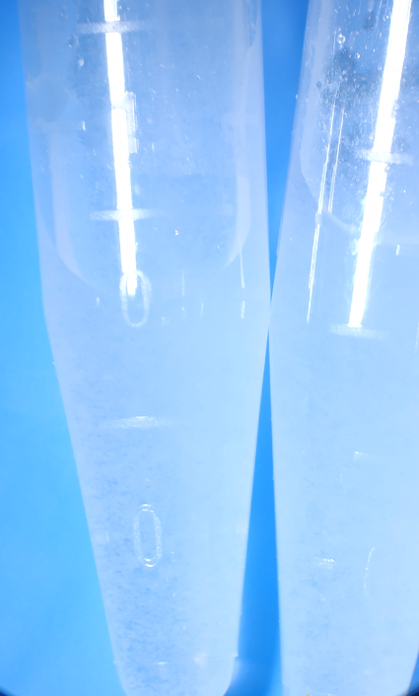
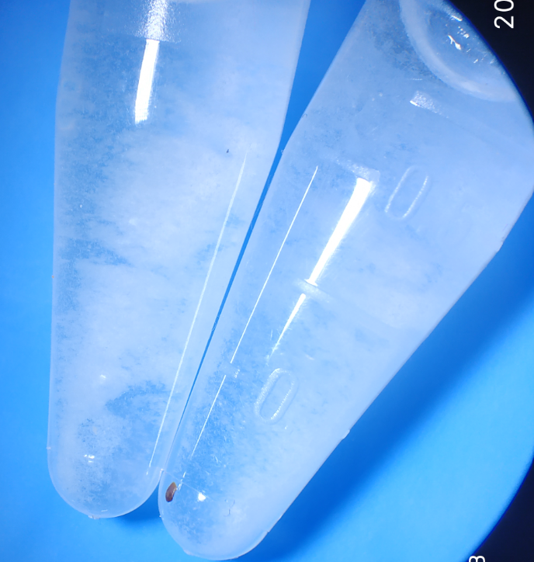
Figure 2
A
B
C
D
Nar+DMSO
(400 mg/mL)
Nar+DMSO
(40 mg/mL)
Nar+5% DMSO+95% PS
(Spin down)
Nar+5% DMSO+95% PS
1 cm
1 cm
1 cm
1 cm
Nar: Naringenin

