Slide 1
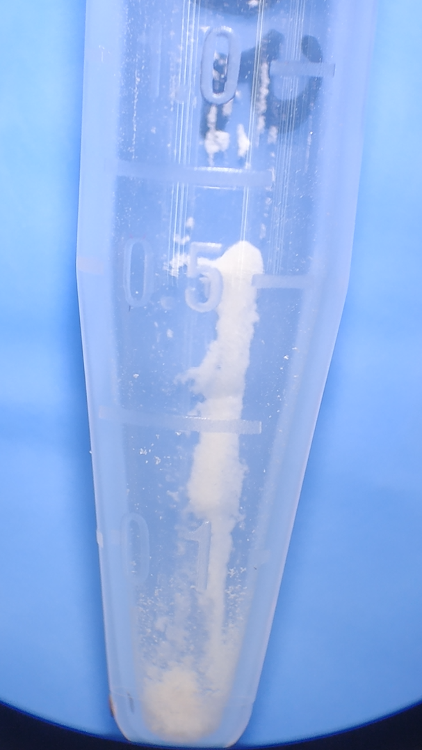
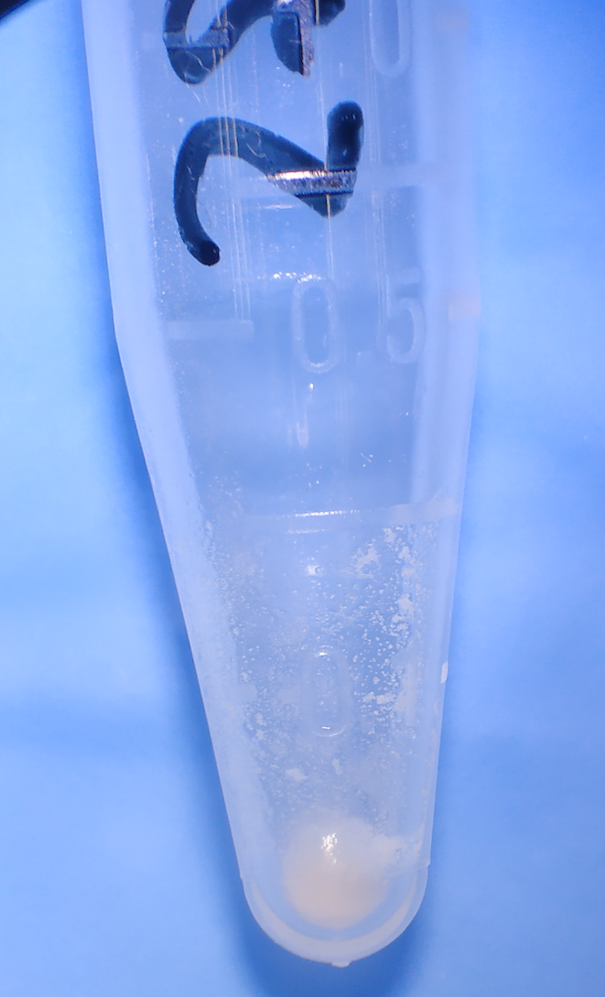
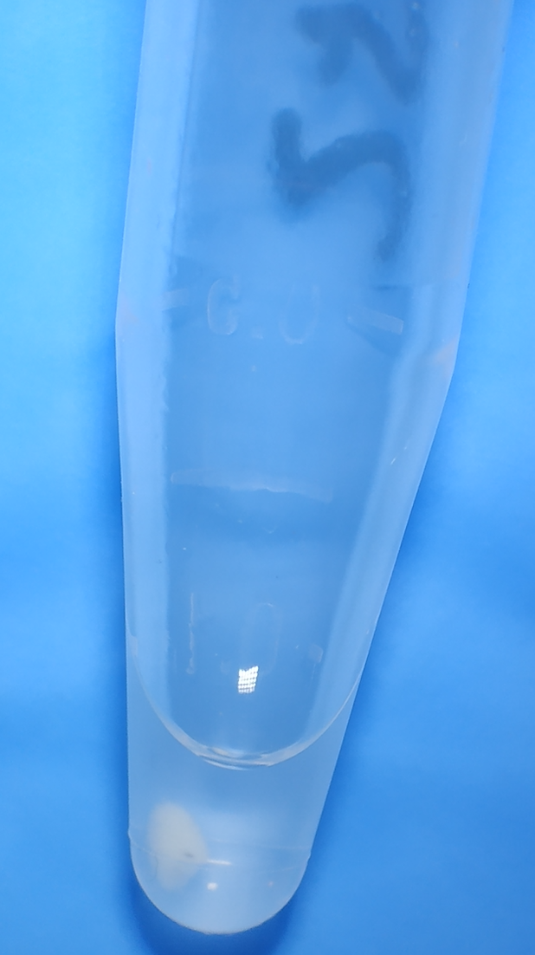
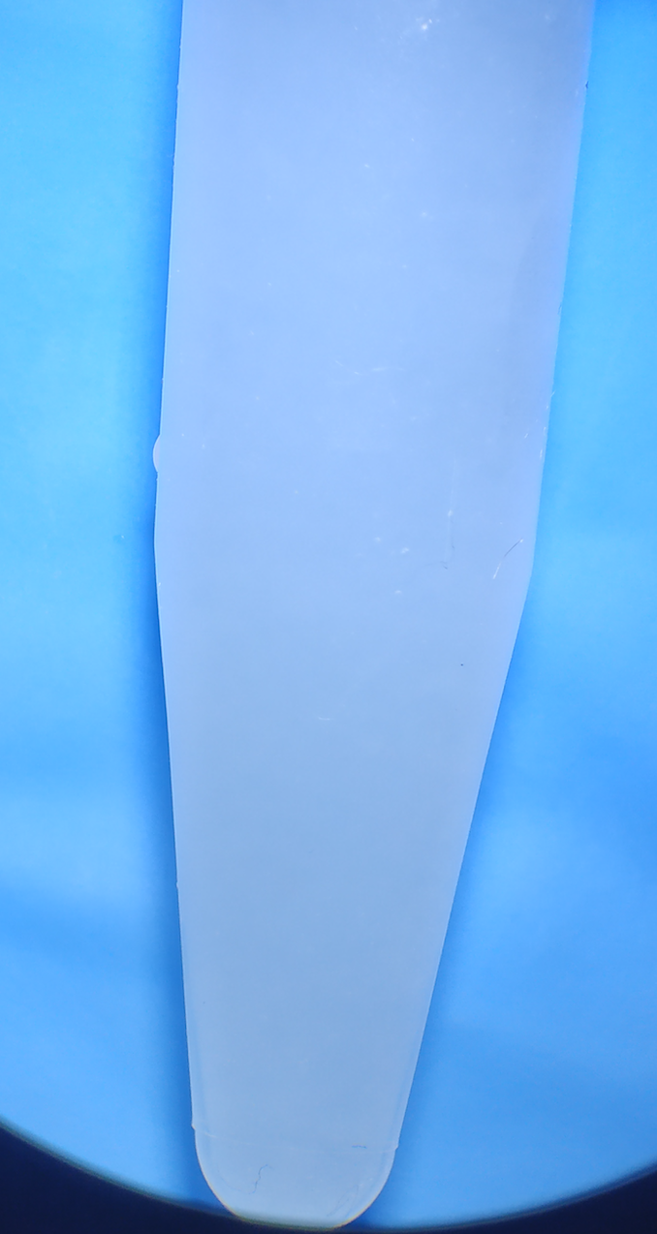
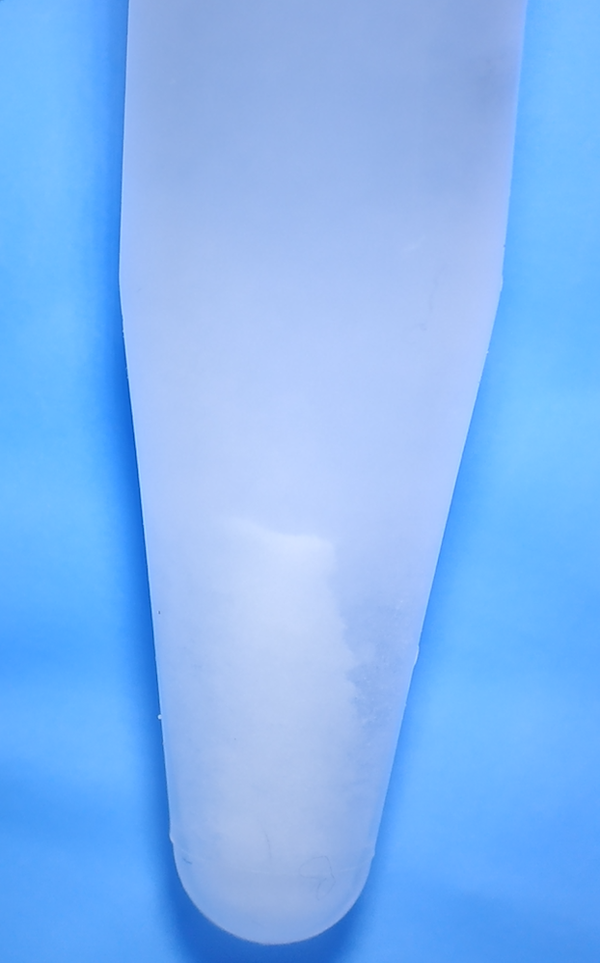
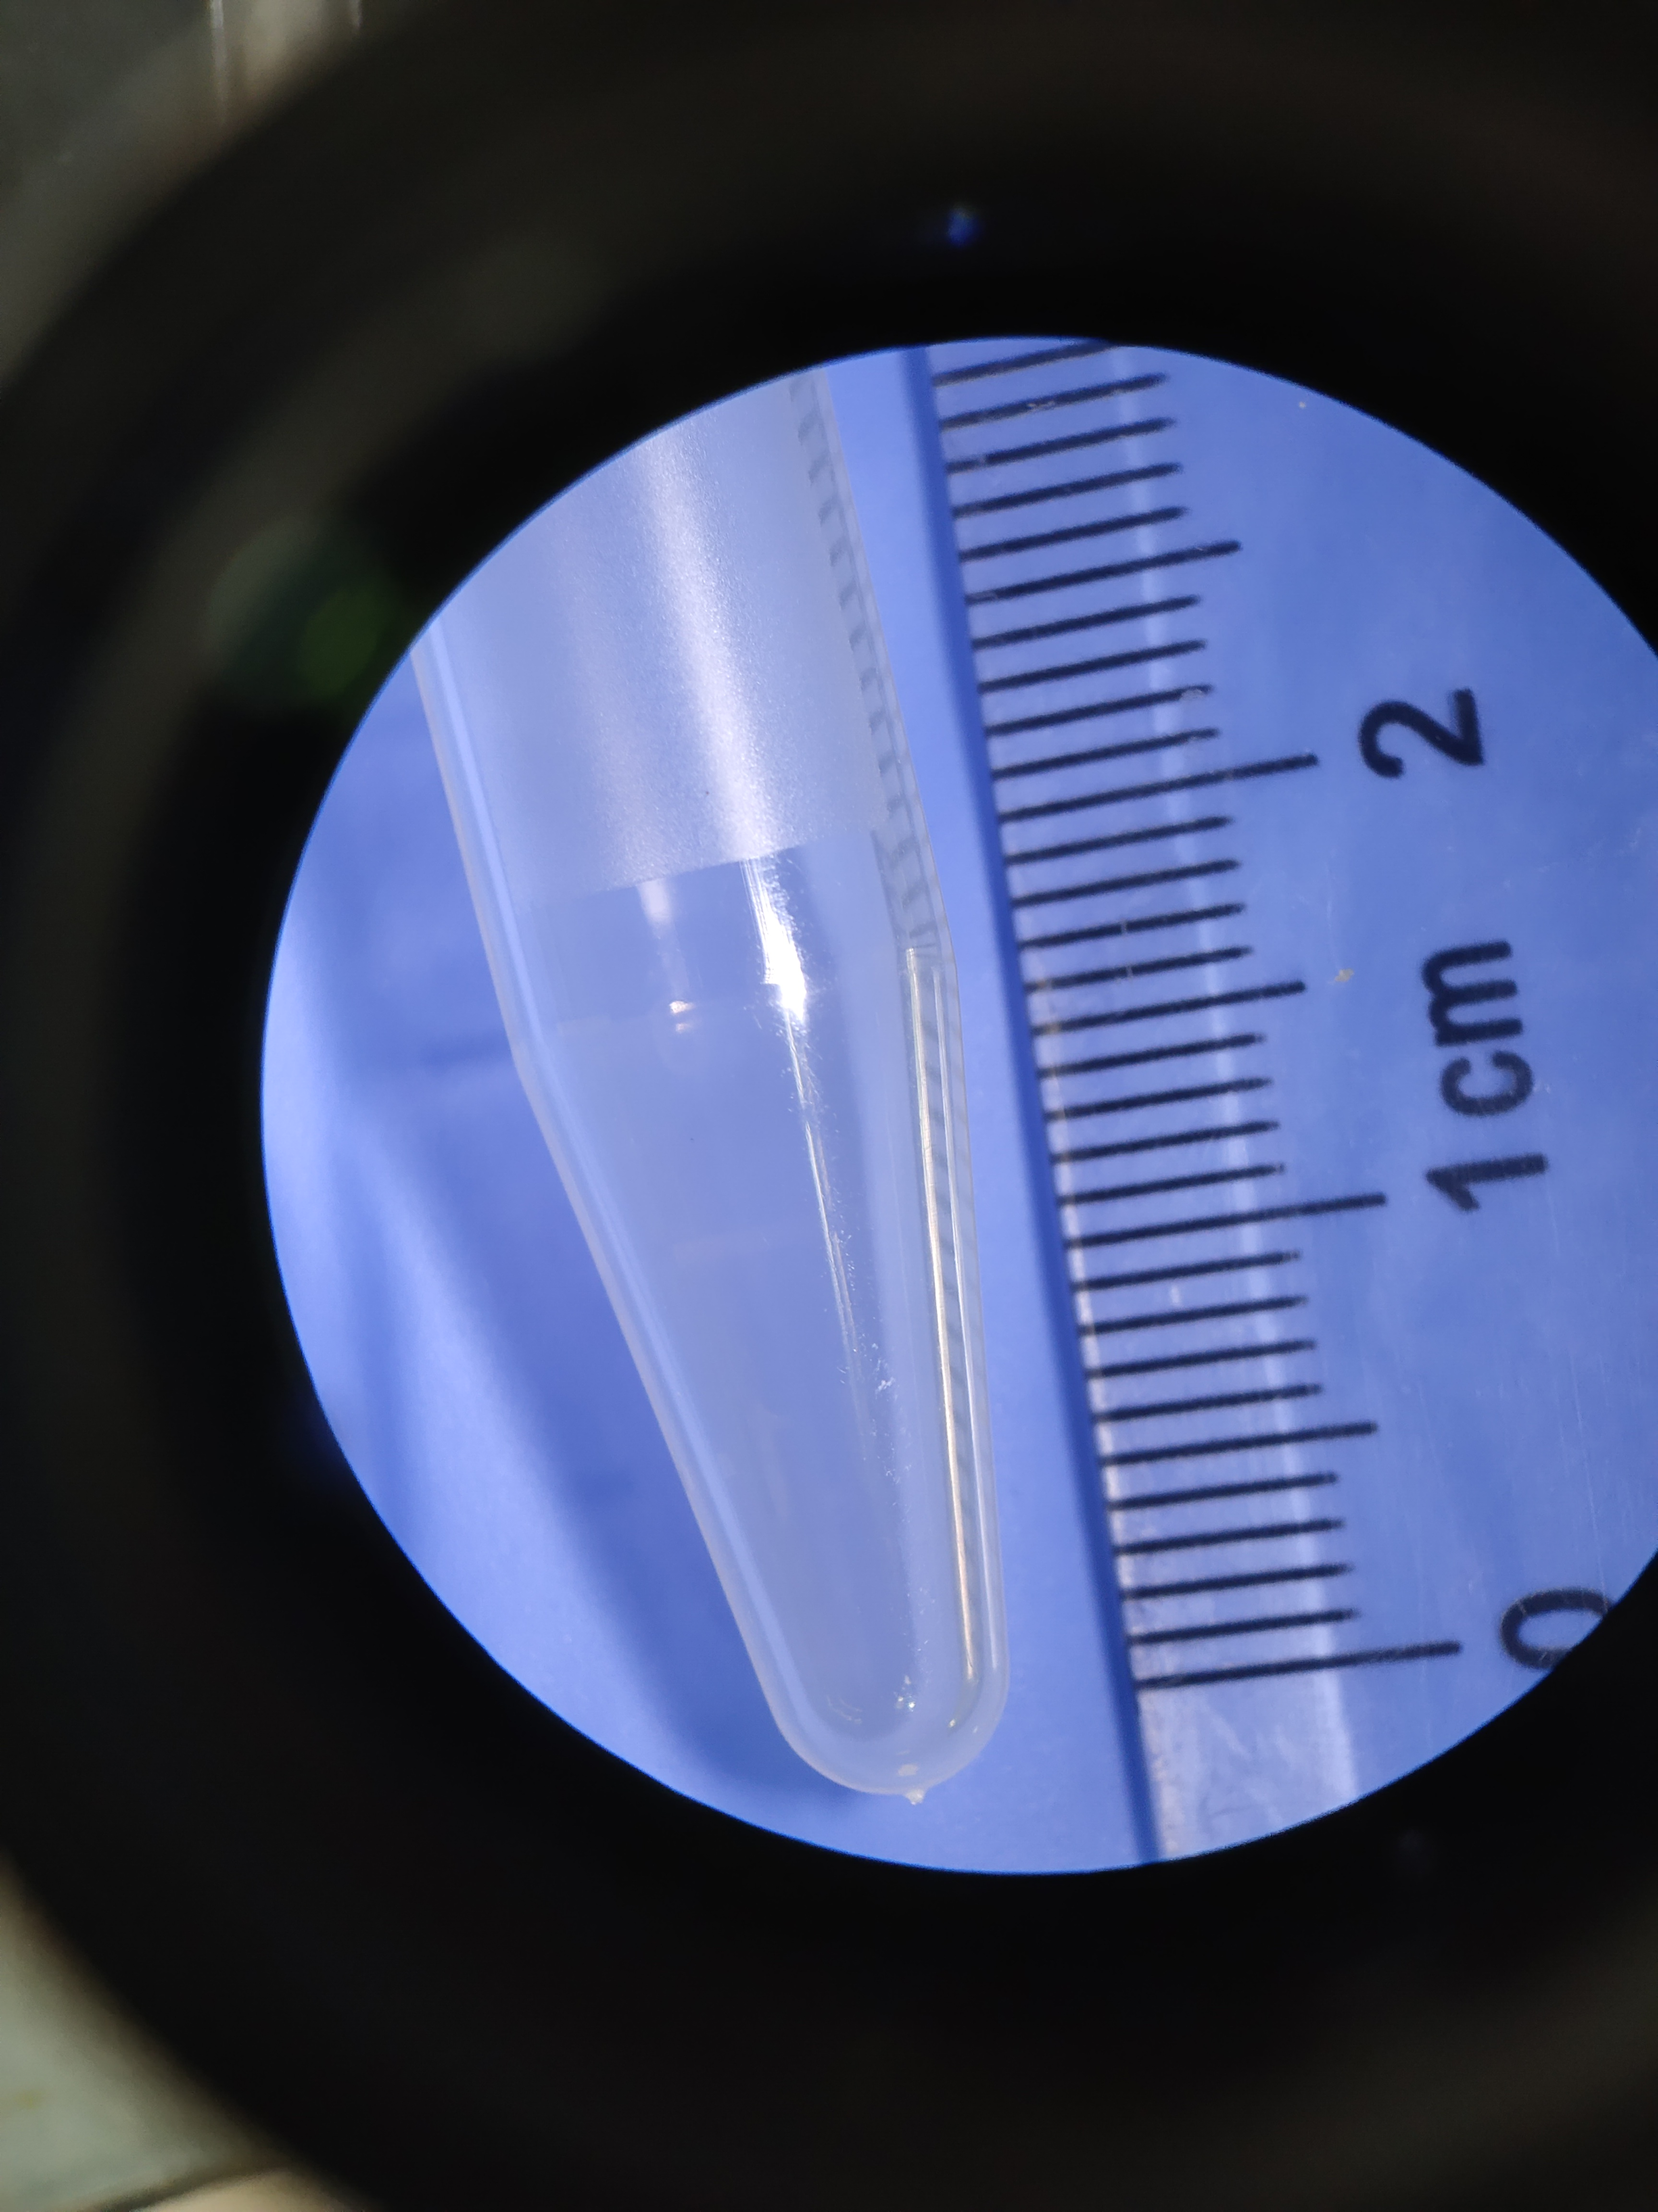
Figure 1
A
B
C
Nar
Nar+ethanol (400 mg/mL)
Nar+ethanol
(40 mg/mL)
1 cm
1 cm
1 cm
D
E
F
Nar+5% ethanol+95% PS
(Spin down)
Nar+5% ethanol+95% PS
1 cm
1 cm
1 cm
Nar: Naringenin

