Slide 1
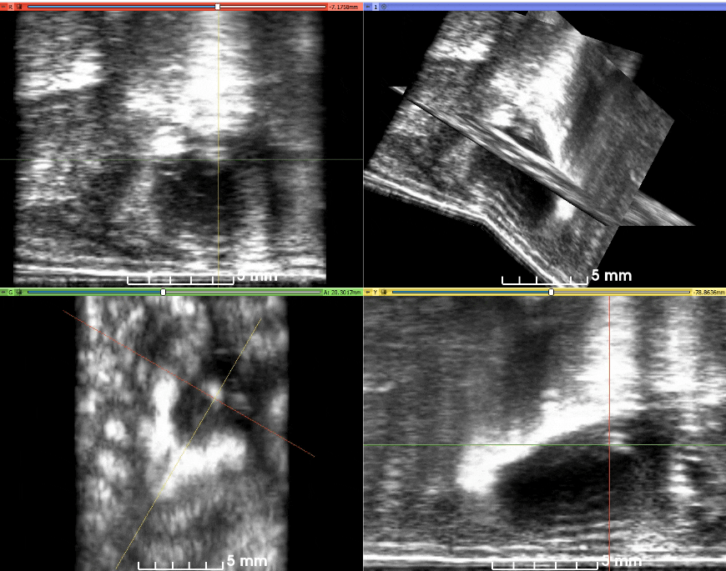
Aortic Valve
Supplemental Figure 1

