Slide 1
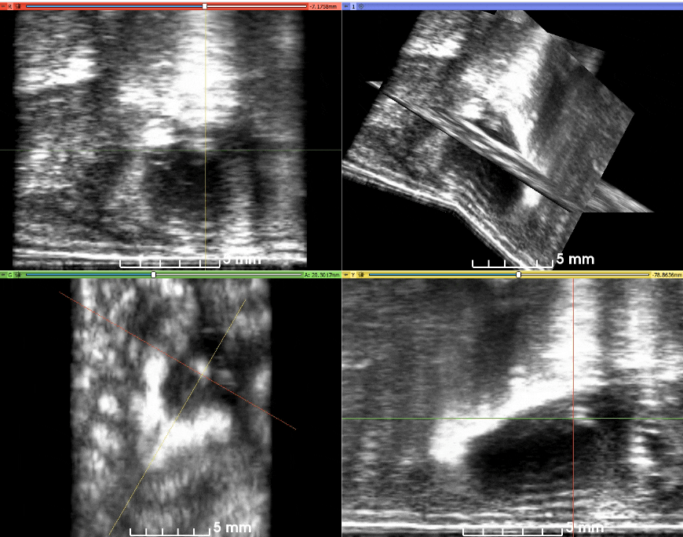
Aortic Valve
Supplemental Figure 1

Slide 2
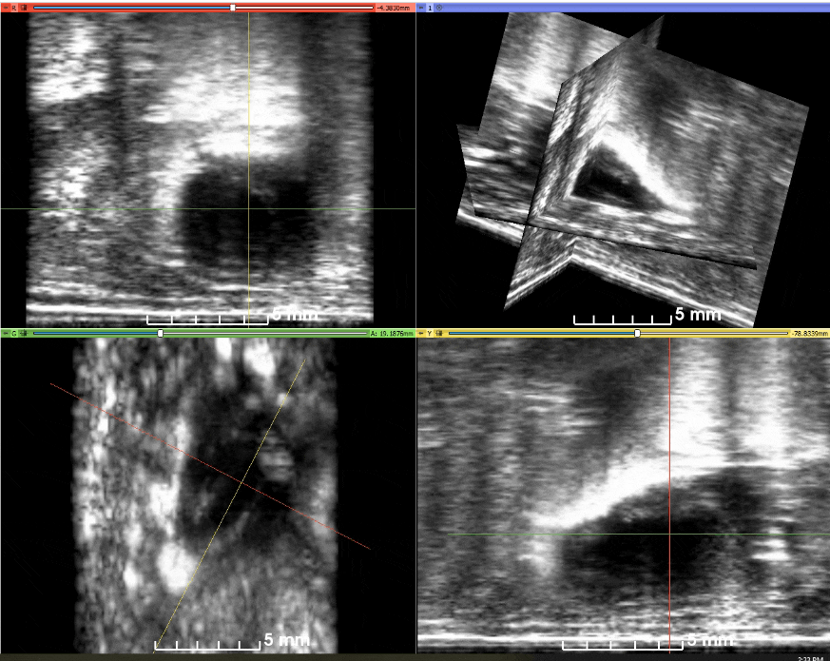
Aortic Arch
Supplemental Figure 2

