Slide 1
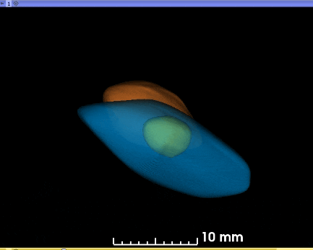
Figure 5
Notes:
Animated 3D reconstruction of segmented kidneys and cyst.

