Slide 1
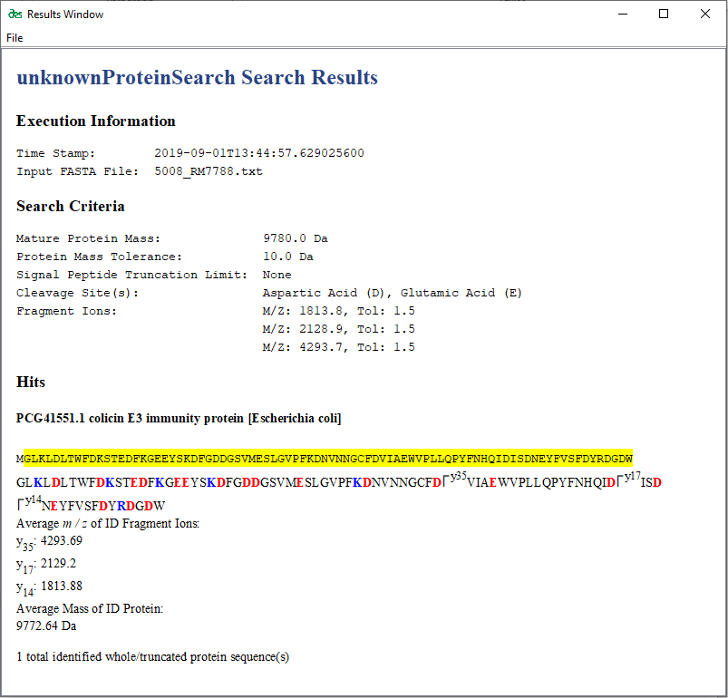
Figure 2
Execution information will be presented here.
Reading 5008_RM7788.txt
-------
SEARCH CRITERIA
-------
Protein Biomarker Mass Window:
From 9770.0 to 9790.0 Da
Searching for these 3 fragment ions:
M/Z: 1813.8, Tol: 1.5
M/Z: 2128.9, Tol: 1.5
M/Z: 4293.7, Tol: 1.5
3 fragment ions must be matched
-------
SEARCH RESULTS
-------
Searched entries:
5008
Time elapsed:
3 second(s)
Protein sequences and/or truncated protein sequences that met the Protein Biomarker
Mass condition:
189490
Protein sequences and/or truncated protein sequences that met the fragment ion
condition:
1

