Slide 1
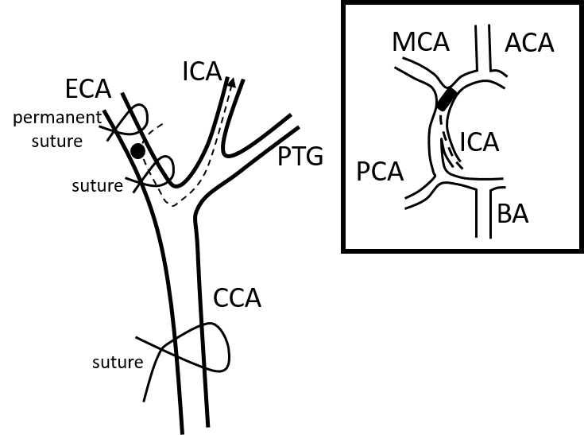
Figure 1

Slide 2
Figure 2

Slide 3
Figure 3
A
B
C

Slide 4
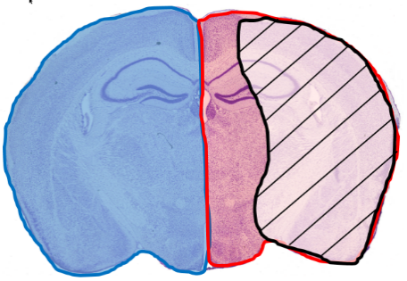
Figure 4
A
B
C

