Slide 1
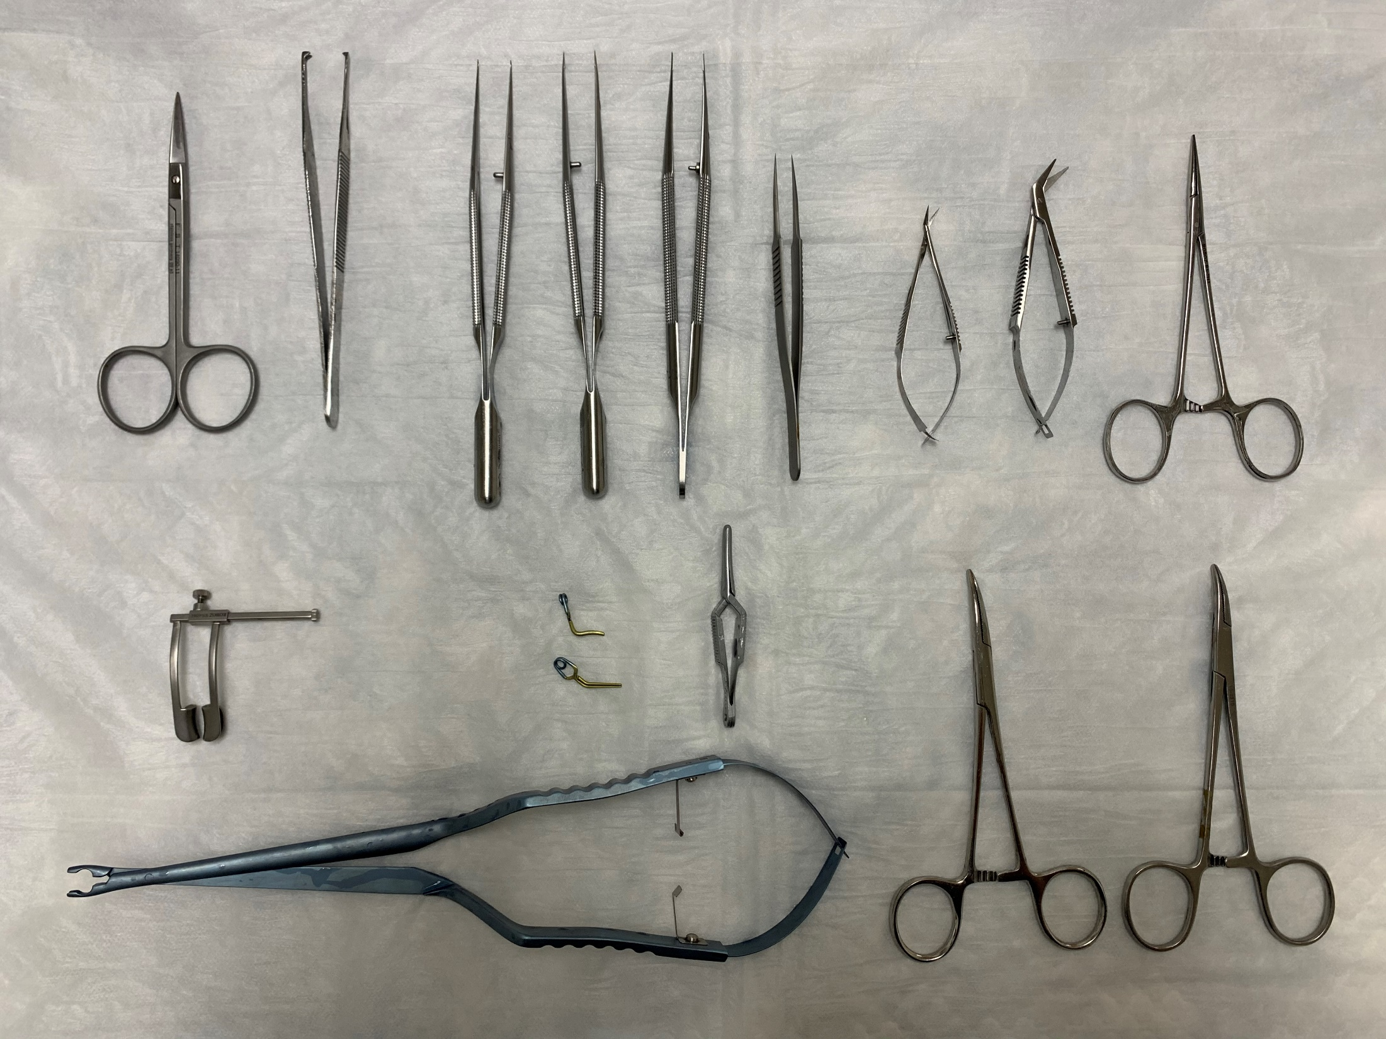
Figure 1.
A
B
C
D
E
F
G
H
J
K
L
M
N

Slide 2
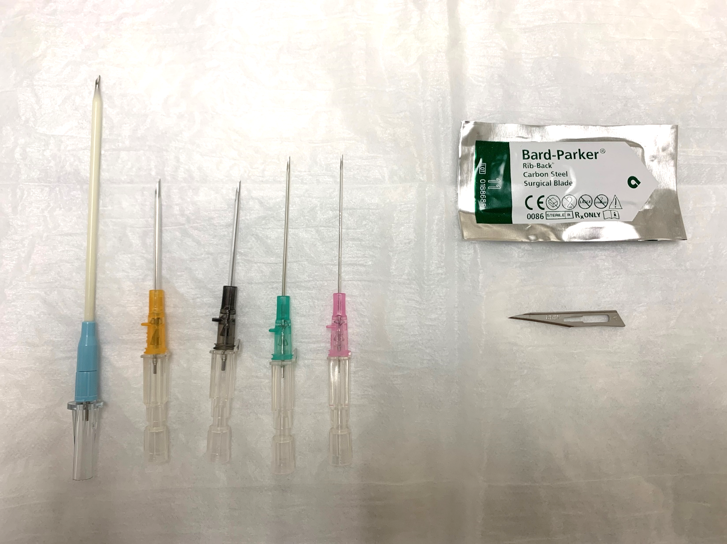
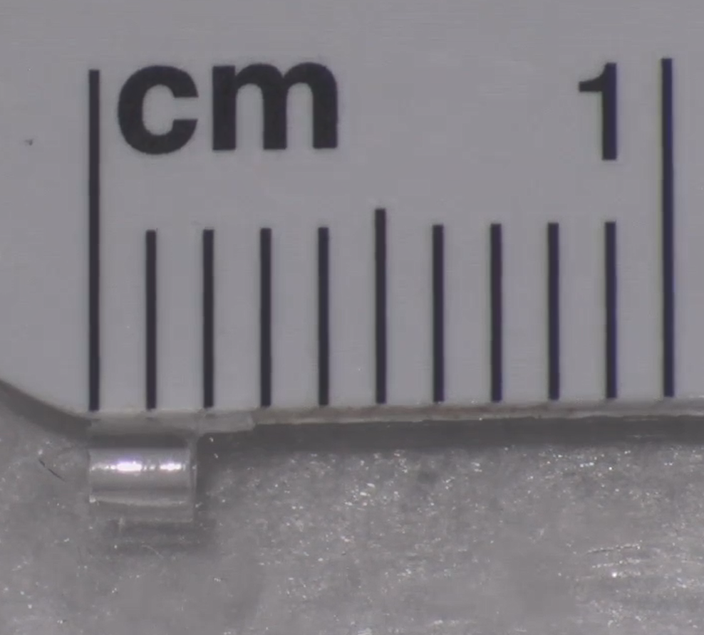
Figure 2.
A
B
C
D
E
G
F
Cuff tab 1 mm
Cuff body 2 mm

Slide 3
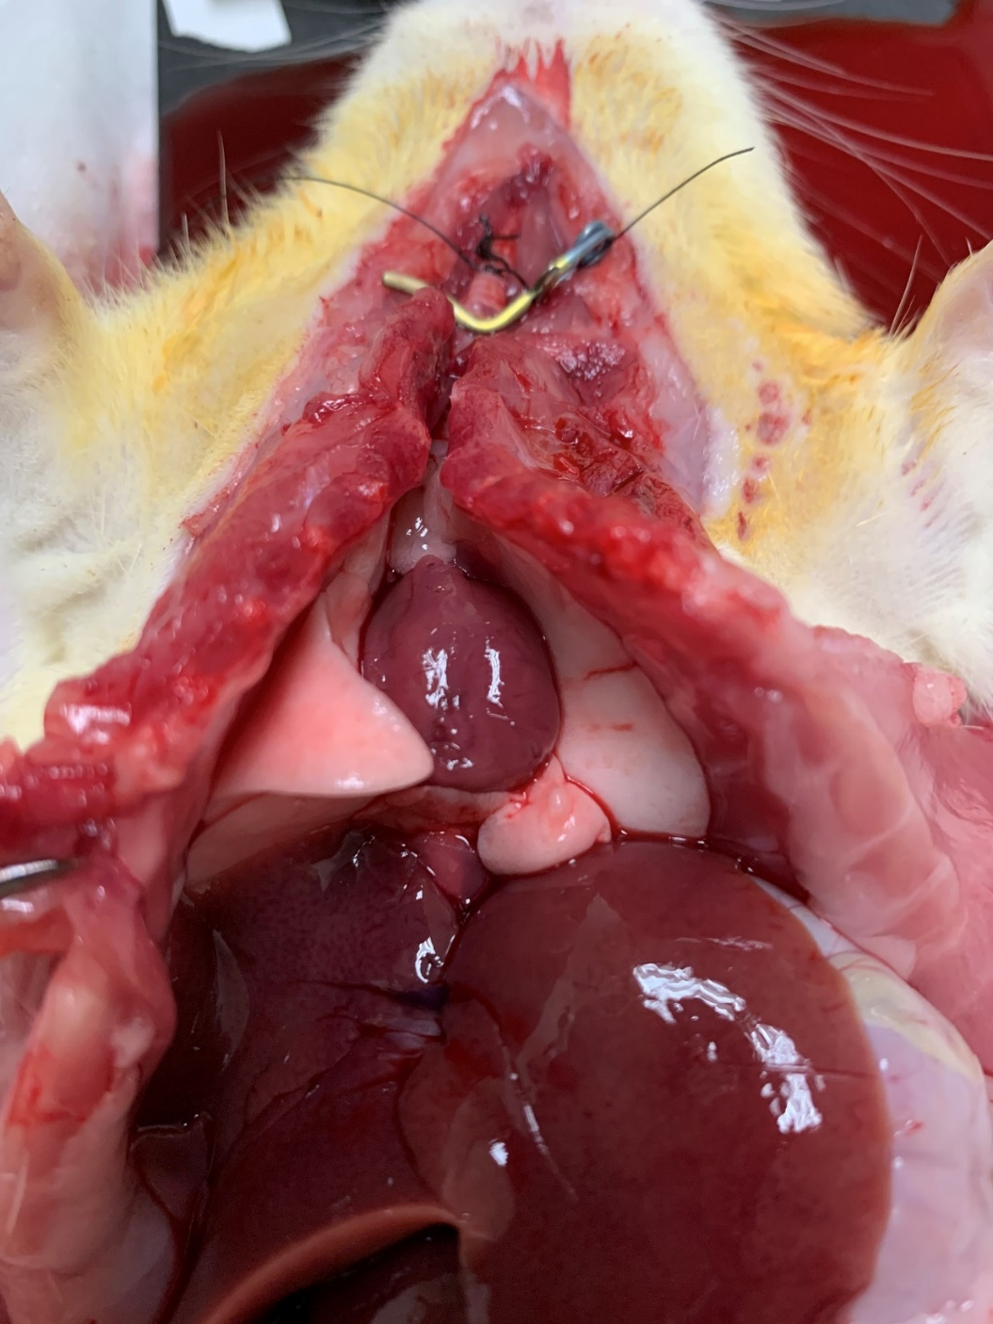
Figure 3.

Slide 4
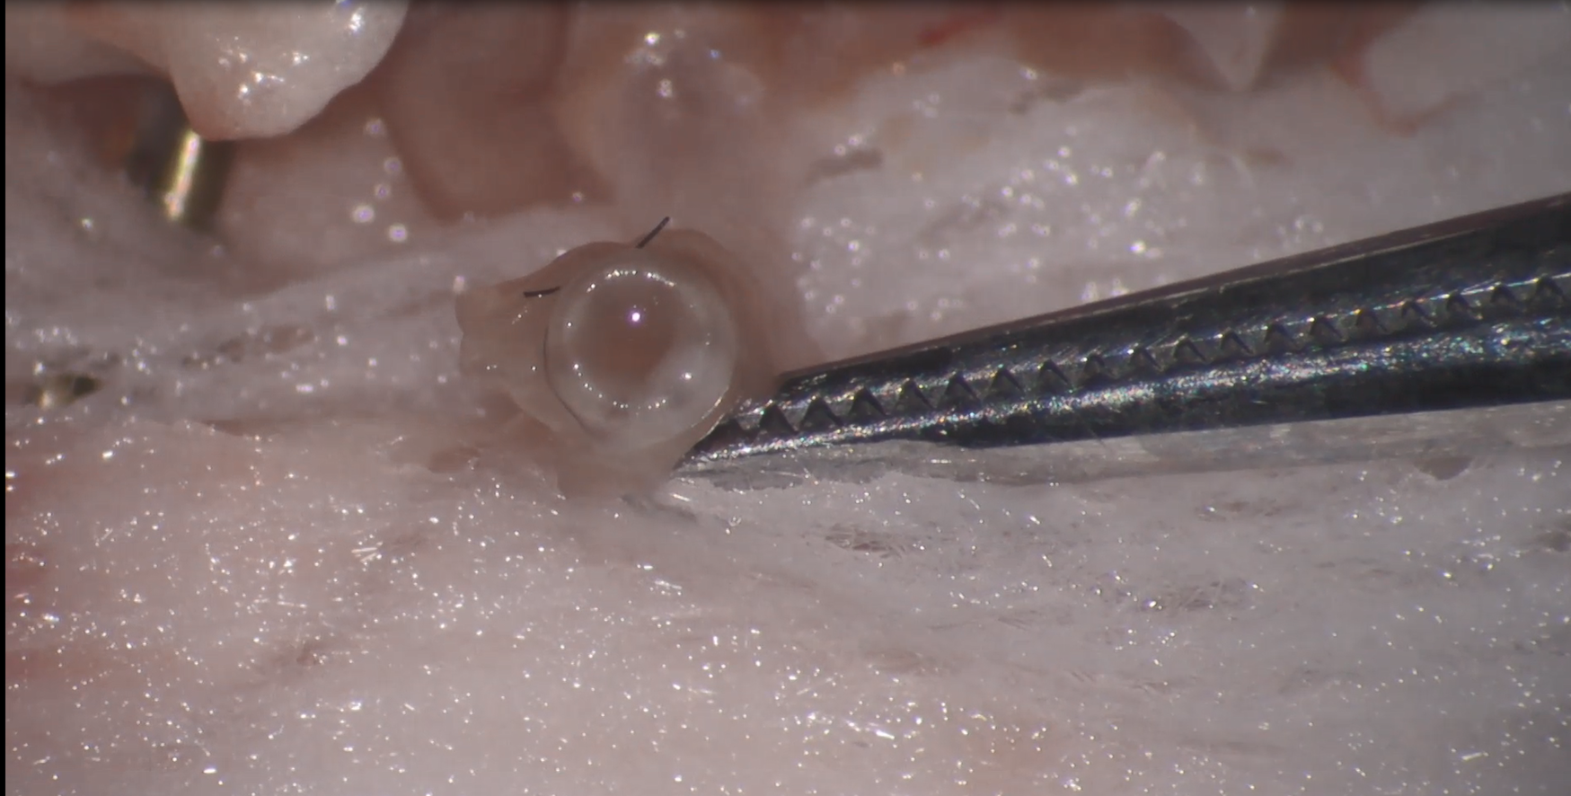
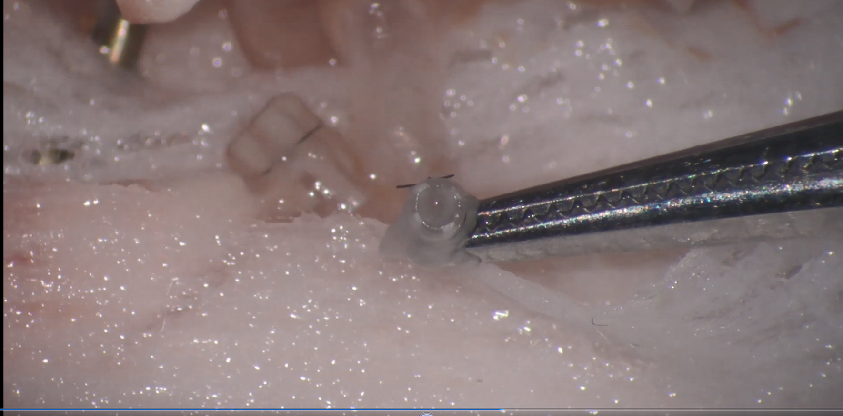
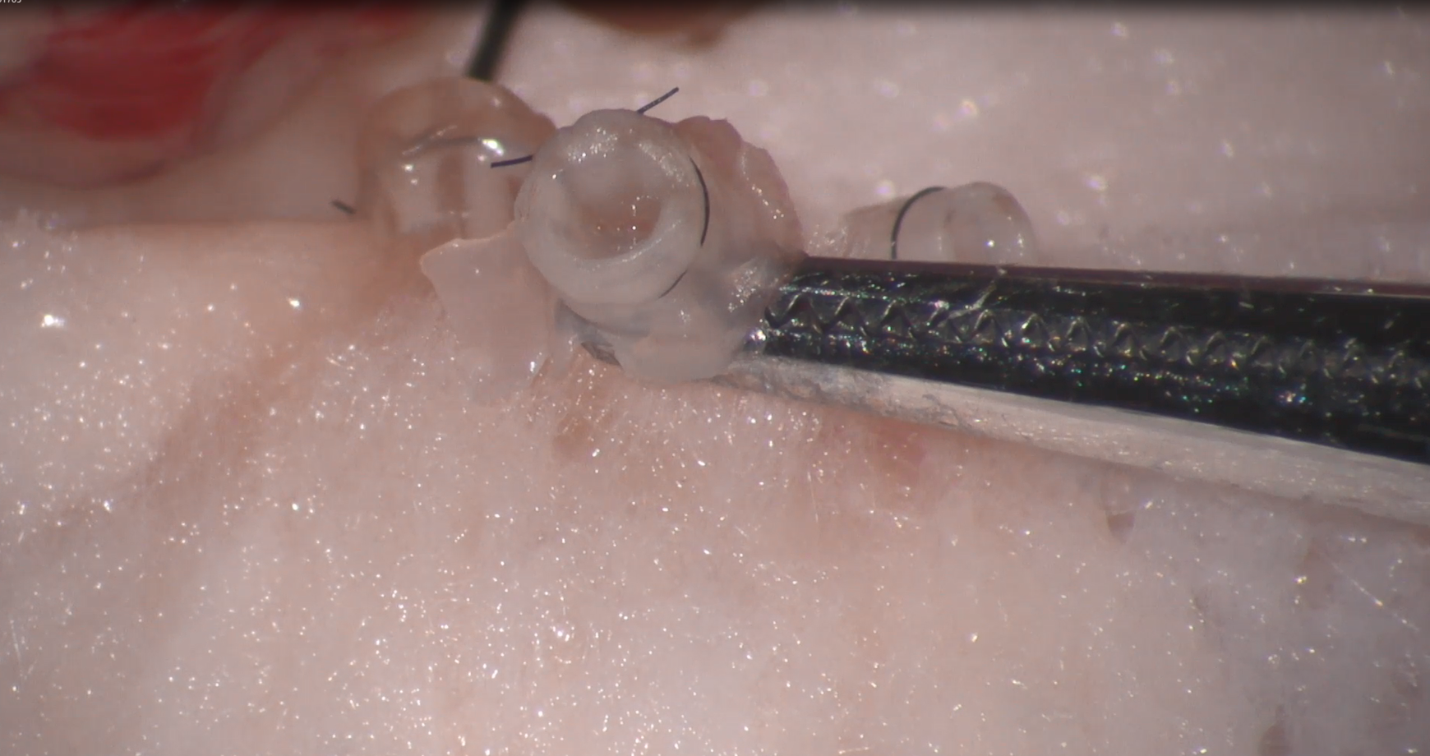
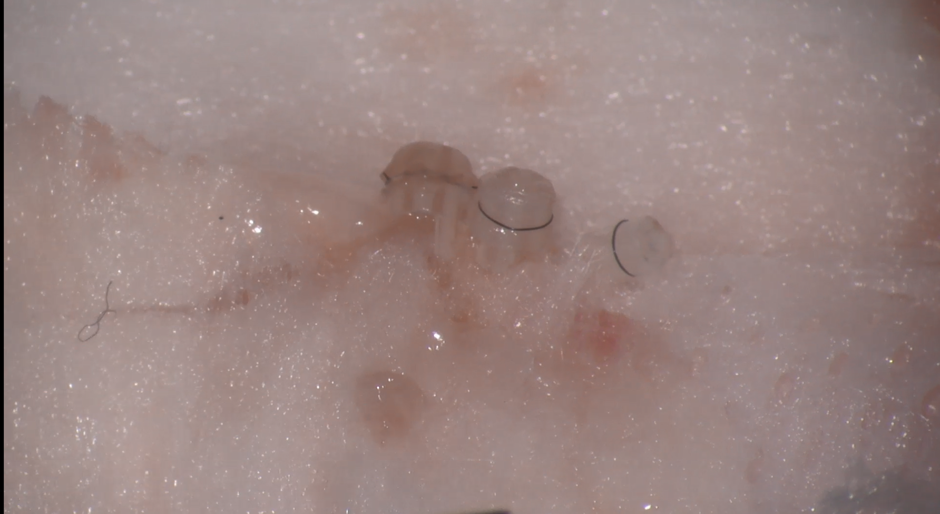
Figure 4.
A
B
PV
PV
PA
C
D
Br
PV
PA
PV
Br
PA

Slide 5
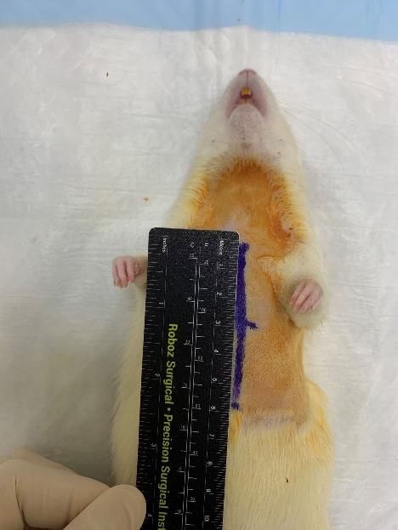
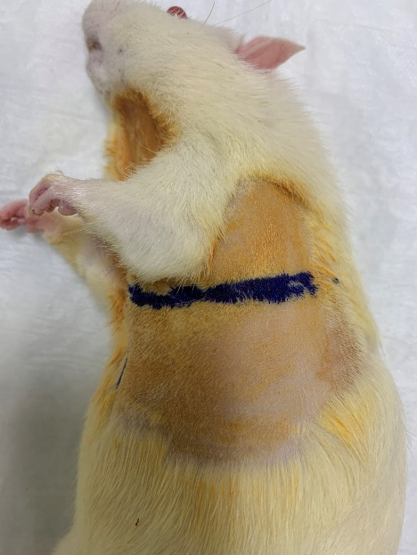
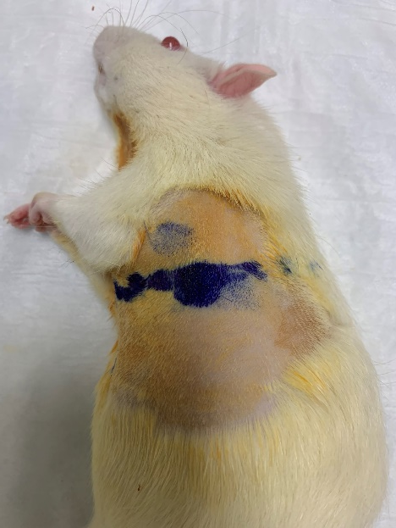
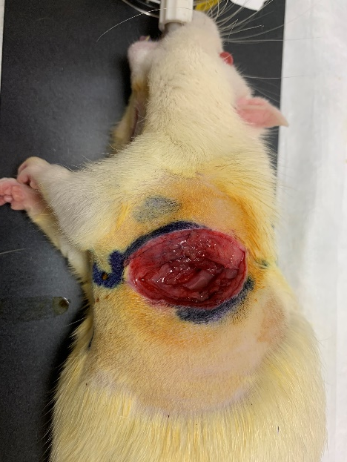
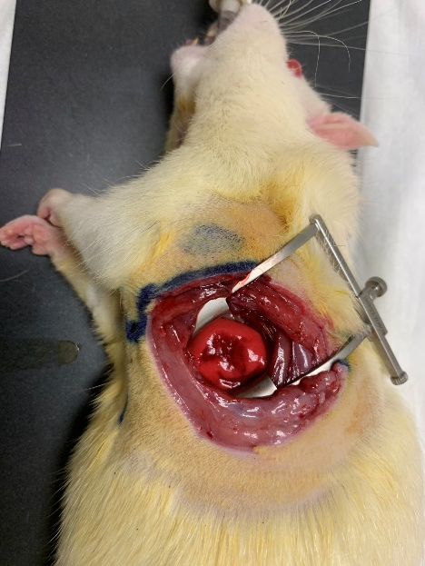
Figure 5.
A
B
C
D
E

Slide 6
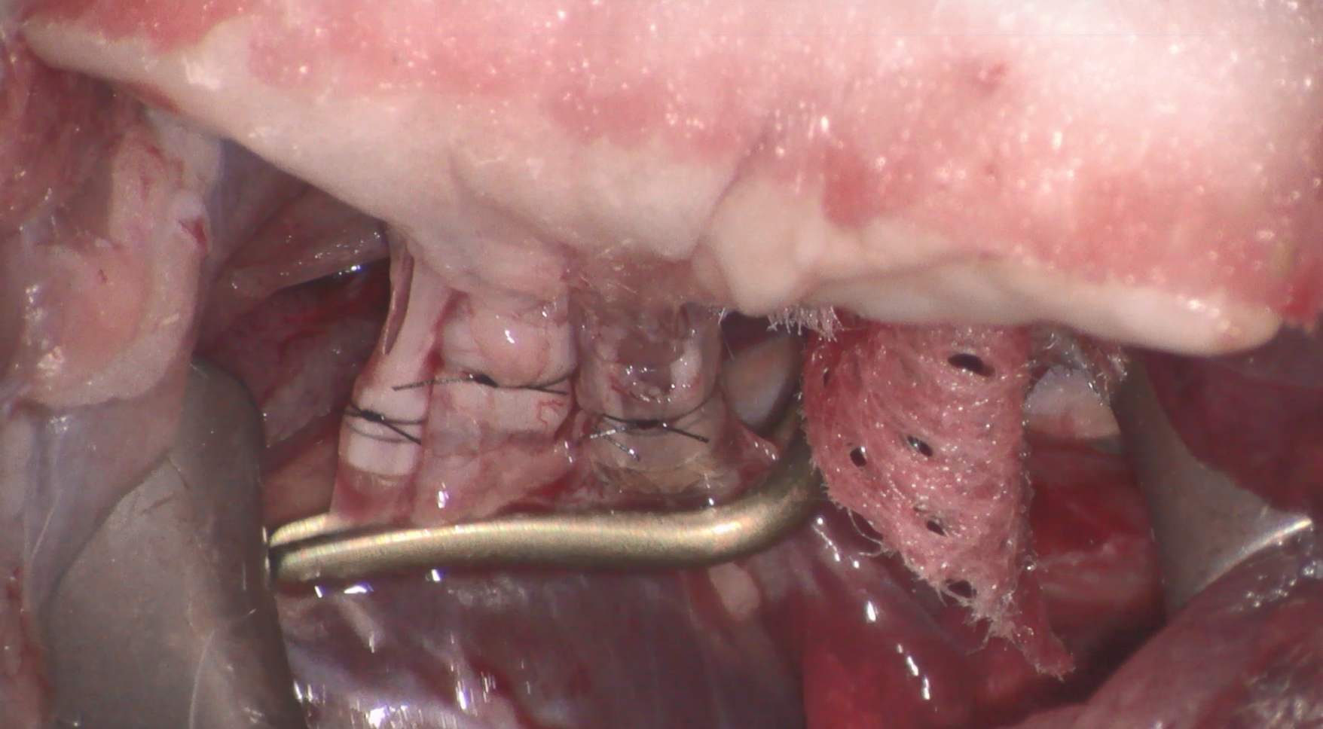
Figure 6.
Br
PA
PV

Slide 7
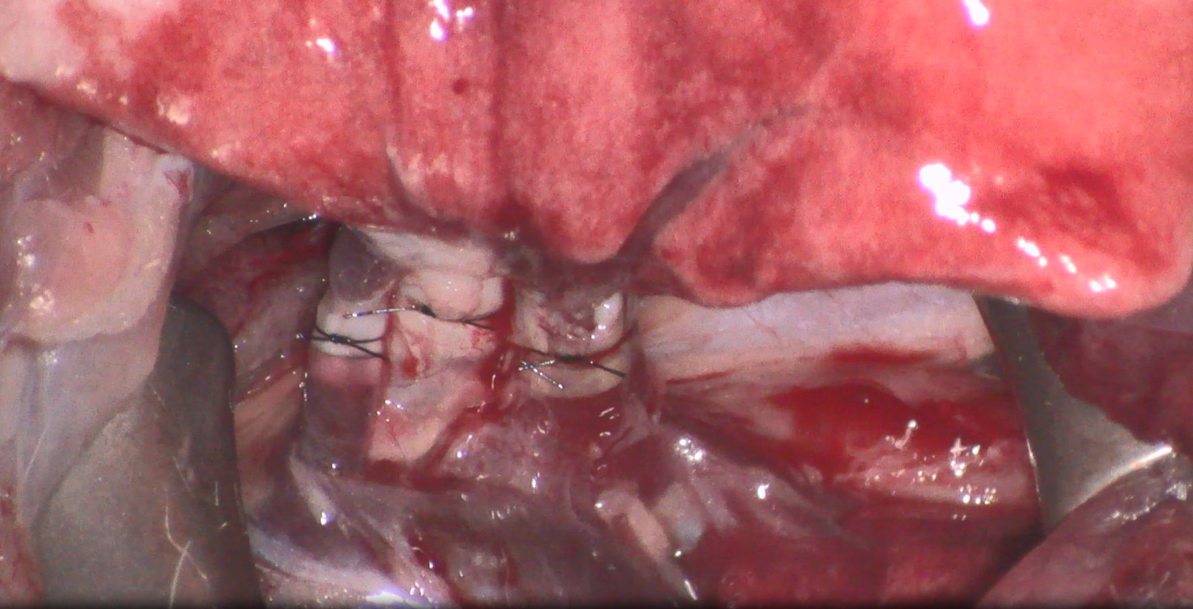
Figure 7.
Br
PA
PV

Slide 8
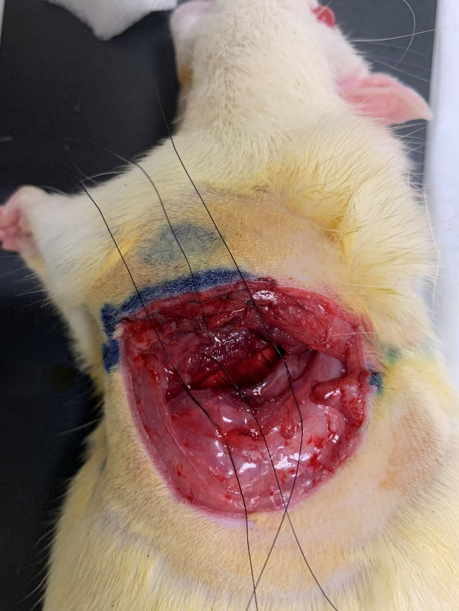
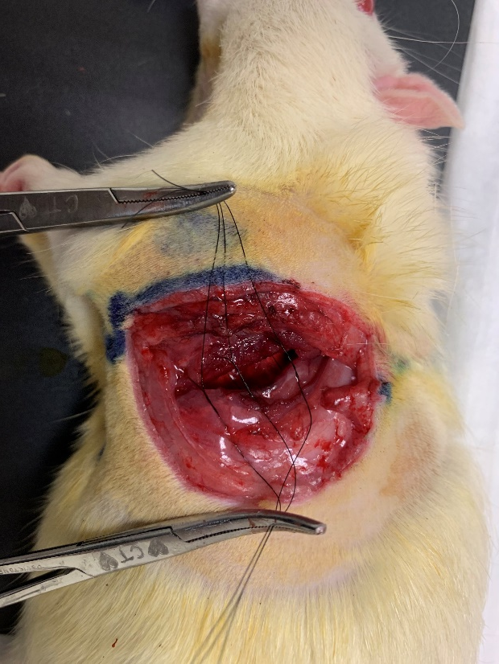
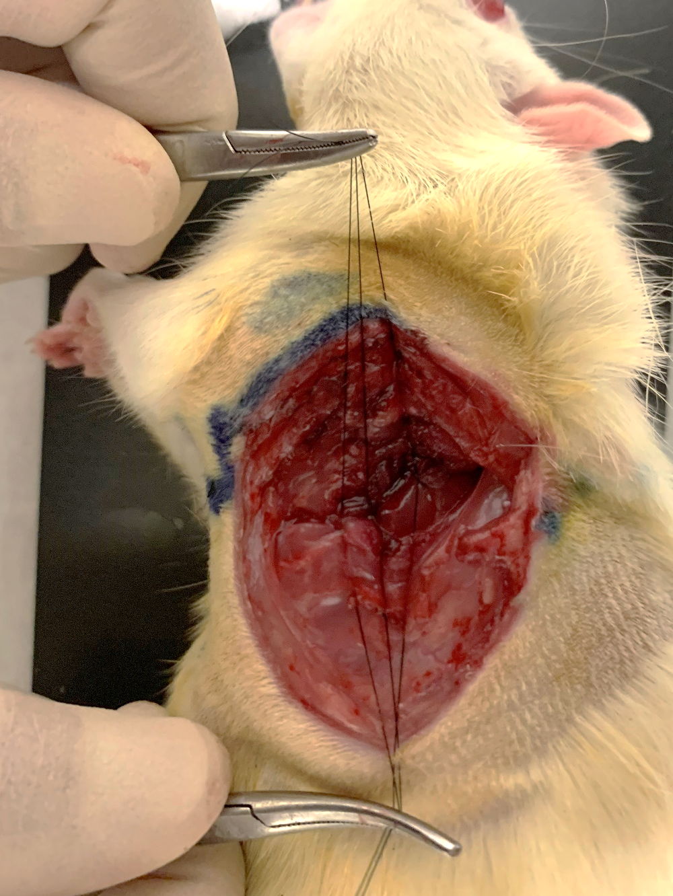
Figure 8.
A
B
C

Slide 9
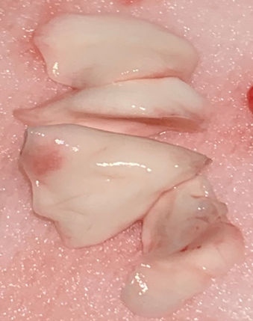
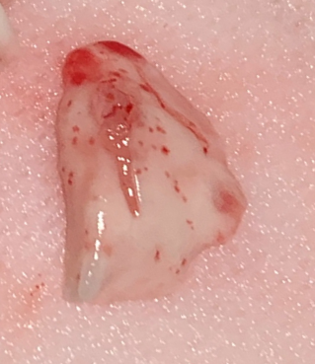
Figure 9.
A
B
Superior: Snap frozen
Upper: Snap frozen
Middle: Histology
Middle: Histology
Inferior: Wet/Dry ratio
Lower: Wet/Dry ratio
Post-caval: Snap frozen

Slide 10
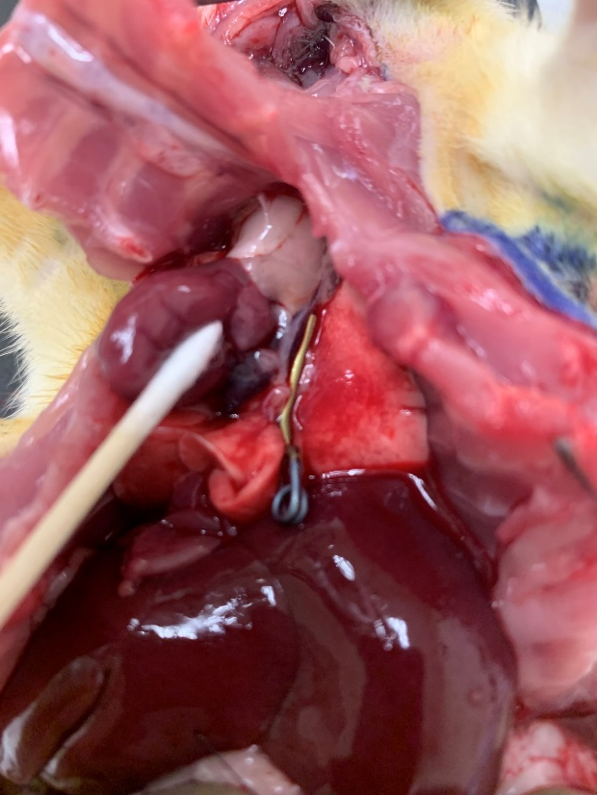
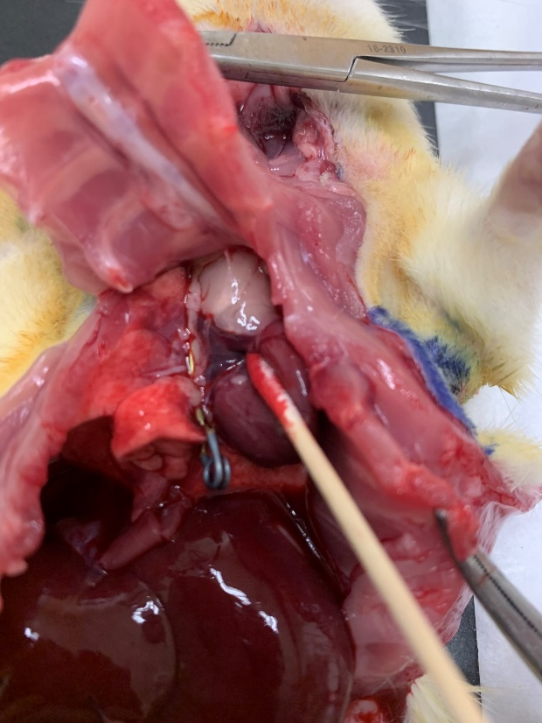
Figure 10.
A
B

