Slide 1
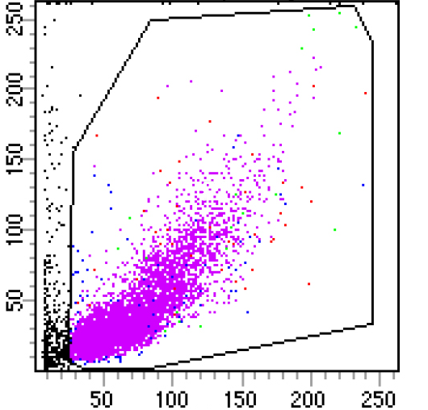
3.4.2 Gating nuclei by forward (FSC) and side (SSC) scatter areas
DAPI-only control
SSC-A
FSC-A

Slide 2
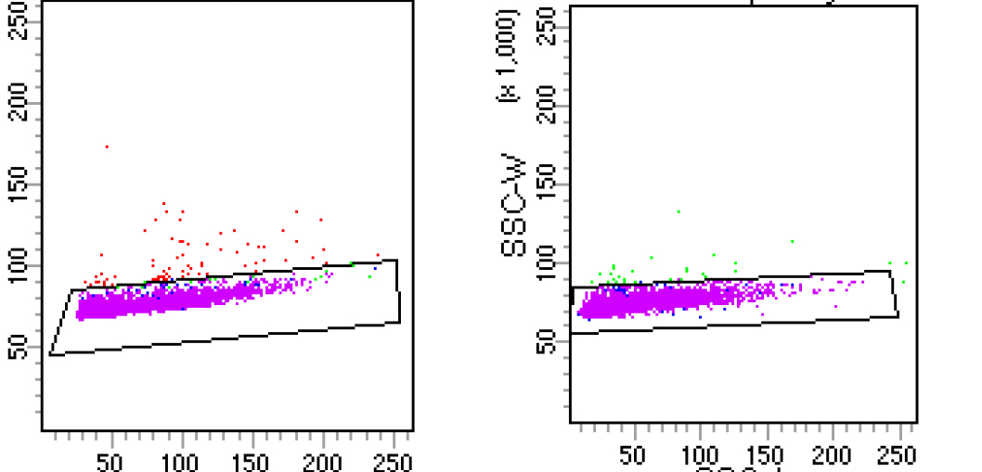
3.5.1 Selecting singlet nuclei populations, excluding doublets
DAPI-only control
SSC-W
FSC-W
FSC-A
SSC-A

Slide 3
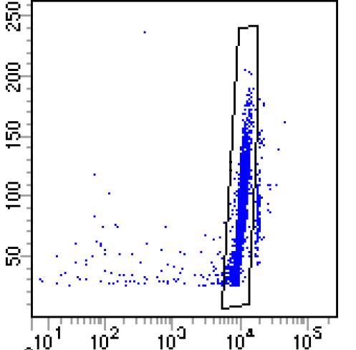
3.6.1 Using DAPI to select intact nuclei, excluding debris and doublets
DAPI-only control
FSC-W
DAPI

Slide 4
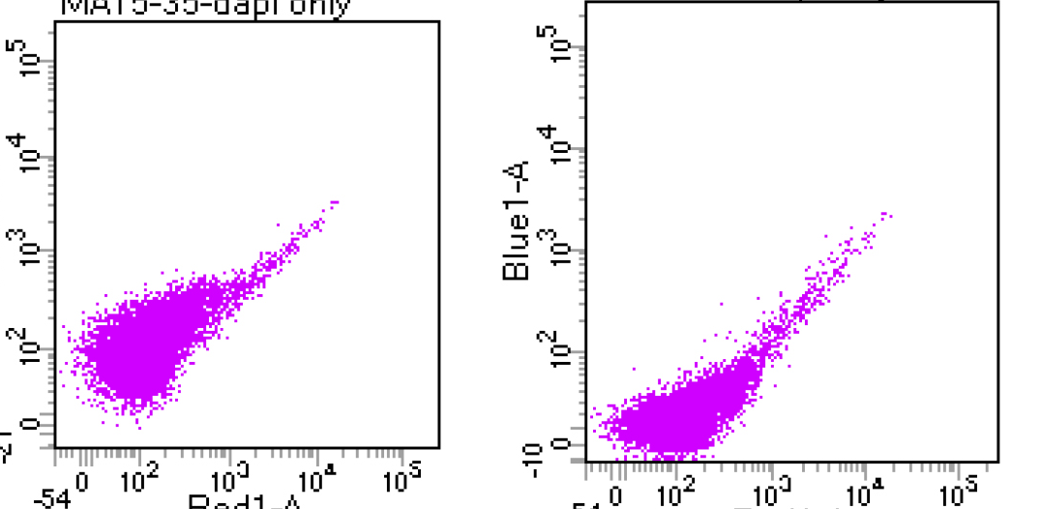
3.7.1 DAPI-only control defines background fluorescence (AF555, APC, FITC )
DAPI-only control
AF555
FITC
negative
negative
APC
APC

Slide 5
3.7.3 NA, Please remove from script

Slide 6
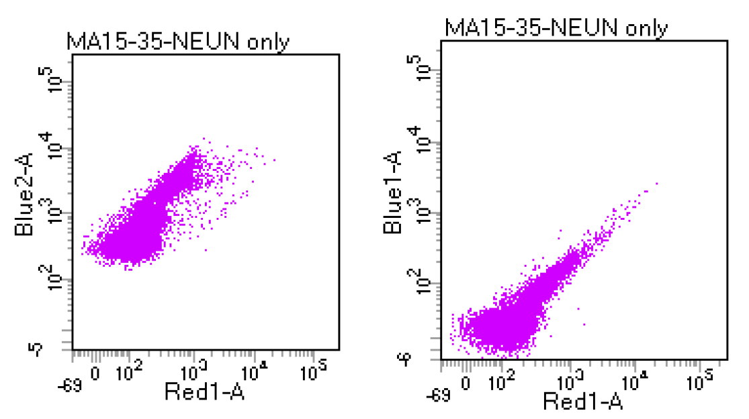
3.8.2 NeuN-only control determines +/- AF555 channel cutoff
NeuN_AF555-only control
NeuN_AF555+
NeuN-AF555
FITC
negative
negative
APC
APC

Slide 7
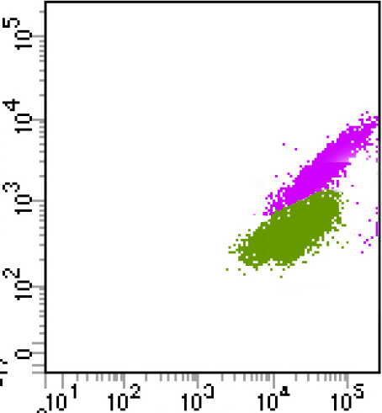
3.10.1 Collecting NeuN+ neuronal and PAX6+ astrocyte populations
Contour plot
Dot plot
AF555+
NeuN+ neurons
NeuN-AF555
NeuN-AF555
PAX6+NeuN–astrocytes
APC+
PAX6-APC
PAX6-APC

Slide 8
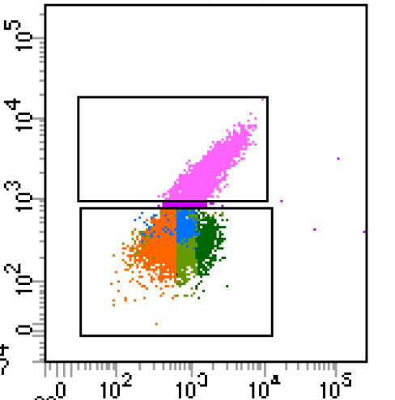
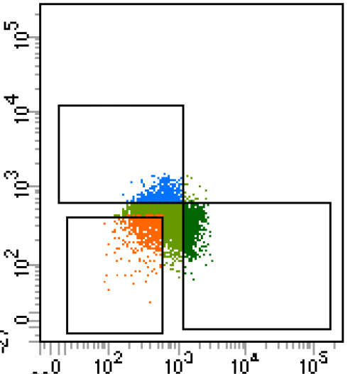
3.11.1 Collecting PAX6+ astrocytes and OLIG2+ glia from the NeuN– fraction
NEUN/PAX6/OLIG2 Triple Antibody Combination
NeuN+
OLIG2+
NeuN-AF555
OLIG2-FITC
NeuN–
NeuN–
PAX6+
Triple
Negative
PAX6-APC
PAX6-APC

