Slide 1
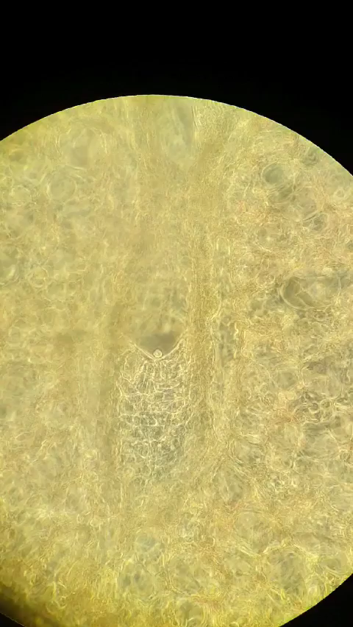
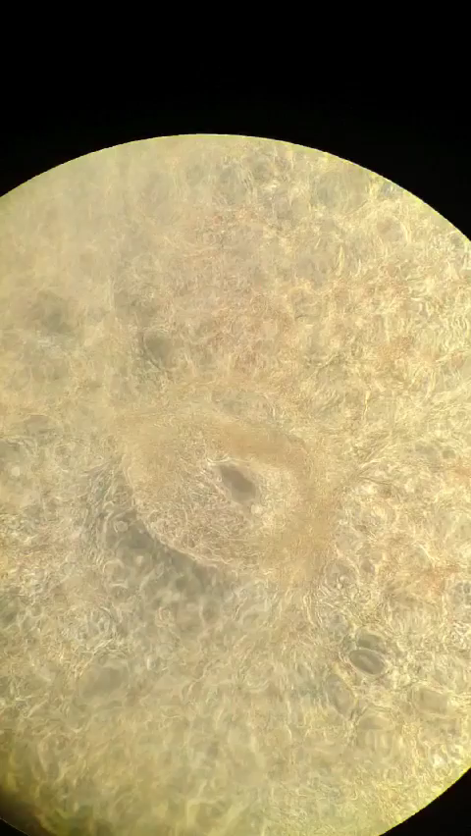
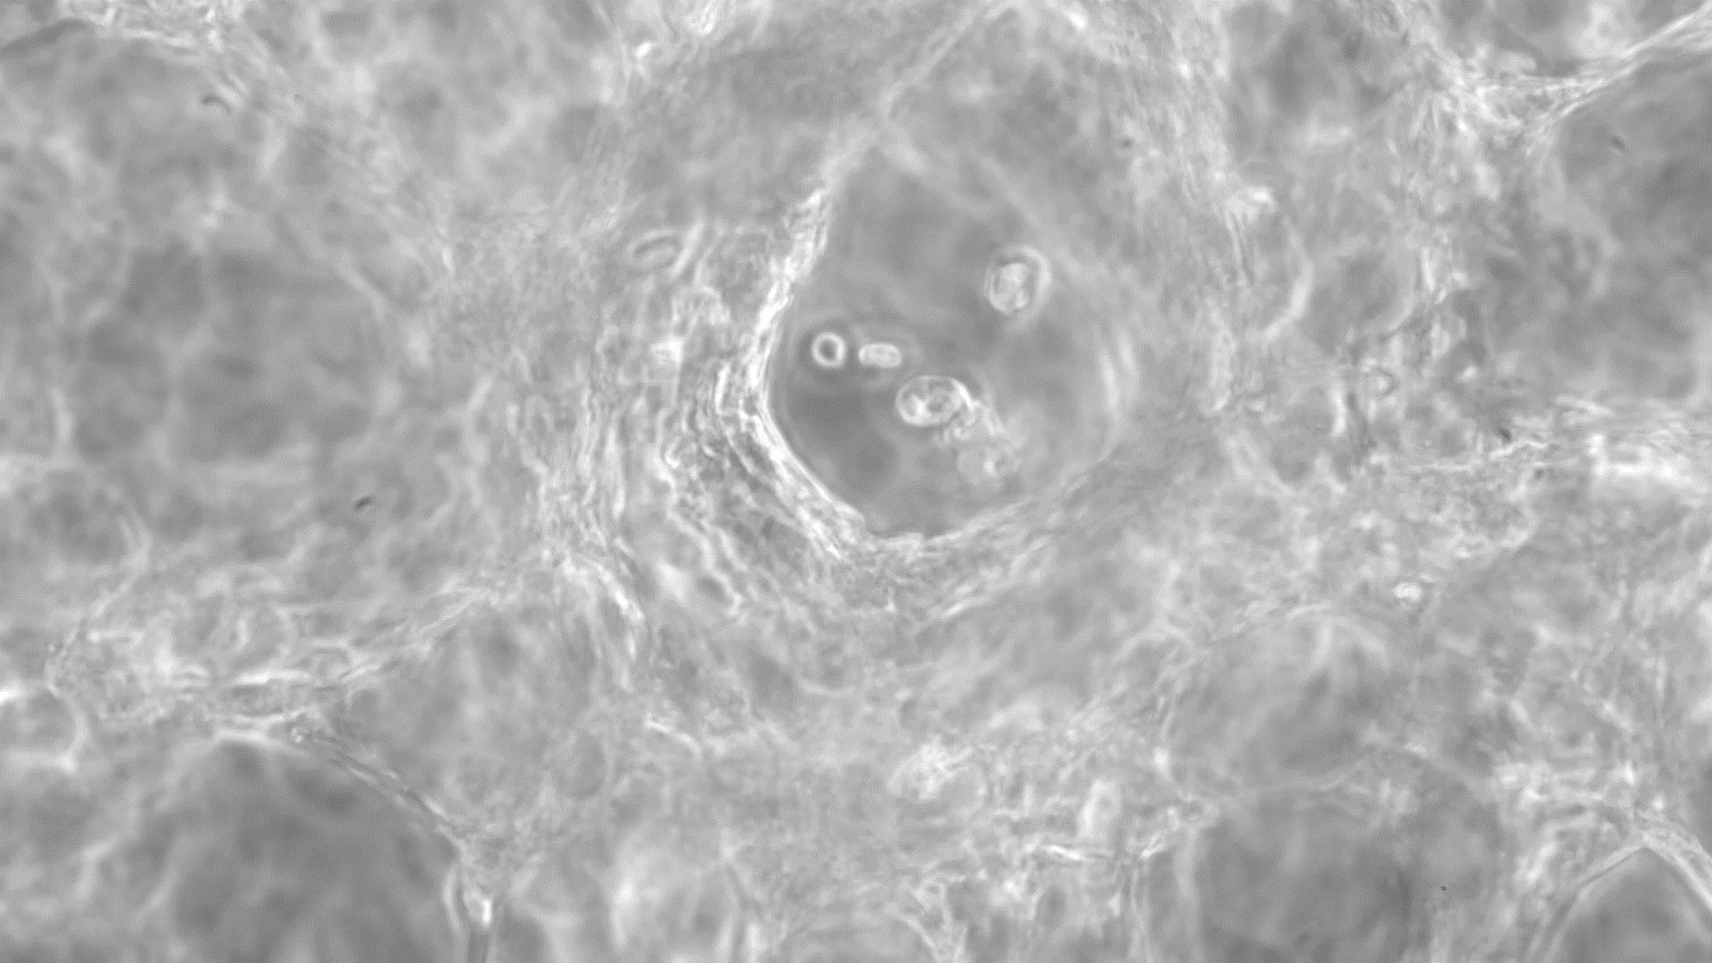
Without Vasoconstrictor
Ø
With Vasoconstrictors
Endothelin-1 (1 uM)
KCl (60 mM)
Notes:
PCLS precision cut lung slices

