Slide 1
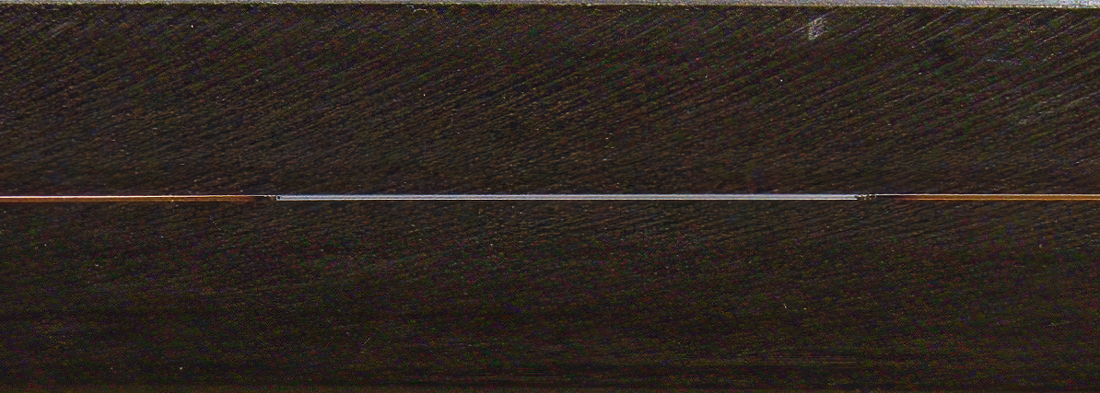
4-5 cm
Figure 1. Representative image of burnt coating capillary. Representative image of fused-silica capillary portion with removed polyimide coating.

Slide 2
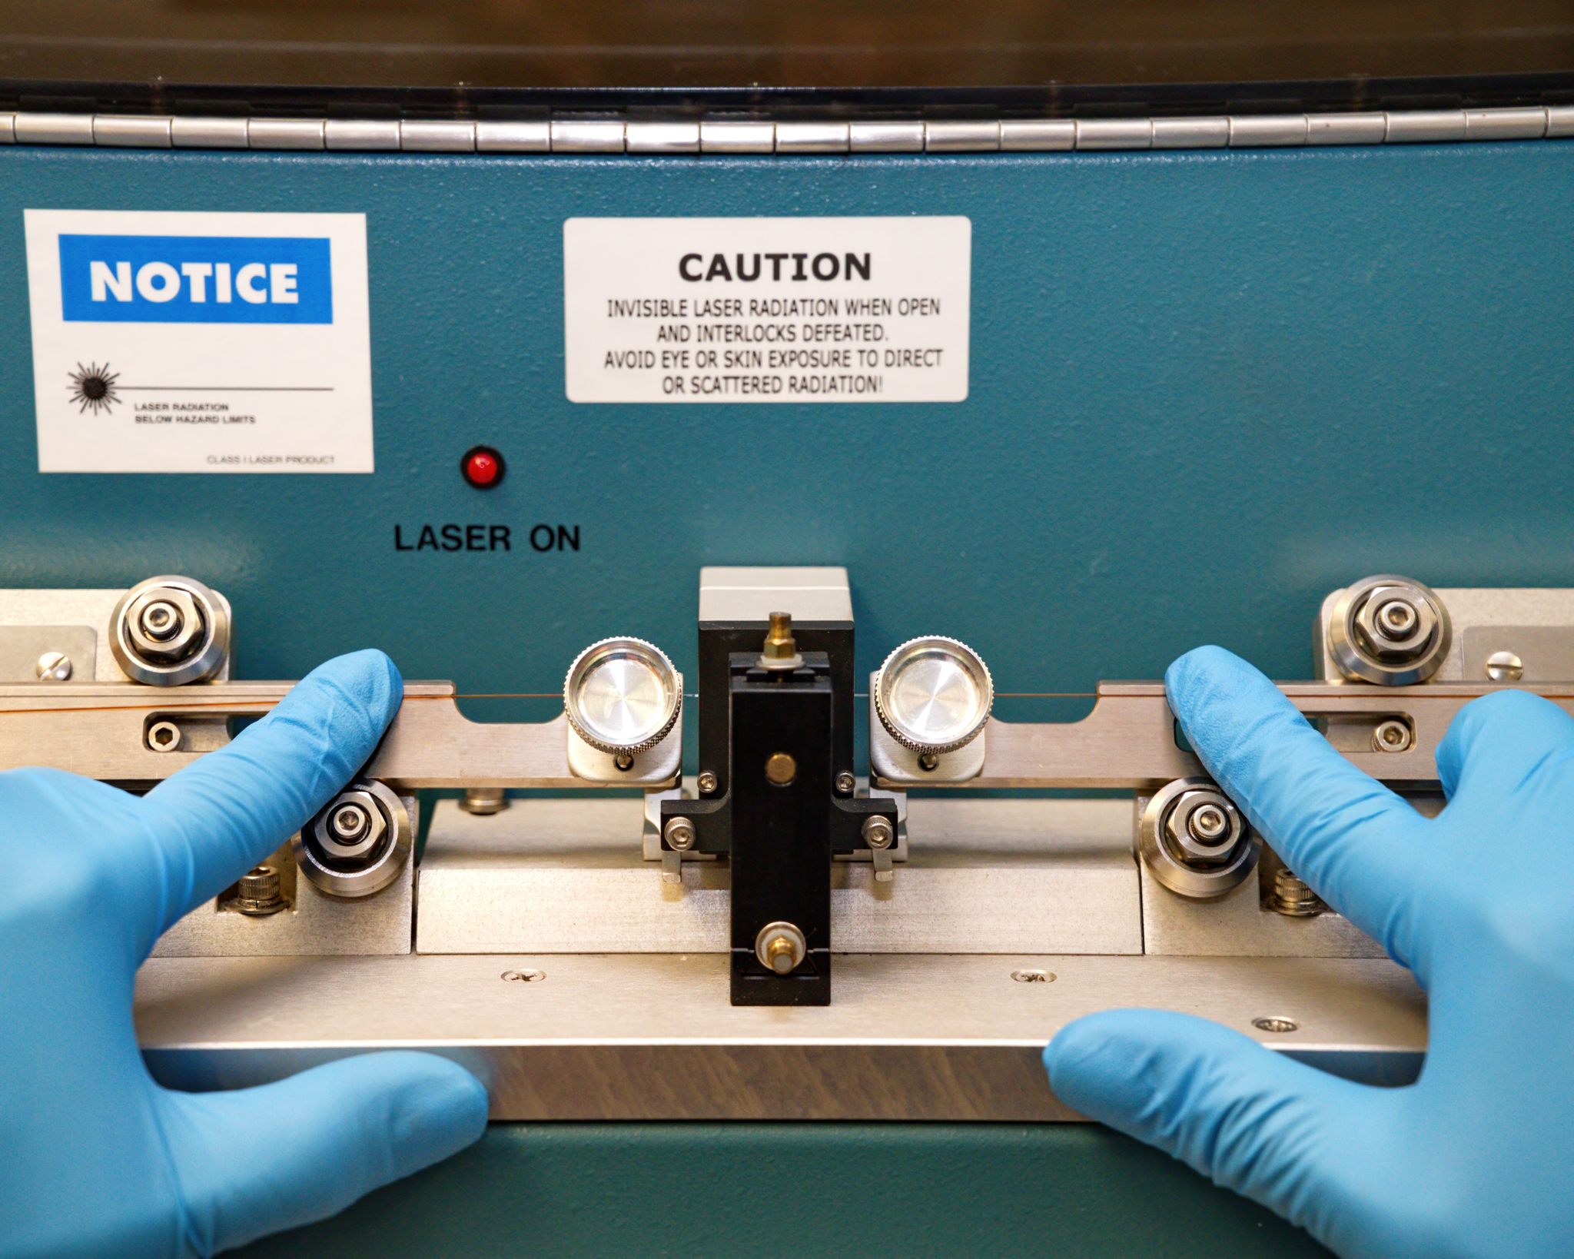
Figure 2. Representative image illustrating loading of column on laser puller. Note how the polished portion of the capillary is aligned inside the laser puller.

Slide 3
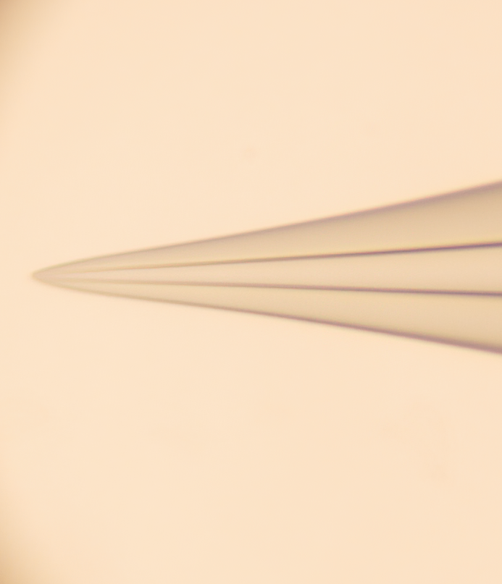
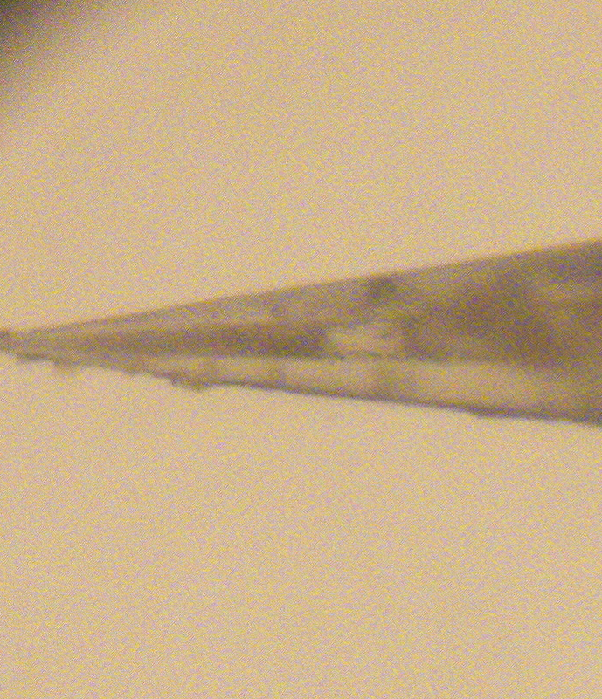
A)
B)
360 µm
1- 5 µm
75 µm
360 µm
1- 5 µm
75 µm
Figure 3. Comparison of pulled column tips with or without frit. (A) A microscopic view of laser pulled tip before initiating frit polymerization. (B) A microscopic view of laser pulled tip after frit polymerization.

Slide 4
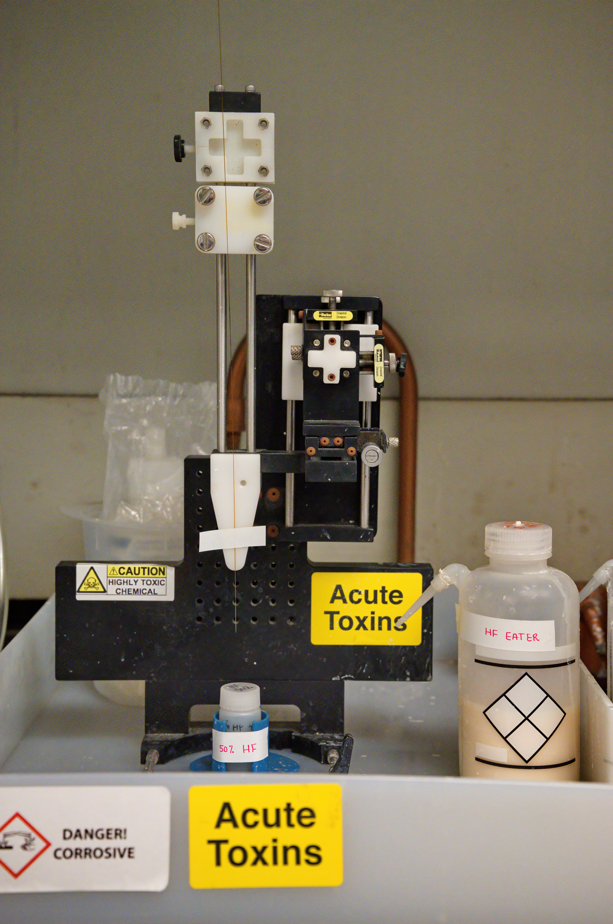
Figure 4. Representation of HF Etching station. HF etching station for immersing the emitter after polymerization of the frit. Here, HF neutralizer solution is labeled as “HF EATER” which is used to wash the column tip after HF etching to safeguard against acid contamination.

Slide 5
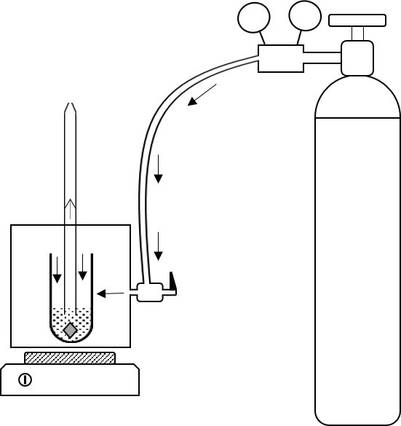
Working pressure gauge
Cylinder pressure gauge
Cylinder valve
Helium hose
Helium regulator
Column
Pressurized
Helium Gas
Helium flow inside hose
Flow of Reprosil-Pur 120 C18-AQ
slurry under pressure
Packing chamber valve
High pressure packing chamber (bomb)
2ml microcentrifuge tube
Pressure release valve
Reprosil-Pur 120 C18-AQ
suspension in methanol
Magnetic stir bar
Magnetic stirrer
Figure 5. Schematic representation of column packing hardware. Schematic diagram of column packing set-up. Hardware system basically consists of pressurized helium gas that is connected through a three-way valve to a high pressure packing chamber housing the vial containing slurry, and column with its tip pointing upwards.

Slide 6
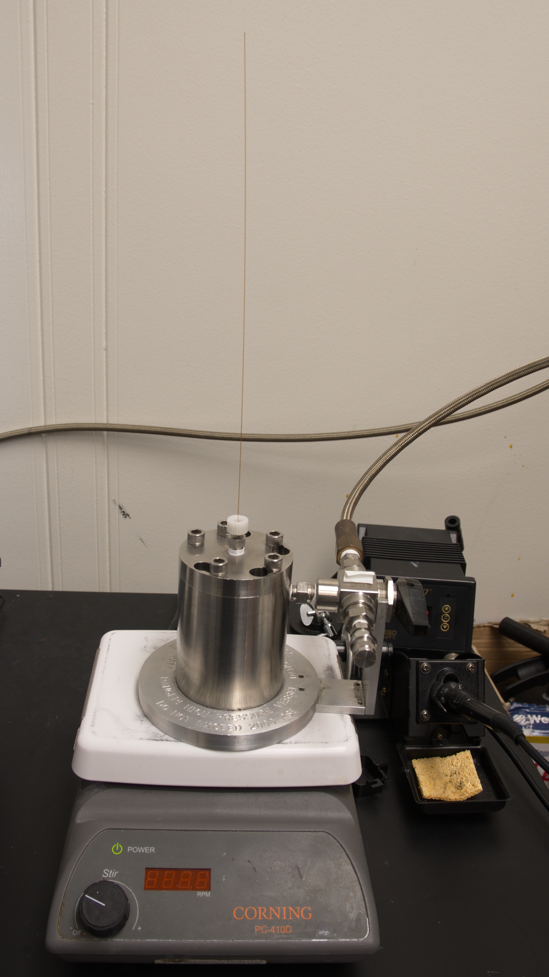
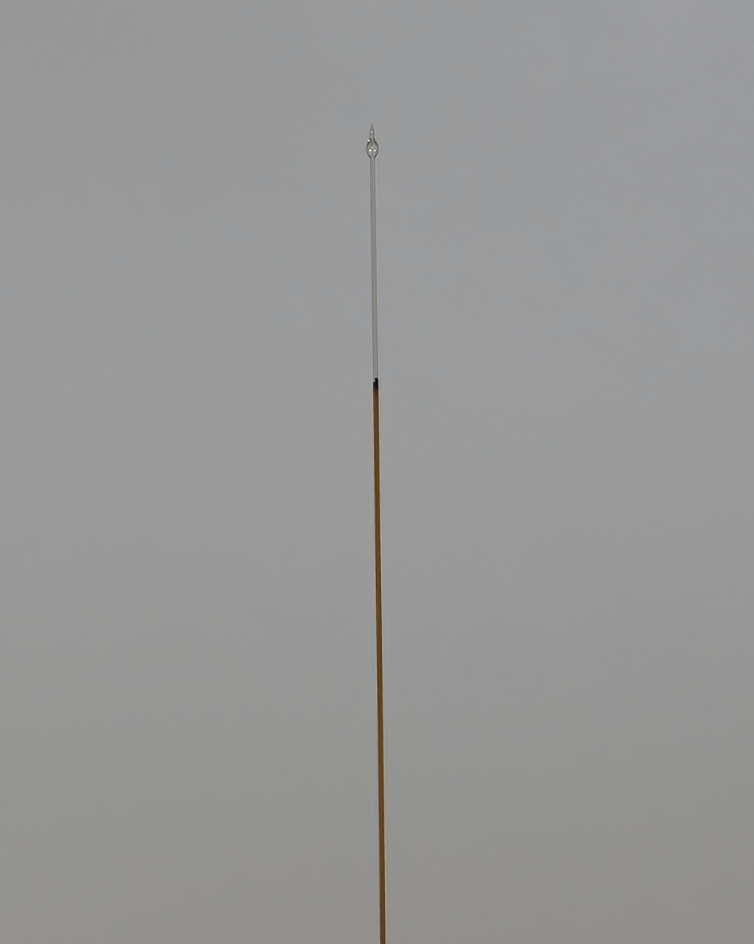
A)
B)
Figure 6. Column packing station. (A) An overall view of column set up on packing bomb (B) A close view of column tip during packing on bomb. Note the solvent droplet formed at the tip of the column.

Slide 7
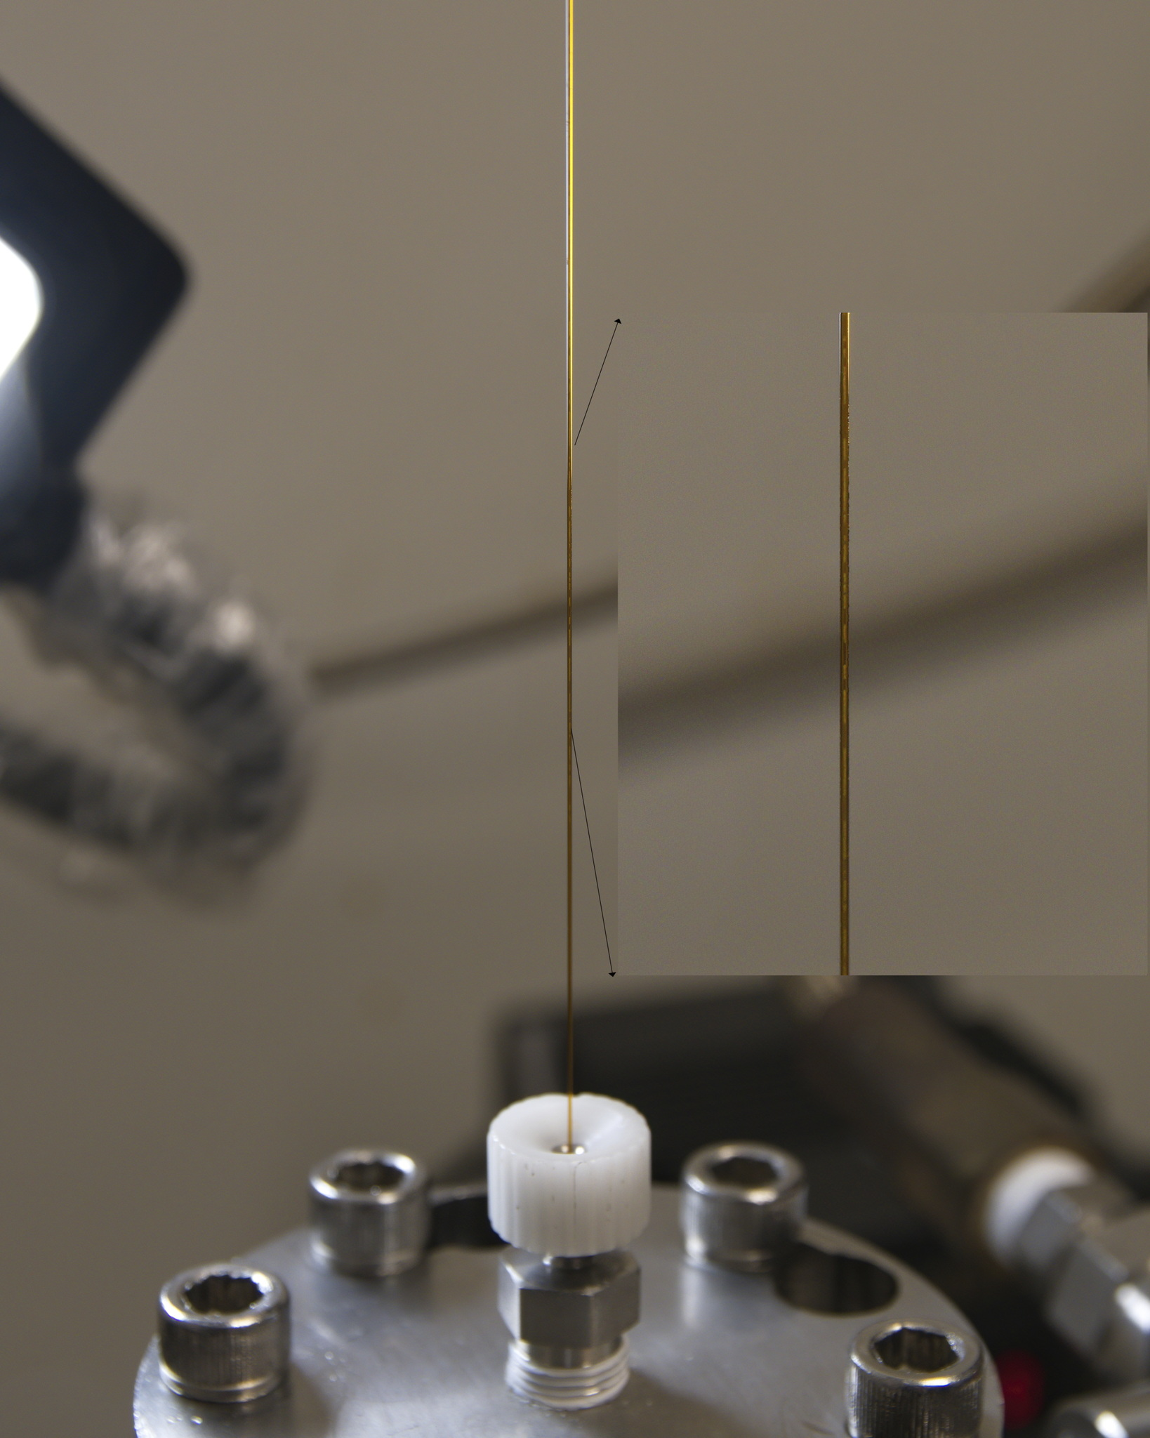
Figure 7. Visualization of slurry movement through the column while packing on bomb. Note the inset image where movement of slurry from the bottom to the tip of the capillary is seen due to helium gas flow inside the pressurized chamber.

Slide 8
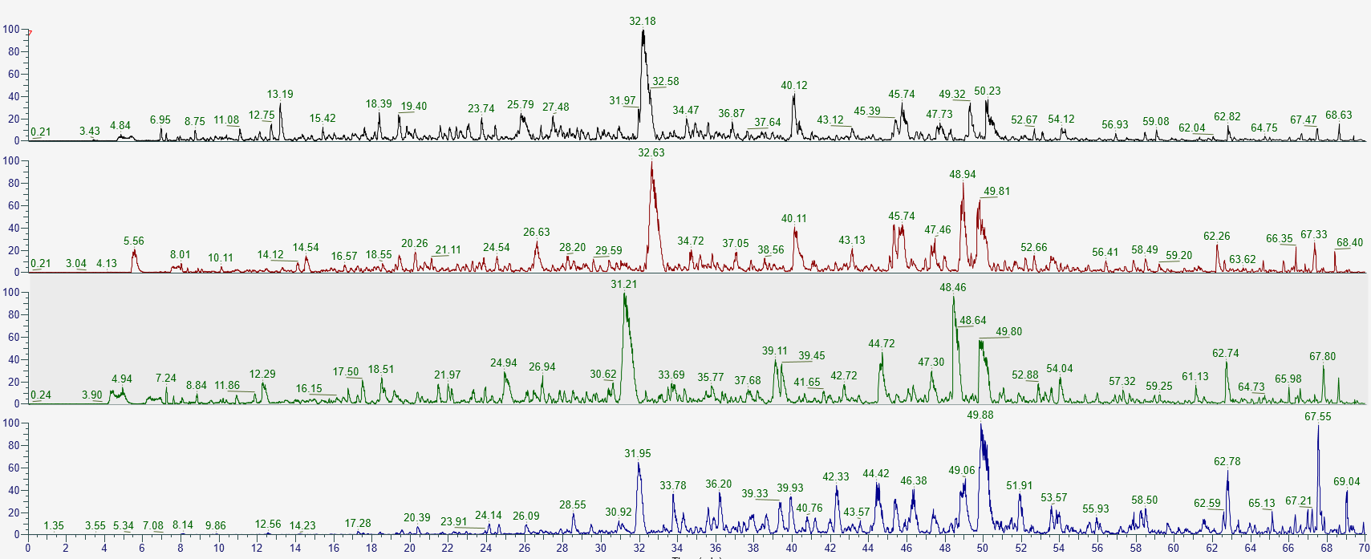
09/2018
Relative Abundance
03/2019
05/2019
09/2020
Time (Minutes)
Figure 8. Evaluation of column performance using a series of columns prepared at different points in time. Comparison of the retention time alignment, peak ion intensity and width in a series of columns packed at different time points over a period of two years in 70 minute LC-MS analysis of HEK293 cell tryptic digest.

Slide 9
Date
Number of Proteins/Peptides
Figure 9. A bar graph representation of number of proteins and peptides identified in 70-minute LC-MS analysis of HEK293 cell tryptic digest on columns analyzed in Figure 8. Data reflect consistent performance of the columns packed using our approach.

Slide 10
Alcohol lamp | Any brand |  | for providing heat
Brechbuehler helium pressure cell | BioSurplus |  | for packing column
Ceramic column cutter | Thermo Fisher |  | for cutting silica capillary
Dimethyl sulfoxide (DMSO) ≥ 99% | Sigma-Aldrich |  | Stored in a flammable cabinet
Formamide ≥ 99.5% | Sigma-Aldrich |  | for making frit
Hydrofluoric acid (HF) (50%) | Fisher Scientific |  | for opening the emitter after polymerization
KASIL (Potassium Silicate Solution) | PQ Corporation PO Box Valley Forge PA 19482 |  | for making frit
Orbitrap Fusion Lumos | Thermo Fisher Scientific |  | for MS data acquisition
P2000 Laser Puller | Sutter |  | for pulling capillary
PTFE 1/16" Ferrule 0.4 mm ID (long) for Tube Fitting | Chromre | 214104 | For bomb setting
Reprosil-Pur 120 C18-AQ, 1.9 um, 1g | Dr. Masch GmbH | r119.aq.0001 | Batch 5910
Soldering | Any brand |  | For initiating polimerization
Stainless Steel Pipe Fitting, Hex Coupling, 1/4 in. Female NPT | Swagelok | SS-4-HCG | for bomb setting
TSP075375 fused silica, 75 µm ID x 360 µOD | MOLEX/Polymicro | 1068150019 | For column tubing
Ultimate 3000 UHPLC | Dionex |  | HPLC type
Name Company Catalog Number Comments
Table of material.

