Slide 1
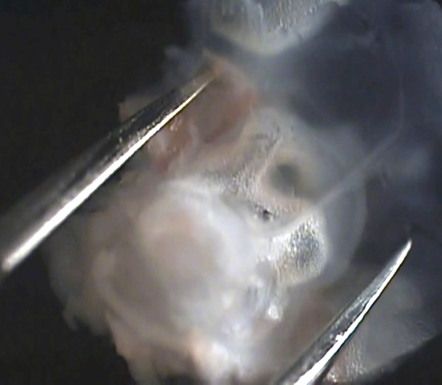
1:23 without figure letters interfering
Cochlea
8th Nerve

Slide 2
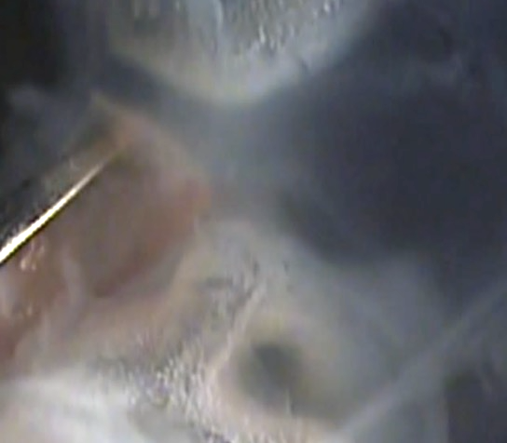
1:30 without figure letters interfering
VA
ES
PSC
SS
CC
ED
ASC

Slide 3
Figure without letters

