Slide 1
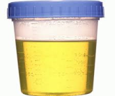
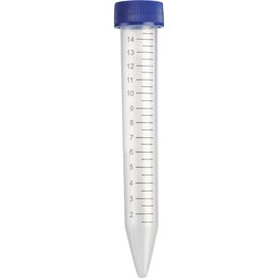
Figure #1
1. Urine sample
Measure urine pH and volume.
2. Centrifuge
Spin at 1200 x g for 10 minutes at room temperature (RT) and discard supernatant.
3. Clean Pellet
Wash pellet with 5 mL of 100% EtOH and
Spin at 1200 x g or 10 minutes at RT (2x).
4. Prepare Pellet
Resuspend pellet with 1ml of 100% EtOH.
5. Stain Nanocrystals
Dilute samples in water (20x) and stain with
5 μM Fluo-4 AM for 30 mins at RT.
6. Visualize Nanocrystals using Nanoparticle Tracking Analysis (NTA)
Load and analyze samples using fluorescent filter settings.
7. Data Acquisition and Analysis
Collect and analyze data from the software.

Slide 2
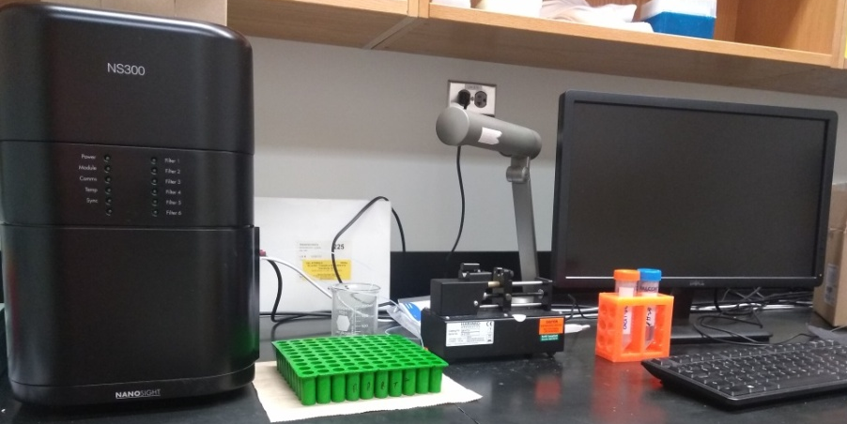
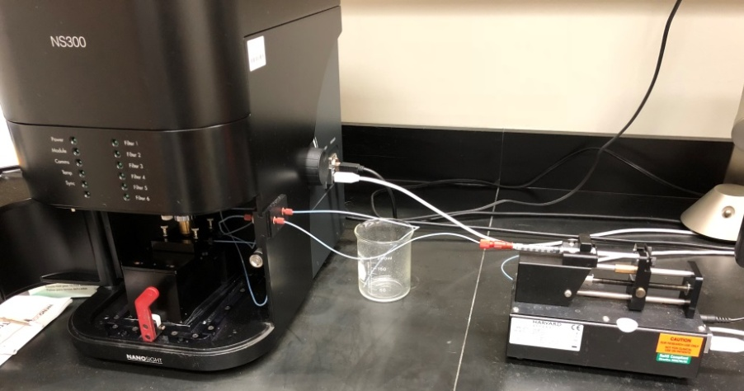
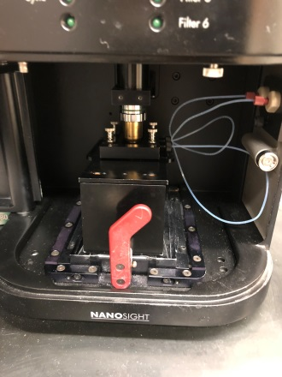
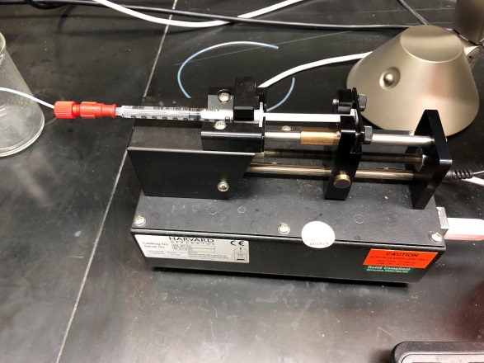
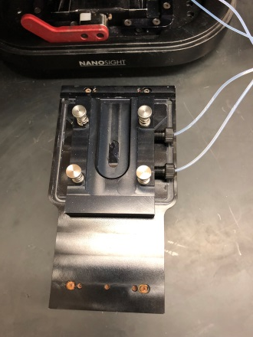
Figure #2
A
Instrument
Computer
B
Injector
Camera
Objective
Lens
Optical Surface
Inlet and Outlet
Tubing
Injector

Slide 3
Figure #3
A
B

Slide 4
Figure #4

Slide 5
Figure #5
A
B

