Slide 1
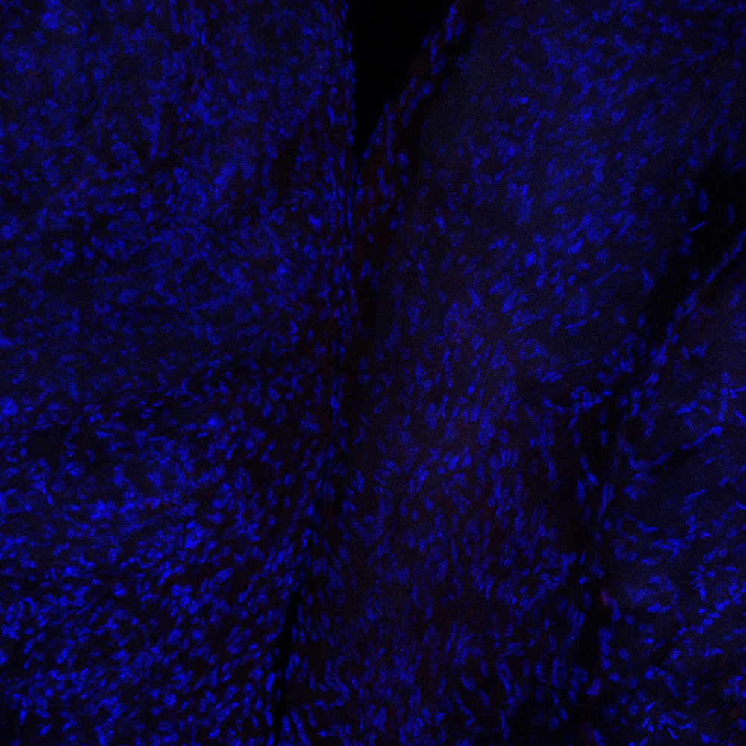

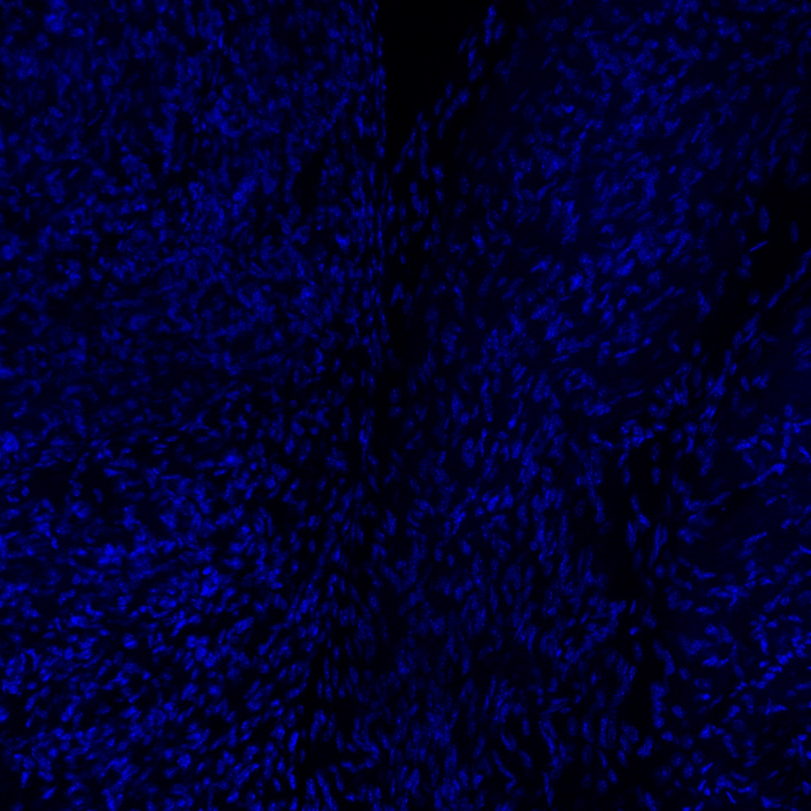



Figure 7.
A
Merge
B
Control
SVC
RAA
50 $μ$m
C
DAPI
SAN
RA
50 $μ$m
50 $μ$m

Slide 2
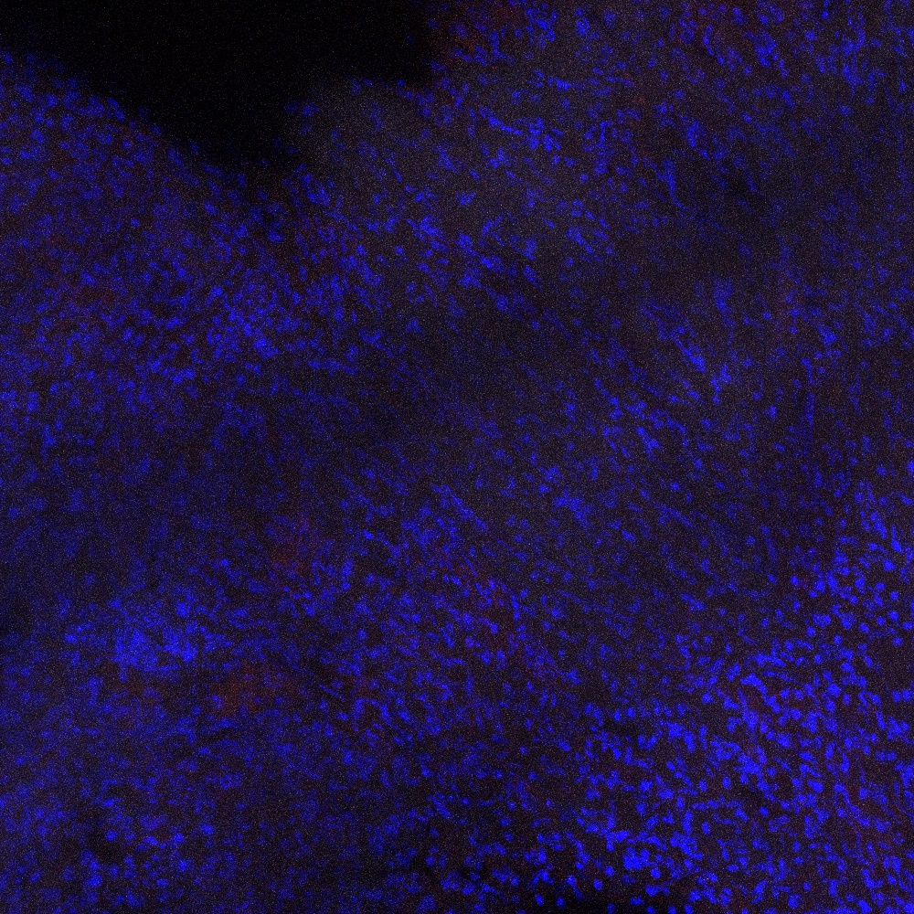
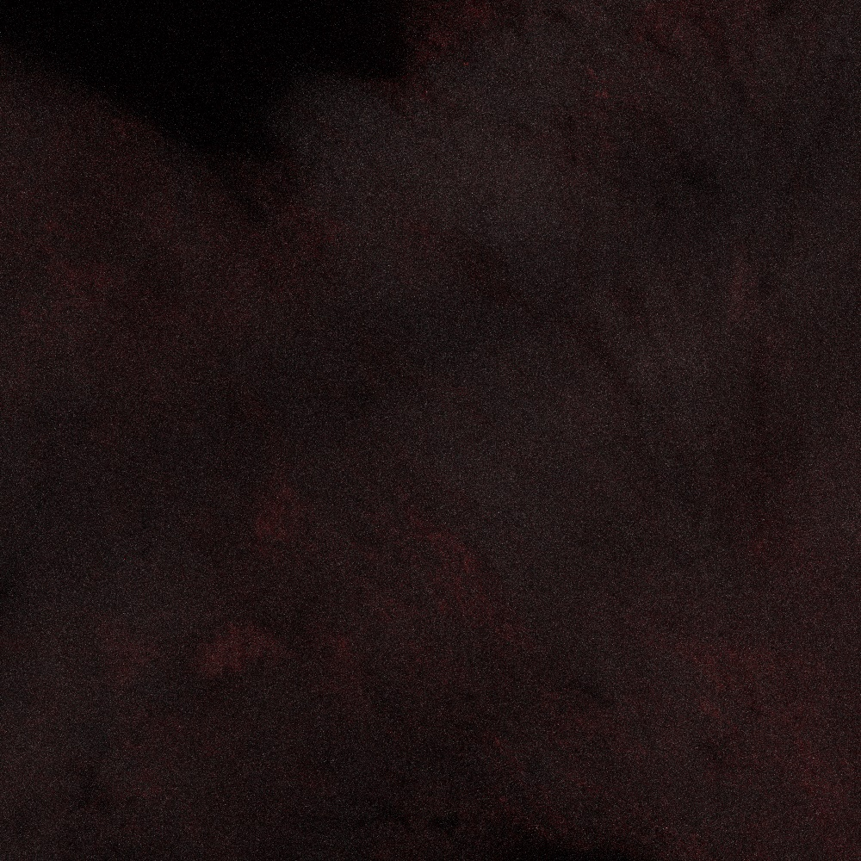
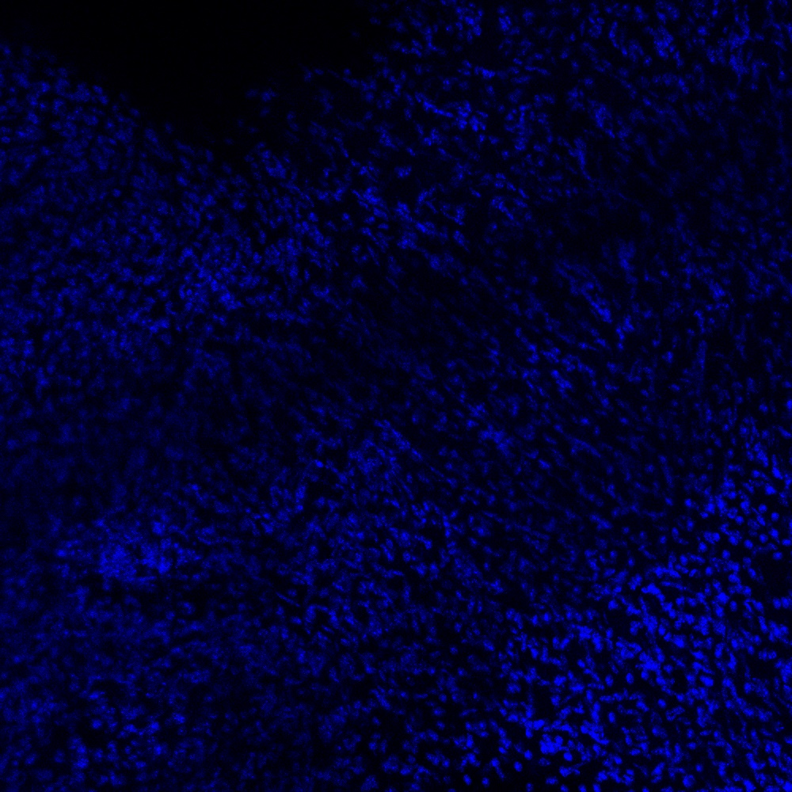



D
Merge
E
Control
IVS
50 $μ$m
F
DAPI
AVN
IAS
50 $μ$m
50 $μ$m

