Slide 1
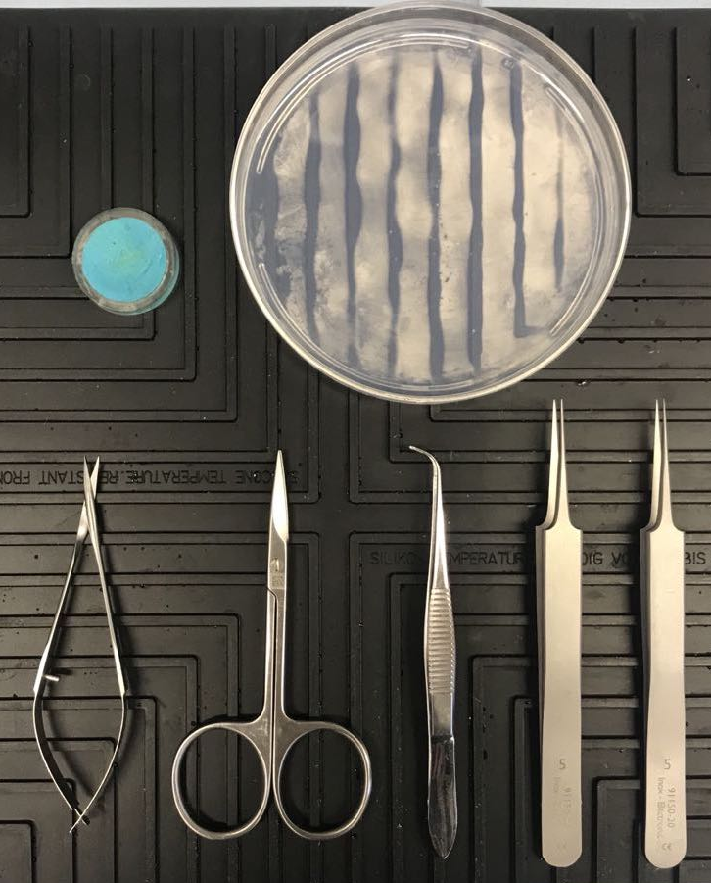
Figure 1.
A
B
C
D
E
F
5 cm

