Slide 1
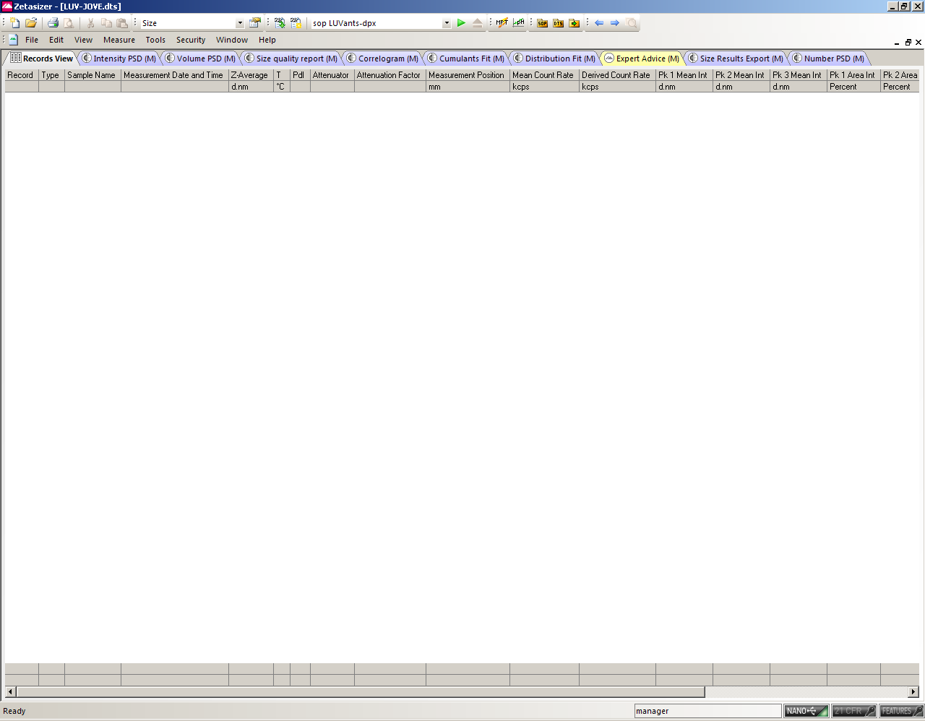
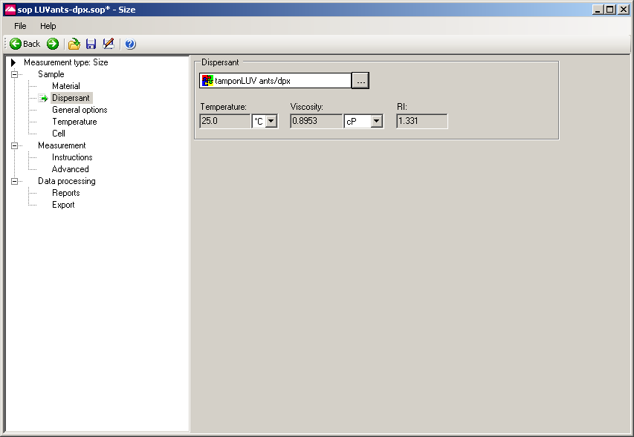
Malvern program – with selected viscosity protocol → 4.1.1. of the script

Slide 2
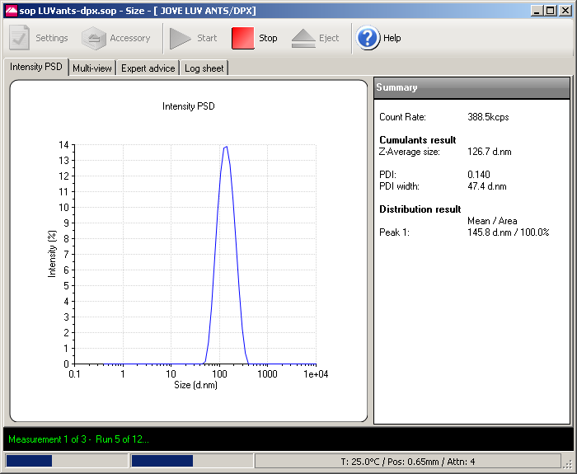
Window showing LUV measurement with idicated siez (z-average) and PDI → 4.2.2. of the script

