Slide 1
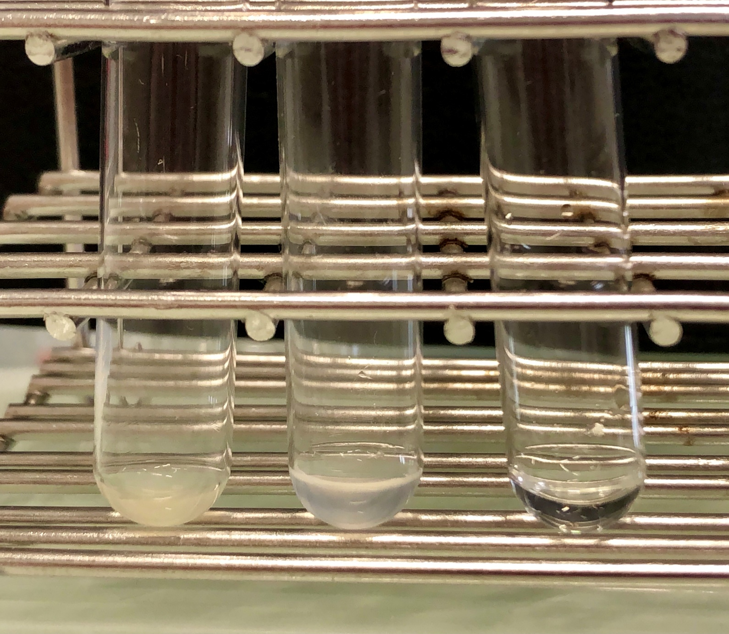
Before LUVs purification
Purified LUVs
Solution after LUVs elution
3.3. Alternative visualization of LUVs purification

Slide 2
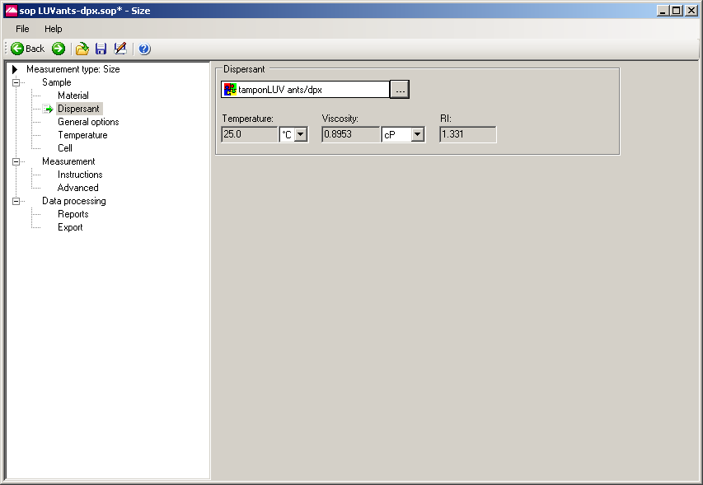
4.1.2. Selection of the SOP condition for LUV measurement

Slide 3
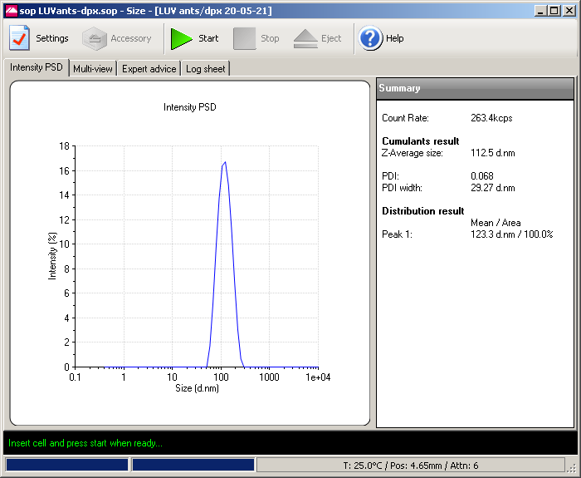
4.2.2. Window showing the measurement of the LUV

Slide 4
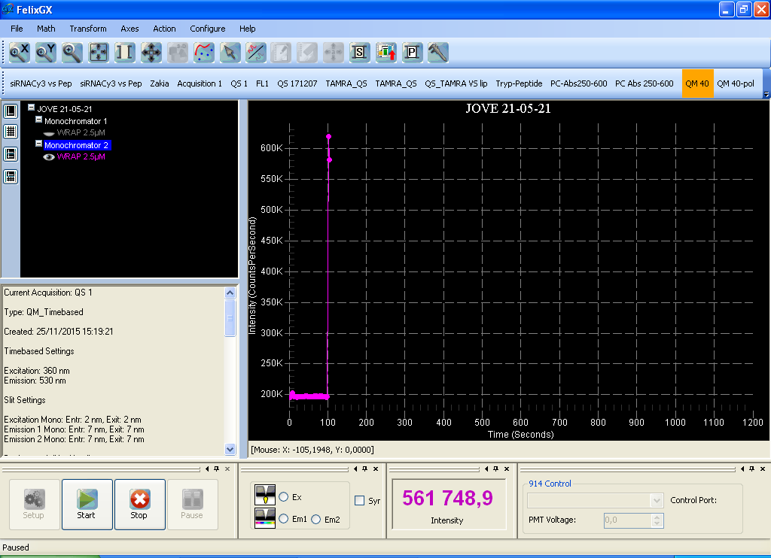
100 seconds
5.2.1. Leakage being measured in LUVs alone during first 100 seconds

Slide 5
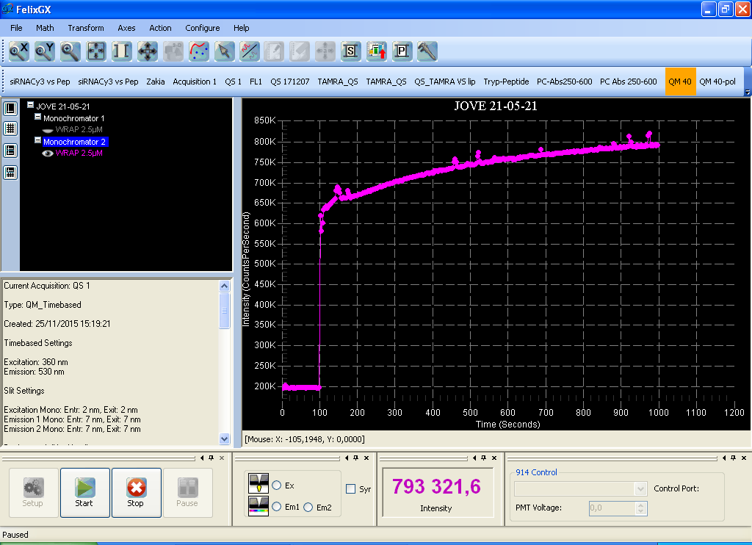
Peptide addition
5.2.2. Leakage being measured after peptide addition

Slide 6
Fluorescence leakage
5.2.2. Leakage being measured after peptide addition

Slide 7
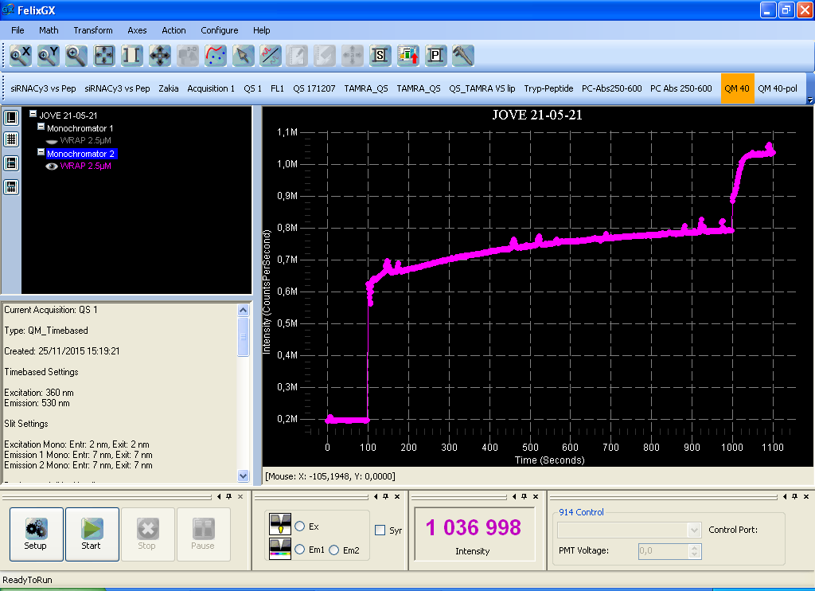
Triton addition
5.3.2. Leakage being measured after peptide addition

