Slide 1
Screen Captured Shots for Article 61955

Slide 2
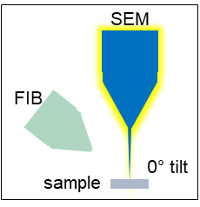
4.2.2.
100x
100 µm

Slide 3
4.3.1.a.
600x
10 µm

Slide 4
4.3.1.b.
600x
Sacrificial region
10 µm

Slide 5
4.3.1.c.
4000x
2 µm

Slide 6
4.3.1.d.
4000x
Charging
2 µm

Slide 7
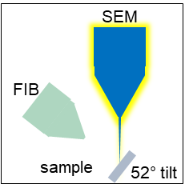
4.4.1.a.
600x
10 µm

Slide 8
4.4.1.b.
600x
Site of interest
10 µm

Slide 9
4.7.1.a.
500x
10 µm

Slide 10
4.7.1.b.
500x
Charging reduced
Cured region
10 µm

Slide 11
5.2.1.a.
2000x
5 µm

Slide 12
5.2.1.b.
2000x
Feature of interest
5 µm

Slide 13
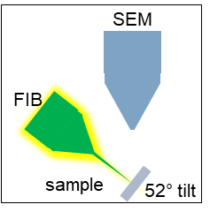
5.2.1.c.
1750x
Feature of interest
5 µm

Slide 14
5.2.1.d.
1750x
Milling window created
5 µm

Slide 15
5.3.1.
1750x
Side window created and placed
5 µm

Slide 16
5.4.1.
1750x
Side window resized
5 µm

Slide 17
5.5.1.a.
1750x
Feature of interest
Bulk window resized and finalized
5 µm

Slide 18
5.5.1.b.
1750x
Feature of interest
Trench begins to form
5 µm

Slide 19
5.6.1.a.
2000x
Checking the trench conditions throughout bulk milling
5 µm

Slide 20
5.6.1.b.
2000x
Checking the trench conditions throughout bulk milling
5 µm

Slide 21
5.6.1.c.
2000x
Checking the trench conditions throughout bulk milling
5 µm

Slide 22
5.7.1.
2000x
Feature of interest
Depth of trench
Confirm trench has milled below feature of interest
5 µm

Slide 23
5.8.1.
1750x
Ion current lowered to 0.92 nA
5 µm

Slide 24
5.9.1.a.
1750x
Feature of interest located
Cleaning window placed
5 µm

Slide 25
5.9.1.b.
1750x
Cleaning window resized
5 µm

Slide 26
5.10.1.a.
1750x
Cleaning cross section milled to proper z-depth
5 µm

Slide 27
5.10.1.b.
2000x
Cleaning cross section milled to proper z-depth
Depth of trench
5 µm

Slide 28
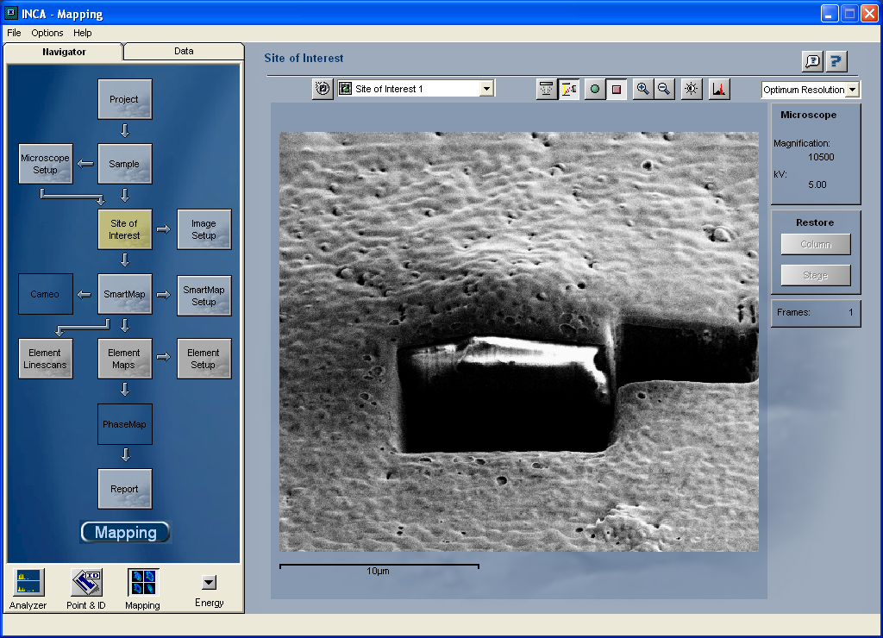
6.1.2
Sample oriented in EDX software

Slide 29
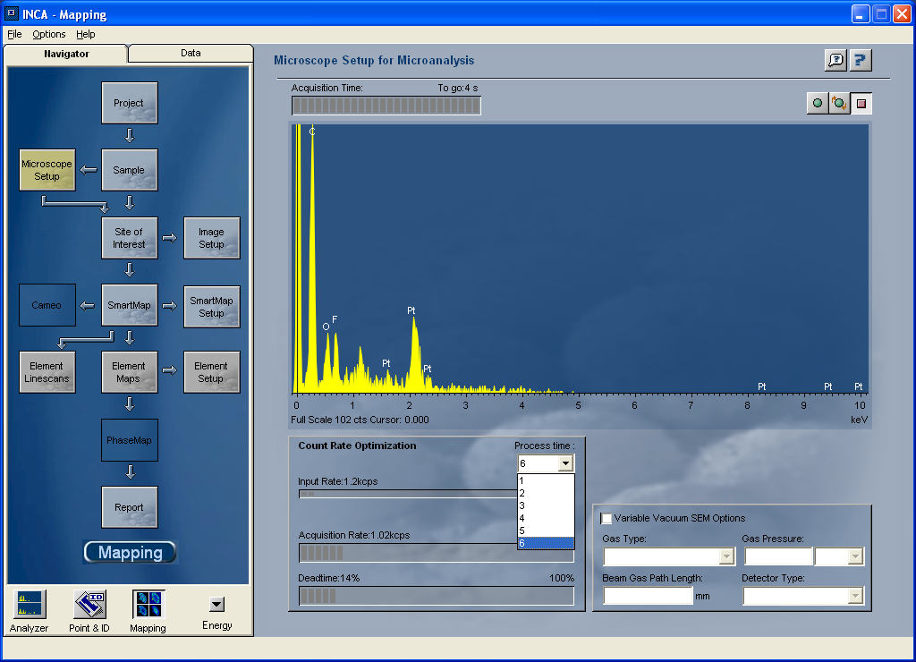
6.2.2
Process time set

Slide 30
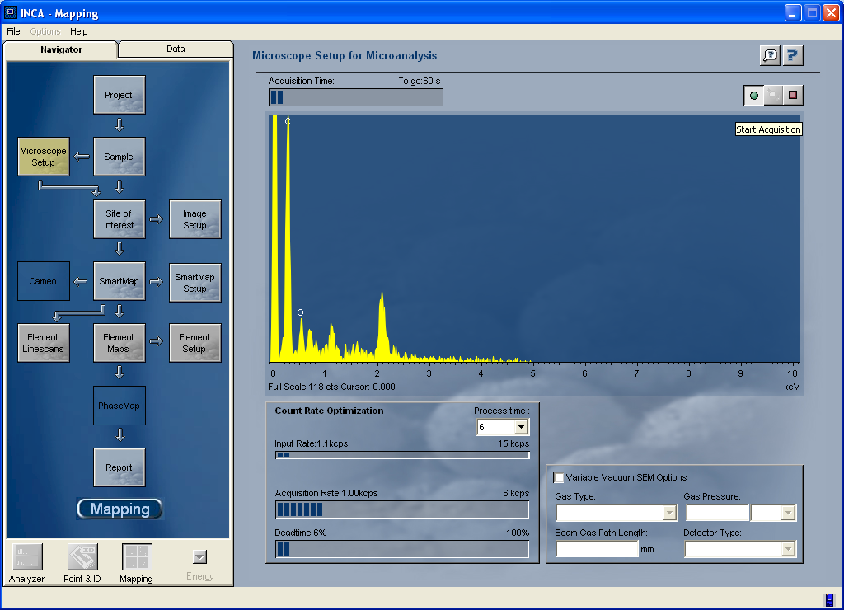
6.3.1.a.
Microscope setup tab opened

Slide 31
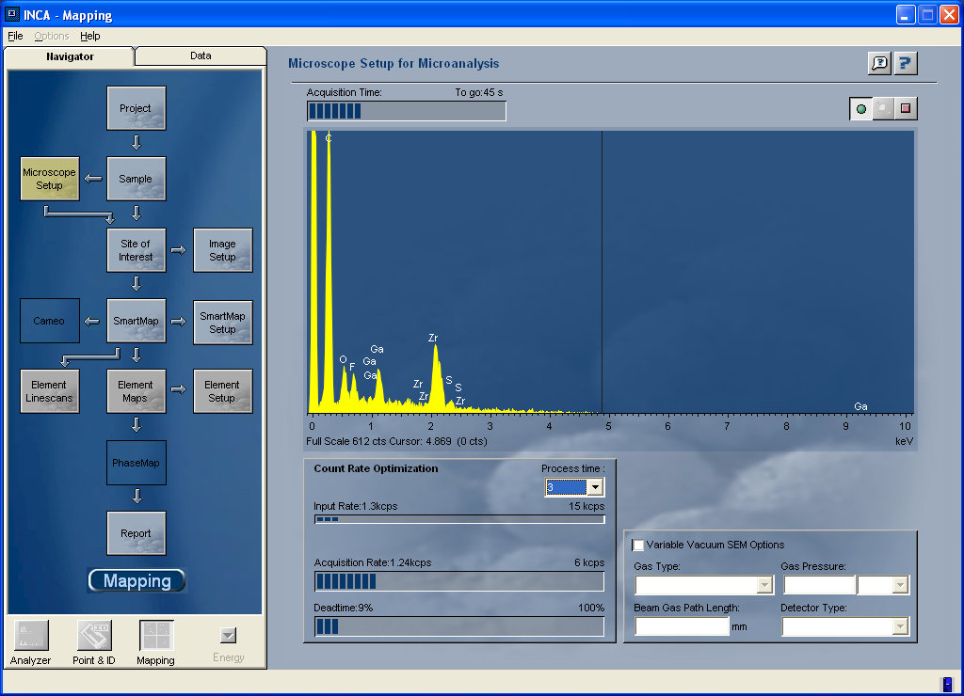
6.3.1.b.
Deadtime measured

Slide 32
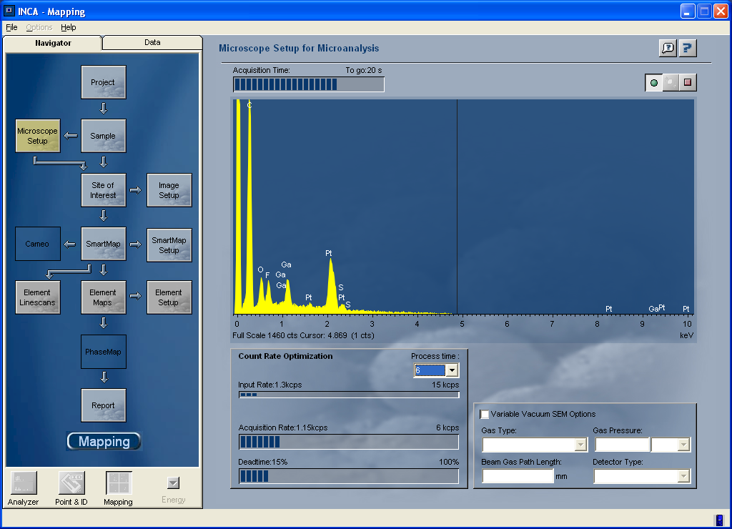
6.3.1c.
Deadtime adjusted

Slide 33
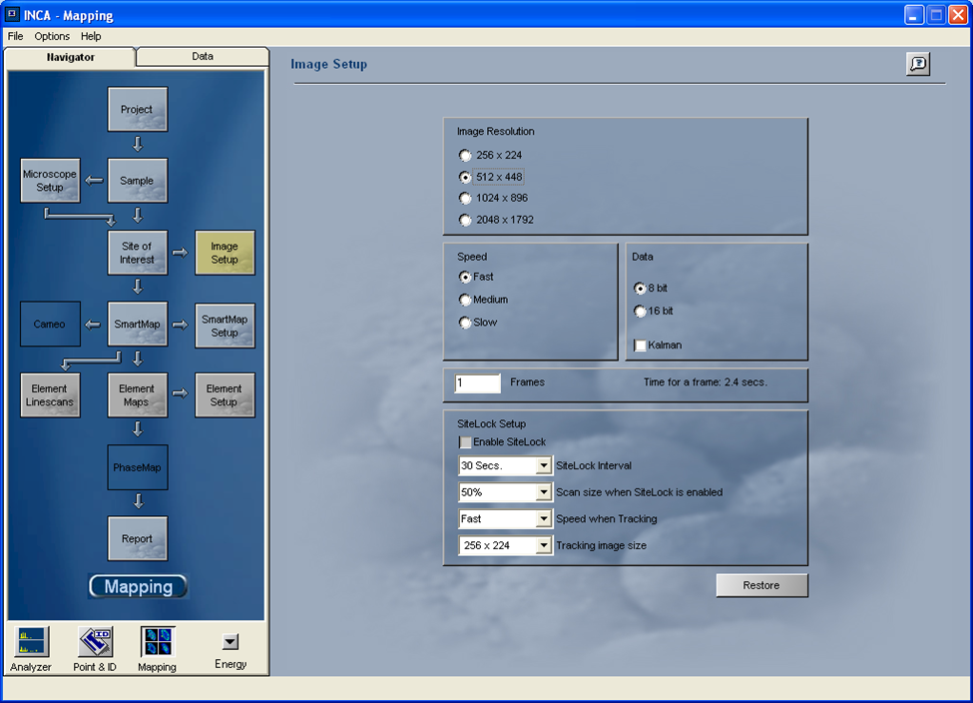
6.4.1.b.
Adjust image resolution and bit depth
Image setup tab opened

Slide 34
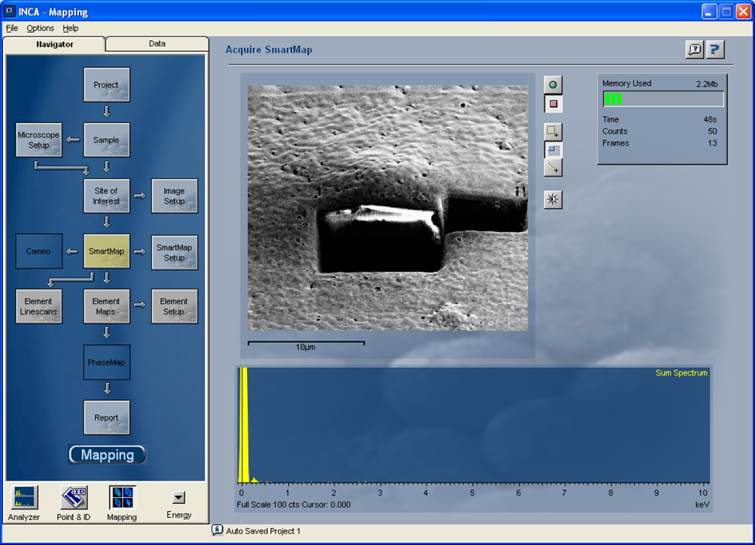
6.4.1.a.
Image acquired

Slide 35
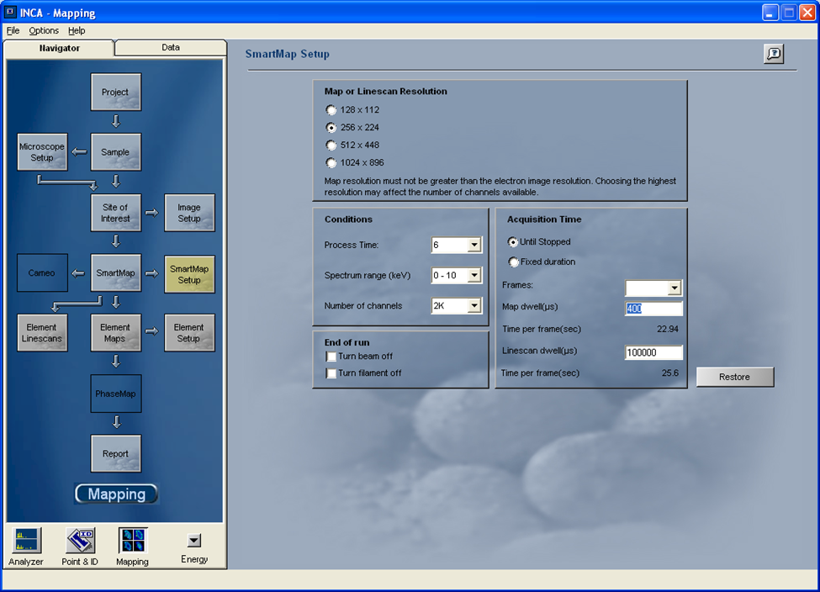
6.5.1
Adjust EDX parameters before data acquisition

Slide 36

6.6.1.a.
EDX area selected

Slide 37
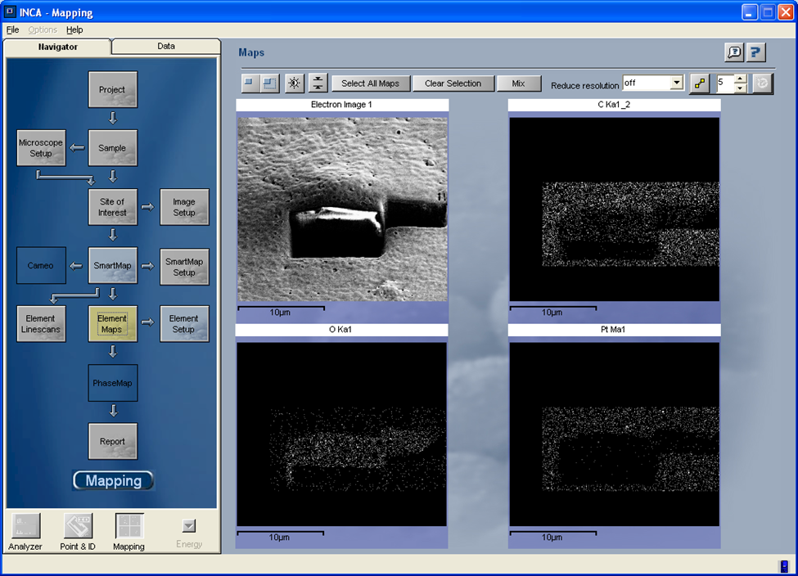
6.6.1.b.
EDX mapping

Slide 38
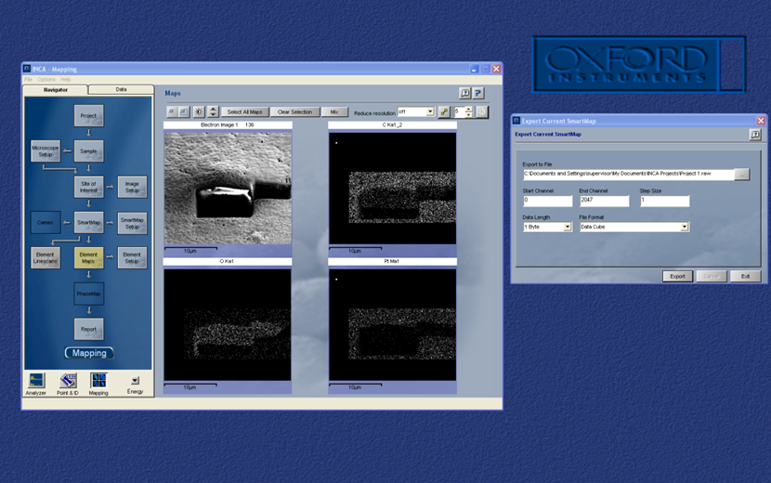
6.6.1.c.
EDX data saved

