Slide 1
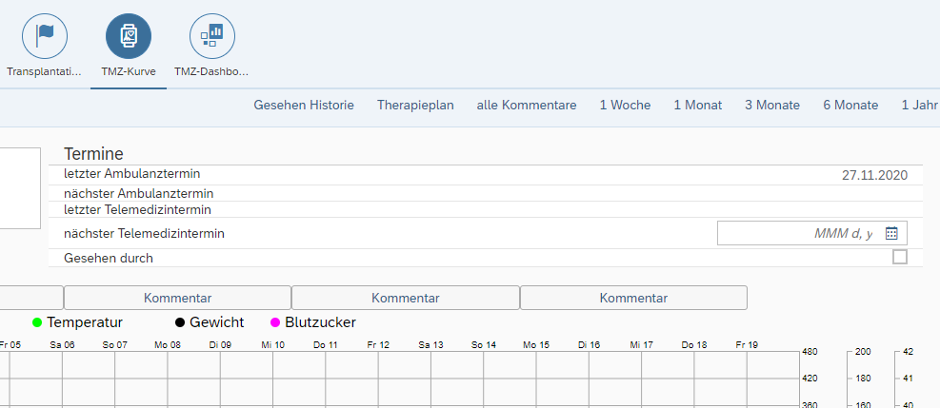
1.3.3. Set the patient’s current body weight in the telemedicine dashboard by clicking on the Therapeutic Plan button, fill in Weight in kg, and click on Confirm Data.
Unfortunately, our dashboard cannot be translated fully. Therapeutic plan (in German Therapieplan)

Slide 2
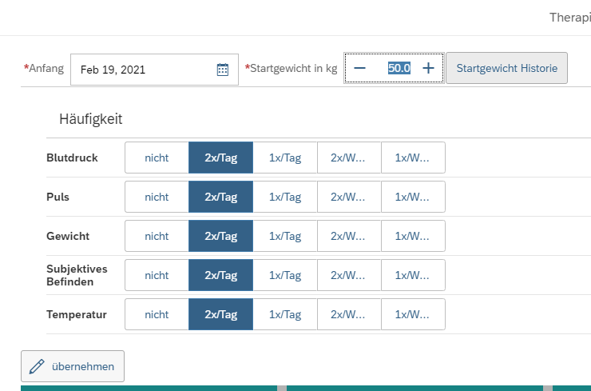
In red frames: setting of weight and frequency Table (Tag means day)
uebernehmen means Confirm data in German
1.3.3. Set the patient’s current body weight in the telemedicine dashboard by clicking on the Therapeutic Plan button, fill in Weight in kg, and click on Confirm Data.
1.3.4. Define the therapeutic plan for home measurements with the patient and fill out the Frequency table in TBase.

Slide 3
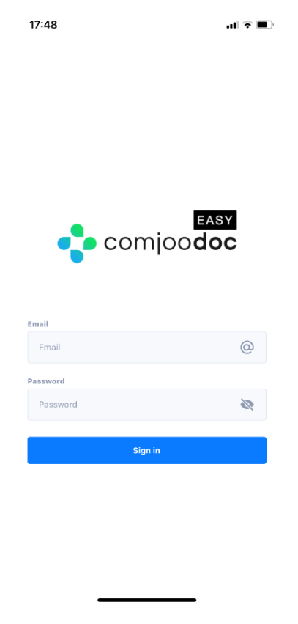
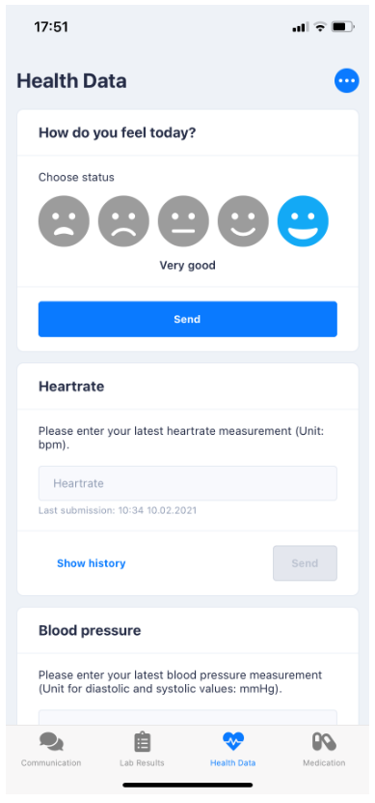
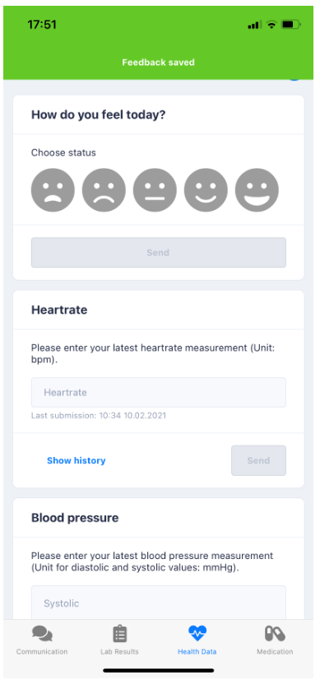
3.1.2 After receiving the initial login data from the nurse, change the login data, and confirm participation digitally. Enter the new login data into the app and push Sign in. After the app opens, enter the well-being status, and click on the Send button. Observe the buzzing sound and the confirmation sign (green banner showing Feedback sent).

Slide 4
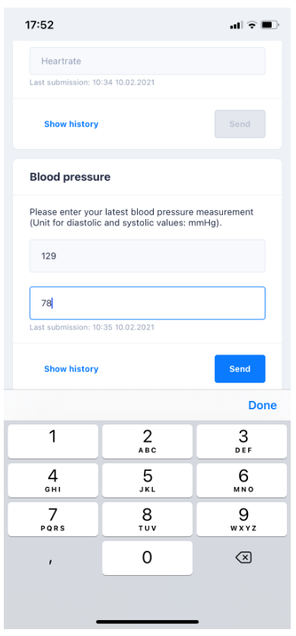
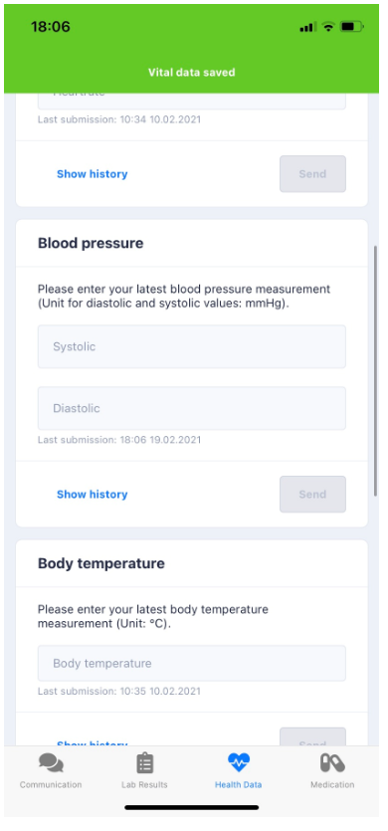
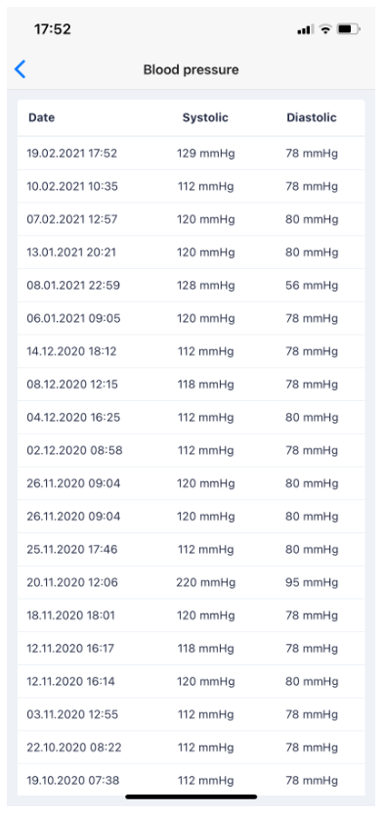
3.1.3. Measure the blood pressure, enter the data into the app, and push the Send button. Observe the buzzing sound and the green banner pop-up showing Vital Data Sent. Look at the Show History list and observe the table with all the values and transmission information

Slide 5
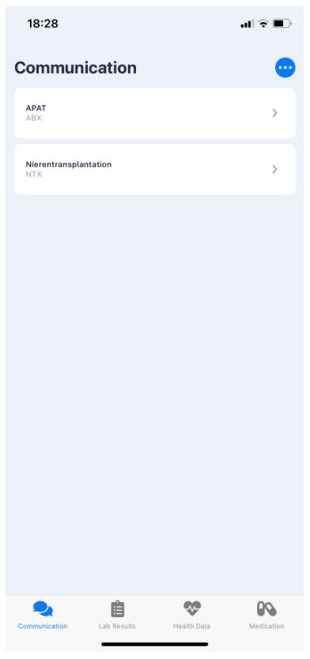
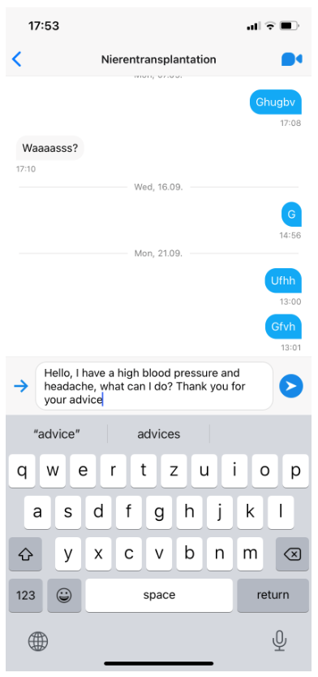
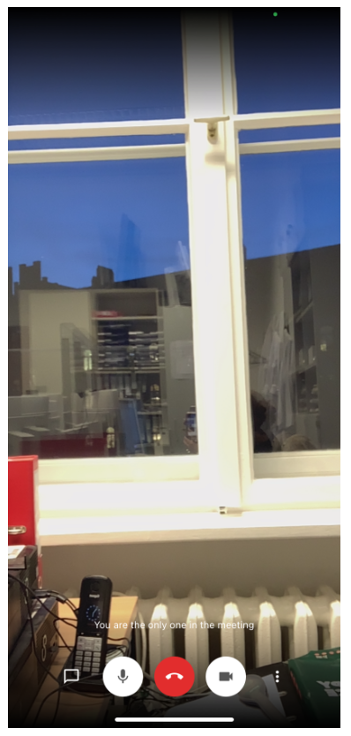
3.1.4. Open the Communication page and send a text message to the nurse. Start a video session by clicking on the Video button (camera icon). Open the Lab Results page and look at recent laboratory data. Open the Medication page, scroll through the medication plan, and confirm medication intake. Set the alert function for timely medication intake.

Slide 6
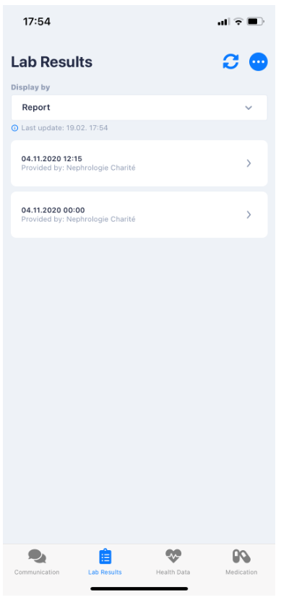
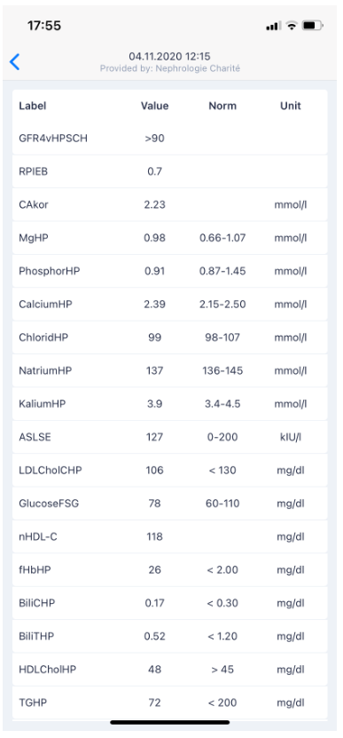
3.1.4. Open the Communication page and send a text message to the nurse. Start a video session by clicking on the Video button (camera icon). Open the Lab Results page and look at recent laboratory data. Open the Medication page, scroll through the medication plan, and confirm medication intake. Set the alert function for timely medication intake.

Slide 7
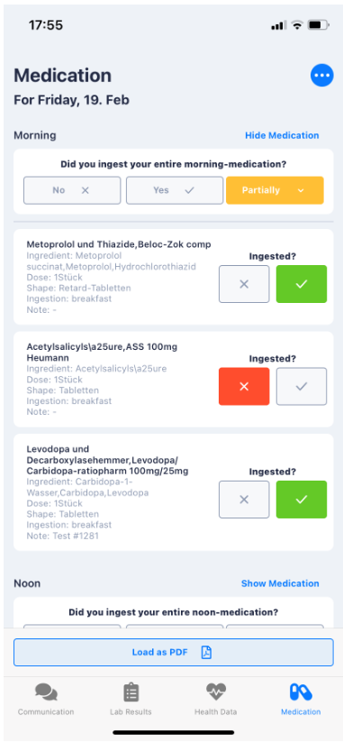
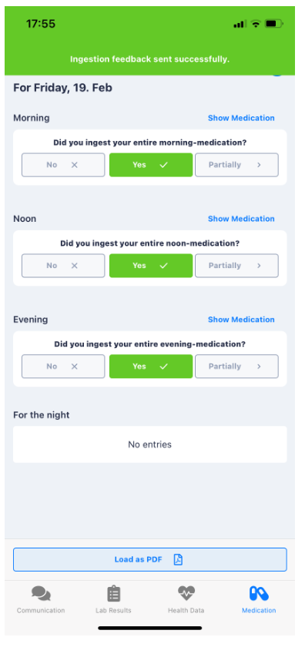
3.1.4. Open the Communication page and send a text message to the nurse. Start a video session by clicking on the Video button (camera icon). Open the Lab Results page and look at recent laboratory data. Open the Medication page, scroll through the medication plan, and confirm medication intake. Set the alert function for timely medication intake.

