Slide 1
Onboarding process of test patient into MACCS platform
Please do not publish these screenshots! They are for a better understanding of the process but, as the platform is still in adaption, can be changed at any time
Regarding screenshots of TBase, another publication is currently submitted to JoVE

Slide 2
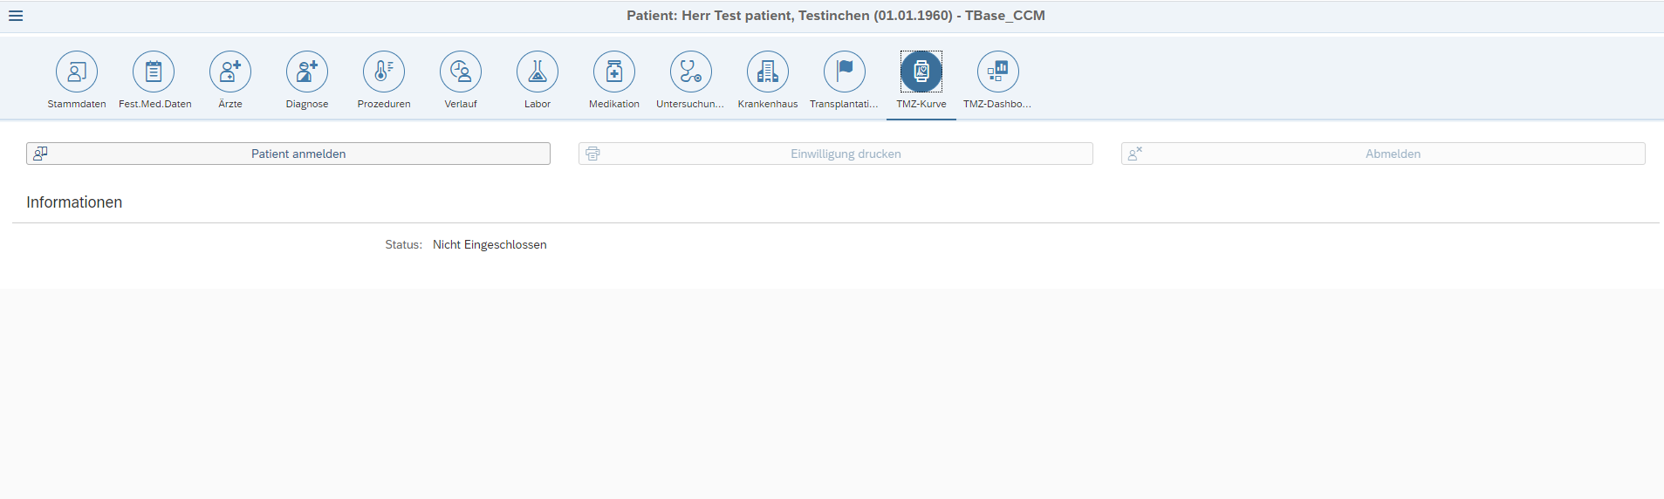

Slide 3
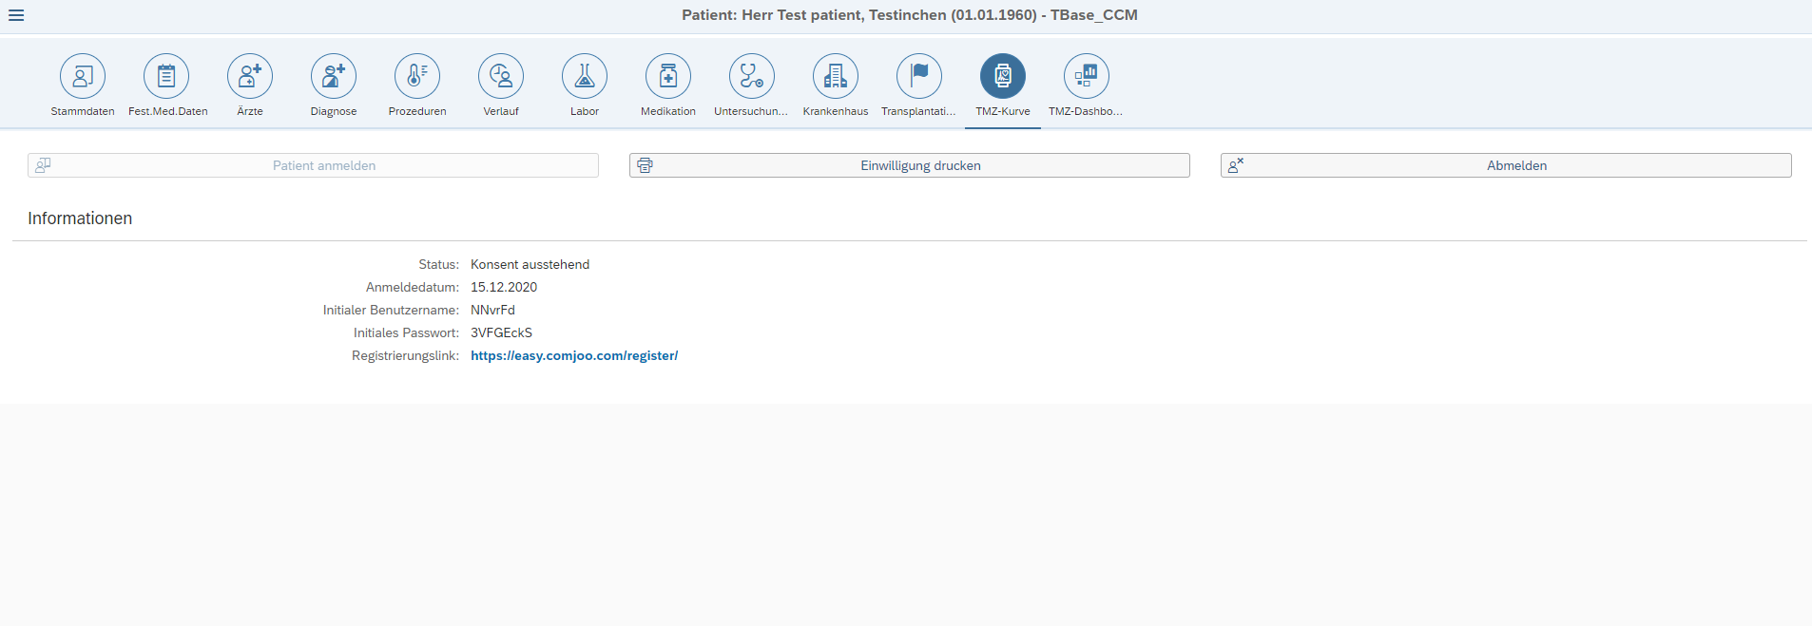

Slide 4
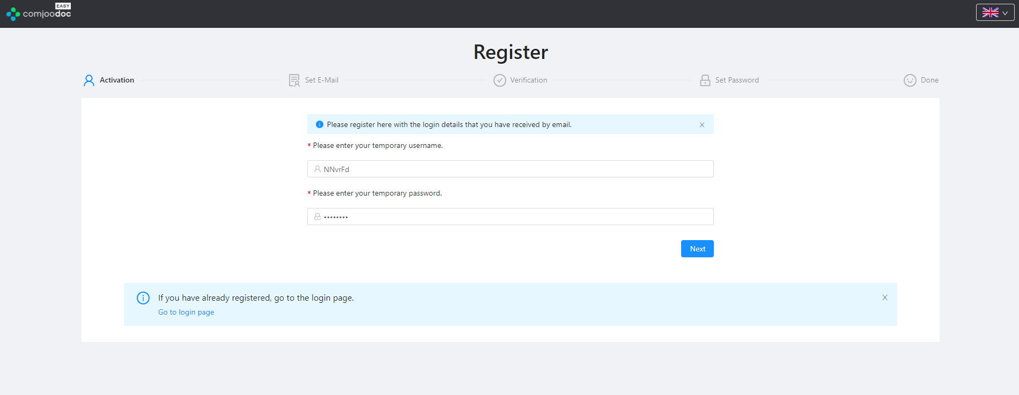

Slide 5
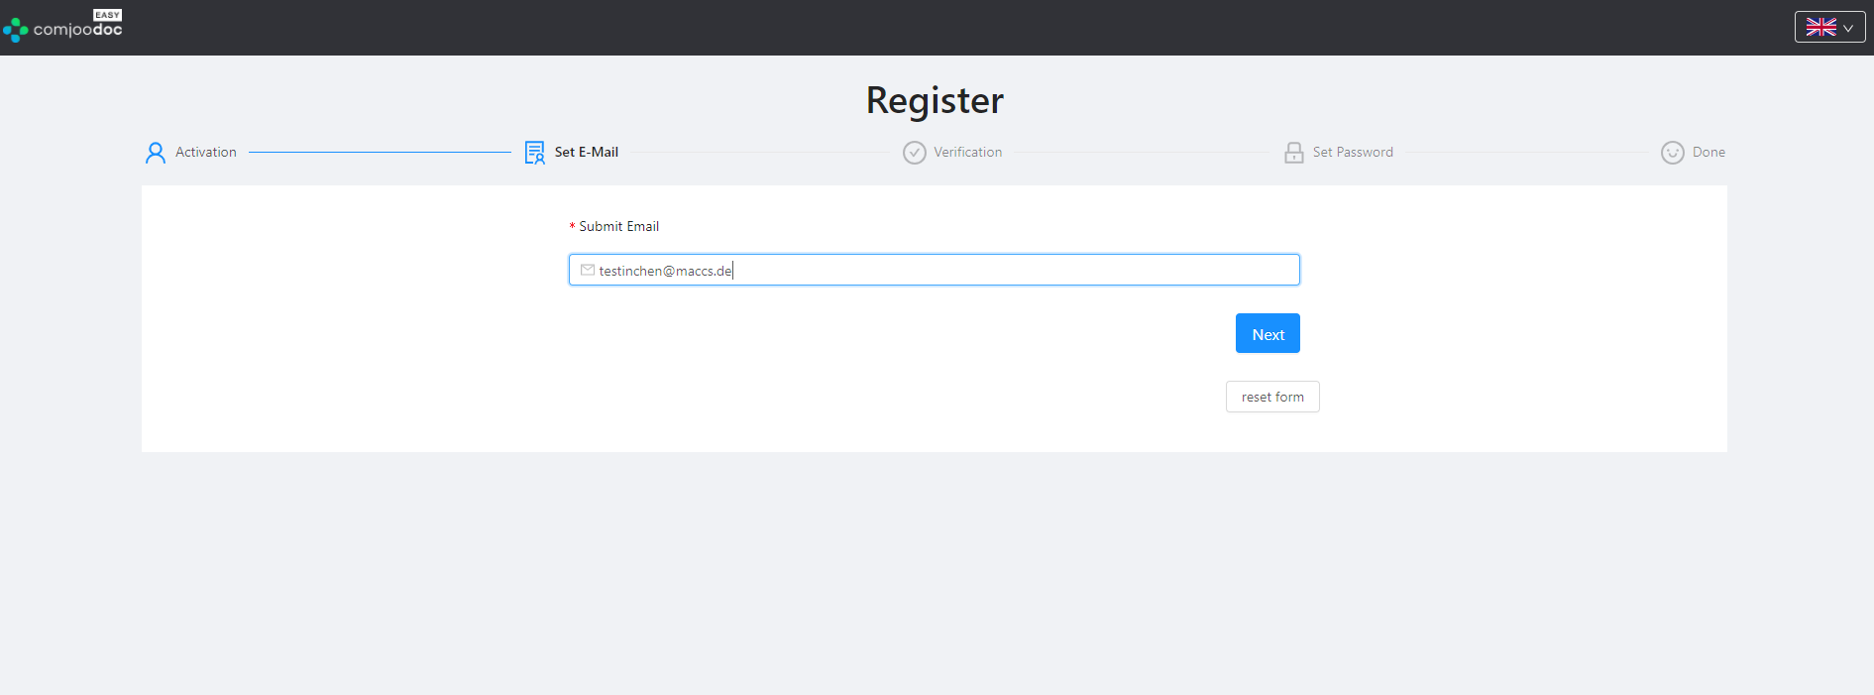

Slide 6
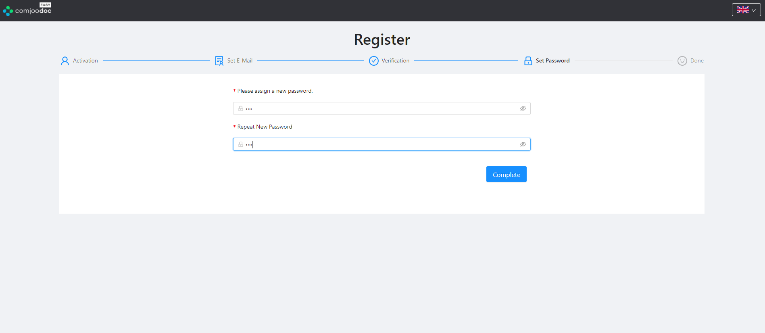

Slide 7
