Slide 1
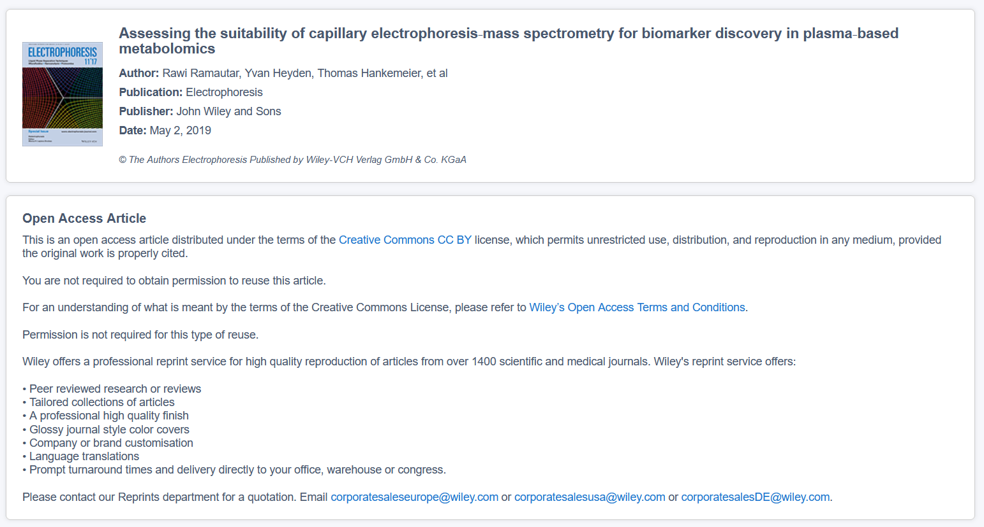
Figure 2 permission: https://s100.copyright.com/AppDispatchServlet?startPage=2309&pageCount=12&copyright=%C2%A9+The+Authors+Electrophoresis+Published+by+Wiley%E2%80%90VCH+Verlag+GmbH+%26+Co.+KGaA&author=Rawi+Ramautar%2C+Yvan+Heyden%2C+Thomas+Hankemeier%2C+et+al&orderBeanReset=true&imprint=John+Wiley+%26+Sons%2C+Ltd&volumeNum=40&issueNum=18-19&contentID=10.1002%2Felps.201900126&title=Assessing+the+suitability+of+capillary+electrophoresis%E2%80%90mass+spectrometry+for+biomarker+discovery+in+plasma%E2%80%90based+metabolomics&numPages=12&pa=&oa=CC-BY&issn=0173-0835&publisherName=Wiley&publication=ELPS&rpt=y&endPage=2320&publicationDate=05%2F02%2F2019

Slide 2
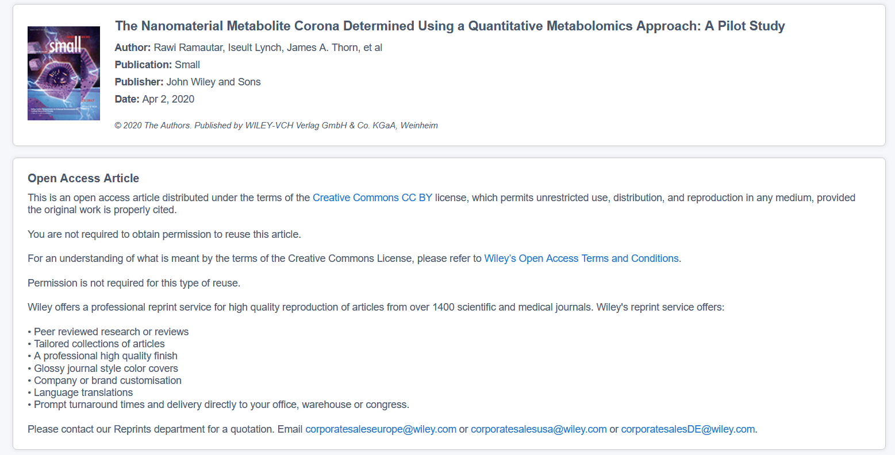
Figures 3 and 4, some Table 2 data permission: https://s100.copyright.com/AppDispatchServlet?startPage=1&pageCount=13&copyright=%C2%A9+2020+The+Authors.+Published+by+WILEY%E2%80%90VCH+Verlag+GmbH+%26+Co.+KGaA%2C+Weinheim&author=Rawi+Ramautar%2C+Iseult+Lynch%2C+James+A.+Thorn%2C+et+al&orderBeanReset=true&imprint=John+Wiley+%26+Sons%2C+Ltd&volumeNum=16&issueNum=21&contentID=10.1002%2Fsmll.202000295&title=The+Nanomaterial+Metabolite+Corona+Determined+Using+a+Quantitative+Metabolomics+Approach%3A+A+Pilot+Study&numPages=13&pa=&oa=CC-BY&issn=1613-6810&publisherName=Wiley&publication=SMLL&rpt=y&endPage=13&publicationDate=04%2F02%2F2020

Slide 3
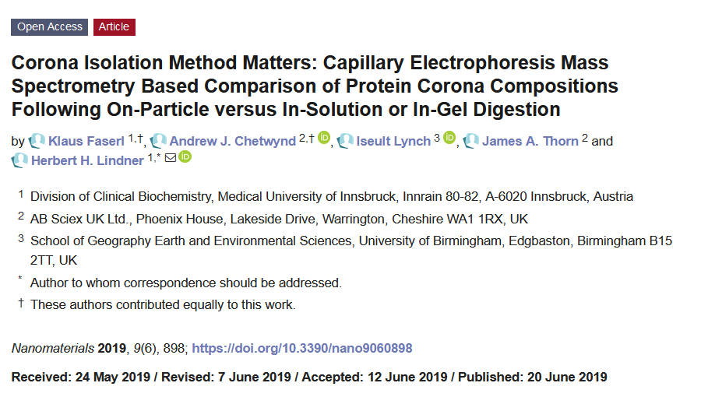
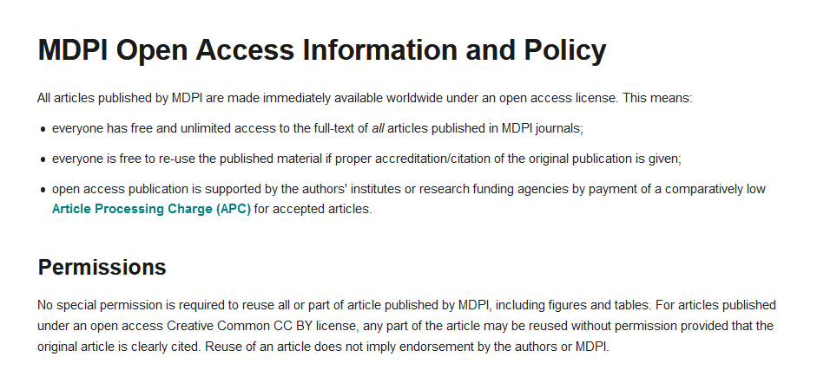
Table 1 permissions, data from table 2 also taken from this paper

