Slide 1
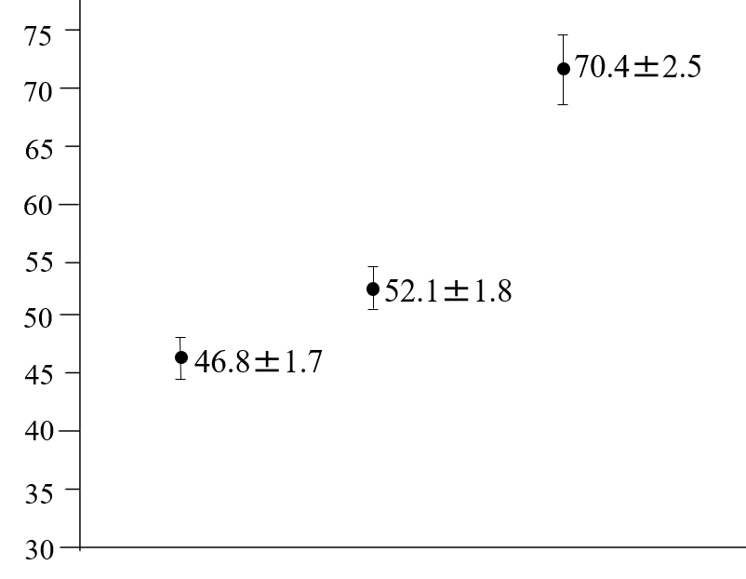
P < 0.01
P < 0.05
Cerebral rSO₂ (%)
HD patients
wit DM
HD patients
without DM
Healthy Subjects
Figure 1. Ito K, et al.

Slide 2
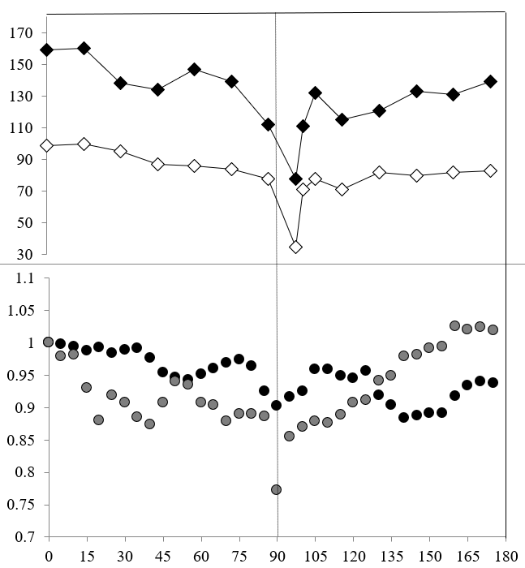
UFR (ml/hr)
670 ml/hr
no water removal
Systolic BP
BP (mmHg)
Diastolic BP
Cerebral rSO₂
ratio of rSO₂
to pre rSO₂
Hepatic rSO₂
Time (minutes)
Figure 2. Ito K, et al.

