Slide 1
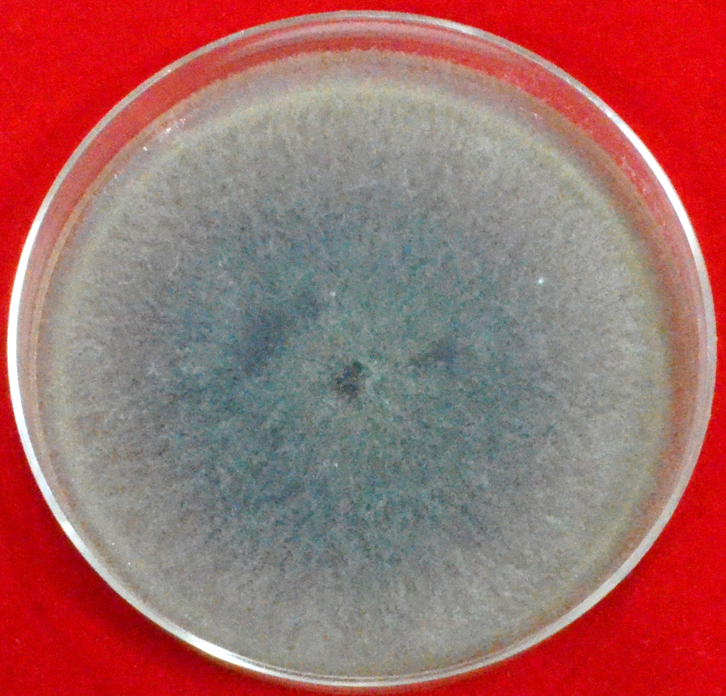
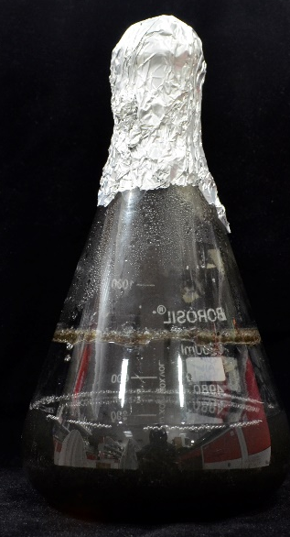
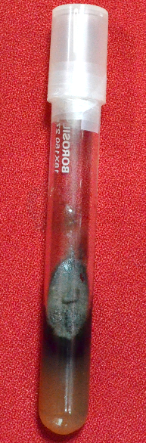
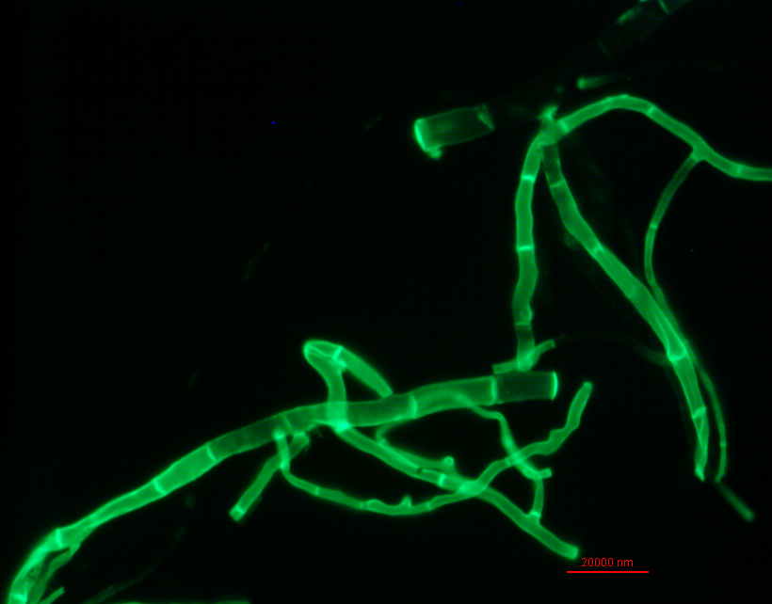
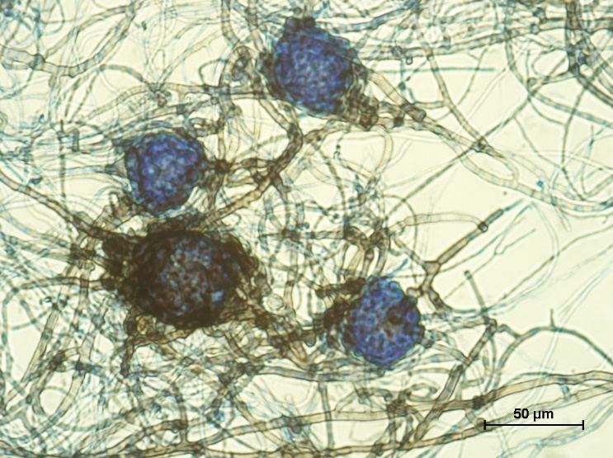
Figure 1
A
B
C
D
E

Slide 2
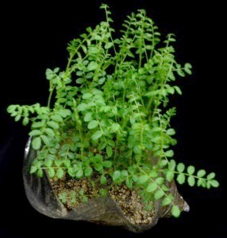
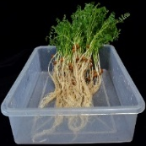
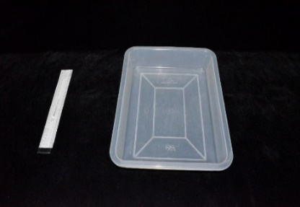
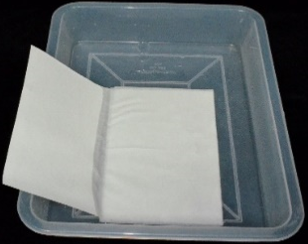
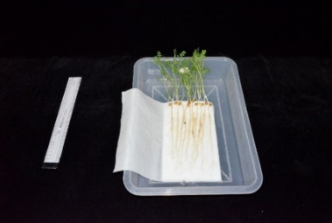
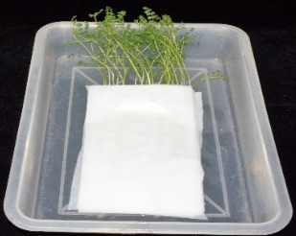
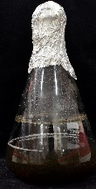
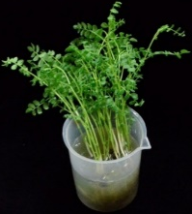
Figure 2
A
Step 1
Surface sterilize the chickpea seeds with 2% sodium hypochlorite
Step 2
Sow the seeds in 15-cm height pot containing Soilrite
Step 3
Uproot the 8 days old seedlings, wash under running tap water and rinse with sterile water twice
Step 4
Inoculate Potato dextrose broth with R. bataticola and incubate at 28ºC for 5-days with 180 rpm in a shaker
Dip only the roots in inoculum and remove the excess inoculum
Step 5
Place pathogen inoculated and mock (water)-inoculated plants in separate blotter paper
Step 6
Keep the trays with plants at 28±2ºC for eight days with 16 h artificial light and relative humidity at approximately 70% and moisten the plants every day with adequate water
Step 7
Step 8
Inspect for root damage on 8 days after inoculation
B
i.
ii.
Step 3-
Nursery
Step 4-
Uprooted plants
iii.
iv.
Step 5-
Fungal inoculum
Step 7-
Blotting paper set up
Step 6-
Dip inoculation

Slide 3
Figure 3
A
B
Shoot
Root

Slide 4
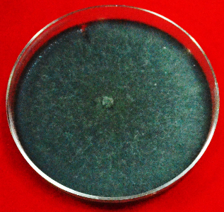
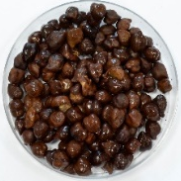
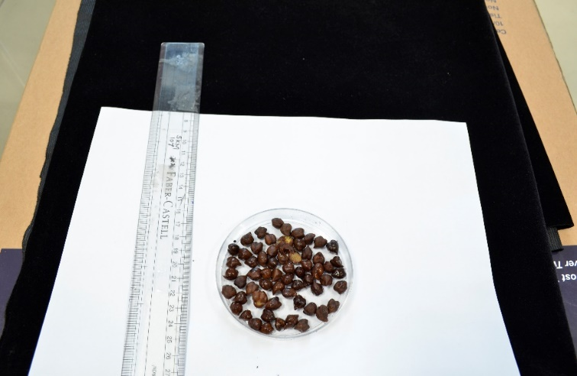
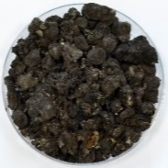
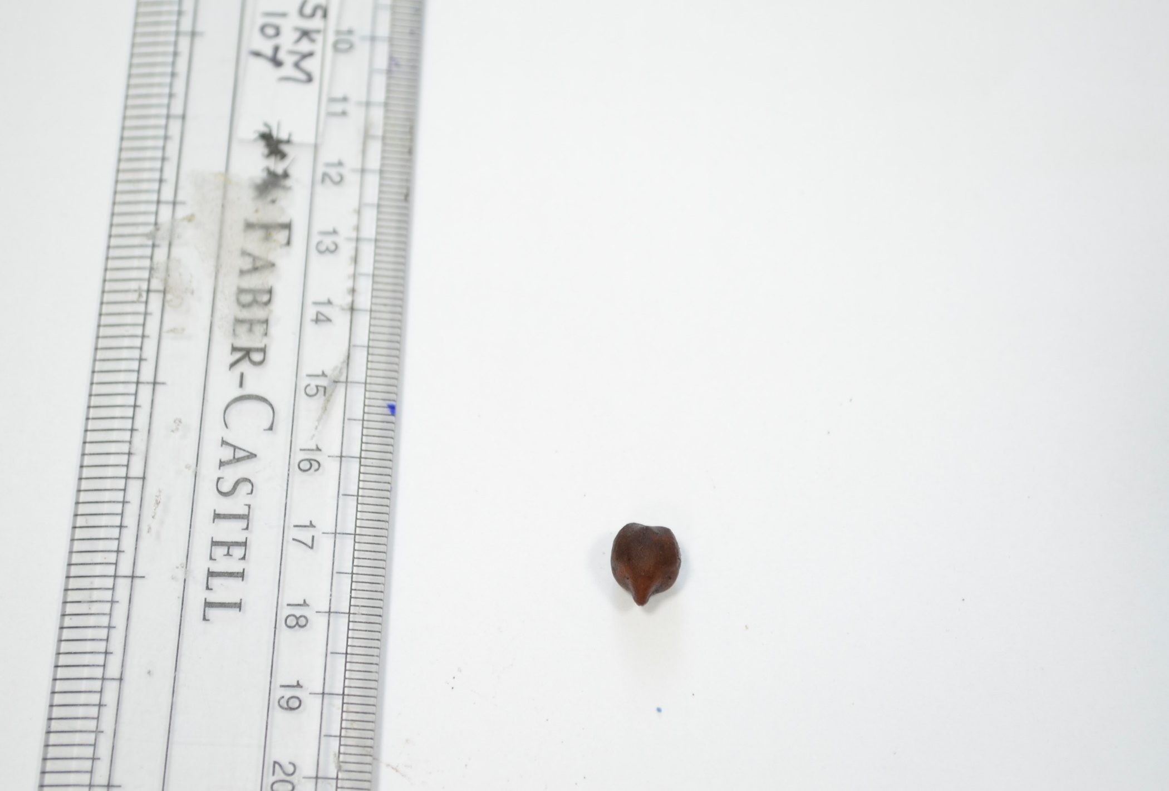
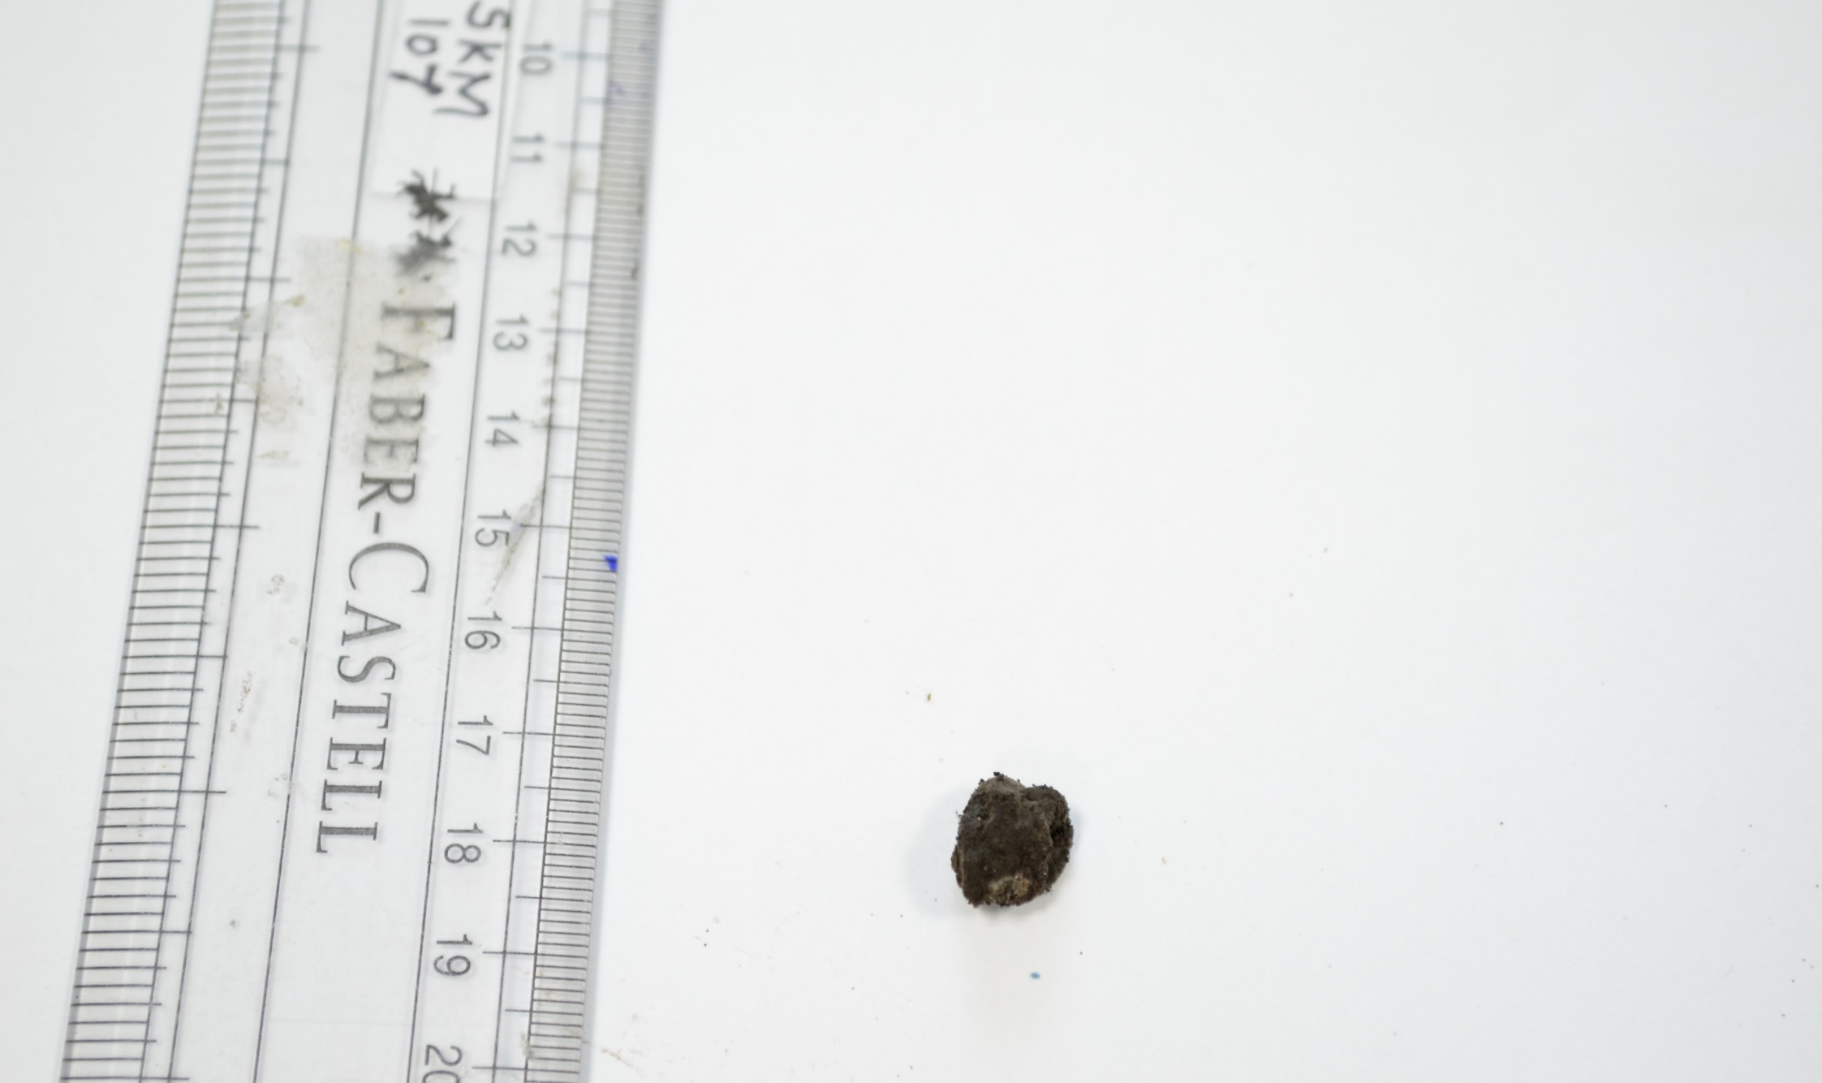
Figure 4
A
Substrate
Soak chickpea seeds overnight and autoclave
Inoculum
10 days old actively growing R. bataticola
Sick culture
Inoculate the substrate (100 g) with five 5 mm fungal discs and incubate at 30ºC for 15 days
Sick pot
Mix 50 g of sick culture with 100 g of soilrite uniformly
Sow the susceptible genotype seeds in sick pot and allow them to grow
Assess the symptoms in roots and foliar
Chop down infected plants and assimilate into the same sick pot
Use the sick pot which is showing 90% of infection for further experiment
B
i.
ii.
iii.
Inoculum
Substrate
Control
No fungal growth
Inoculated
Fungal growth

Slide 5
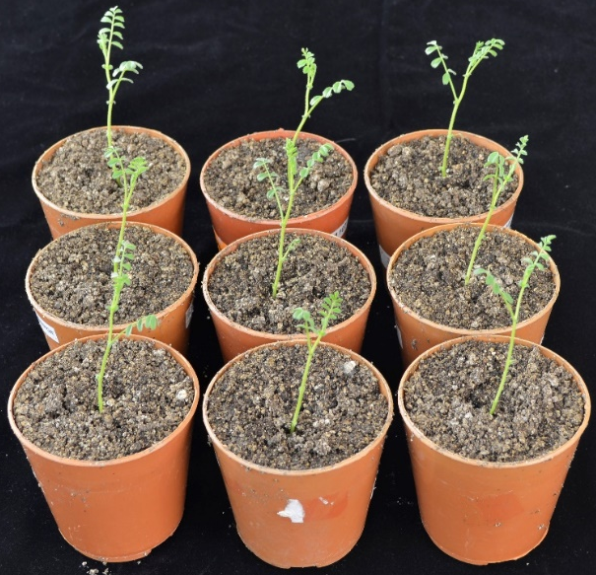
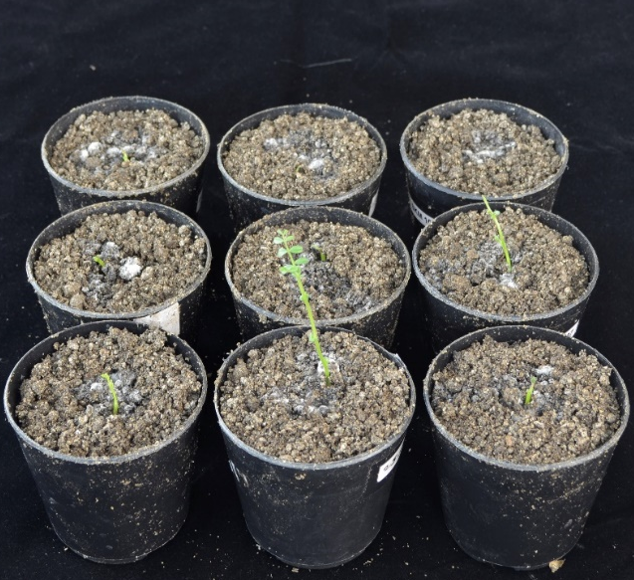
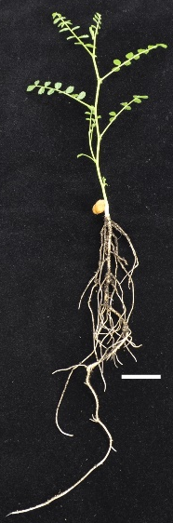
Figure 5
A
B
C
Control
D
Sick pot
Mock
DRR Infected
E
F
Control
Sick pot

Slide 6
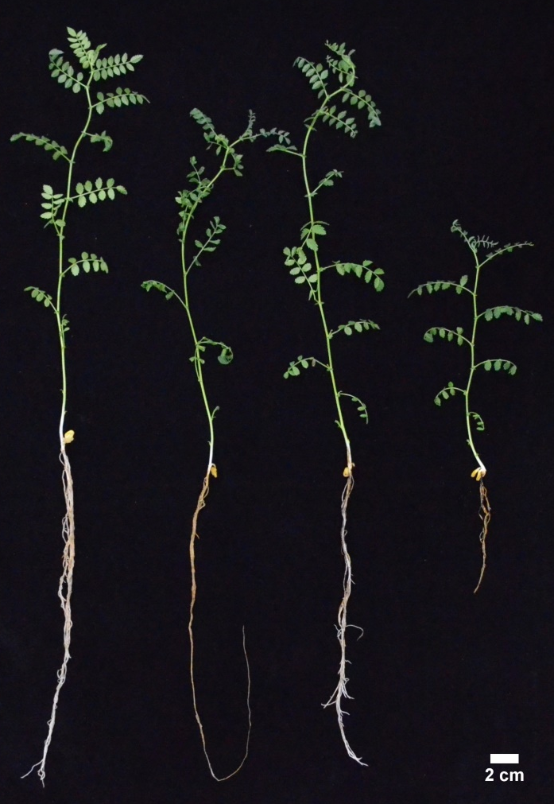
Figure 6
A
Control
Drought
Pathogen
Combined
stress
B
Control
Drought
Pathogen
Combined
stress

