Slide 1
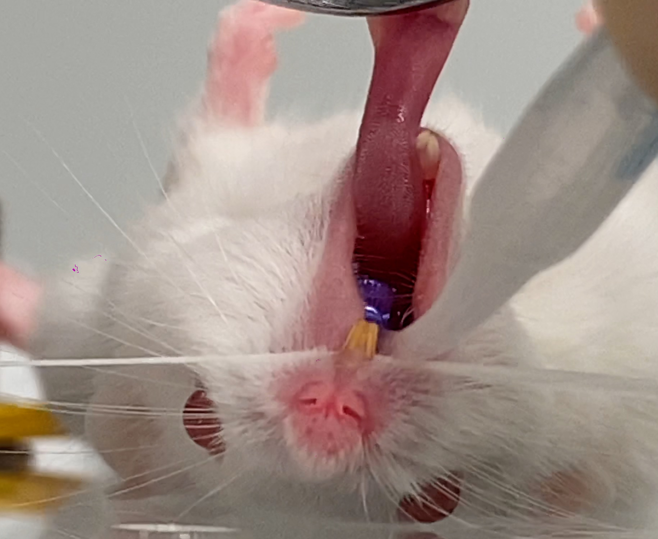
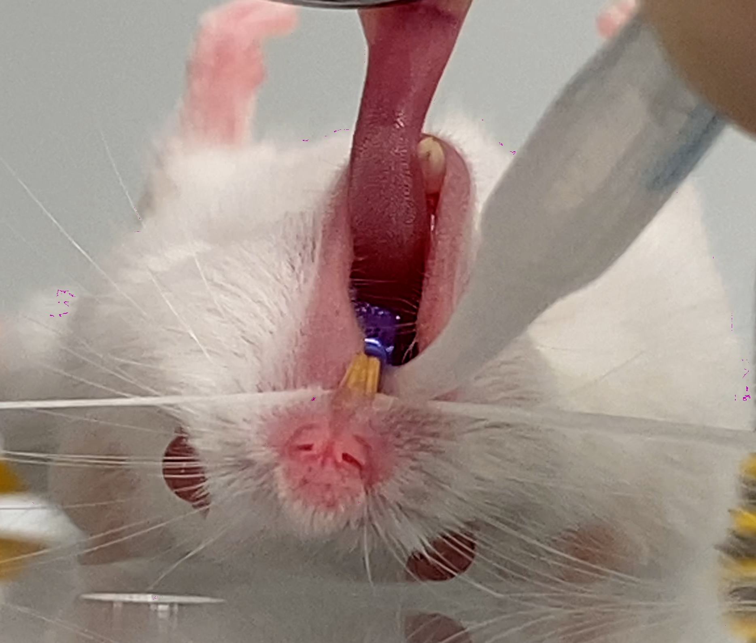
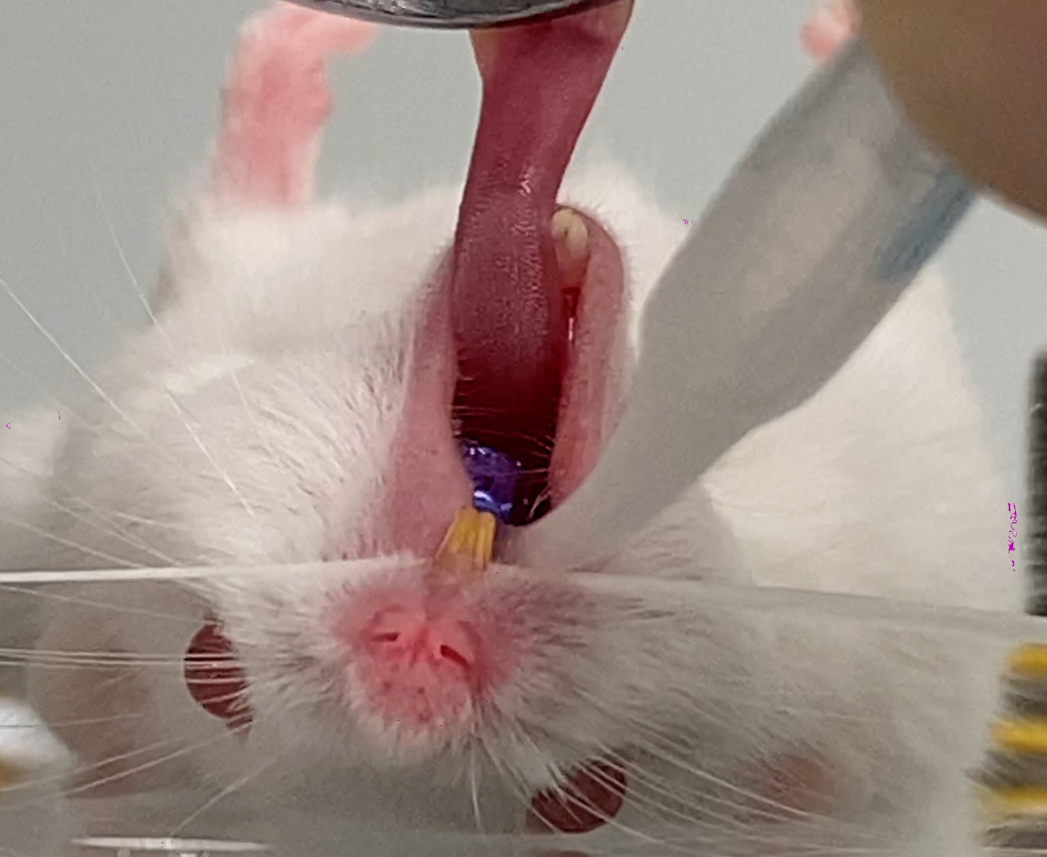
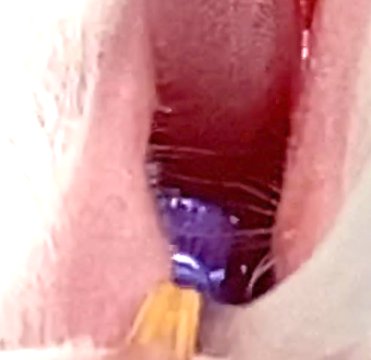
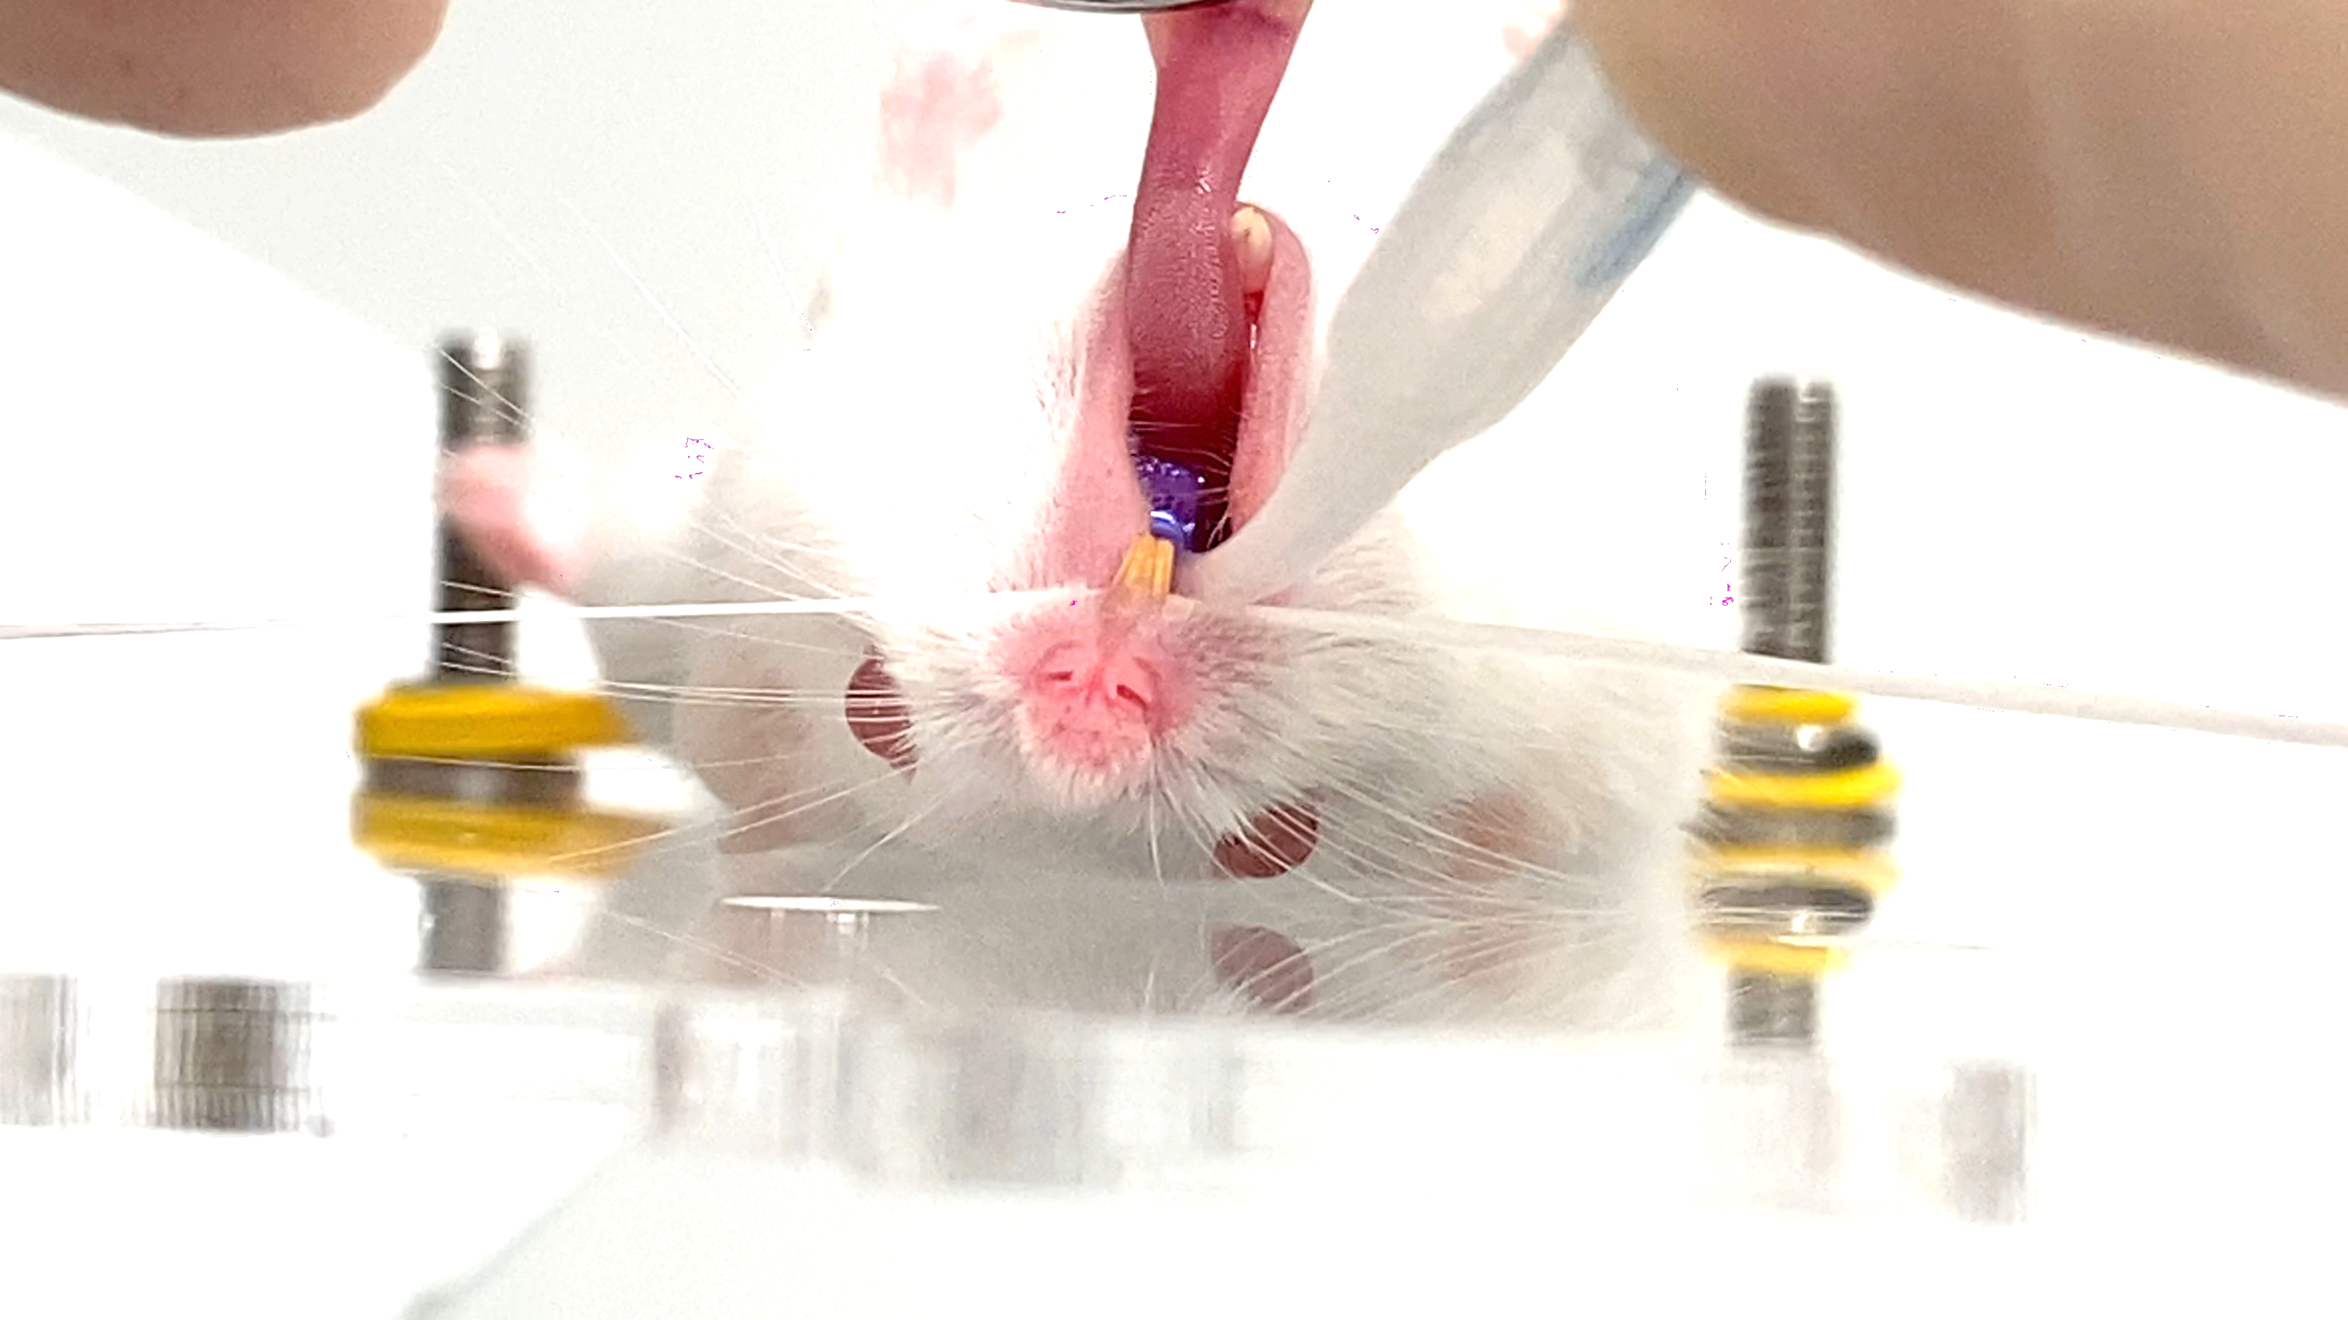
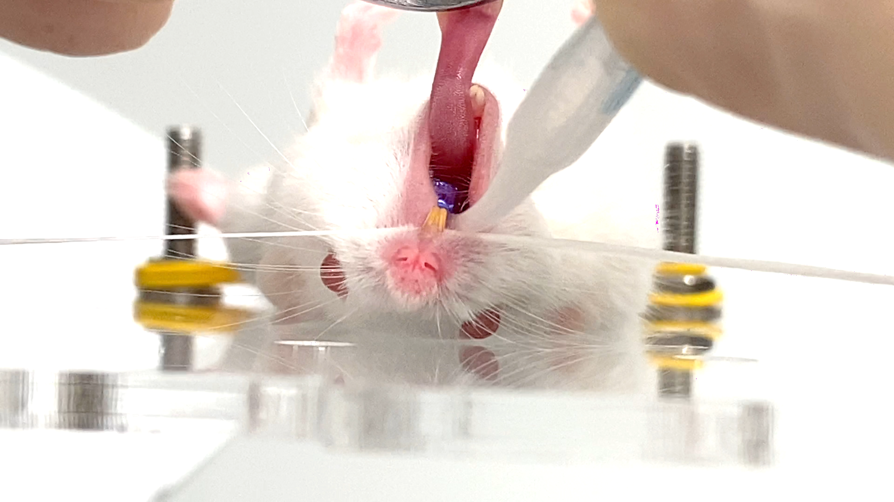
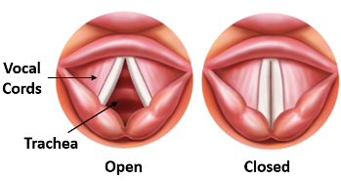
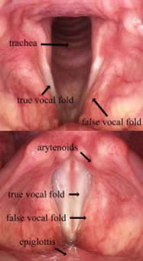
Narrow opening
、
Medium opening
Wide opening
Above: The images above show the three different status of vocal cords when mouse breathing . The orifice between the vocal cords is the trachea of mouse, also the opening that we need to visualise and aim with.
The images are captured from the first 10 second of the video clip 2379. mov (for 3.3.2, 3.3.3 and 3.4.1, take 2)
Left: Trachea and vocal cords of human for better understanding

